Slide 1

Designing Mobile
User Experiences
13) Design at Scale
TIMING/VIDEO
Remove auto-advancing after creating a video version:
On/Off:
In the tabs (not menu): “Slide Show”
[X] Play Narrations
[X] Use Timings
[ ] Show Media Controls
Clear the timings completely:
Select all the slides
Right click a slide > “Slide Transition…”
In the “Advance slide” section uncheck “Automatically after”
NOTHING LONGER THAN 20 minutes!
@shoobe01 @udemy
Notes:
Last time I talked about how to communicate the design choices you’ve made. Now I want to wrap up with some reminders about designing to the user’s context, for yourself and your whole team.

Slide 2
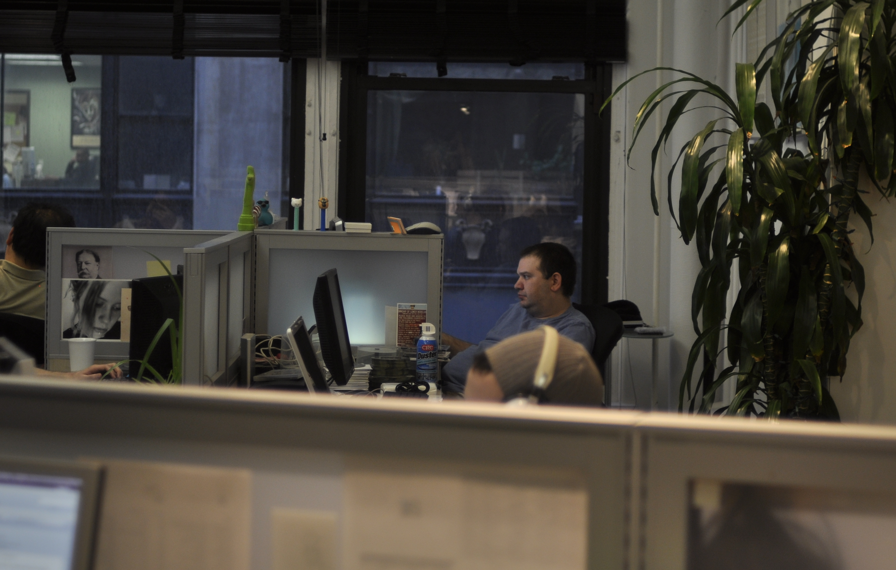

Notes:
Empathy – the capacity to recognize emotions that are being experienced by another person – is one of the many ‘soft’ skills a great UX team should make core to their process.
Empathizing with users leads to a genuine understanding of how to solve their problem and ultimately to building better products.
Context is a nice place to start. Their device, their environment, and so on. [CLICK] The needs of this guy at his desk…

Slide 3
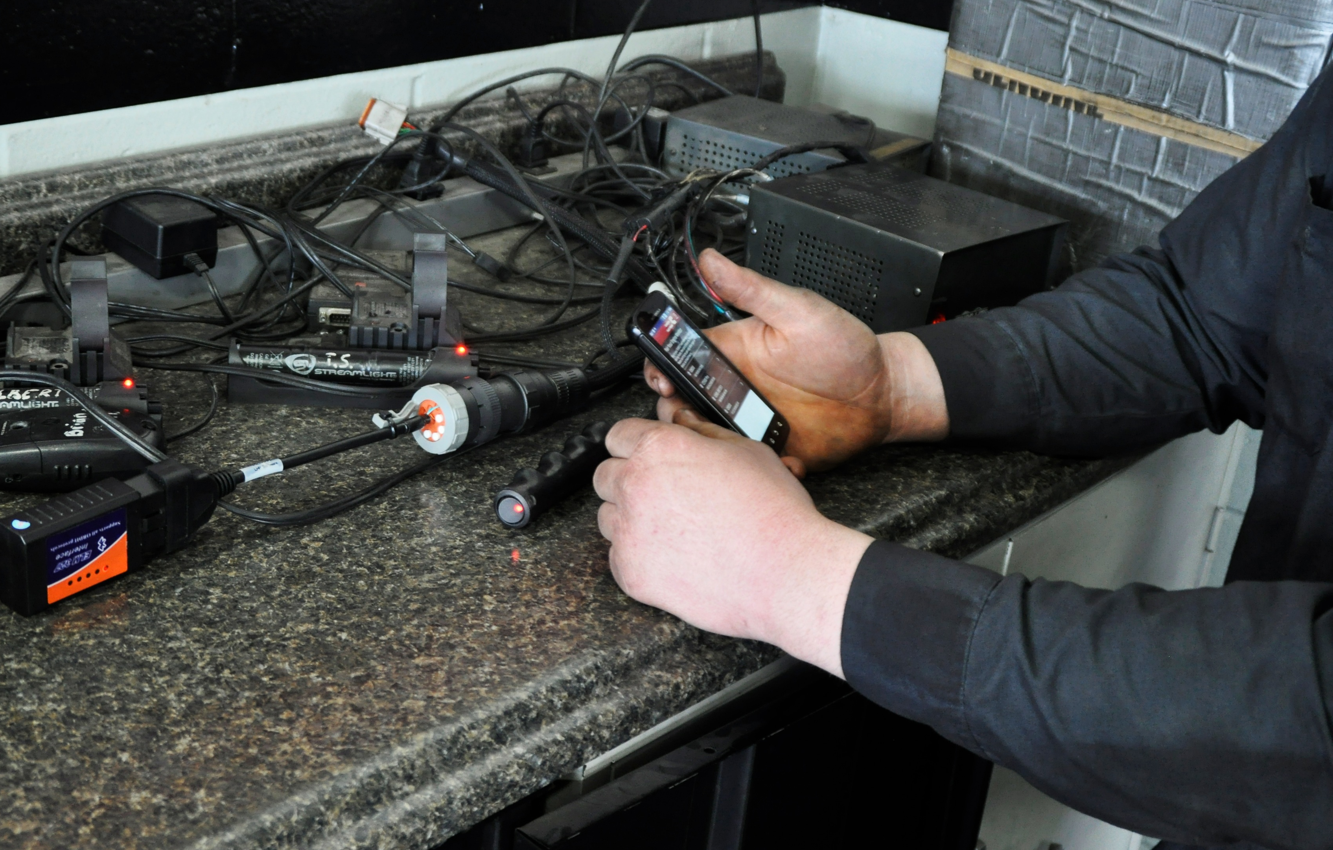
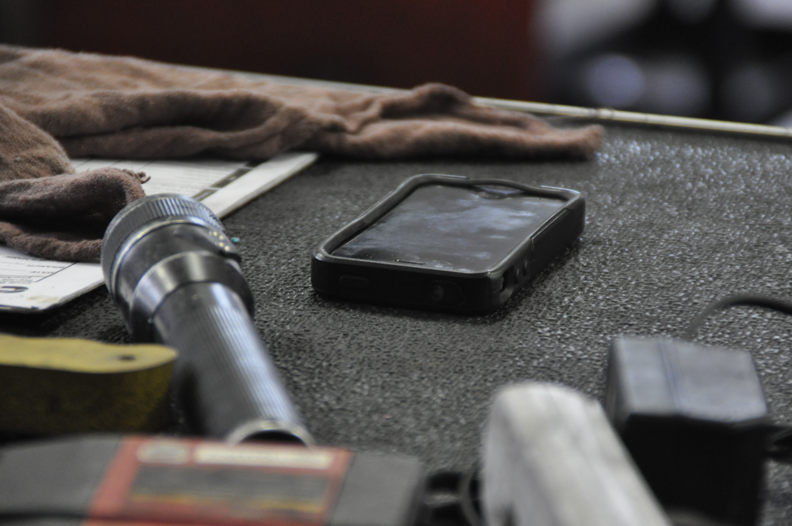
Notes:
Are very different from the needs of this guy.

Slide 4
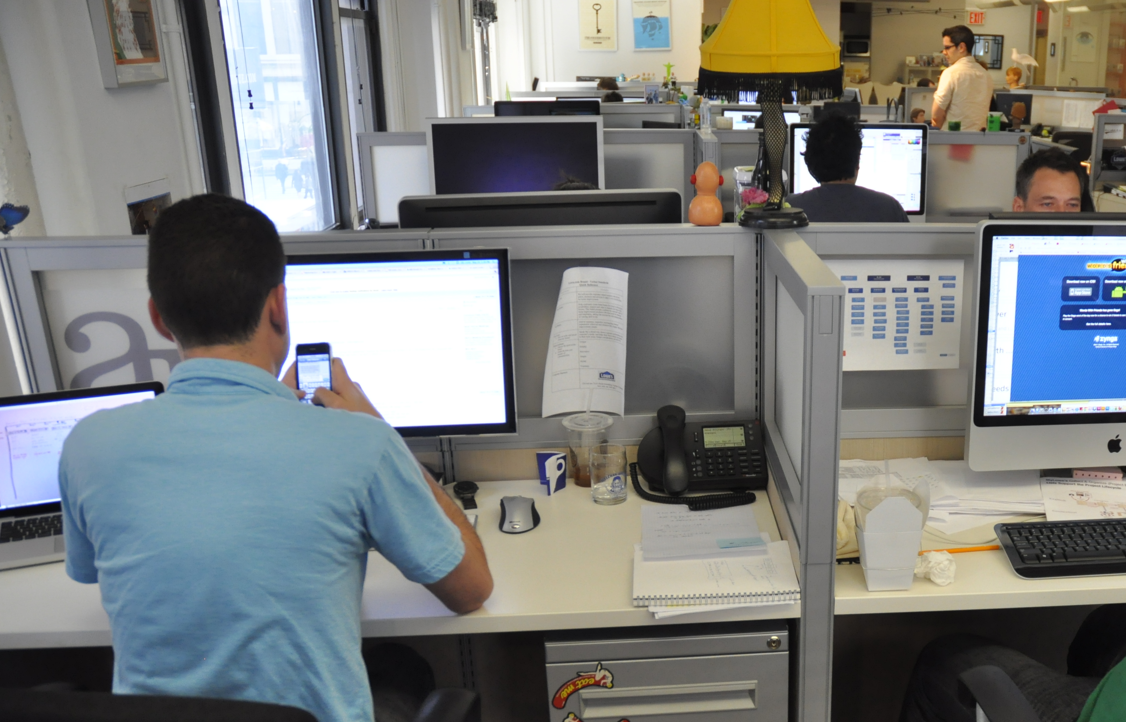
Notes:
If you are designing for use under ideal conditions — or any single set of conditions — you are doing it wrong.
We’ll focus first on the most basic and beneficial way to get there. Phones and tablets are not desktop computers. You can help yourself a lot by just designing and checking your work at scale.
Take the design out of Graffle, Visio, Axure, Photoshop, InDesign or whatever, and get it off the computer. No need for clever prototype tools (though things like GetLaunch or PopApp also do work well), just put screens into the device gallery on your phone.

Slide 5
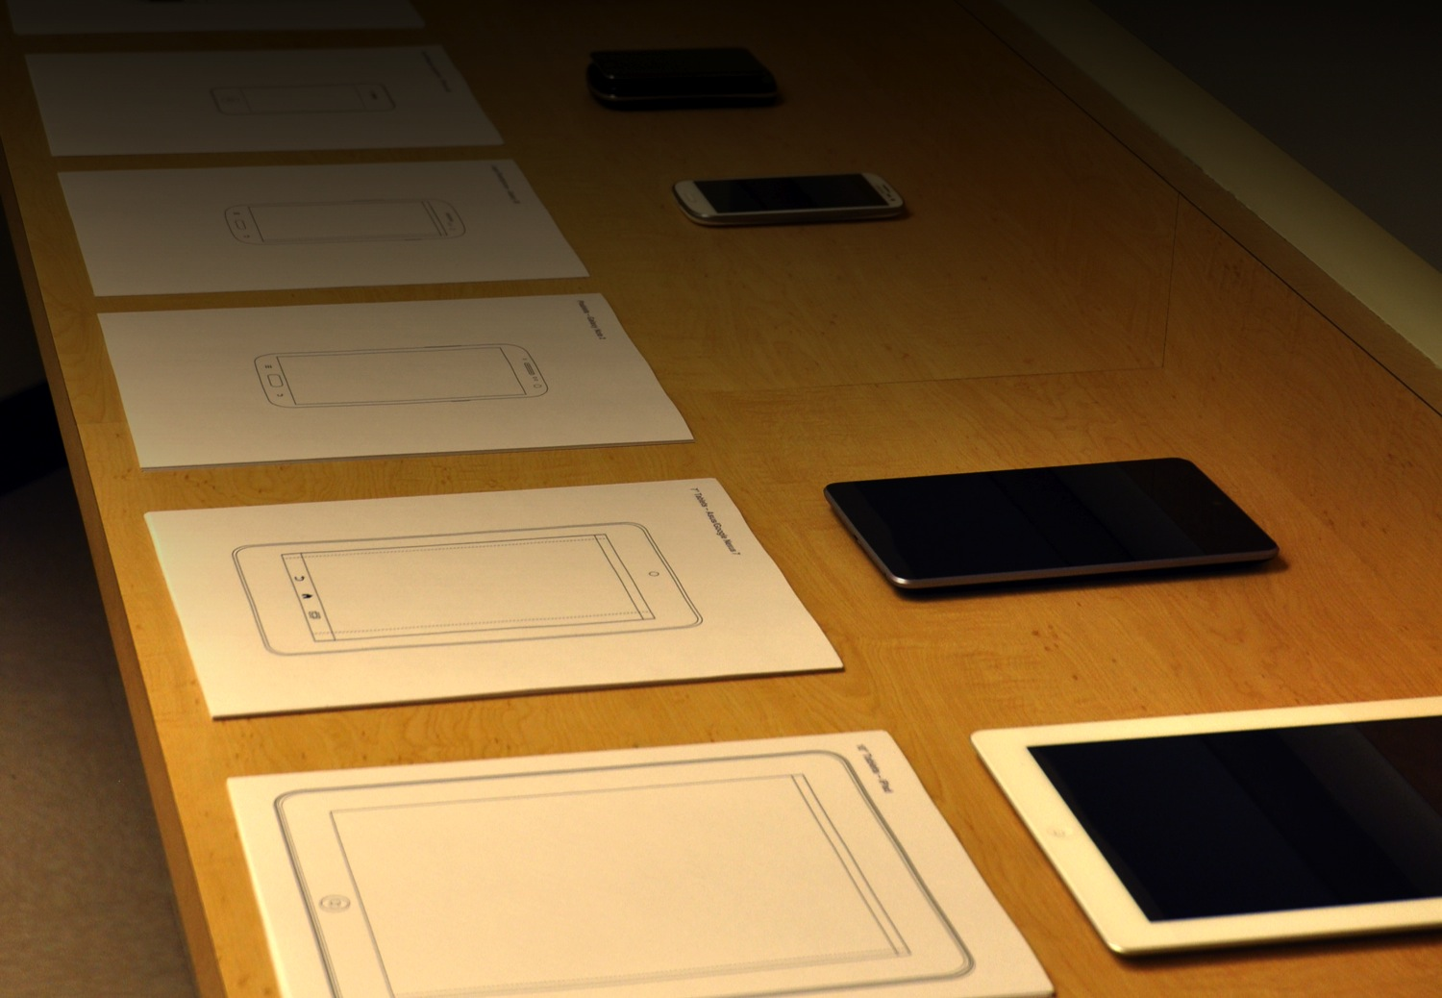
Notes:
Put your designs on the phone whenever you can, or all the time with Edge Inspect and other cross-platform tools.
Better: carry the phone outside and actually tap on the screen. How it works and looks on the real device in real environments is very different from how it looks on a computer in your office.
When ideating with the team, bring device templates, and devices so everyone can not just wave their arms, but try out your product, and others, right there.

Slide 6
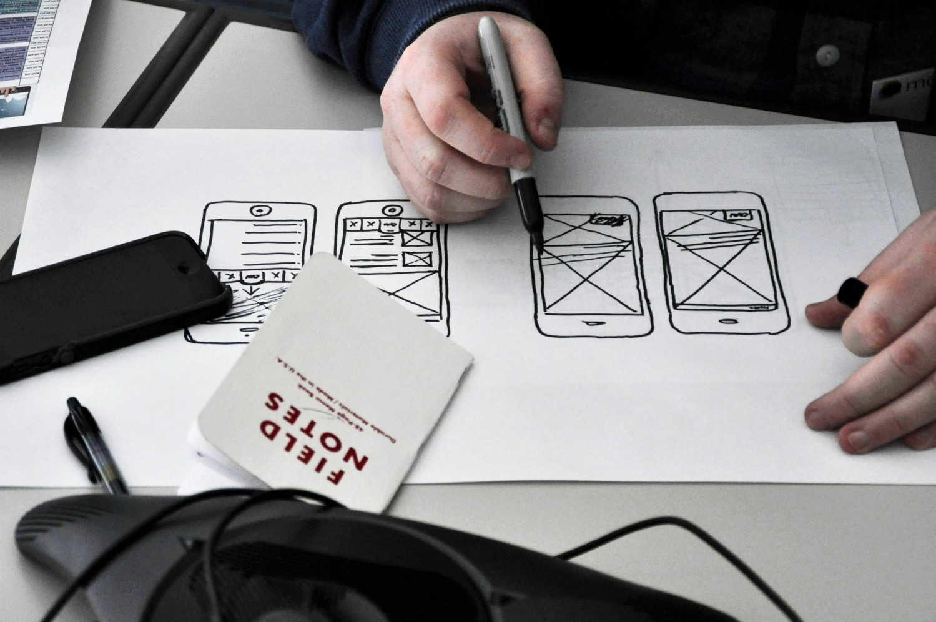
6
Notes:
Sketch at device scale, so you start with it being the right size. Avoid too much reliance on your computer screen, and on Powerpoint to show it off.

Slide 7
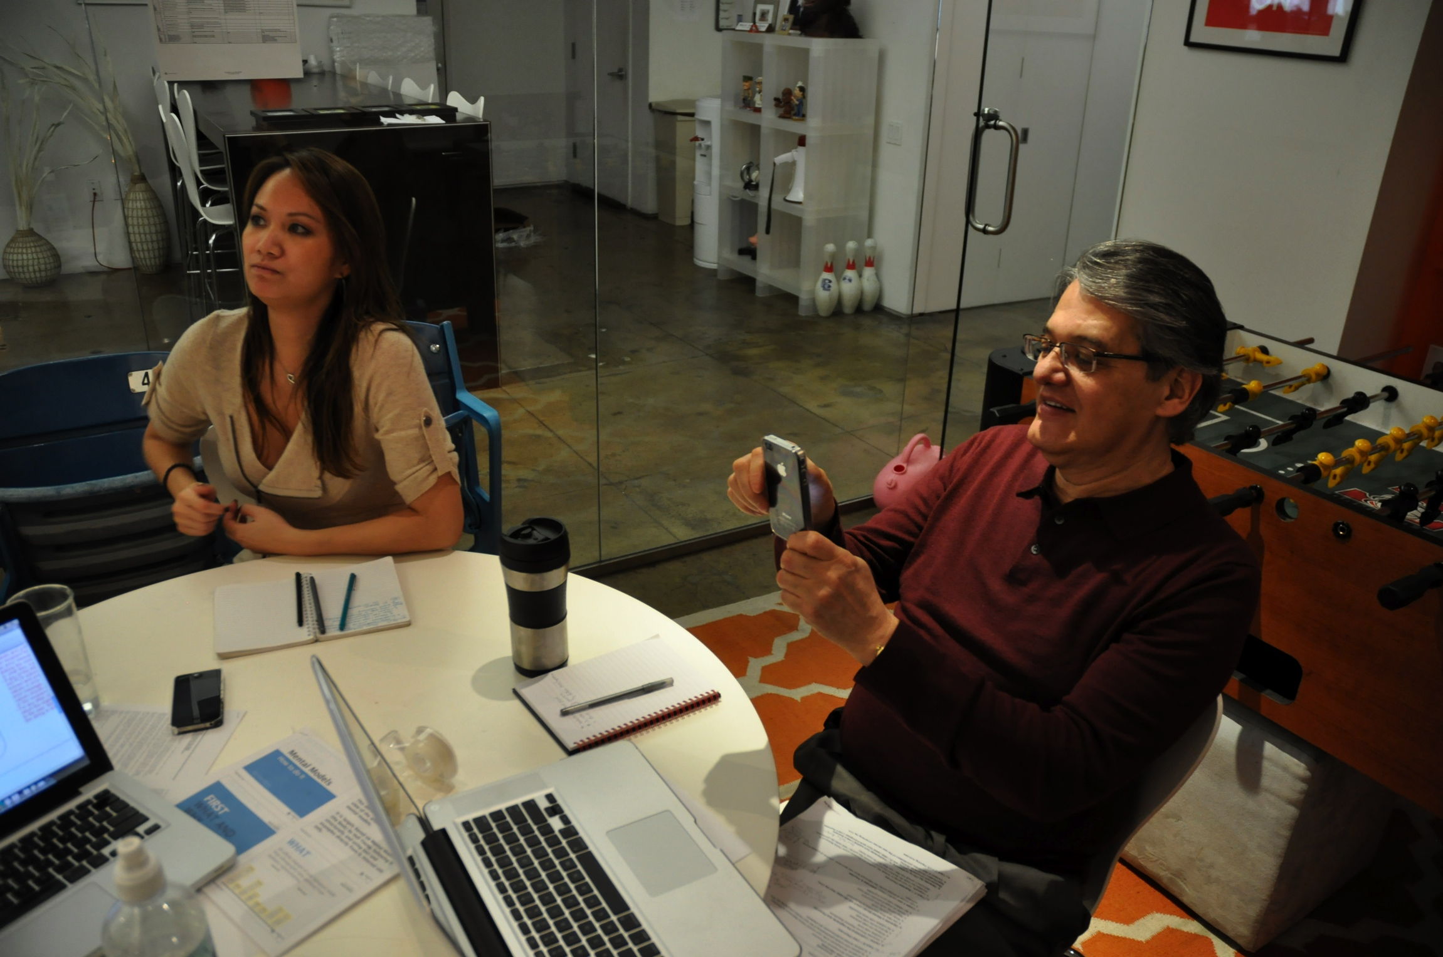
7
Notes:
Try it out. Pass it around the room to make sure you aren’t foolish, or to share the design the way it will really work, in meetings with clients or stakeholders.

Slide 8
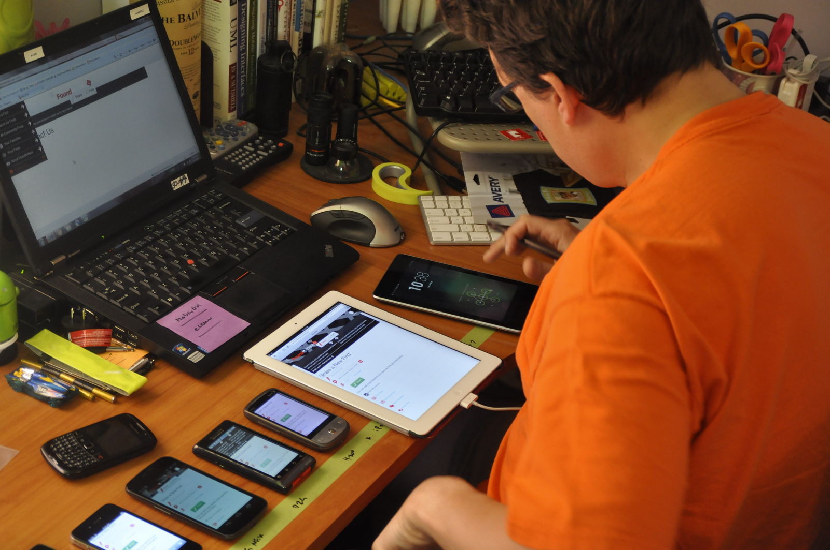
Thing
Notes:
Test, test, test. Test on real devices, not just emulators. First, in your office, like this maybe. When testing responsive websites or any multi-screen experience, do this.
Get all the devices out at the same time, and do end to end testing to make sure it doesn’t just work, but makes sense. It’s MUCH easier to see mismatches and inconsistencies like this than testing individually.

Slide 9
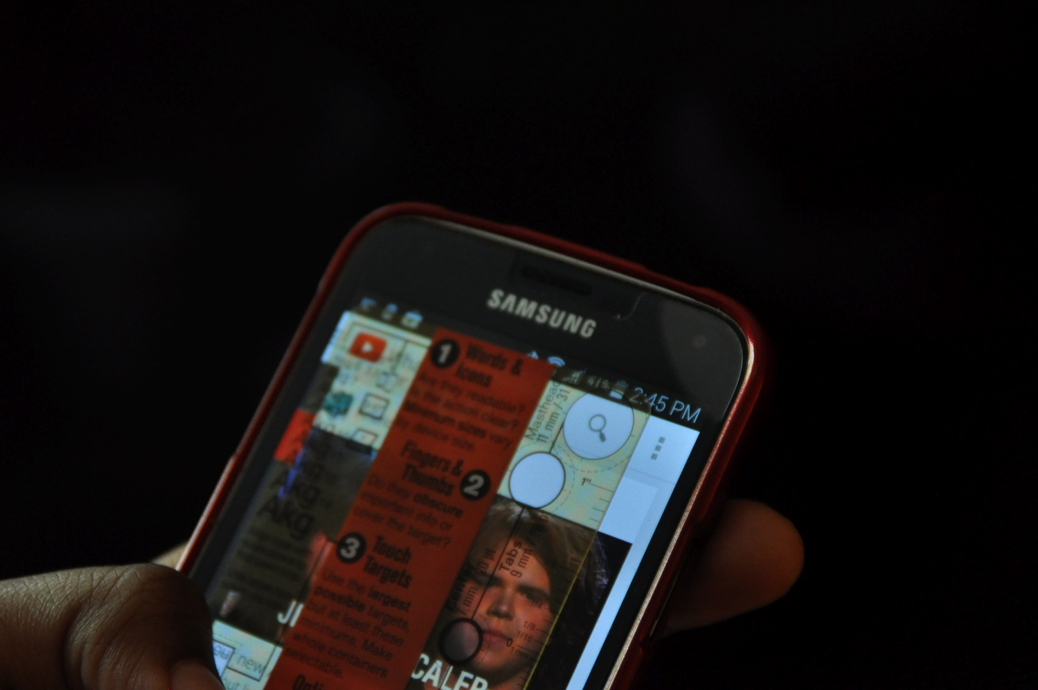
9
Notes:
When it comes time to measure and confirm sizes are correct, you can do it directly on the device to make sure your sizes are right.
You can use any old circle template, but I made up my own little tool I keep in my pocket, because this is so important. Yes, you can buy one from me if you want to, also.
(Get the template and see video about how and why to use it at http://4ourth.com/tt)

Slide 10
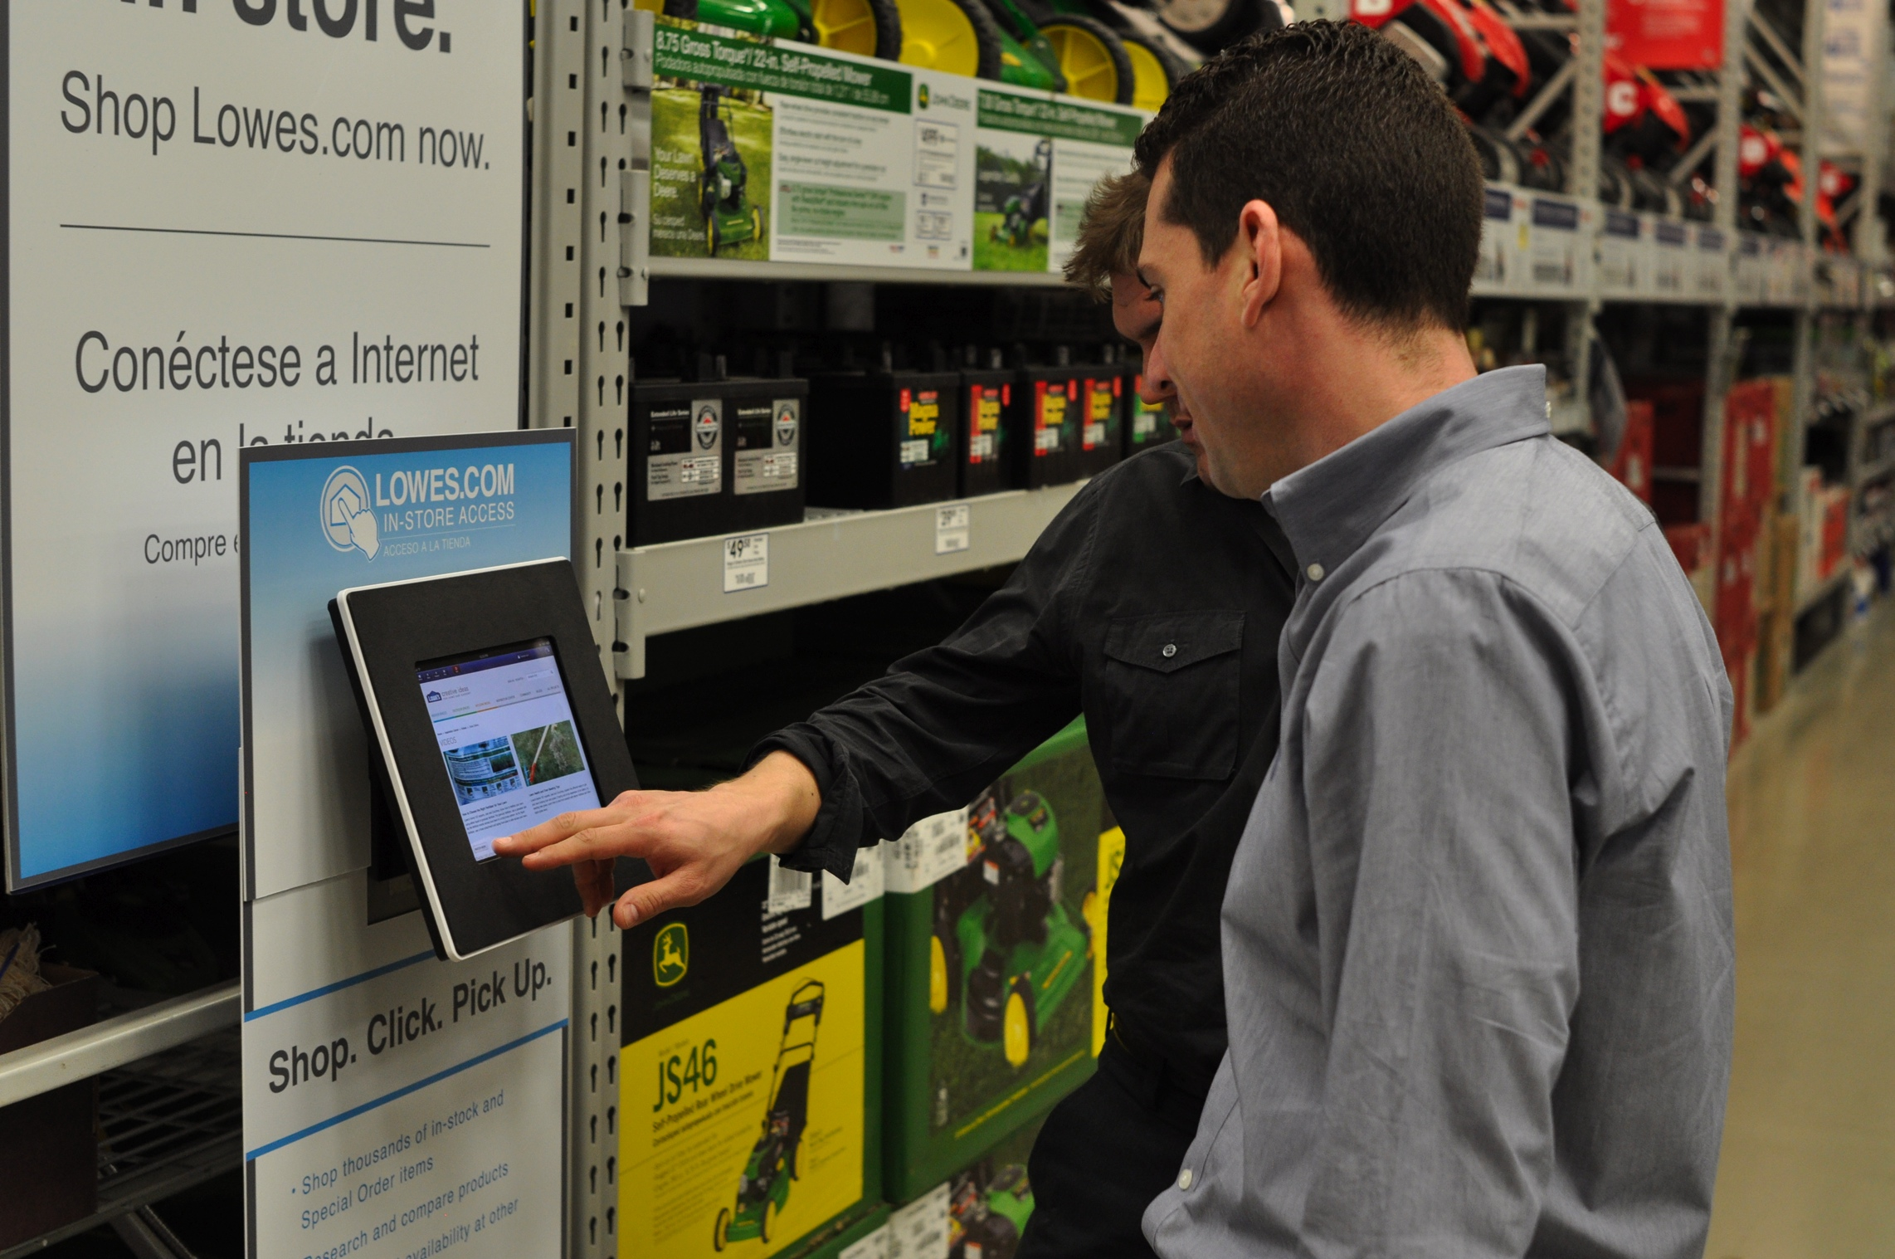
10
Notes:
Don’t just use real devices, but visit or simulate real environments whenever you can. We had one of these prototype kiosks in the office, but one day we drove down the street to a store with them installed as a trial. It was a totally different experience in the actual setting despite every pixel being exactly the same.
People using it in trucks? In auto repair shops? In mines in Brazil or village clinics in Africa? You can’t really tell how it will work from your cubicle in the Financial District, or a usability lab.

Slide 11
Context is about people.
Notes:
Context was denounced a few years back as being too presumptive. What those folks got right was the assumption that mobile was one thing: people on busses and busy executives. But at the same time they discarded the differences in user context, and assumed all desktop computing on the other hand was the same.
Now we are proving nothing should be assumed. “Desktop computers” have touchscreens and can be picked up and carried off. Mobile people use their devices in different ways.

Slide 12
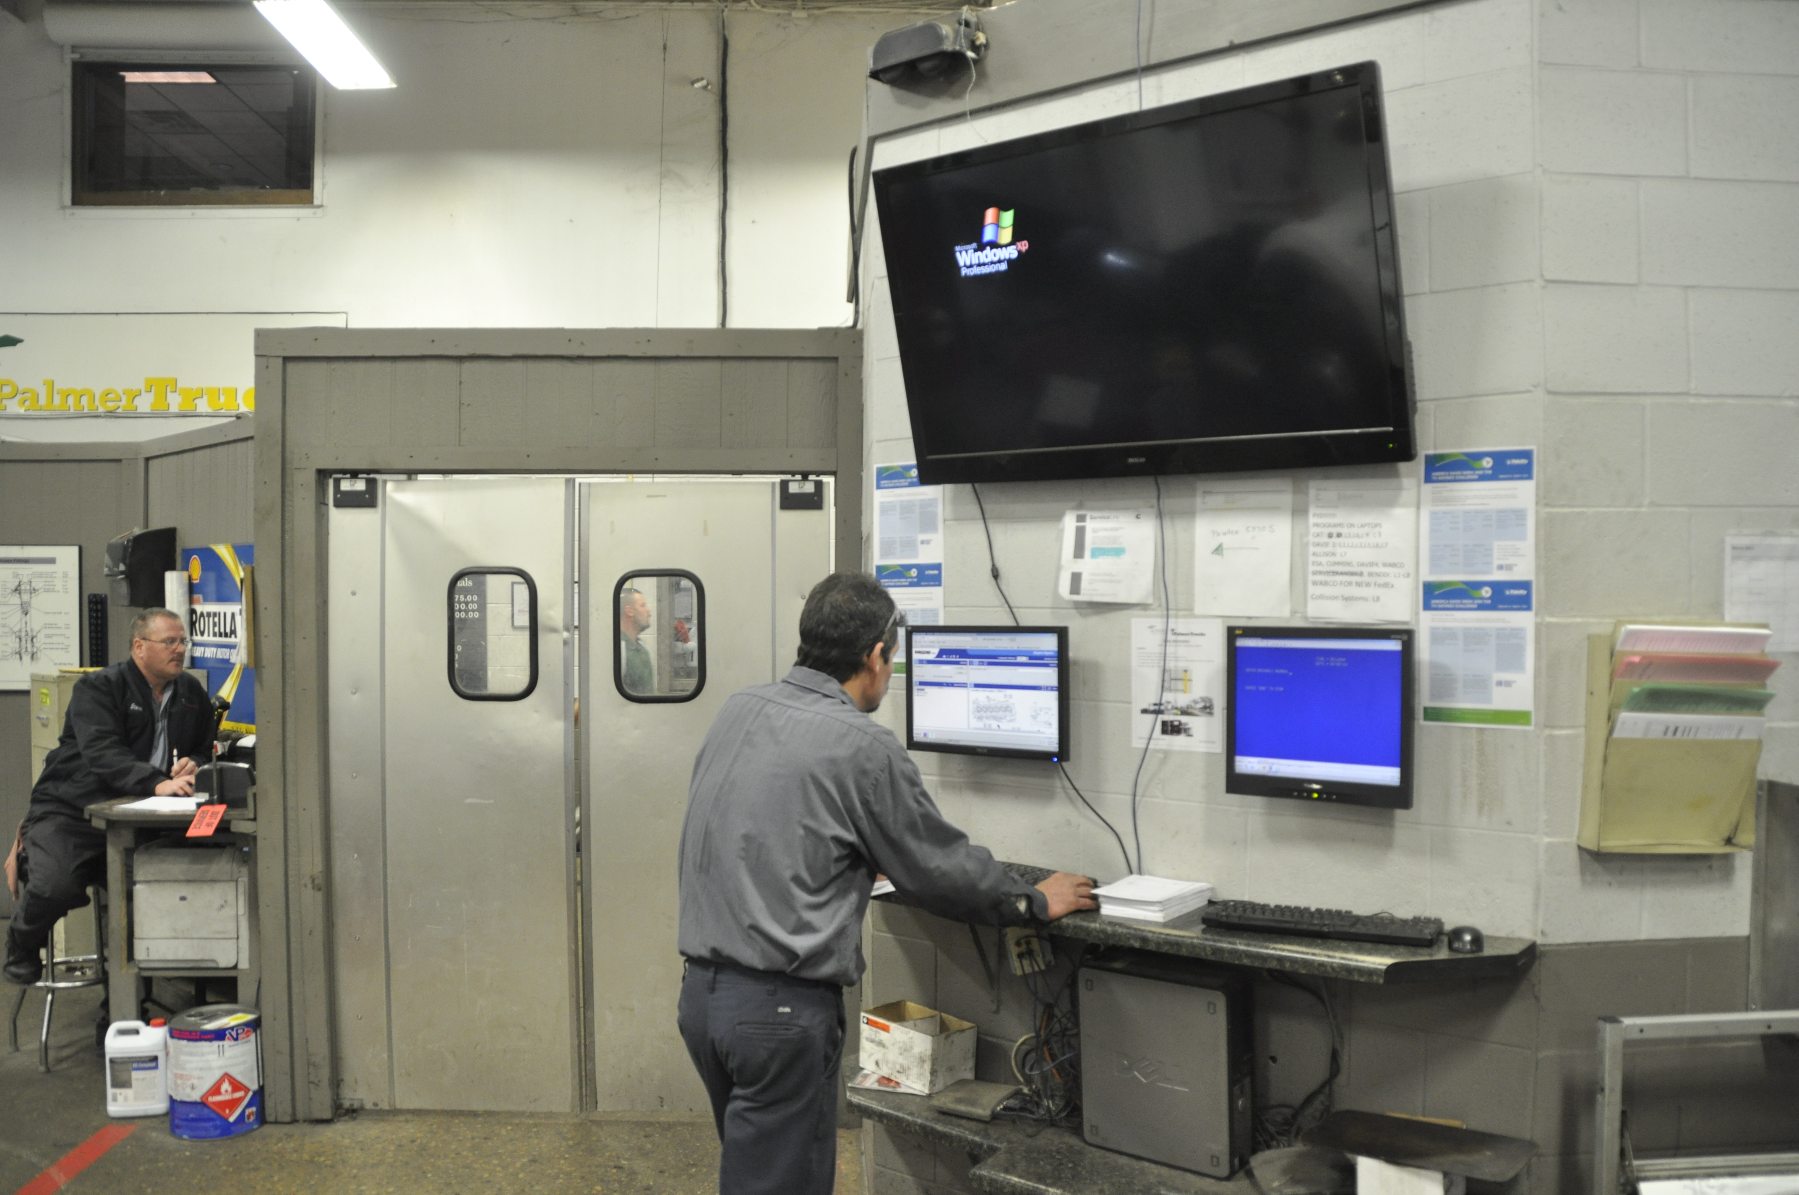
Notes:
This guy is on a “Desktop Computer.” But his context has almost nothing to do with any office worker. Sitting there in Photoshop or Axure you could hardly be more removed from him.
You can’t tell how he works or how his environment changes interaction completely without watching and asking him about it.

Slide 13
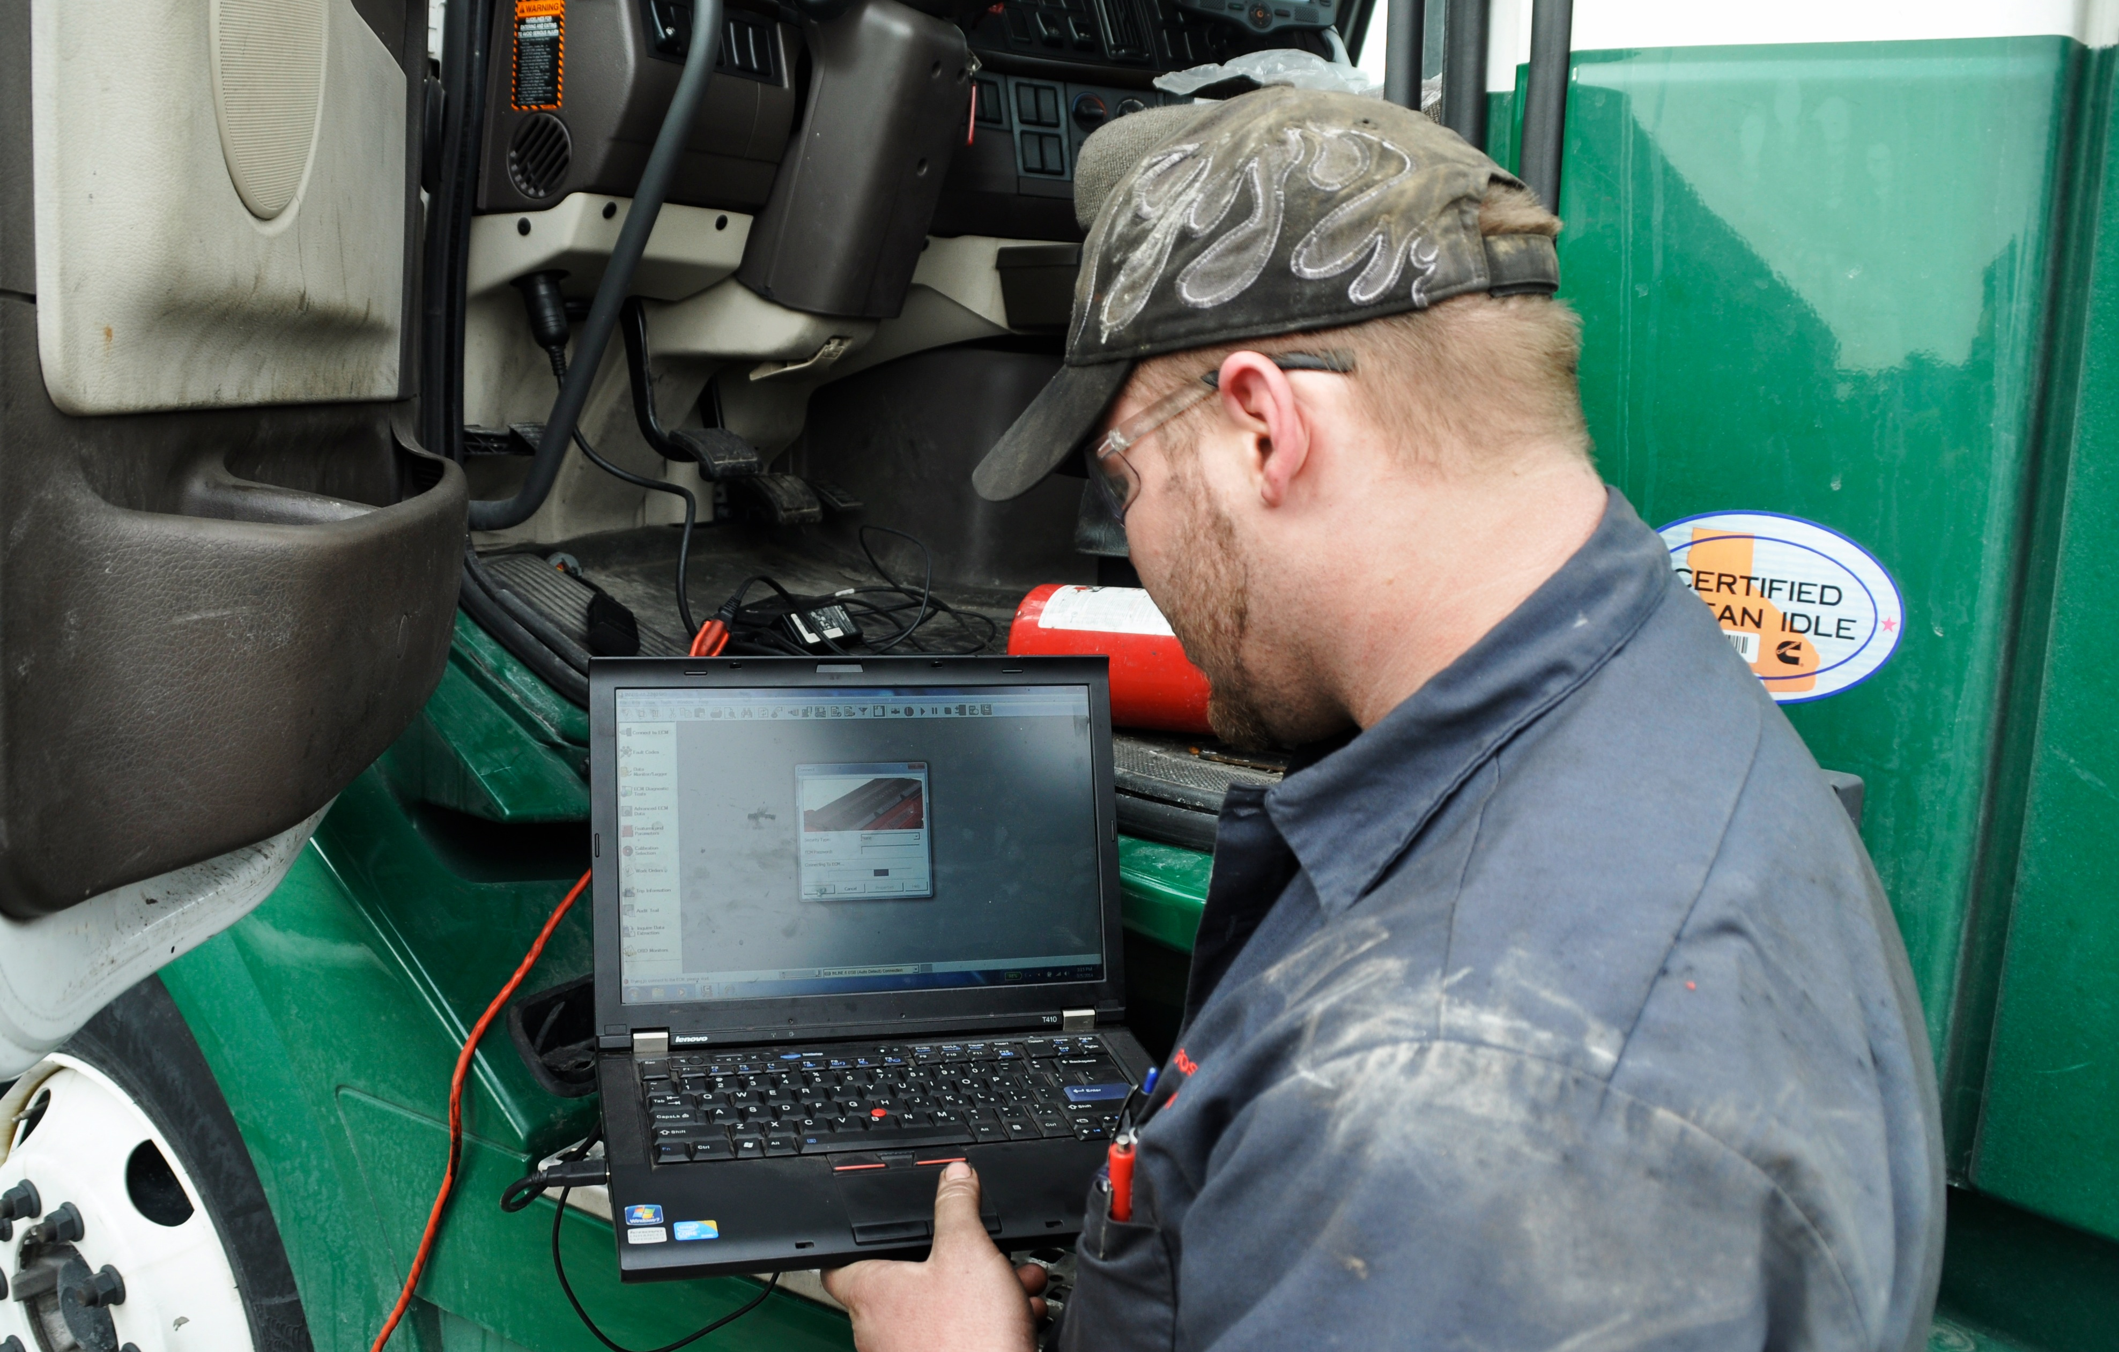
Notes:
At its core we’re now talking about research, or Usability Testing. But specifically, I like Ethnography.
That’s just the proper name for getting out into the real world and seeing people work in their real environment.
This is also a desktop computer, but is different from your desktop or the wall-mounted one. And only for now. This sort of stuff is becoming mobilized, fast.

Slide 14
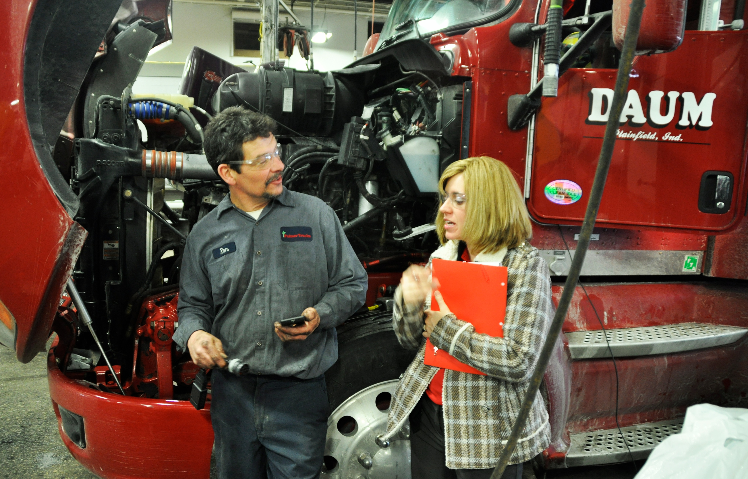
Notes:
Ethnography is also called Field Research or Contextual Research. You can do studies much like classic lab usability tests — as well as just observation, or inquiry about how they do their work today — but you do it outside the lab.
You talk to people, ask them how they do their jobs, and watch them as they work as usual.

Slide 15
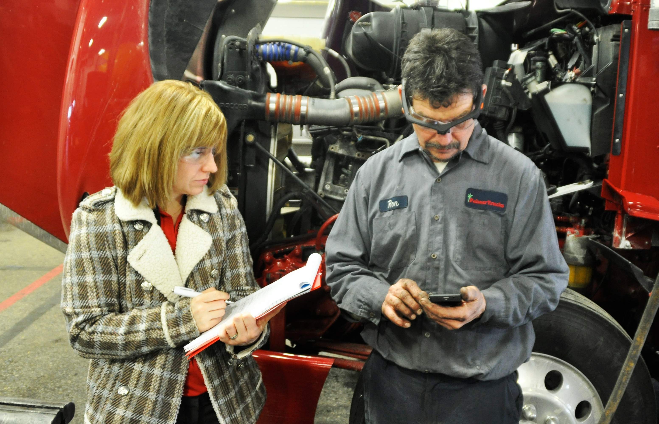
Notes:
You can take notes, record, photograph. Here, we’re doing a plain old usability study on a prototype of a mobile app, and the participant is wearing video recording glasses.
We actually do our recording from LITERALLY the user’s point of view.
This is a whole practice area of its own, so go hire a researcher or team of them to help you with this if you can.

Slide 16

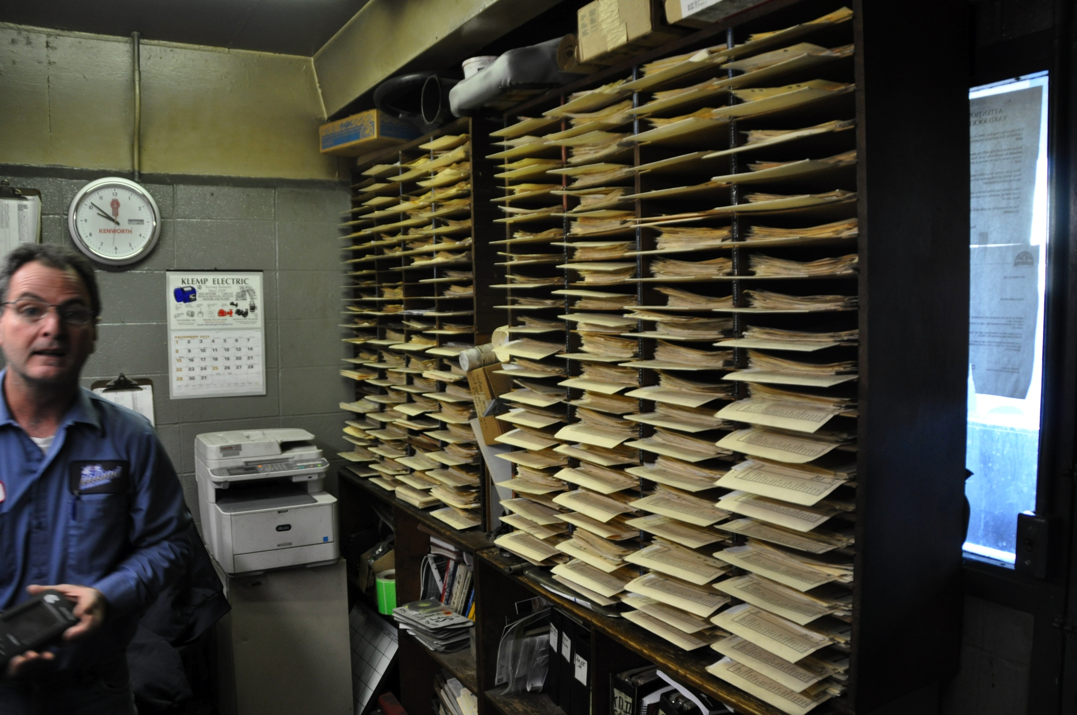
@shoobe01
@techjobslafair
16
Notes:
Don’t be too narrowly focused on your test when you visit sites or customers. The classic example is the post-it. If you look at the computer screen, you only get part of the picture; what are users not able to remember or do, so are writing down, or reminding themselves how to do with Post Its around their monitor?
This photo here is a good example. As part of just testing a product related to a connected vehicle device, I was on site with these truck maintenance guys. Years into this project, I found this. They are, after many failed attempts to implement devices like the thing he’s holding, disappointed with digital recordkeeping and data collection, so have a ROOM of cubbyholes with paperwork.
That had never come up. They didn’t think it was worth mentioning. I just stumbled across it. What are you missing by making assumptions about your users or asking questions too narrowly?

Slide 17
One last problem.
Notes:
Now I want to finish you off with one last pitfall to watch out for.

Slide 18
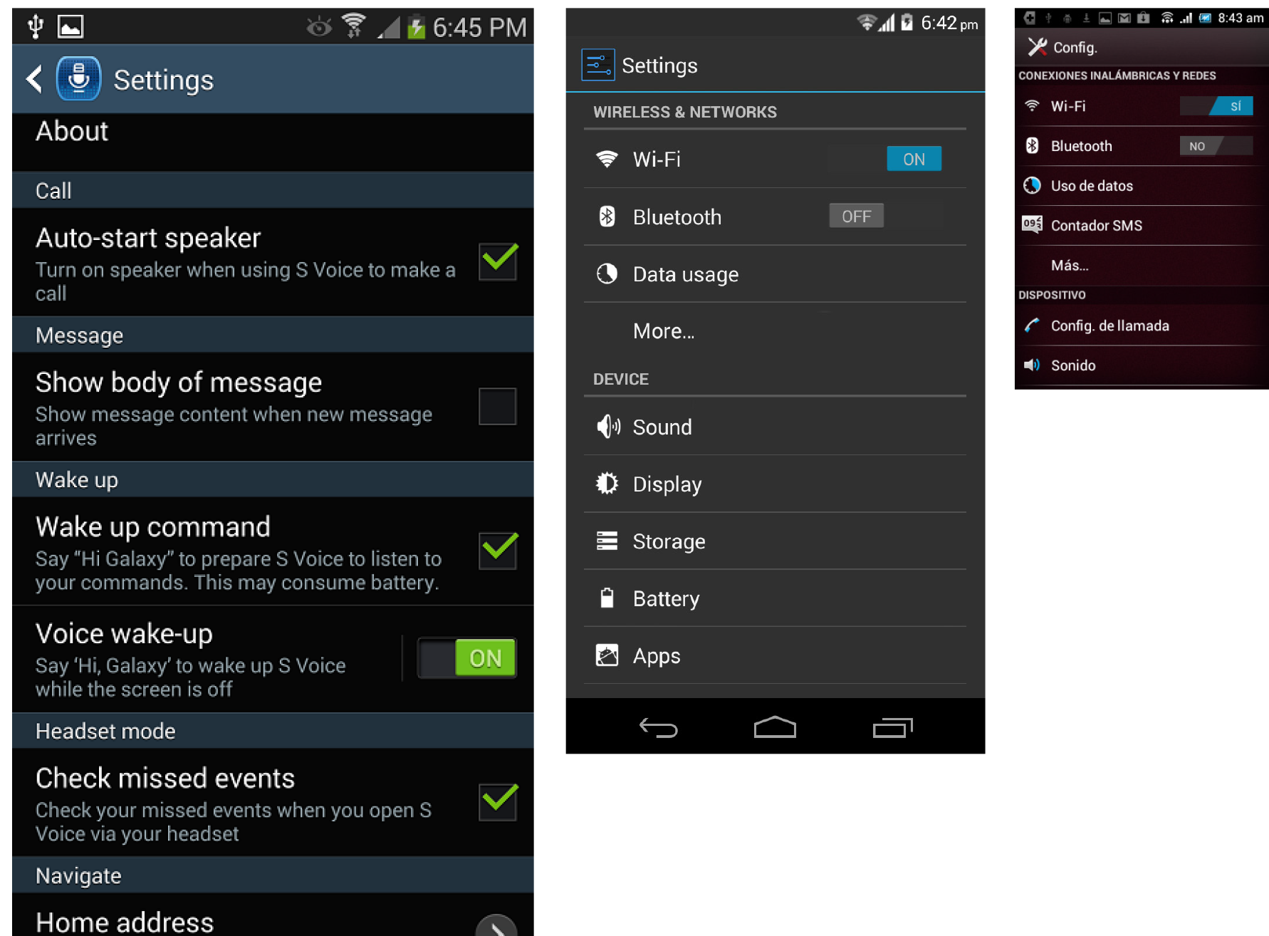
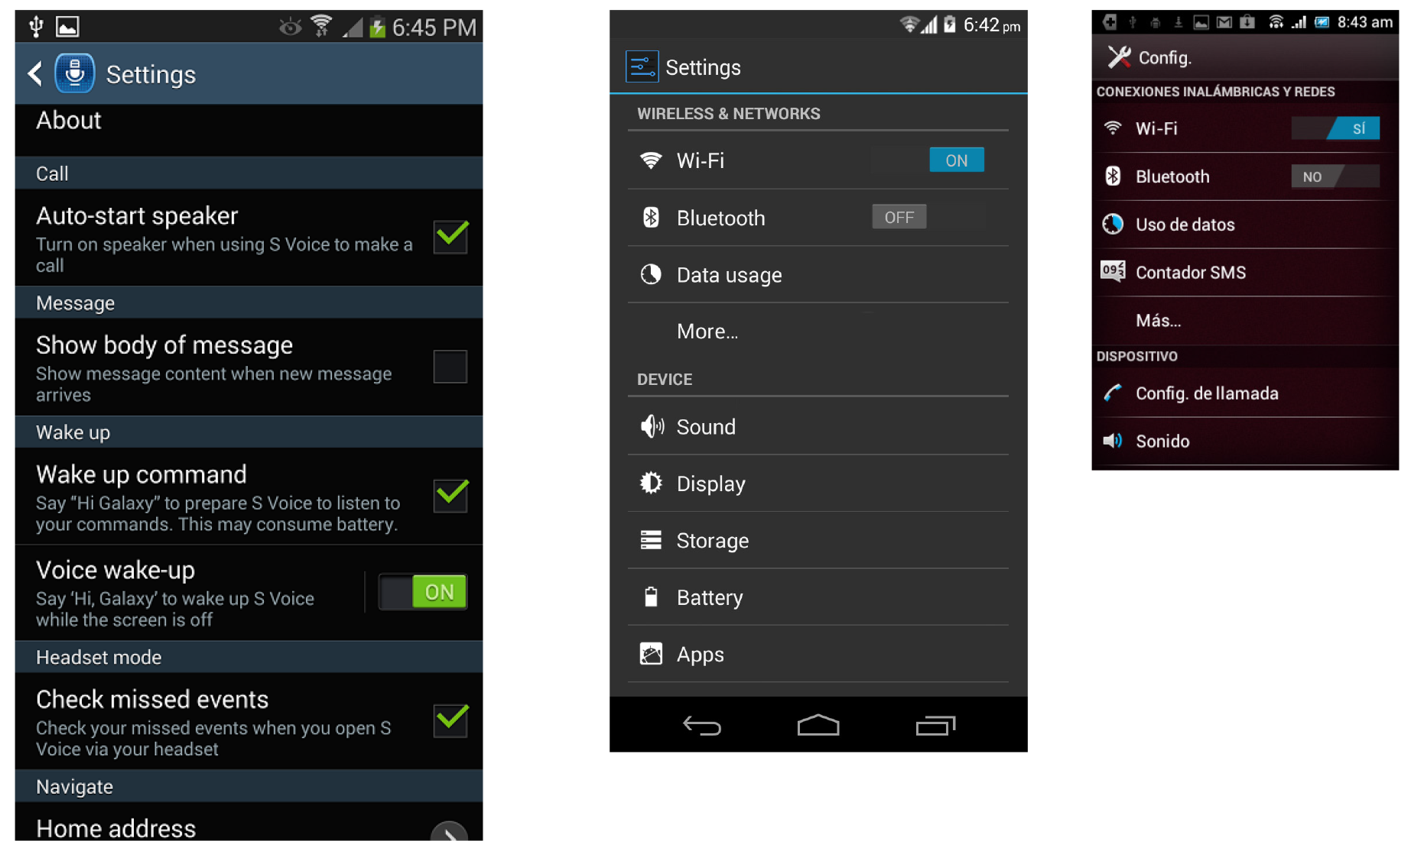
83%
92%
112%
Really: 267ppi
Really: 445ppi
Really: 180ppi
XHDPI: 320ppi
XXHDPI: 480ppi
MDPI: 160ppi
Notes:
Disappointingly, we can’t as app and web designers and developers think entirely at user scale. There are issues involving the way that device independent pixels and viewport scaling works [CLICK] The key issue is the OS makers and device manufacturers hear nothing but your cries of “fragmentation!” and try to simplify to as few scales as possible.
But that means they lie. They group items into a fairly small number of categories. Yes, even Apple. Mostly Apple. The iPad Mini and iPhone 6 plus simply lie and rescale everything you do. There is no good way around it.
Even aside from those lies, the matching between infinite variability in devices and classes of pixels scaling means your text, icon or touch target could be a bit larger or quite a bit smaller than you planned on.
Samsung Galaxy Note 2 – XHDPI: 320 – 267ppi – 83%
Google Nexus 5 – XXHDPI: 480 – 445 ppi – 92%
Sony ST21i - MDPI: 160 – 180ppi – 112%

Slide 19

Notes:
So you make a button 7 mm tall, to assure people can click it and nothing else, set it to the correct size in device independent pxels [ CLICK] and when it gets onto real phones it’s as small as 5 mm.
That’s often going to be intolerable [CLICK] bringing your intended sizes far below useful, or so large nothing fits on the screen.

Slide 20
Solve problems for people
not computers.
Notes:
Okay, I lied. I don’t want you to end disappointed. Let’s all go out energized to improve the world. Because we can. As long as we remember to. User experience is about solving problems for people
CLICK
And not getting caught up in the technology. Efficiency improvements should let users get on with their lives faster, not just be about more sales or reducing IT costs.
We can do this. And with the reach of mobile, we can do it for huge numbers of people all over the world.

Slide 21



^{Steven Hoober}
^{steven@4ourth.com}
⁺¹ ⁸¹⁶ ²¹⁰ ⁰⁴⁵⁵
^{@shoobe01}
^{shoobe01:}
^{www.4ourth.com}
Notes:
If you want to read the articles and research reports all this is based on, see my design pattern wiki, see the references to the side, or just contact me.
If you forget the addresses I list, just Google my name and you’ll find me. I’m pretty easy to find on the Internet, and happy to discuss any of this…

Slide 22
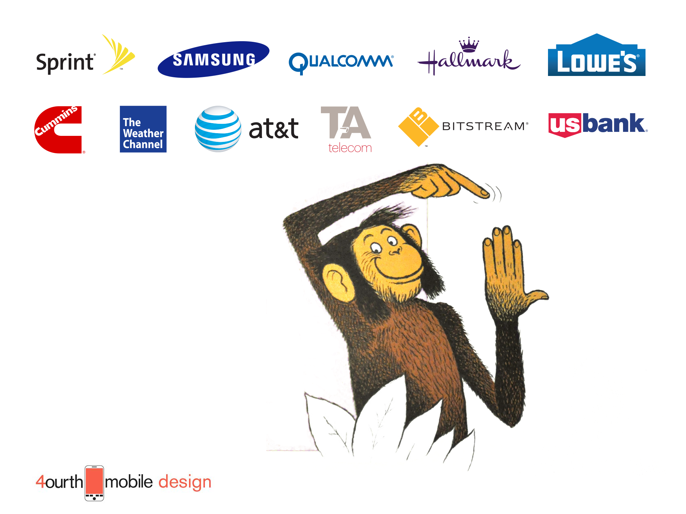
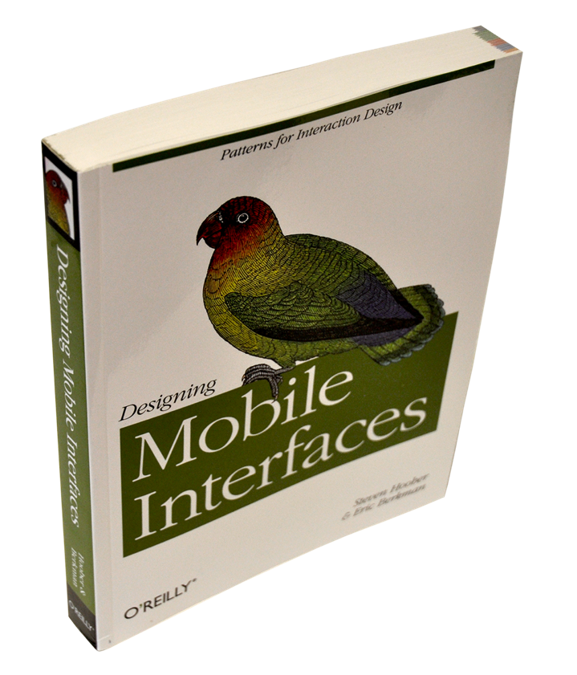
Notes:
And you can also ask me to help address your specific problems or concerns. I have worked with big companies and small, globally and locally, on web, apps, wearables, data and more.
The book Designing Mobile Interfaces is not about how to make the best iOS app, but just like I have talked about here how to make the best mobile experience, regardless of the technology you choose or are forced to use.
I’ll be happy to talk about helping you create the best experience for your users.

Slide 23
^{Steven Hoober}
^{steven@4ourth.com}
⁺¹ ⁸¹⁶ ²¹⁰ ⁰⁴⁵⁵
^{@shoobe01}
^{shoobe01:}
^{www.4ourth.com}

