Slide 1
TIMING/VIDEO
Remove auto-advancing after creating a video version:
On/Off:
In the tabs (not menu): “Slide Show”
[X] Play Narrations
[X] Use Timings
[ ] Show Media Controls
Clear the timings completely:
Select all the slides
Right click a slide > “Slide Transition…”
In the “Advance slide” section uncheck “Automatically after”
NOTHING LONGER THAN 20 minutes!
The complete guide to Designing Mobile User Experiences 12) Interaction & Specifications
@shoobe01
4ourth.com
Notes:
In the last segment we designed detailed interactions for input and selection. Now, let’s talk about how we keep track of that, and communicate it to the rest of the team.

Slide 2
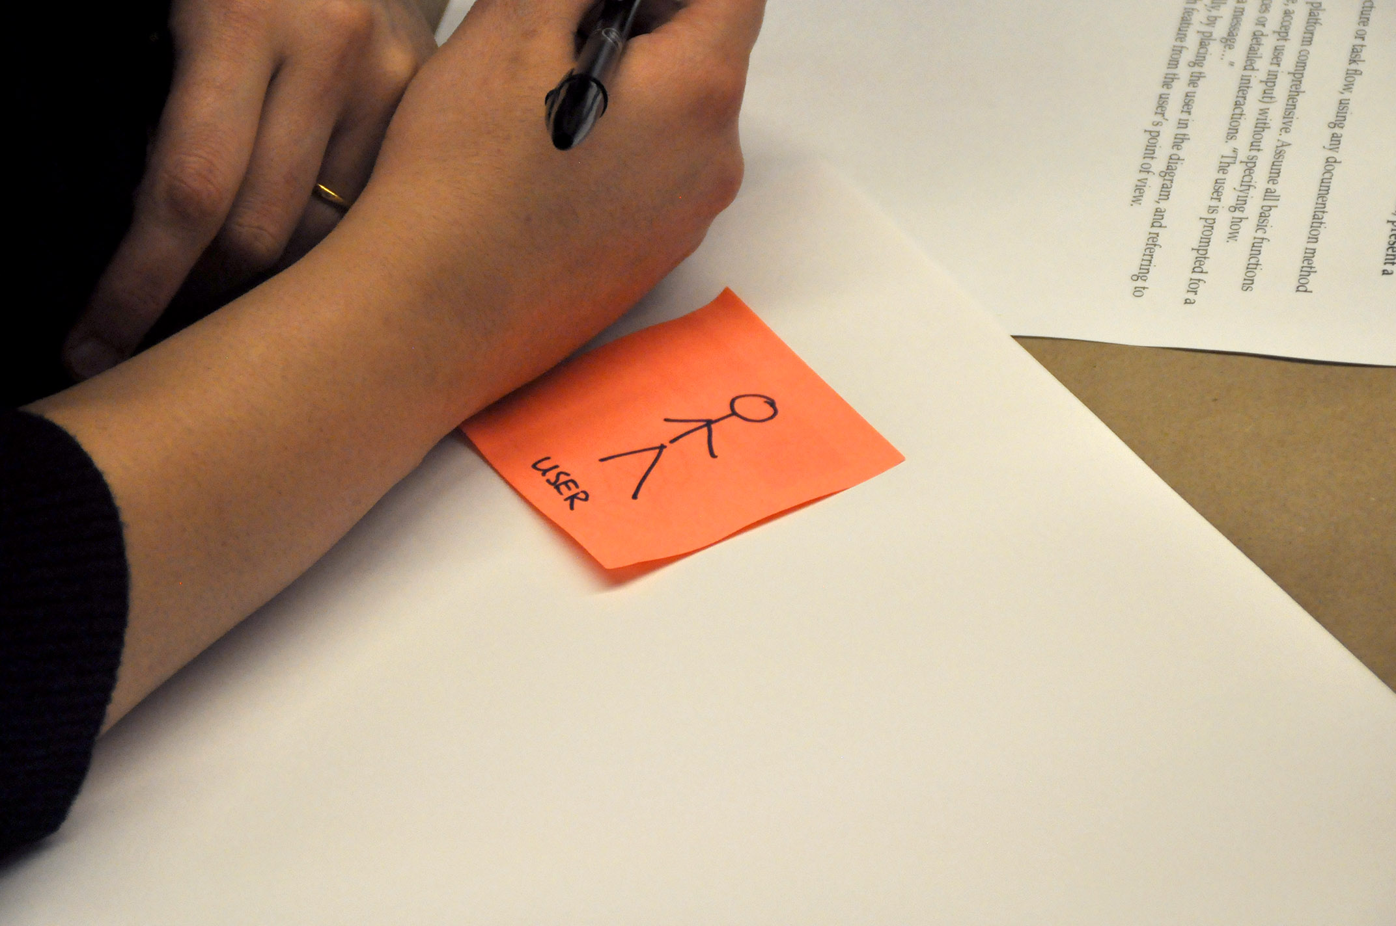
Notes:
Several times a week, someone I know or follow discusses the value of designing in the browser—that is, opening a text editor and creating HTML as the first step of detailed design. Lean and other speedy processes are the current thing, and if anything each month gives us another way to shortcut our work and go faster still.

Slide 3
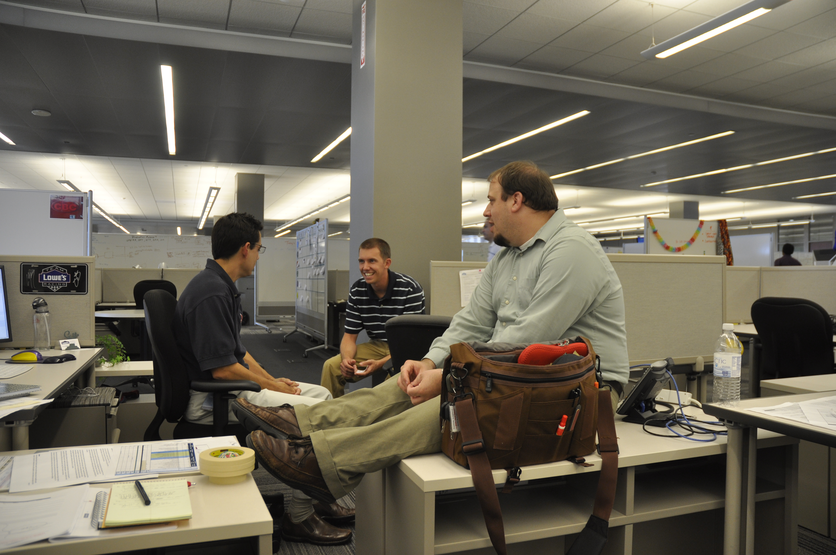
Another Product Owner
Product Owner
Program Architect
User Experience
Notes:
We are supposed to sit together, and talk about the design and issues we have.
CLICK
Okay, we do that.

Slide 4
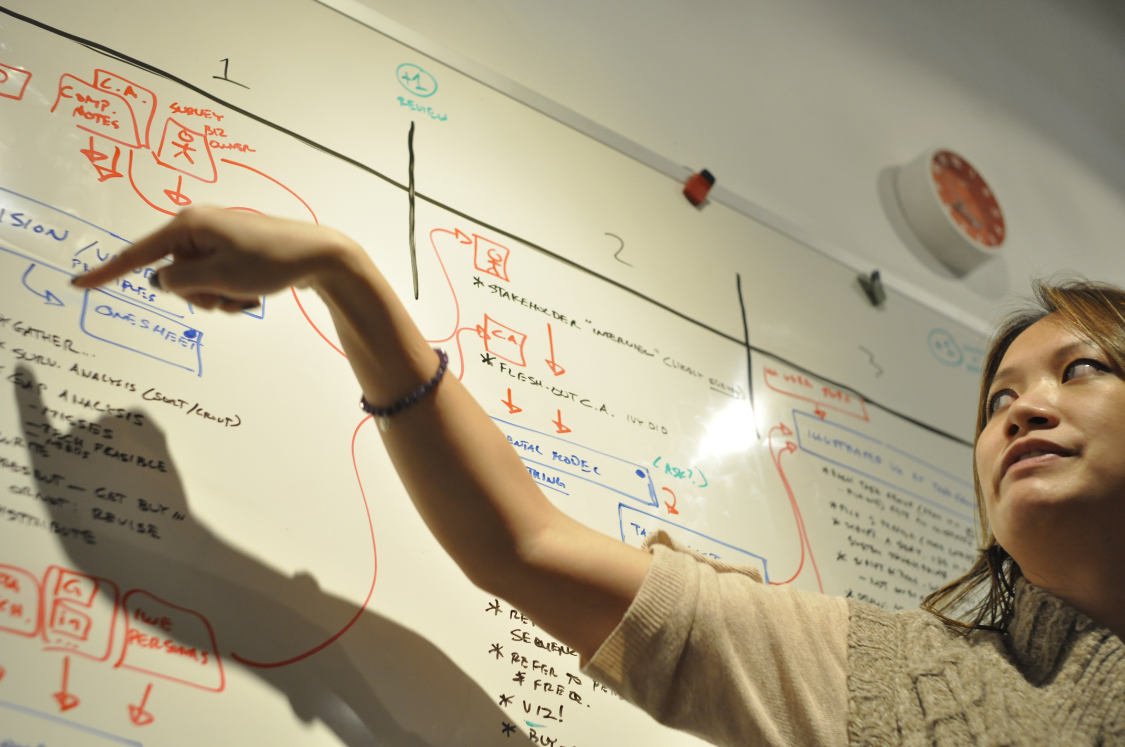
Notes:
We are supposed to talk through our ideas, using quick methods like whiteboards and paper to get the point across. Yup. We do that also.

Slide 5
Why document, really?
Rapid, Lean, Code First or Only |  | Document
Demonstrate right away. Test with real/realistic interaction. Try out new ideas. |  | Faster than you think. Permanent. Unambiguous. Descriptive, not interpreted. Solutions, not techniques.
Only for one platform. Memories are short. Decisions, reasons, intentions not saved. Perceived as final. Risk of debt. Hard to collaborate. Do you really annotate your code? |  | Can be slow. Requires specialized staff. Just the start: Must maintain, store, make available to everyone. Not automatically good. Must follow best practices and save reasons. Feels old fashioned. Not buzzworthy.
Notes:
I don’t brag about my credentials much, but this Is one. I have worked in about a dozen different named processes. I have been trained in Agile half a dozen times, and have completed over 150 successful, launched Agile projects alone (I stopped counting several years ago). I have worked for a lot of different organizations, from strategy to interface design, and have seen it all.
And in my experience — and talking to a lot of others — these processes just don’t work that well. Especially if you follow a user-centric ethos, and you spend time seeking the right solution, and end up being multi-platform, you have to design things, make decisions, and stick to them if you want to get anywhere.
We forget. People are terrible at remembering project details, interactions and decisions. So we have to document somewhere permanent so we know why we did what we did.
Projects that go too fast aren’t designed. Not just interface design, but software and architecture design. Decisions are made due to comfortable and available technology. Overly-speedy projects get bogged down in technical debt very, very fast.
And documentation isn’t that slow. I have worked on lean projects, where I’d whiteboard out the design solution for the emergent issue while people stood around, then get on the computer to draw it before I forgot. I’d be able to finish in time to print it out and stick it on the wall before the developers came back with their detailed questions.

Slide 6
Notes:
Hell, I’ve done that at hackathons, and if you don’t think that’s a high-speed environment, I encourage you to go to one sometime.

Slide 7
Notes:
I still write UI Specifications. Nope, don’t call them wireframes, but specifications. Half the page is occupied with details of how the interface works, how it should be built, and what the user can do to it. It’s a specification that we can hold the developers to, and test against.
This isn’t a burden, but often means much less work for developers, as I give them the sizes, colors, methods of movement, timings, opacity, and everything I can. Usually, already translated to the platform, so Android gets SPs and DPs, not pixels or inches.
You can prototype all you want still, but once you’ve figured out how it works — even down to timing on animations — then write down what the results are so the developers can implement it right, instead of guessing.
There’s not a bit of ambiguity, which easily emerges even from turning a prototype into real production code.

Slide 8
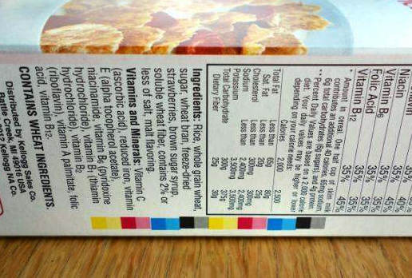
PHOTO. REG CODES ON CEREAL BOXES.
Notes:
I very rarely do comps, never design in comps, and never do them endlessly, building every screen, every view, and every platform. Because what’s “every” mean anyway?
In print (and package design) errors in printing, the slight changes in box size as they are run, etc. are all considered tolerances, or normal variations, not errors. Accounting for overlaps and inaccuracies in ink placement is a whole (very specialized) practice area called trapping. I have books on my shelf dedicated just to trapping.
It’s baked into the entire process of print, from design through QA. These little colored boxes are “registration marks,” allowing the printers to line up the inks, and allowing inspectors to check that it was done well, and consistently.

Slide 9
Notes:
The important parts of this document aren’t the drawings. Thought they help and are used at some stage. No, the key part…

Slide 10
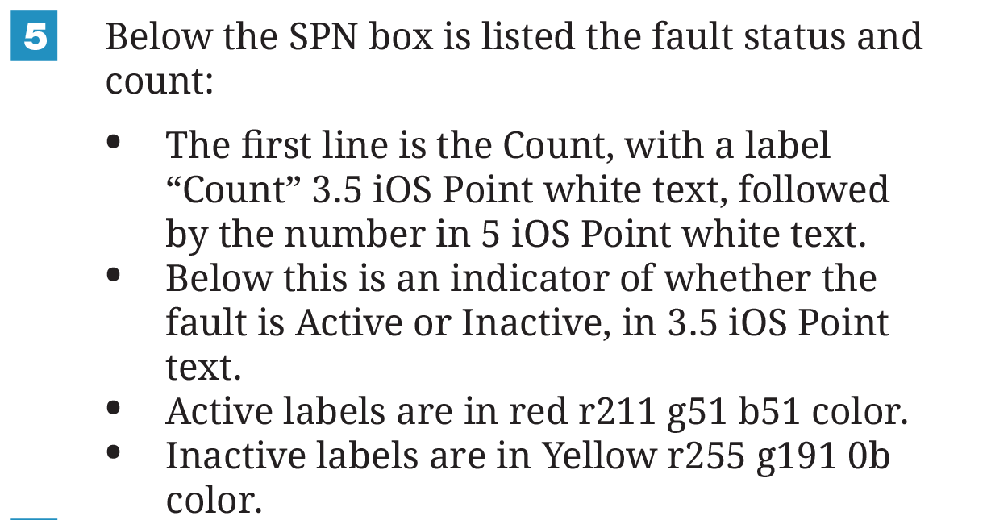
Notes:
… are the words.

Slide 11
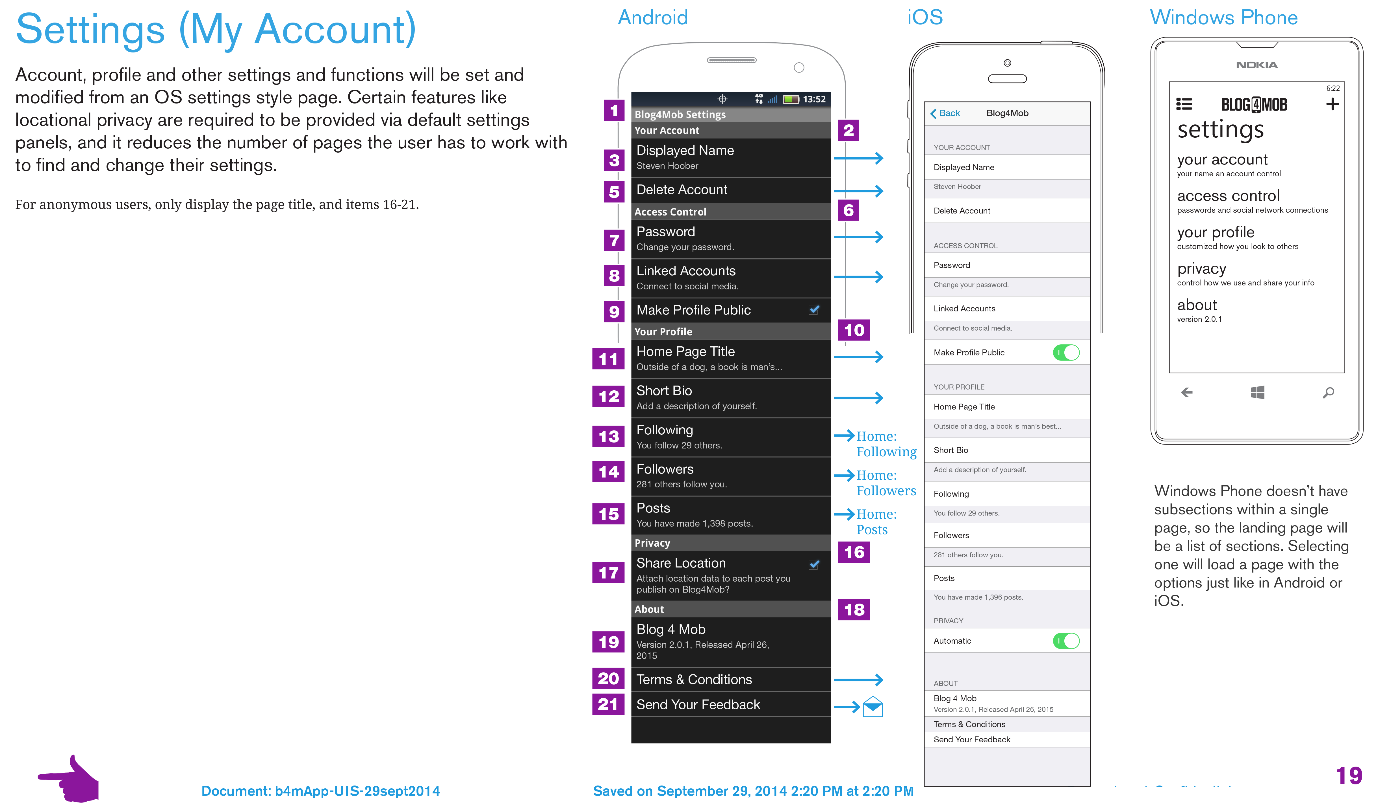
Notes:
Specifications allow you to design systems, and to design different scales or different platforms side by side.

Slide 12
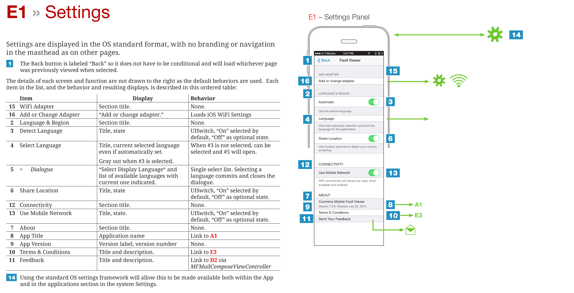
Notes:
There are even charts and tables, describing behaviors. A picture does not say a 1000 words in all cases, and it’s subject to interpretation. Tables and bullet lists are all that are needed anyway.
Building a settings panel in an app isn’t about replicating the UI in a drawing, it’s just a configuration file. So we give the implementation teams what they need to do that.

Slide 13
Notes:
Yes, this starts getting into functional specifications. But that’s fine. Because of what layer we work at. This is the presentation, the user-facing layer.
Even if the whole team is contributing, who better to document these than the UX designer?

Slide 14
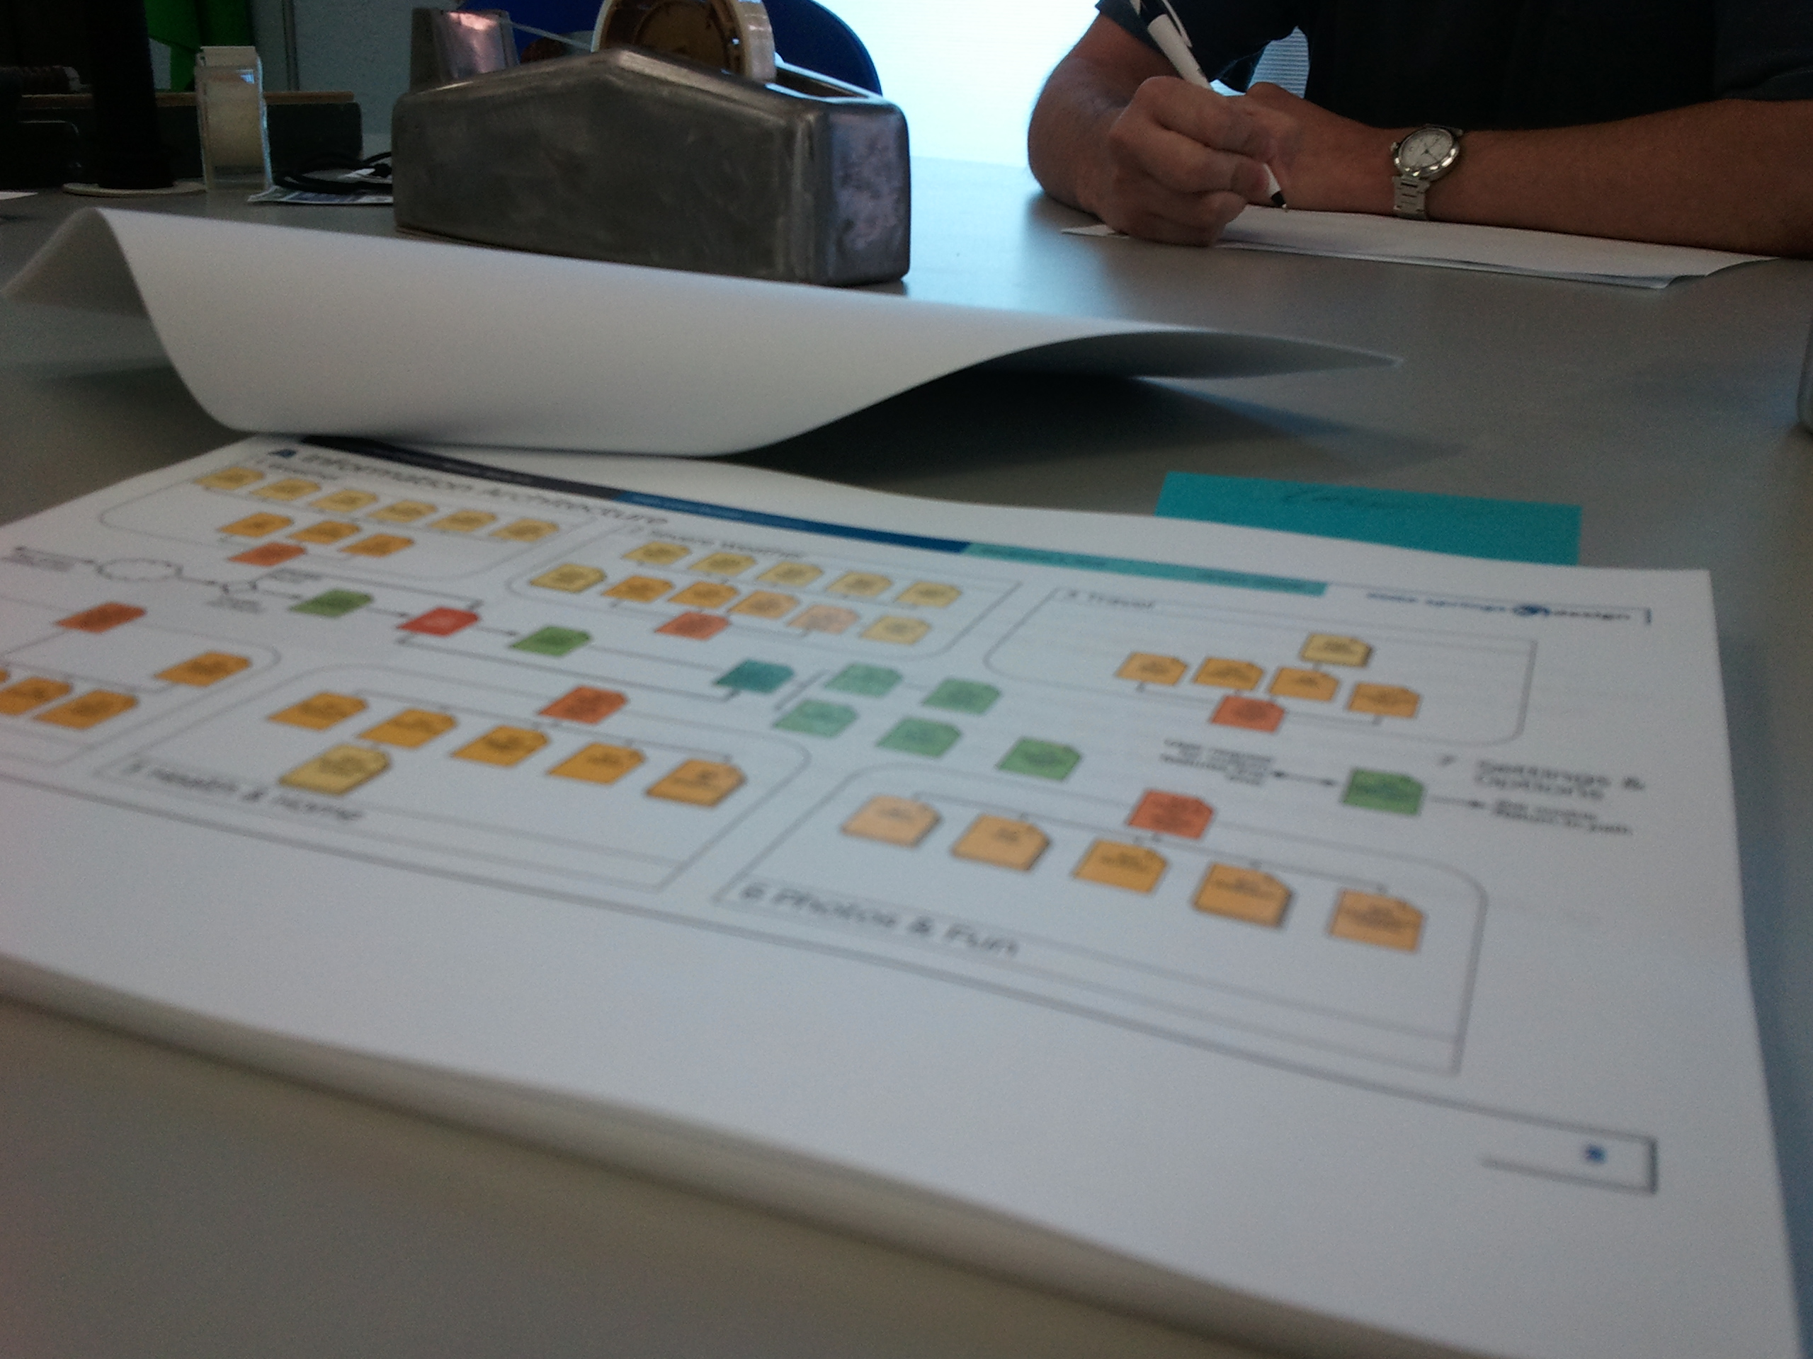
Notes:
Everyone should review the document.
If you distribute a draft document and everyone goes “okay” after a day or two, be scared. You will certainly make mistakes, and leave things out. If no one discovers your mistakes, they aren’t looking hard enough.
And here I will drop my experience again. Not only is my conviction of documentation style from experience in projects, but in researching how documentation is used. Mostly semi-formally, by just keeping notes. But once I was able to start a large documentation effort by engaging in research with the various software implementation teams (from a variety of phone manufacturers if you wondered). These are research-based, proven out best practices.

Slide 15
Documentation formats
Best practices for good outcomes:
Absolutely permanent numbering schemes.
PDF distribution. Print and bring it over if you can.
Words on the left, drawings on the right.
Every page has full project name, file name, date.
Preconditions, postconditions.
Describe the intent, or at least the place in the system.
Include IA diagrams, other earlier artifacts.
Notes:
I won’t show you the same document again, but give you a few best practices instead.
- It’s a specification, so treat it almost like a legal document. Number everything, and numbers are permanent. B6d, bullet #7 is always the same, even years later. Developers will start naming components off your format if you stay consistent, and test will use them for their cases.
- Make it easy to consume. So far, PDF is best for general purposes. There are some online tools, but they are not ideal yet. And if you work with a vendor, do they have access to your repository? Well…
- People are normally distributed between words-centric and picture-centric. The word-centric people get lost in drawings, so lead with words.
- I have seen dev managers hand out assignments by taking the stapled stack of UI spec, and tearing off sheets to give to their team. Make sure each page says what project and section it is.
- And also where it is in the system. Preconditions, and links out to other components, clearly labeled.
- Make this a permanent document. That task flow, and any other information architecture documents should be kept in final format inside this, so it’s the single explanation of the system. You will want all this in a year—or five—when the project gets a major overhaul and no one knows how it works today.

Slide 16
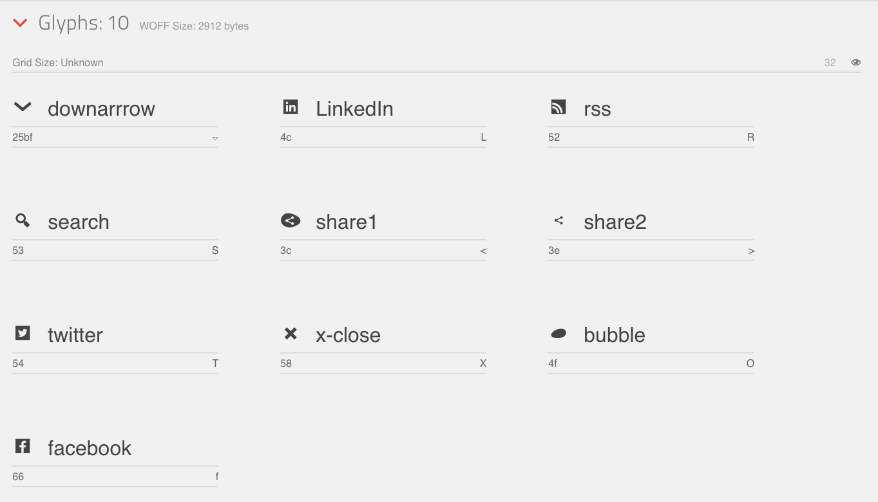
Notes:
It’s not the 1990s anymore. I was working in the Web then and we spent a lot of time in Photoshop to make websites look the way we wanted, then slicing images to fit in tables. That’s over.
Lines, boxes, buttons, backgrounds, and type. Most things you make are going to be programmatically specified in native code or CSS, not sliced from a Photoshop comp.
I have designed launched mobile apps with ONE raster image. I am waiting to deliver a mobile website with zero, since I am increasingly using vector type, not to mention SVG and Canvas-drawn items.
Know your dimensions. I have given them in human scales before, but know how to translate millimeters and points to iOS “points”, to Android SP and DP, and what a pixel on the Web means.

Slide 17
“Because resources can change between platform versions, you should not reference built-in icons using the Android platform resource IDs.”
Notes:
Apps don’t support icon fonts natively yet, and while you can do it, there’s some configuration to mess with. So you draw icons. I mean, here’s the Android guidance on those.
“Provide your own” is what it says.

Slide 18
Default Android Drawable
ic_menu_refresh
Custom Icon
masthead/MenuUnits
Notes:
They are wrong. Without a question, wrong. People get familiar with their OS, within 20 minutes some studies indicate, and anything that breaks that paradigm confuses them.
For icons — on apps at least — you should always using the basic icons provided by the OS, and use them whenever you can to have the same meaning. Specify these also, so there’s no confusion about them.
Especially on iOS, they only build icons for themselves so the colors are limited, but if you must make a custom one because of that, copy the existing icon shapes, pixel for pixel.
Yes, icons do change from one release to the next. That doesn’t mean we throw our hands up and scream “fragmentation,” but plan for it. Check with older icons especially on Android where your binary may work on many OS versions. Make sure they are visible in all cases, and keep up on new releases so you can change to accommodate those.

Slide 19
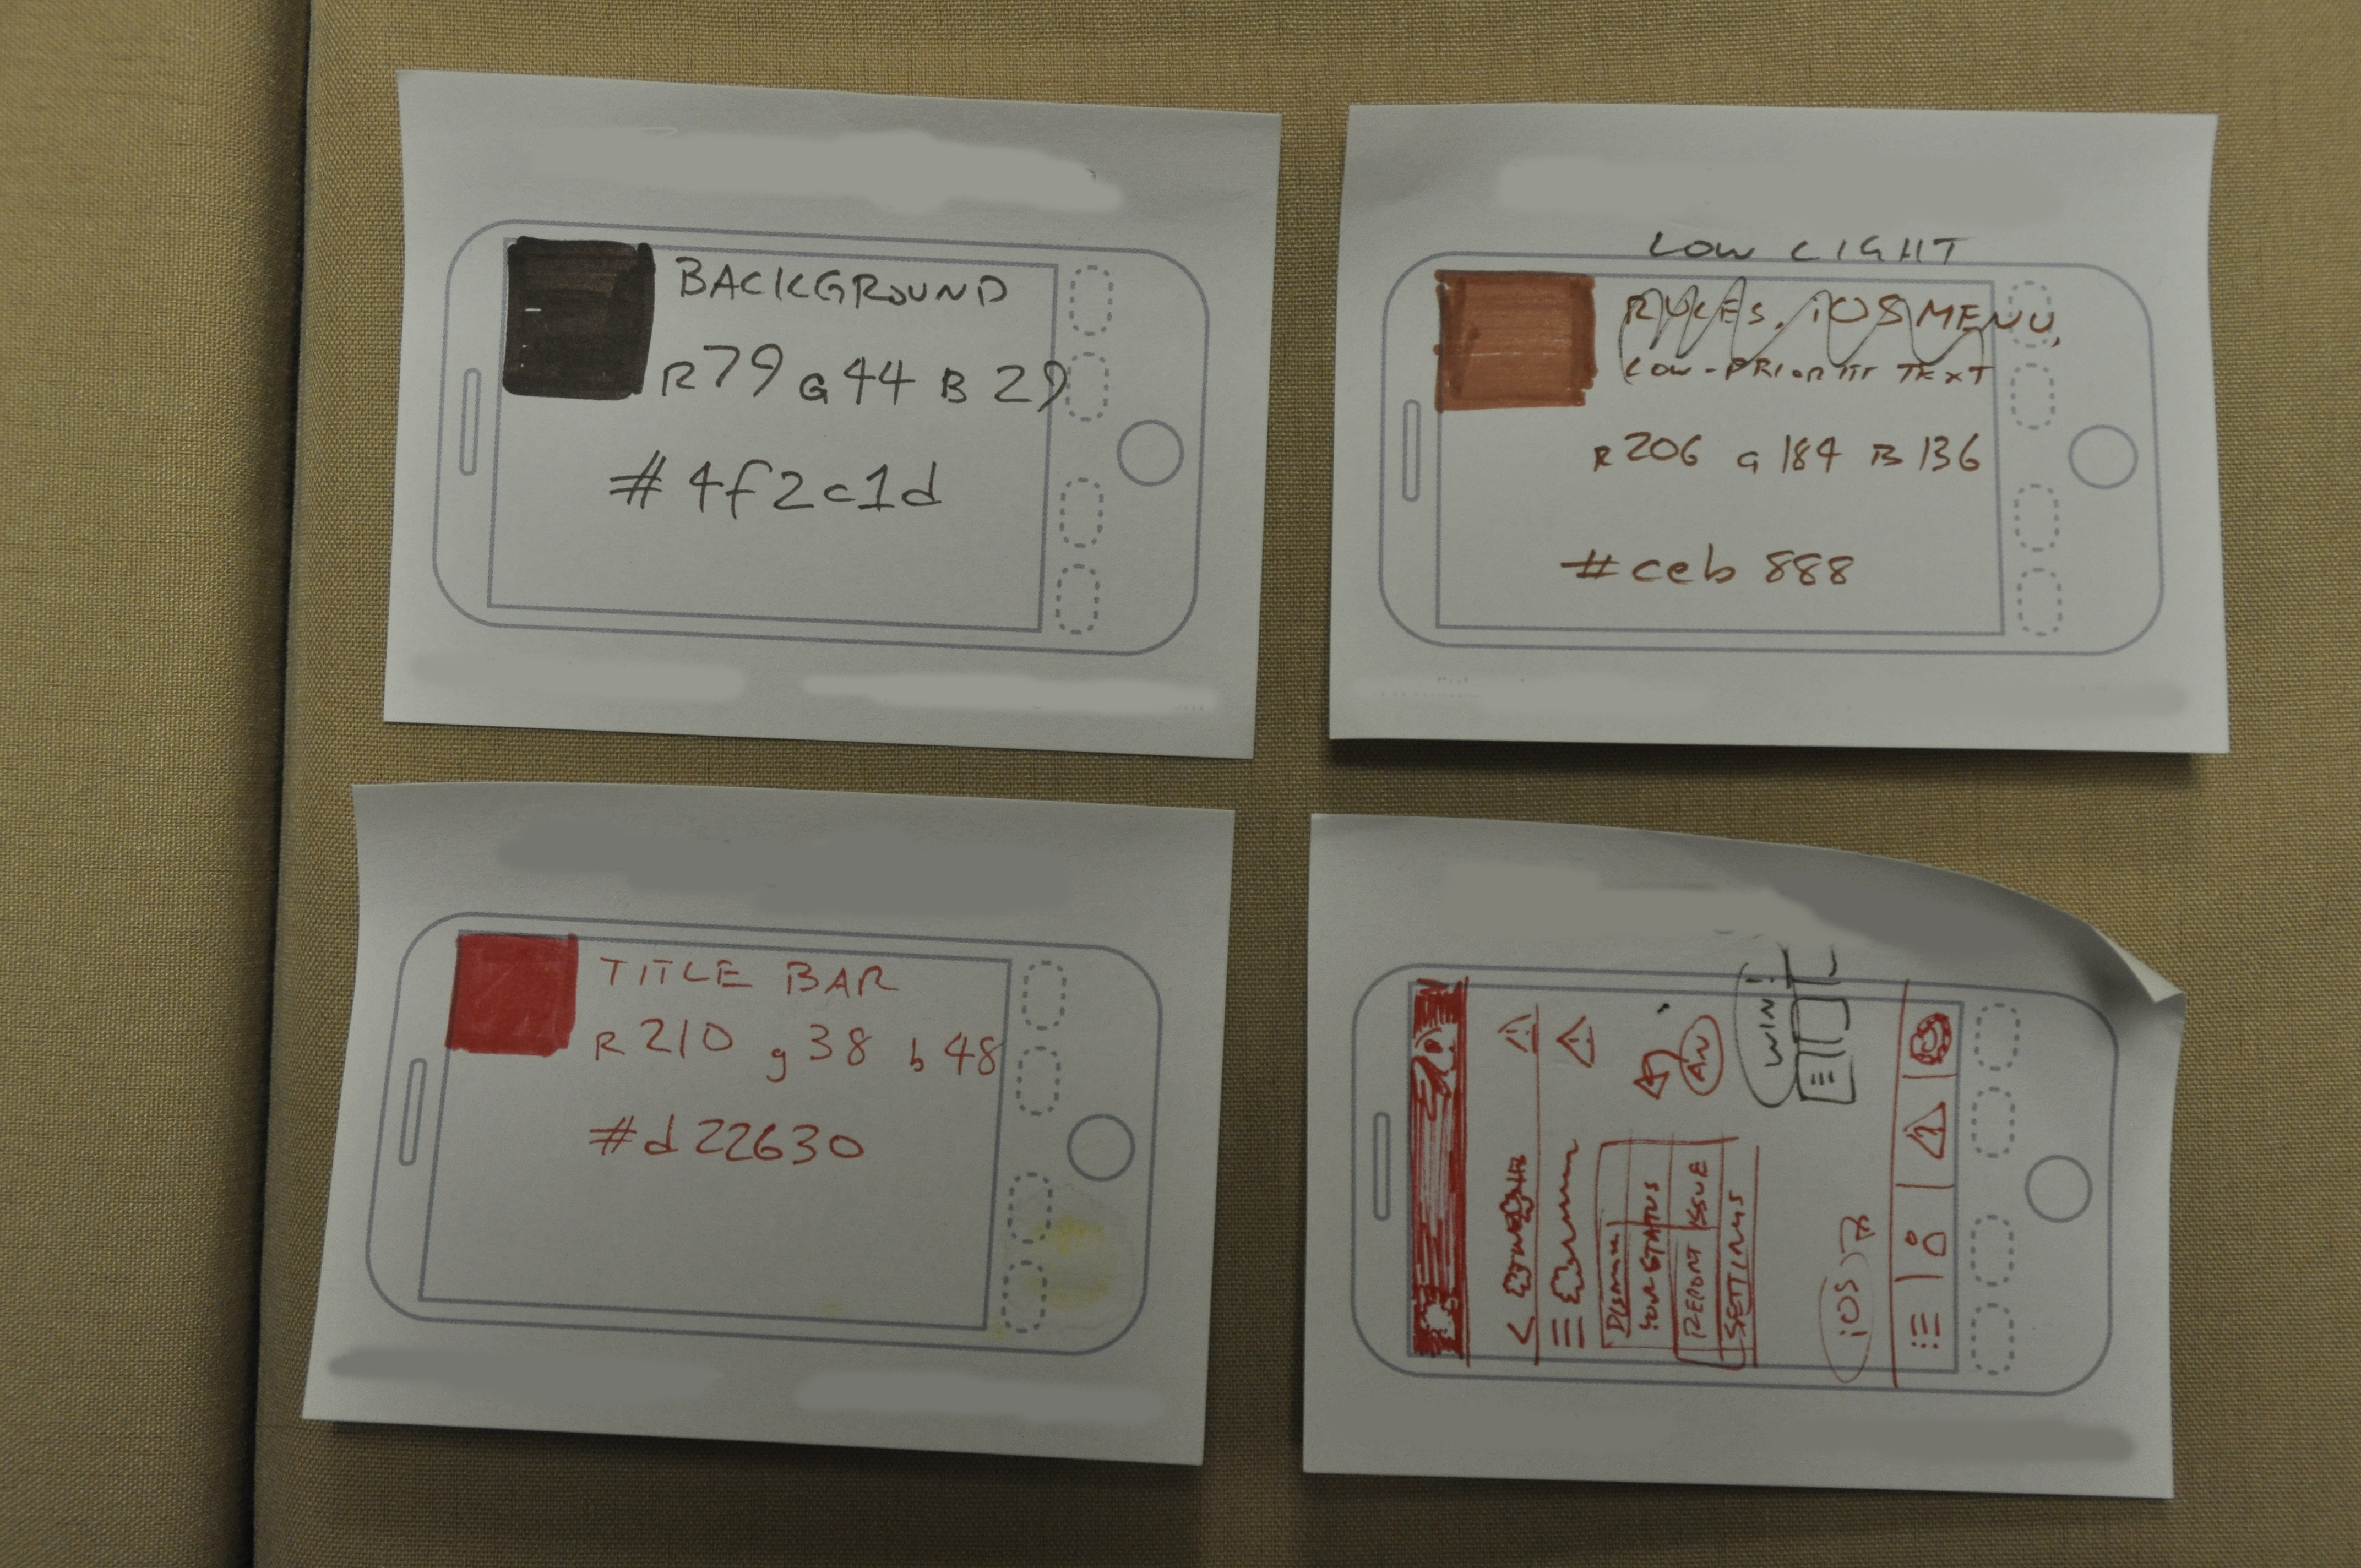
Notes:
If you zoned out on all this because you disagree with my documentation treatise, this is all true no matter how you do your process.
Here’s some of the critical style and layout information for a recent very lean, very fast project. I delivered the raster images… never. We kept changing our minds so I never finished them. But with this, and a few more page design scribbles…

Slide 20
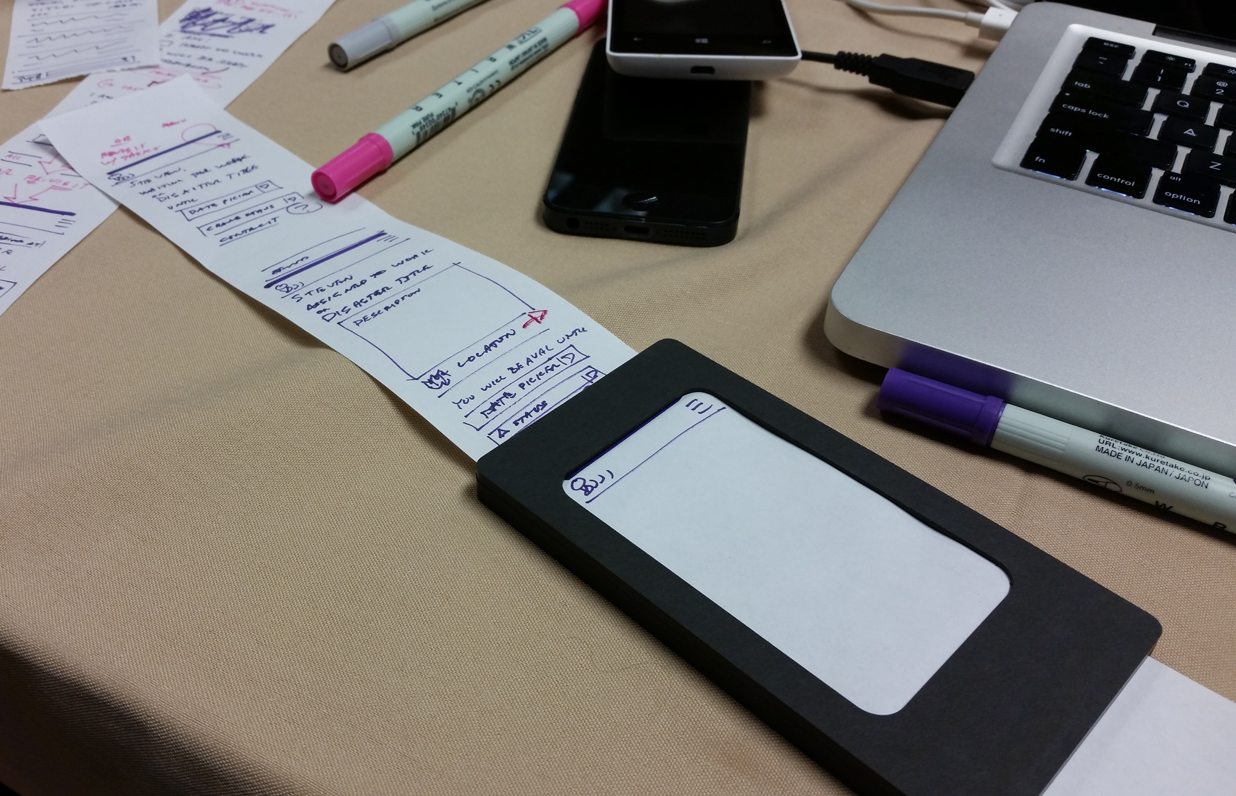
Notes:
… which I drew on a tool I am actually having /made/ I believe so much in quick UI sketching, they were able to get the app including UI banged out in a couple days.
No comps, no slicing photoshop, and totally a UX designer deeply involved.

Slide 21
Documentation doesn’t replace you.
Notes:
In the way good presentations are about the story not the Powerpoint slides, never forget that documentation IS just an artifact. The design exists either way, and your expertise is needed no matter what to explain, to fix problems, to change scope.
The real point of Lean is — I think — to encourage collaboration and participation. I think it’s done wrong, but the goal is laudable.
Whatever you do: be available, approachable, and clear. Know the design inside and out so you can not be lost when you take that 2 am call from India.

Slide 22
In Part 13:
Design at scale
Empathy.
Work on devices.
Sketch at scale.
Context.
Ethnography.
Scale factor issues.
Notes:
In the next section—the last section--we’re going to wrap up with some tips on keeping the user and their context in mind while designing, and some freshly-released pitfalls from Apple to watch out for.

