Slide 1
TIMING/VIDEO
Remove auto-advancing after creating a video version:
On/Off:
In the tabs (not menu): “Slide Show”
[X] Play Narrations
[X] Use Timings
[ ] Show Media Controls
Clear the timings completely:
Select all the slides
Right click a slide > “Slide Transition…”
In the “Advance slide” section uncheck “Automatically after”
Designing Mobile User Experiences 12) Interaction & Specification Resources
@shoobe01
4ourth.com

Slide 2
Interaction & Specification
Read More:
Here's some discussions of tools, tactics, documents and the whole principle of how UX can work with lean and Agile teams.

Slide 3
Who Builds a House without Drawing Blueprints?
http://cacm.acm.org/magazines/2015/4/184705-who-builds-a-house-without-drawing-blueprints/fulltext
Long, well-written screed on why specs are important. As one comment says, sad we have to be arguing for this in 2015.
The need for specifications follows from two observations. The first is that it is a good idea to think about what we are going to do before doing it, and as the cartoonist Guindon wrote: "Writing is nature's way of letting you know how sloppy your thinking is."

Slide 4
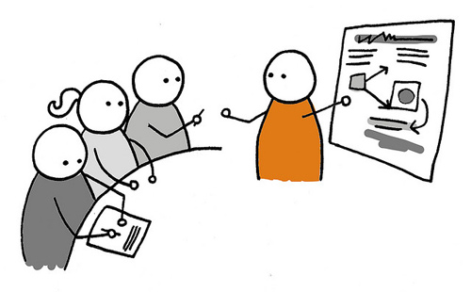
Lean UX: Getting Out Of The Deliverables Business
http://www.smashingmagazine.com/2011/03/07/lean-ux-getting-out-of-the-deliverables-business/
I simply do not buy some of the supposedly key tenets of Lean like in the title. No deliverables?
But even then, there’s much to the principles of being fluid, reactionary and build what is needed, not what is on a flow chart somewhere. Read up on this and understand it.

Slide 5
Why I detest the term “Lean UX”
http://whitneyhess.com/blog/2011/02/27/why-i-detest-the-term-lean-ux/
Whitney Hess says it better than me in many ways. So I’ll stop talking.
“Lean UX” implies that less UX is being done. That couldn’t be further from the truth, nor is it something we should encourage. And anyway, UX shouldn’t be measured in time spent conducting activities or producing activities; it should be measured in its depth of integration in a company’s philosophy and culture.

Slide 6
Tools for Mobile UX Design
http://www.uxmatters.com/mt/archives/2013/06/tools-for-mobile-ux-design.php
I wrote two articles on this, one giving an overview of everything from spreadsheets to html, and the other diving into how I use InDesign to create UI specifications (wireframes, if you insist).
Here’s the second one:
http://www.uxmatters.com/mt/archives/2013/09/tools-for-mobile-ux-design-adobe-indesign.php

Slide 7
UX Tools
http://uxdesign.cc/ux-tools/
Many others discuss the tools they use, but far too many are anti-inclusive, and talk down about other tools.
This one isn’t even an article, but just a list of everything used, by category. Worth it as a resource at least, if you hear a term and aren’t sure what people are talking about. You can impress the boss by looking it up in the meeting then commenting as though you already knew that.

