Slide 1
TIMING/VIDEO
Remove auto-advancing after creating a video version:
On/Off:
In the tabs (not menu): “Slide Show”
[X] Play Narrations
[X] Use Timings
[ ] Show Media Controls
Clear the timings completely:
Select all the slides
Right click a slide > “Slide Transition…”
In the “Advance slide” section uncheck “Automatically after”
NOTHING LONGER THAN 20 minutes!
The complete guide to Designing Mobile User Experiences 11) Input & Entry
@shoobe01
4ourth.com
@shoobe01 @udemy
Notes:
Last time we talked about how to make things readable and understandable on the screen. Now, to the input side of the equation.

Slide 2
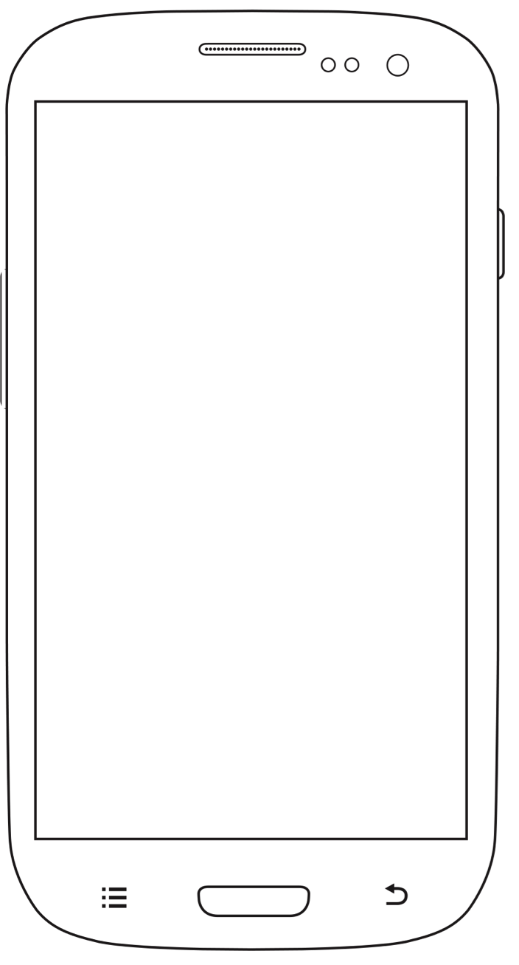
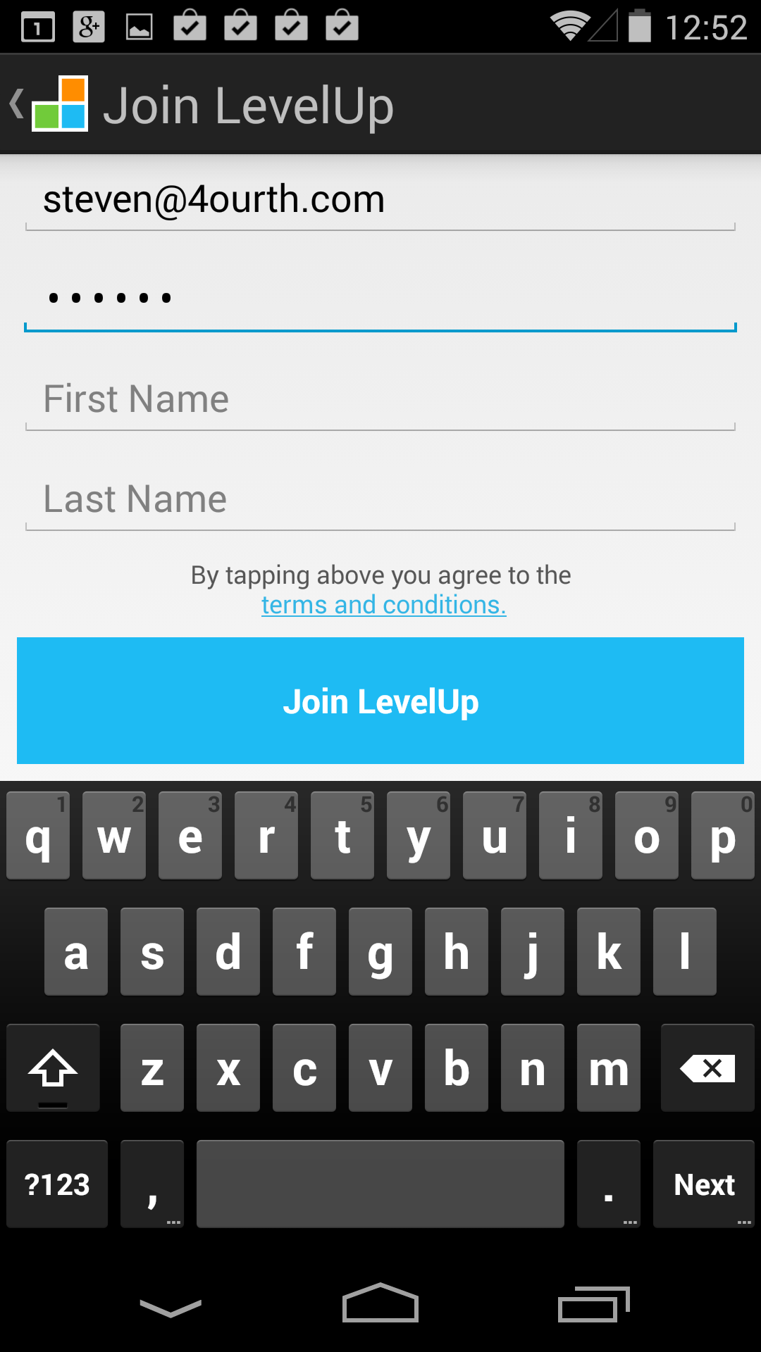
Notes:
As much as mobiles intelligently, pre-emptively push information to your users, sometimes you simply must request or allow input.
This is not the place where I talk about optimal form design. Forms are the default we’ve grown up with on the web, and it’s been too often a mistake – A holdover from paper form days. We make users do the work of computers.
On mobile, users expect their devices to be aware, intelligent and connected. Combined with more difficult entry in these default typing-and-selection sorts of things makes forms bad. We need to instead reduce the number of inputs we need to ask for, and be intelligent about those we do employ.

Slide 3
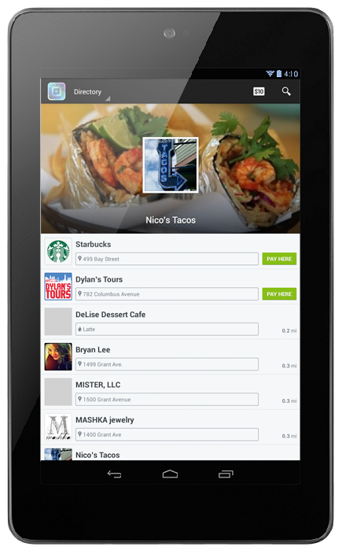
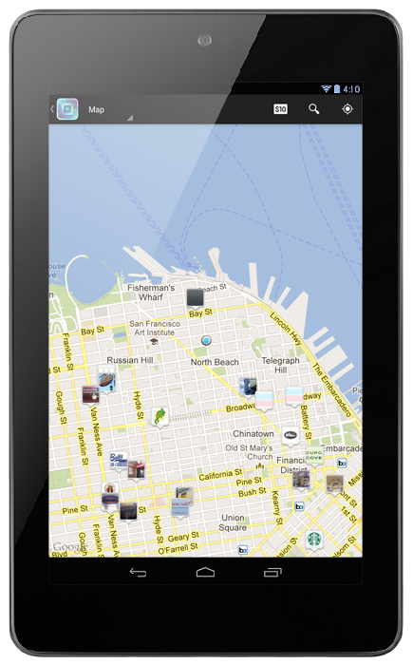
Notes:
Say you are building a store locator function as part of your tablet app. You don’t ask users to type their location in, do you? Because the device knows already.
I don’t even put in “Search” buttons for things like this (not that I claim to have built this Square wallet app I am showing off here), and at least for maps, most designers don’t. When you open the feature, you get a map.

Slide 4
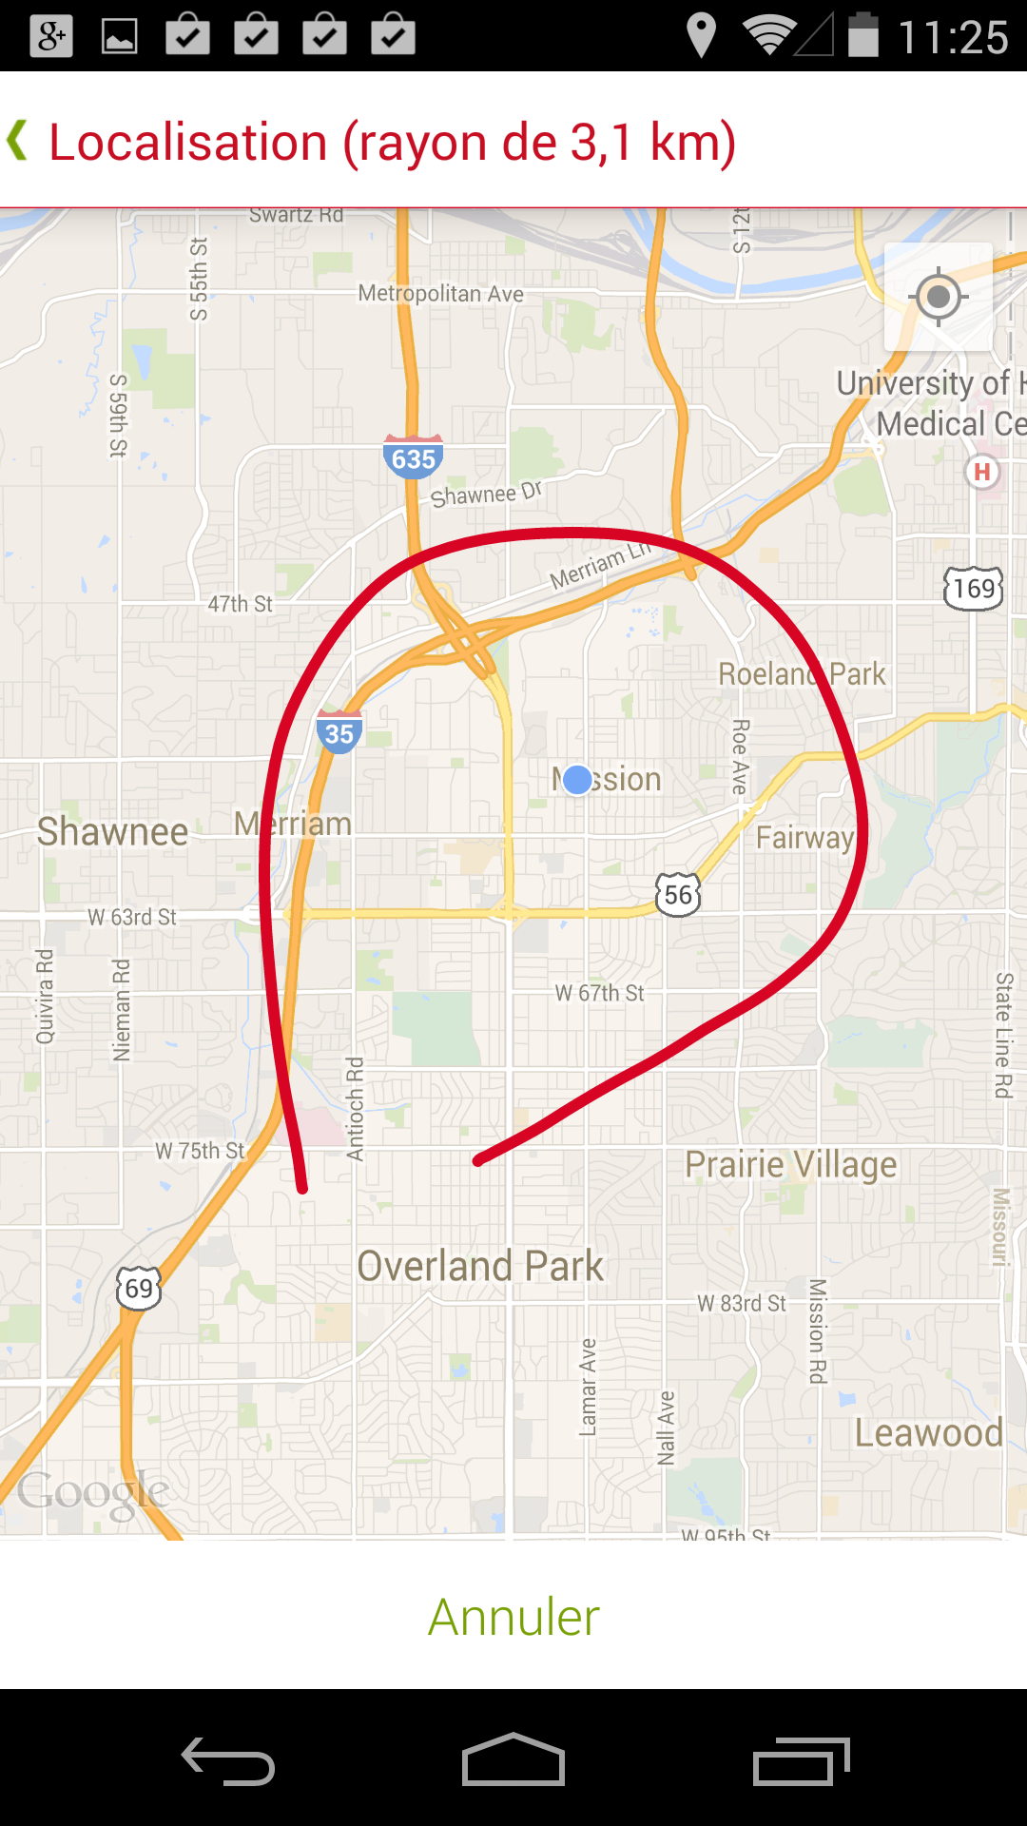
Notes:
Even when you have to gather user input — like this hotel finder where the user’s location context is irrelevant — think about the easiest and most natural way to do it with the input types available.
Why ask for location by making people type when you can give them a map, and let scroll, zoom or CLICK draw on it? Gesture input, with direct feedback, seems a lot more natural, quick, easy and a lot less error-prone than typing.

Slide 5
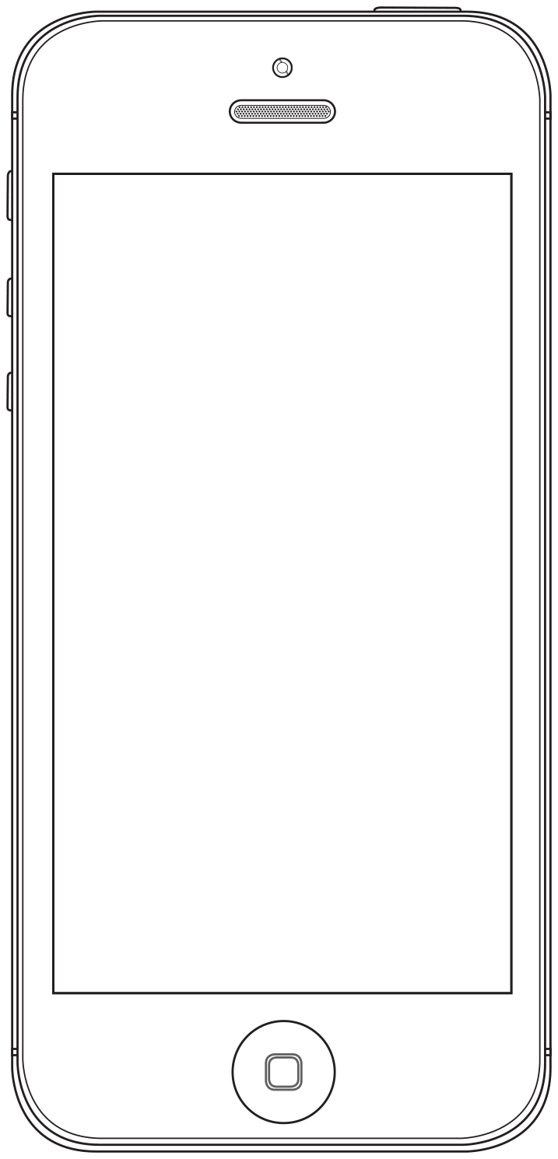
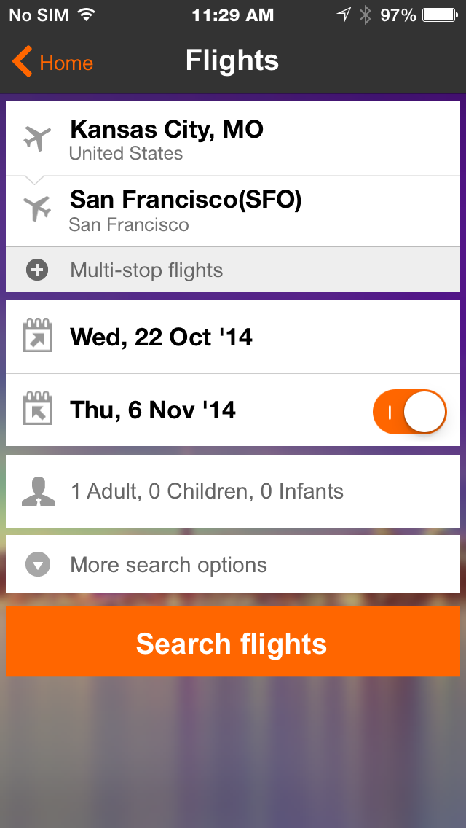
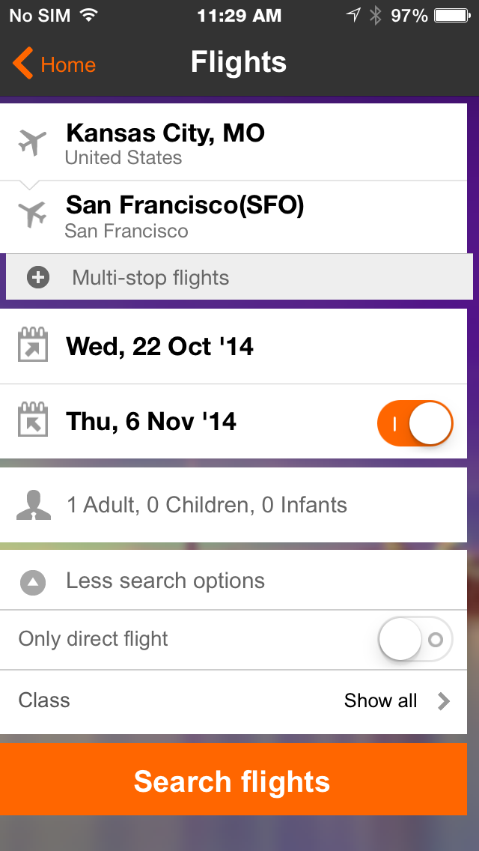
Notes:
When you do have forms, make them simple, and as short as possible. Avoid asterisks or anything like that for optional or required fields by hiding the optional items under an appropriate label.

Slide 6
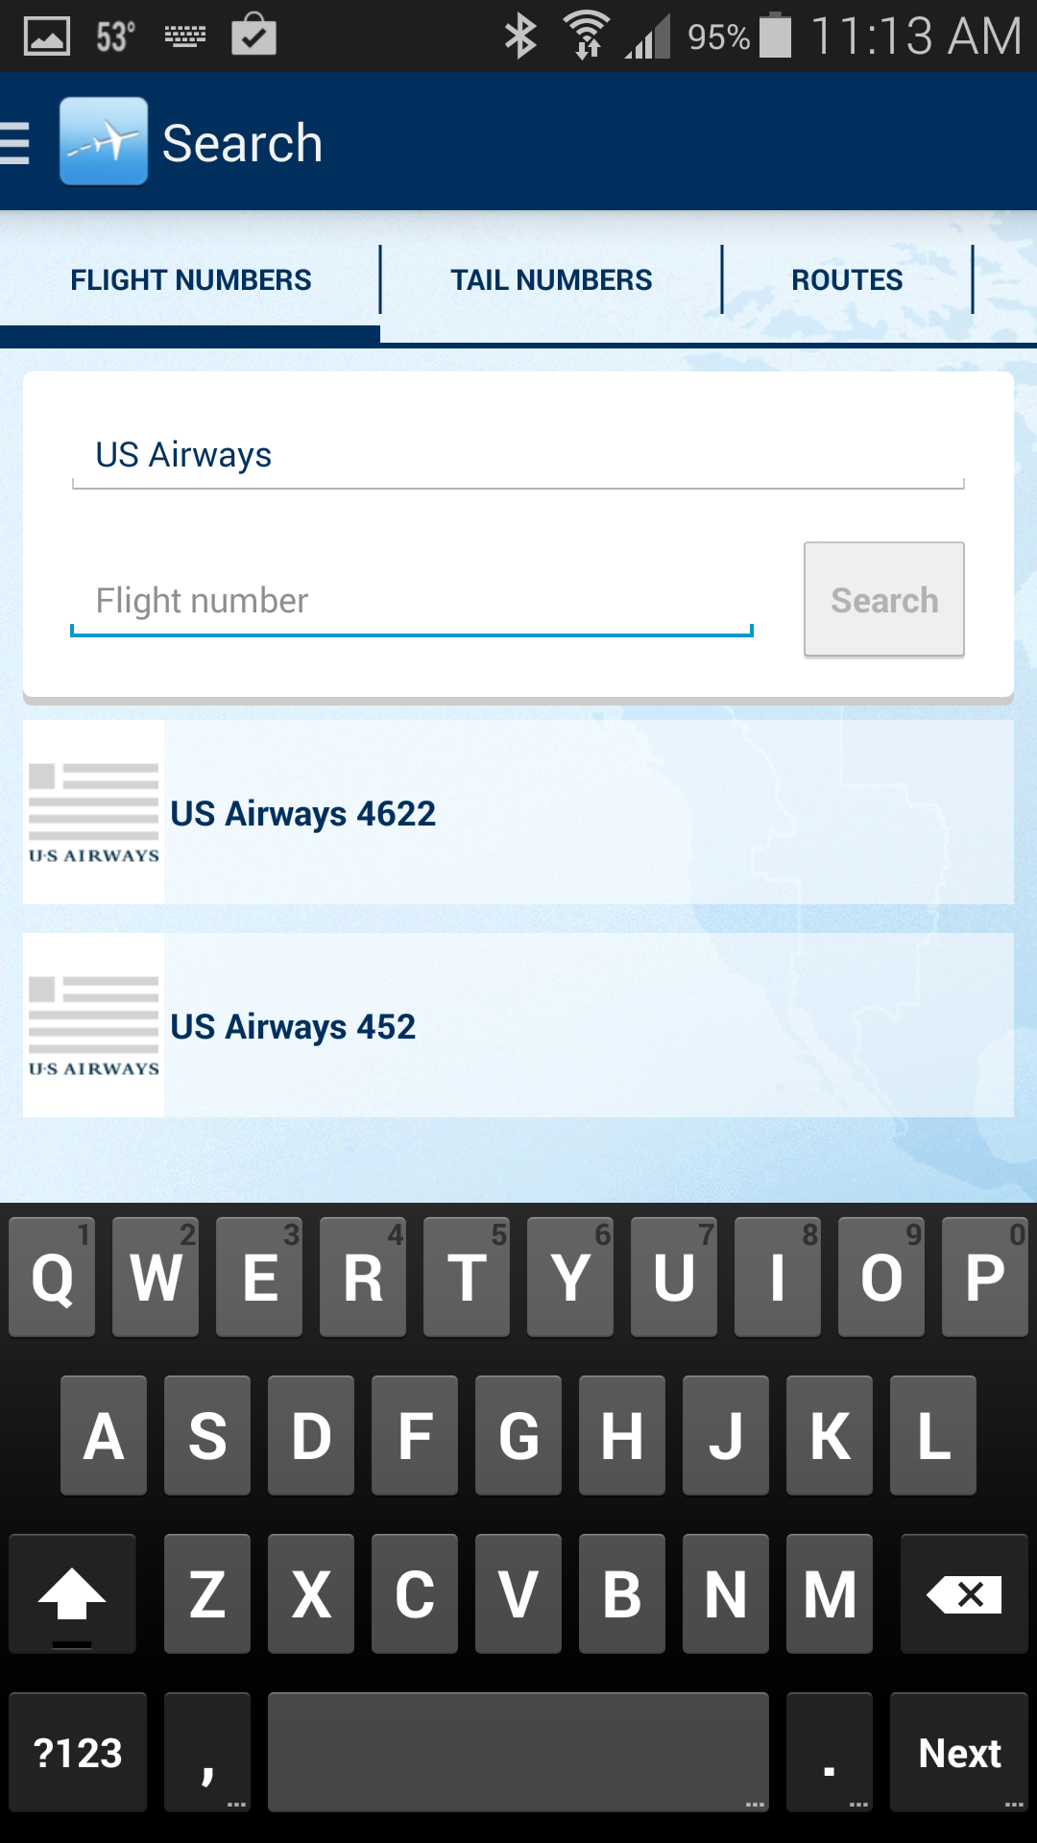
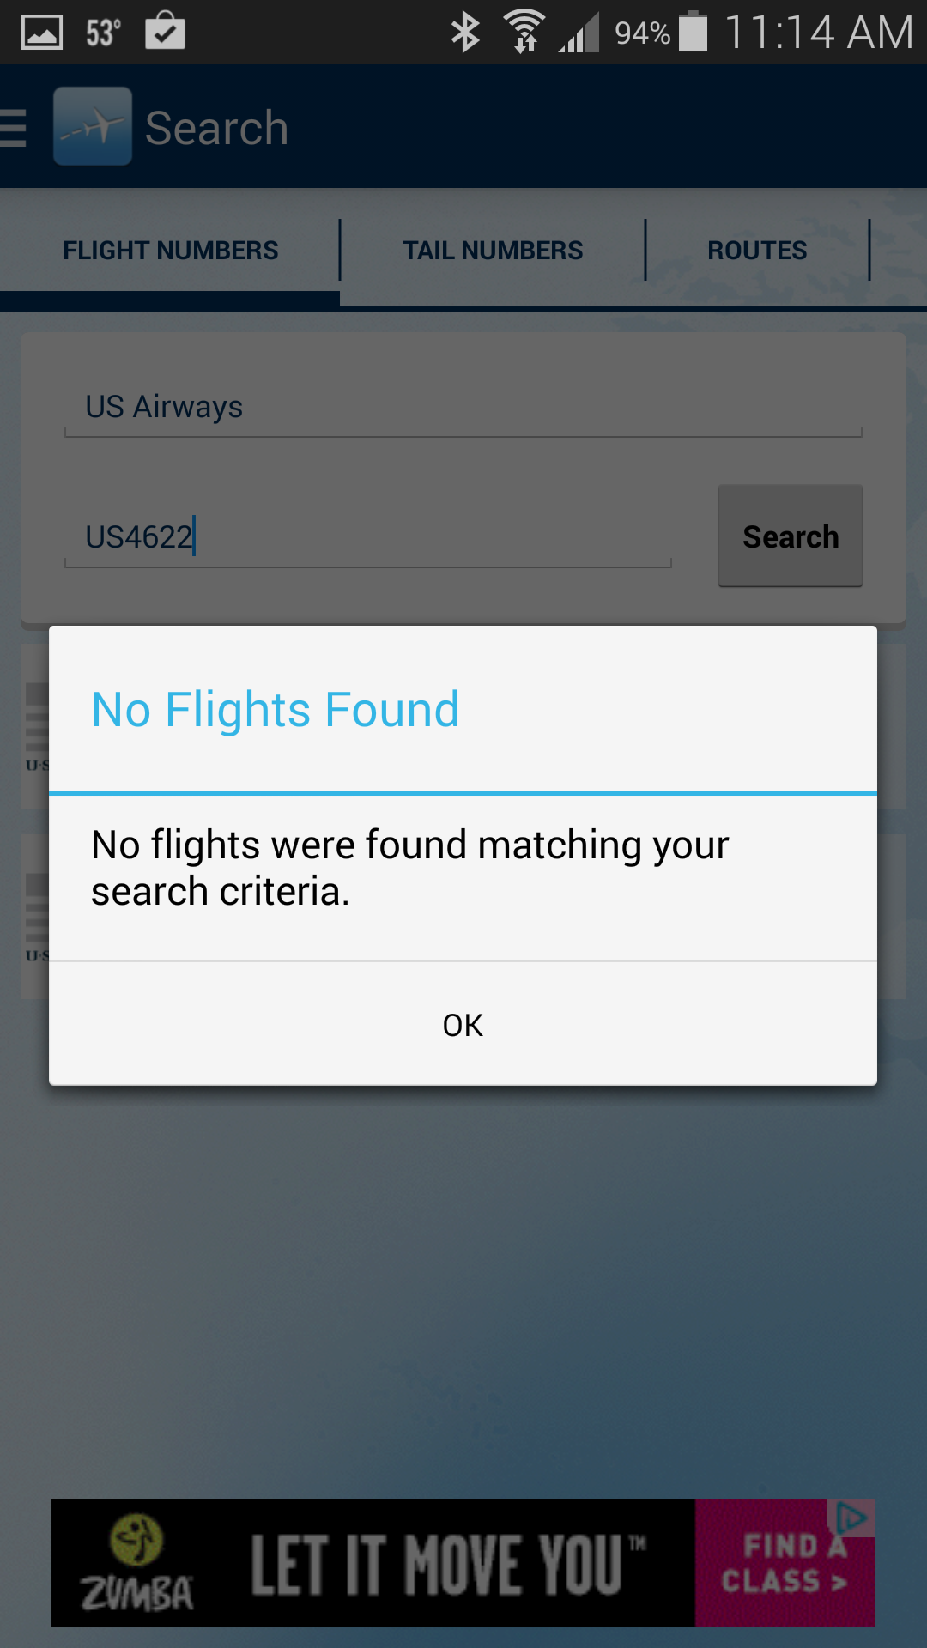
Notes:
I am not going to talk about every input type, though you should be familiar with them all. But let’s review a few of them.
Text fields are going to be one of the most common. And, the most commonly messed up. This is typical. The system only accepts numbers (it even SAYS “Flight Number”), but the field is set to… nothing in particular. So defaults to the normal keyboard, and you either enter the wrong information or have to manually switch to numeric entry.
Think of the principles of resilience design again and:
Don’t make the user take extra actions.
Default to the most likely information, or mode.
Whenever possible, make it impossible to enter incorrect or invalid information.
Don’t show errors. Don’t punish the user, but find a way to help them, and lead them to the next step. An error dialog should never happen as that’s another thing for the user to dismiss, then they have to guess what part didn’t work.

Slide 7
Input Types
color
date
Datetime
email
month
number
range
search
tel
time
url
<input type="number" pattern="[0-9]*" maxlength="4" />
Notes:
Input types vary by platform, and in non-linear ways. There’s no such thing as one that is better than another.
Lack of support for an input type will not cause an error, but simply fall back to the default method. So if you have an old or odd OS, or an old web browser, setting input to Phone won’t break anything, you just won’t get snazzy input you expected.
Especially on the web you can also hack things nicely. The last line gives us the nice big phone number entry buttons, but with only numbers 0-9, not the pound and star.

Slide 8
Notes:
So, by default you get the left input when you say you want “Number.” But you really want the one on the right. No funny characters, and nice big buttons as well.

Slide 9
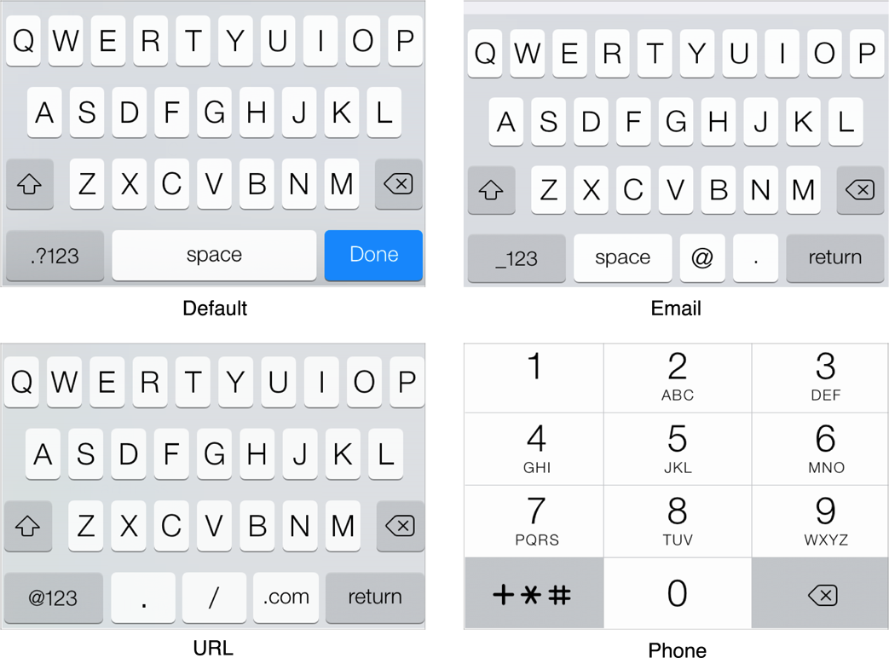
Notes:
There are lots of these.
Email seems silly to many, but how many clicks to get to the @ key otherwise? We try to eliminate single extra clicks or screens from our design flow, right? Save up all the times the product owner says “three clicks and they are gone” and (though it’s wrong) remind him he said clicks, not screens.
A URL one also exists with slashes and “dot-coms” and so on.
These are not just mobile, incidentally. Built-in field validation generally prevents input outside the allowed range of input even when there’s a keyboard. So, proper input types are good for responsive web design regardless of platform.

Slide 10
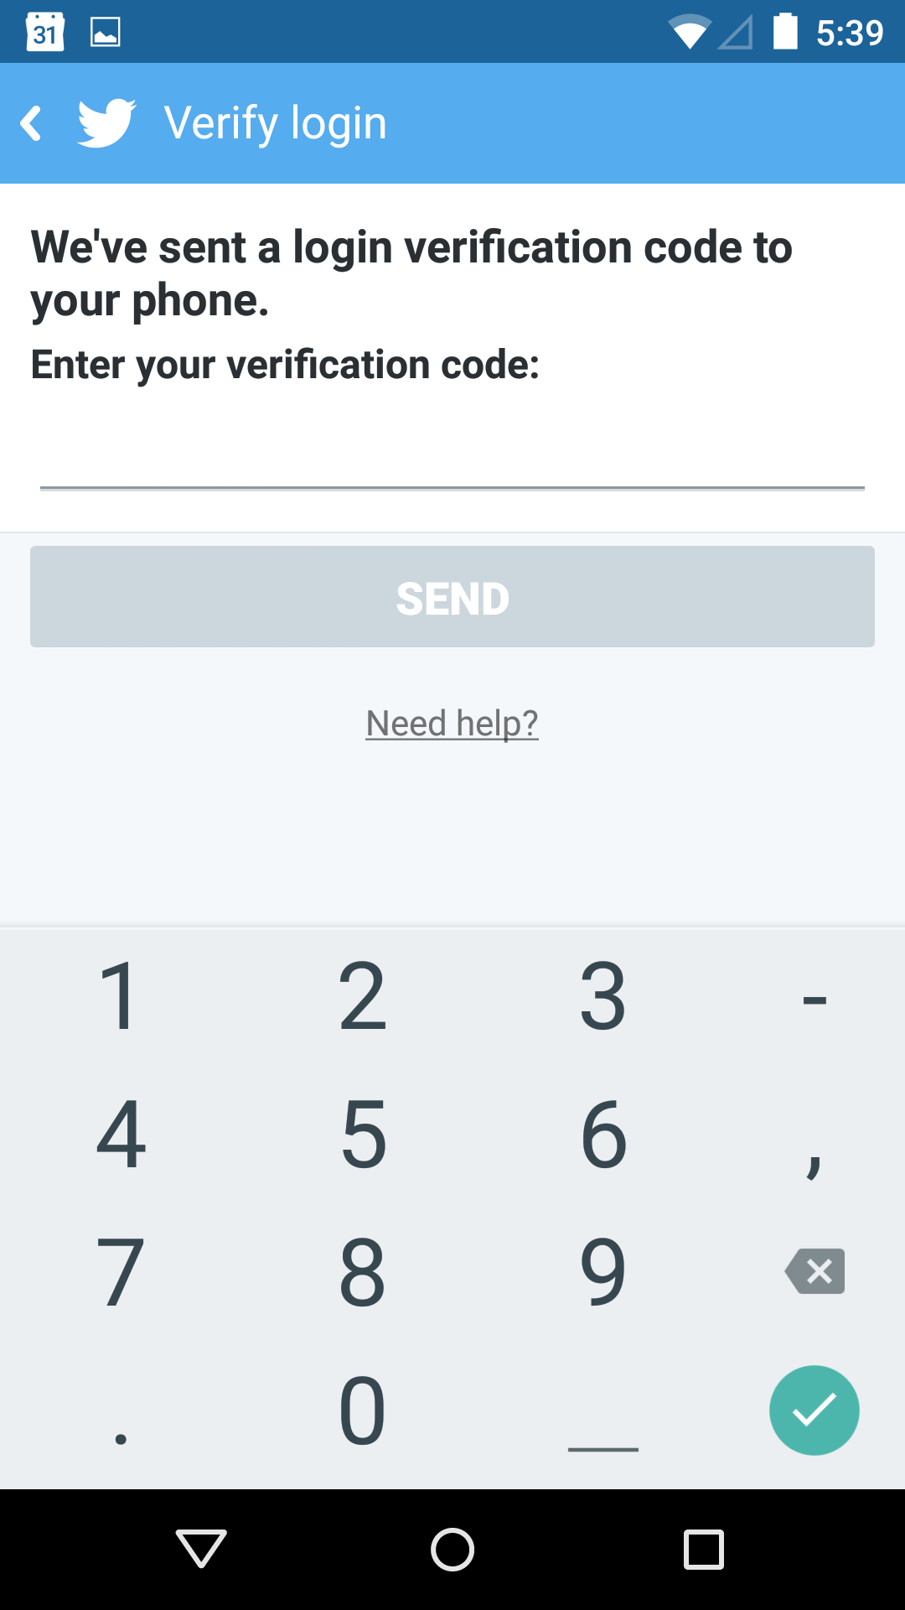
Notes:
Inputs can even inform us. The FlightAware app on the left says Flight Number, and partly has to SAY “number” because they don’t restrict to that entry and they aren’t thinking of the real context.
Something as simple as a validation code from Twitter is designed to have the numeric entry pad open while you see the message. The user has no questions about whether that’s a Zero or a letter O, without explicit explanation. The entry pad communicates that, as well as technically restricting it.

Slide 11
Notes:
Even when you allow or require typing, you do it intelligently. You think about what users know, care about and tolerate.
This thing automatically detects location and populates it. Note here it’s only got coarse location so we don’t use the centroid of the area and call it a street address. We use the data we have correctly, within the constraints we know. So we expect people to revise it, and that autocompletes with the Google Places API. There’s LOTS of info out there. How can you use it to make your users’ lives easier?

Slide 12
Input Trait Types
Sentence case
Title Case
ALL CAPS
all lower case
Notes:
Especially in apps, you get to set whether autocomplete works, whether you spell check, what the enter key says or does, even whether the input is a sentence — so starts with a capital letter — or a title or name so every word starts with a capital letter.
These little microinteractions really, really streamline the use and appearance of your app, and help keep your data clean and sensible. Don’t blow them off, but specify them, and get nitpicky when it comes to finding bugs before you launch.

Slide 13
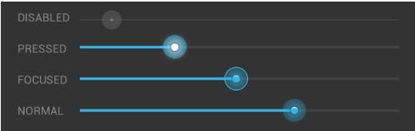
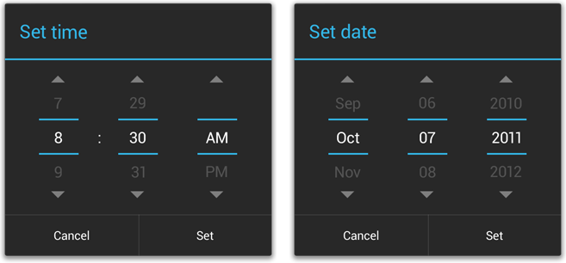
Notes:
There are lots of other neat input types, and you need to know how they work, and when to use them. Unfortunately, so many that it would take a couple hours just to review them all, so I just tease you with these pictures. Know that most things can be customized, so don’t settle for a date picker when you can have a date picker that only includes dates in the relevant ranges.

Slide 14
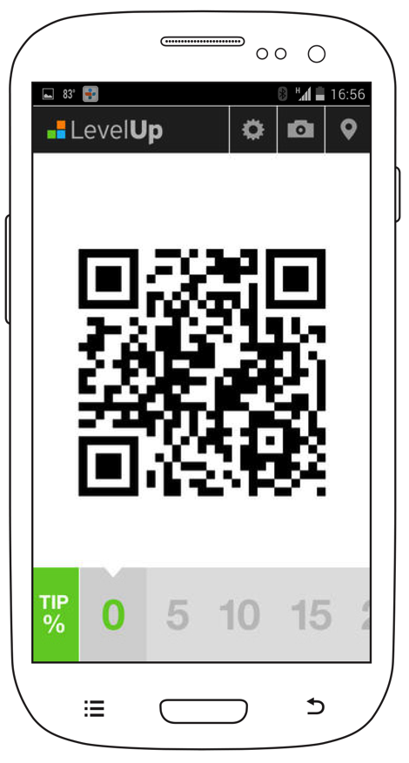
Notes:
Always ask if user input is needed at all. If it is, do they need to type it, or is some other control better. CLICK This bar at the bottom can be slid along to select the tip. Much cleaner, and faster.

Slide 15
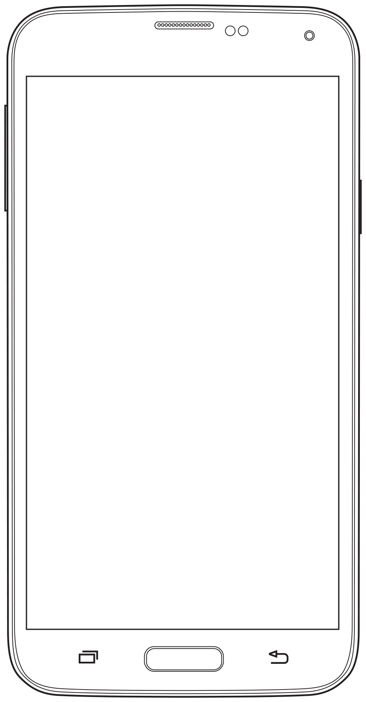
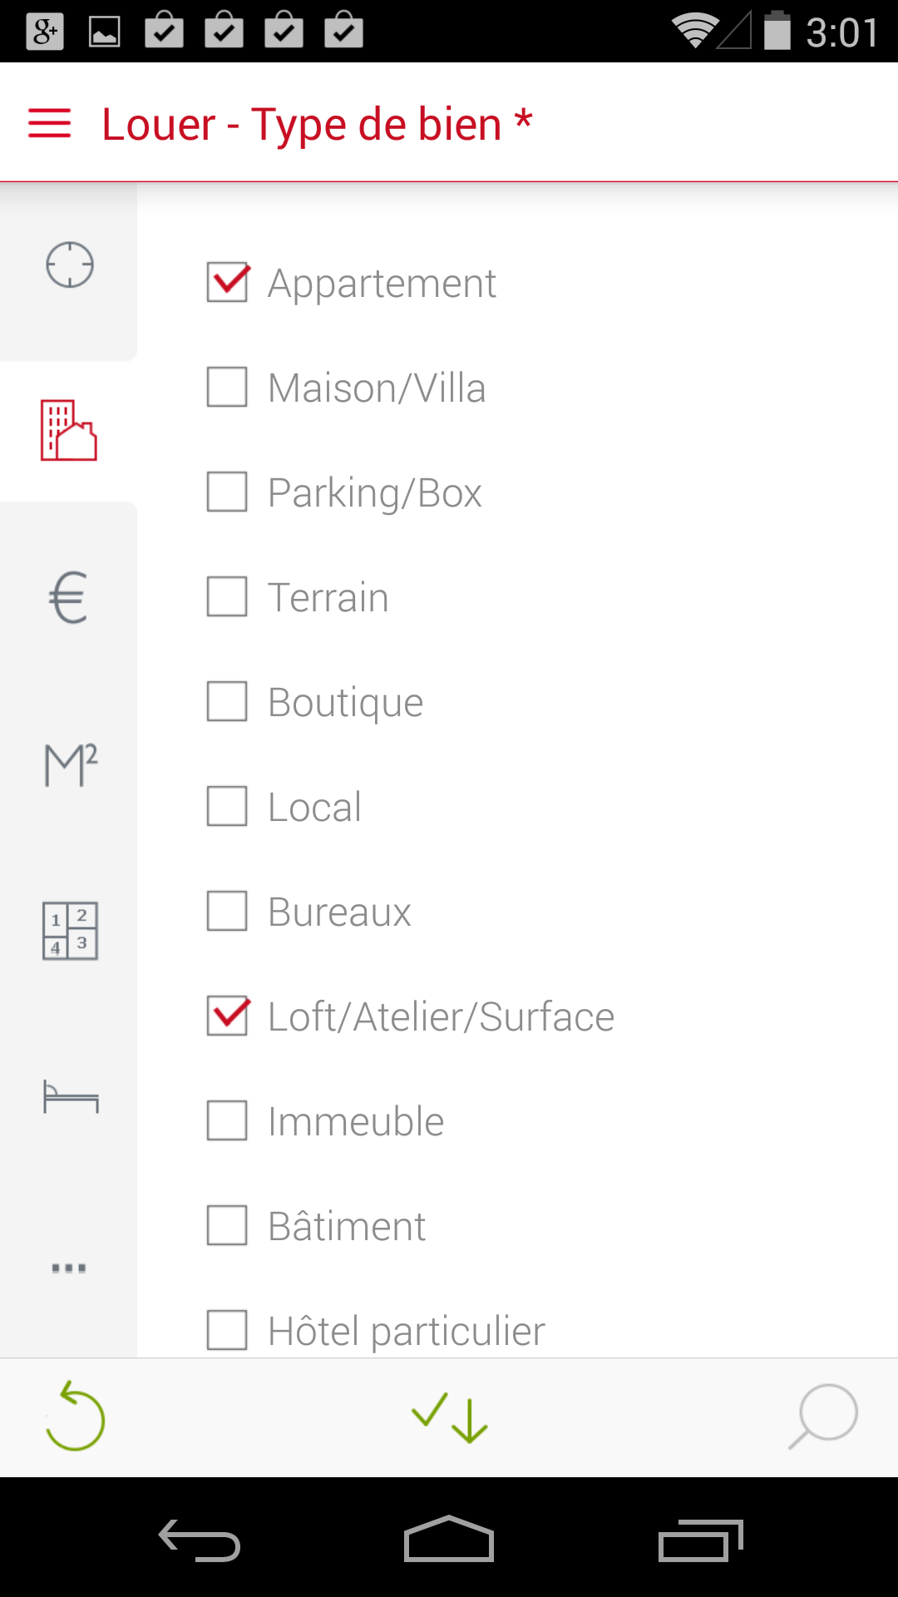
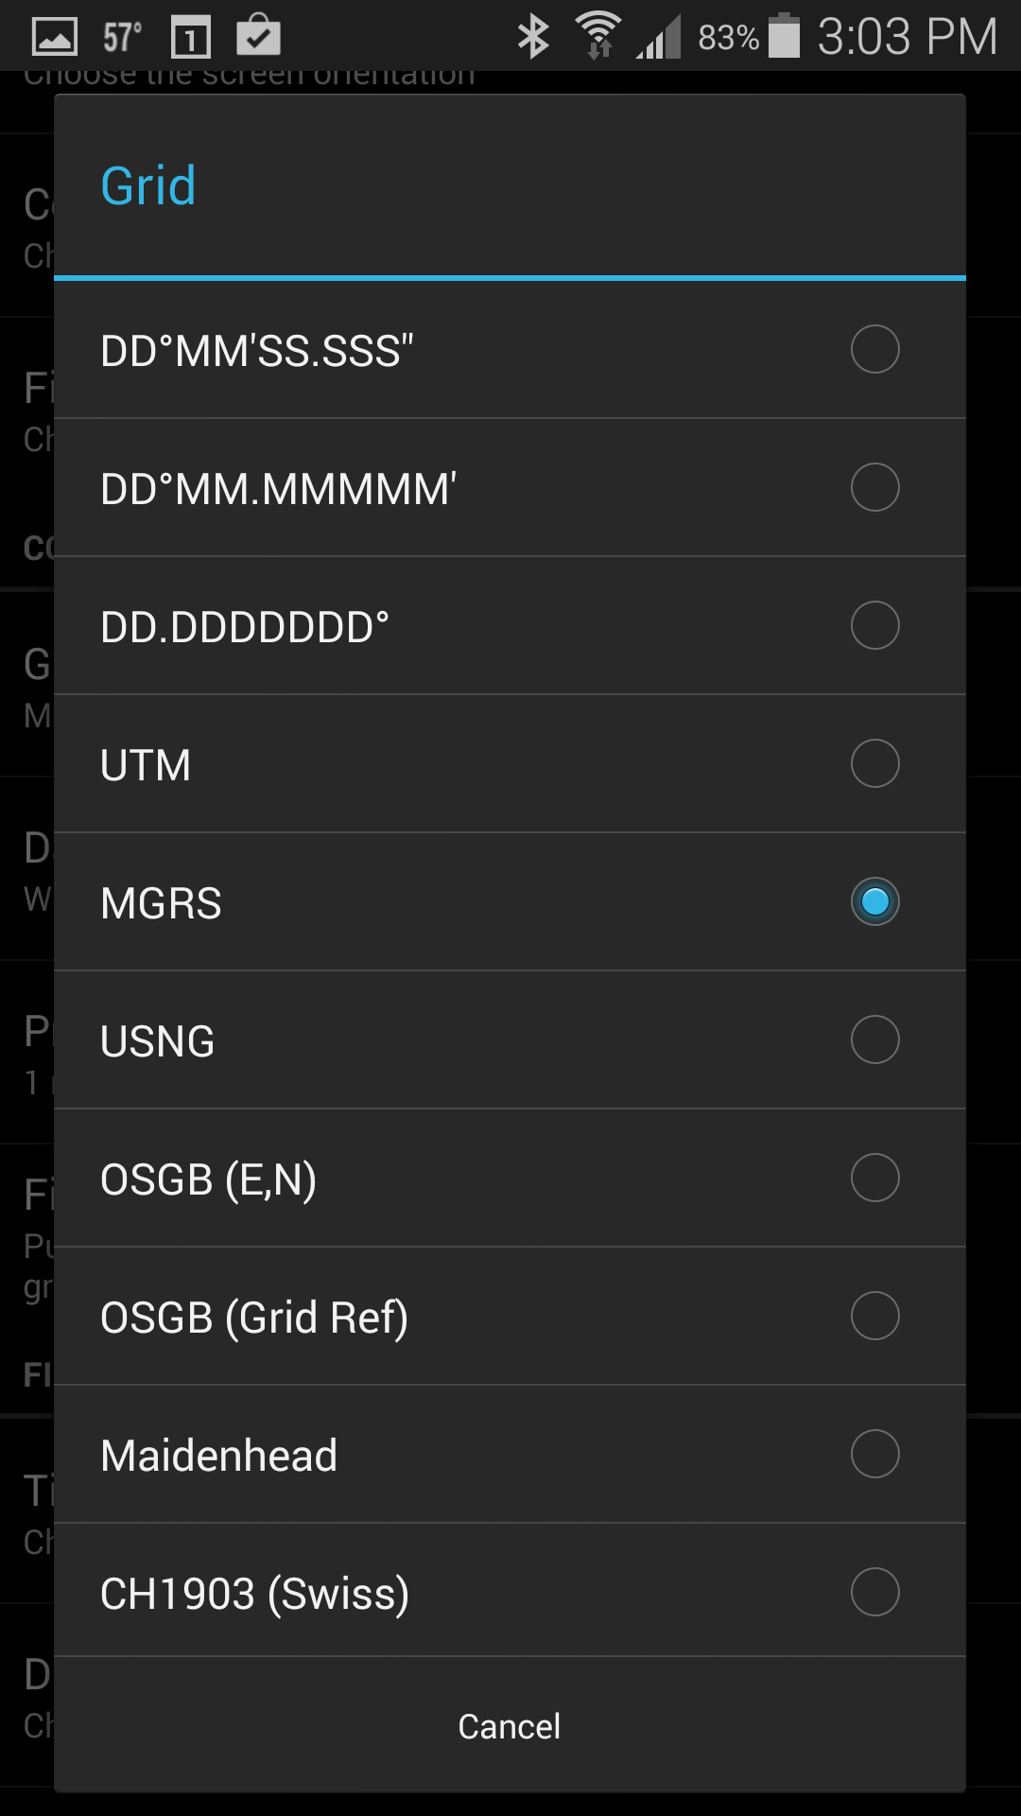
Notes:
And now I want to finish you off with a reminder that none of these steps are independent, or precisely sequential. For example, should you allow users to make a selection inside the page, in a dialog, or in an entirely other page?
Sometimes you have no choice, as the right item is a picker, and those appear as a dialog anyway. Otherwise, you have to think very hard about how the user will interact with the information. Is a dialog going to take them out of process more than a long page inline?

Slide 16
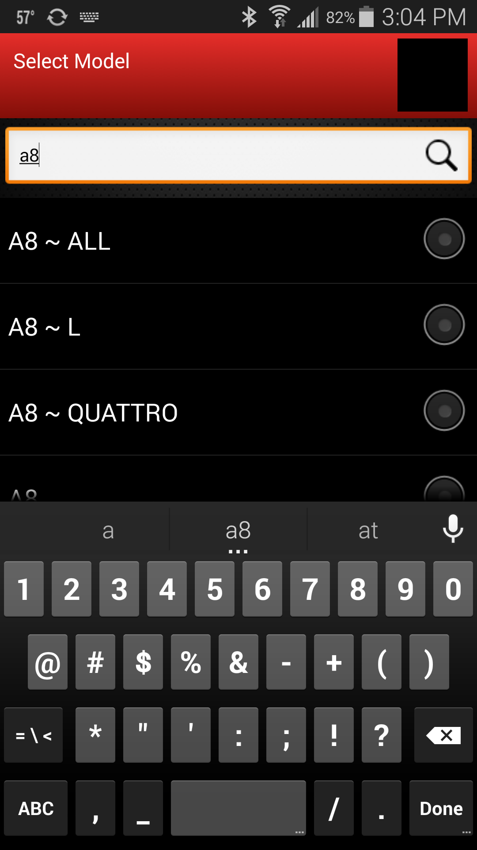
Notes:
What’s too much scrolling for one page? Would it help if the user could type to narrow the results by typing like in the address book?
You’ll recall I said at one point those boxes on the task flow diagram aren’t pages, and this is what I meant. That input box might include dialogs, or even whole pages, each of which you have to design in some way.

Slide 17
In Part 12:
Interaction & specification
Lean and Agile UX.
Document formats.
Specifying vs. drawing.
Native UI features.
Design is about you.
Notes:
In the next segment I’ll talk about how we communicate these design decisions we make to the team, and document them for the future.

