Slide 1
TIMING/VIDEO
Remove auto-advancing after creating a video version:
On/Off:
In the tabs (not menu): “Slide Show”
[X] Play Narrations
[X] Use Timings
[ ] Show Media Controls
Clear the timings completely:
Select all the slides
Right click a slide > “Slide Transition…”
In the “Advance slide” section uncheck “Automatically after”
Designing Mobile User Experiences 11) Input & Entry Resources
@shoobe01
4ourth.com

Slide 2
Input & Entry
Read More:
There are a number of best practices for forms. There’s a lot to learn about all the input types, but don't get caught up in the details. Just try to think about the principles, and most of all how to avoid entry entirely.

Slide 3
Mobile Inline Form Validation
http://www.uxmatters.com/mt/archives/2012/09/mobile-inline-form-validation.php
If you have a form, there are some really simple, well-proven methods for them to work better, and this is my input on getting forms to work on mobile.
That said, I hardly ever use these guidelines. Not that they are wrong, just that I avoid form-like input so much it never comes up. See?

Slide 4
Good practices for mobile forms
http://applidium.com/en/news/good_practices_for_mobile_forms/
Someone else’s rather good article, with lots of images and real-world examples, of how to make good forms. It also mostly tries to avoid them entirely, so now you know it’s not just me.
The keyboard can be a major source of frustration for users, here are some tips to limit its use in a mobile context.
Use mainly action buttons, native gestures (tap, swipe) and native features (tap-to-call, GPS, camera).

Slide 5
The Problem with Password Masking
https://www.schneier.com/blog/archives/2009/06/the_problem_wit_2.html
Bruce Schneier is the man on technical security. If you do anything with security, authentication, etc. you should read his blog religiously.
Shoulder surfing isn't very common, and cleartext passwords greatly reduces errors. It has long annoyed me when I can't see what I type: in Windows logins, in PGP, and so on.

Slide 6
Hide/Show Passwords
https://storify.com/lukew/hide-show-passwords
Luke Wroblewski has long been championing not masking passwords, or more often a show/hide method outlined here. Most usefully for you, these techniques are used all over the place, and in very large scale, not just for the latest cool app.
I even contributed some of the numbers of millions of users working with a masking free system at a large telecom. No problems. If you can’t sell your management on this being secure and usable, it’s time to move on.

Slide 7
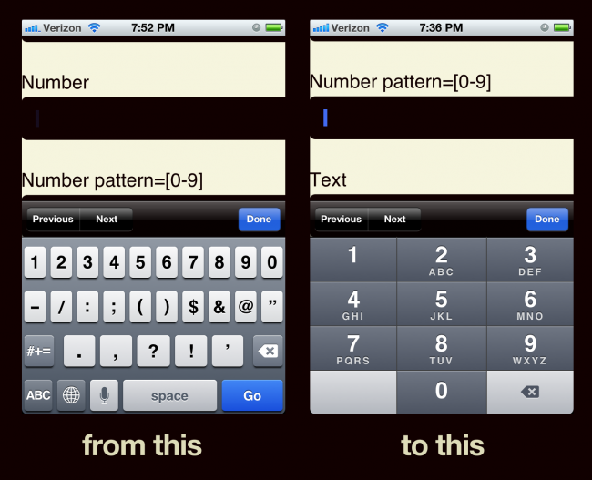
Better Numerical Inputs for Mobile Forms
http://bradfrostweb.com/blog/mobile/better-numerical-inputs-for-mobile-forms/
I will never stop ranting about a “flight number” field that pulls up the full keyboard. Don’t do that. Give people the right input method. Yes, even on the Web this works! Detailed, but easy to follow technical discussion of it here from Brad Frost.

Slide 8
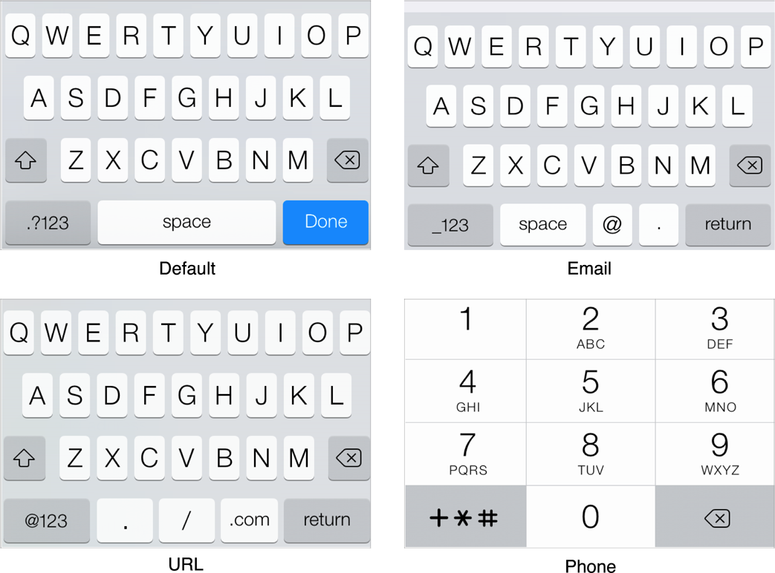
Managing the Keyboard
https://developer.apple.com/Library/ios/documentation/StringsTextFonts/Conceptual/TextAndWebiPhoneOS/KeyboardManagement/KeyboardManagement.html
Official Apple documentation about using the right input method (pulling up the right keyboard really) for your inputs.

Slide 9
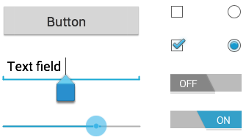
Input Controls
http://developer.android.com/guide/topics/ui/controls.html
Brief Google page on options for input controls. Google and Apple have many more discussions of inputs on the developer side, but I think you need to start with these so you even know what to look for.

Slide 10
Maybe we could tone down the JavaScript
https://eev.ee/blog/2016/03/06/maybe-we-could-tone-down-the-javascript/
On page bloat and bad behavior from needless javascript, especially inputs:
There’s no good reason for any of this. These aren’t cutting-edge interactive applications; they’re pages with text on them. We used to print those on paper, but as soon as we made the leap to computers, it became impossible to put words on a screen without executing several megabytes of custom junk?
I try to avoid this by actually specifying in design that things like form elements are plain, vanilla form elements. I don’t know why, but front end code has gotten weird and hacky lately, as well-described in this article.

Slide 11
Designing for Touch
http://developer.android.com/reference/android/widget/TextView.html
For example, this page which outlines all the types of input, and attributes you can set the input fields to. Lots of neat stuff. Skim this when you have time and you may find something awesome you can use.
Controls whether links such as urls and email addresses are automatically found and converted to clickable links.
If set, specifies that this TextView has a textual input method and automatically corrects some common spelling errors.
Determines the minimum type that getText() will return.
If set, specifies that this TextView has a textual input method and should automatically capitalize what the user types.
Makes the cursor visible (the default) or invisible…

