Slide 1
TIMING/VIDEO
Remove auto-advancing after creating a video version:
On/Off:
In the tabs (not menu): “Slide Show”
[X] Play Narrations
[X] Use Timings
[ ] Show Media Controls
Clear the timings completely:
Select all the slides
Right click a slide > “Slide Transition…”
In the “Advance slide” section uncheck “Automatically after”
NOTHING LONGER THAN 20 minutes!
The complete guide to Designing Mobile User Experiences 10) Interactions & Touch
@shoobe01
4ourth.com
Notes:
In the previous section I told you how understanding touch helps you figure out where to put controls and information on the page. Now, we’re going to talk more about designing the text and icons themselves.

Slide 2
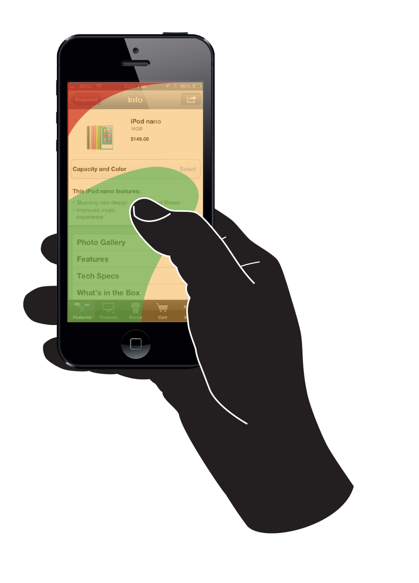
Touch is not about
Finger size
Thumb reach
No-go corners
Pinpoint accuracy
iPhones only
Notes:
First, I don’t want to hear a word about this stuff. People don’t hold their phone with one hand, only tap with their thumb, or stretch to reach other areas.

Slide 3
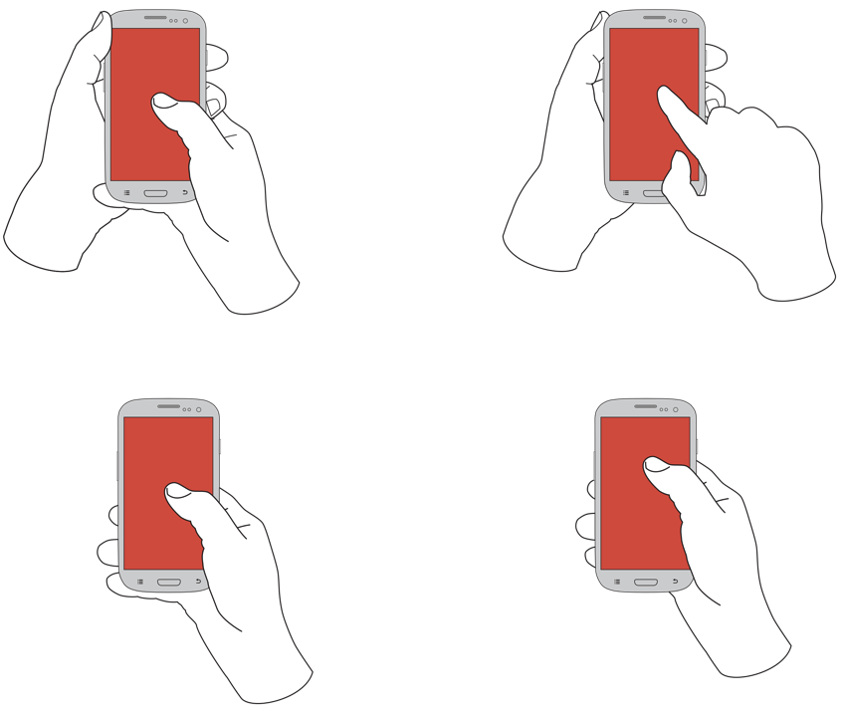
26%
10%
36%
49%
Notes:
People hold their phones in MANY ways. Sure, 75% of users only touch the screen with one thumb. But that can be misleading. [CLICK]
-- Because less than HALF hold the phone with one hand also, and that’s for phones. Much less for phablets and tablets of course. [CLICK]
-- 36% “cradle” the device, using a second hand for reach or stability. [CLICK]
-- And fully 10% hold in one hand, and tap with a finger, giving a totally different interaction.

Slide 4
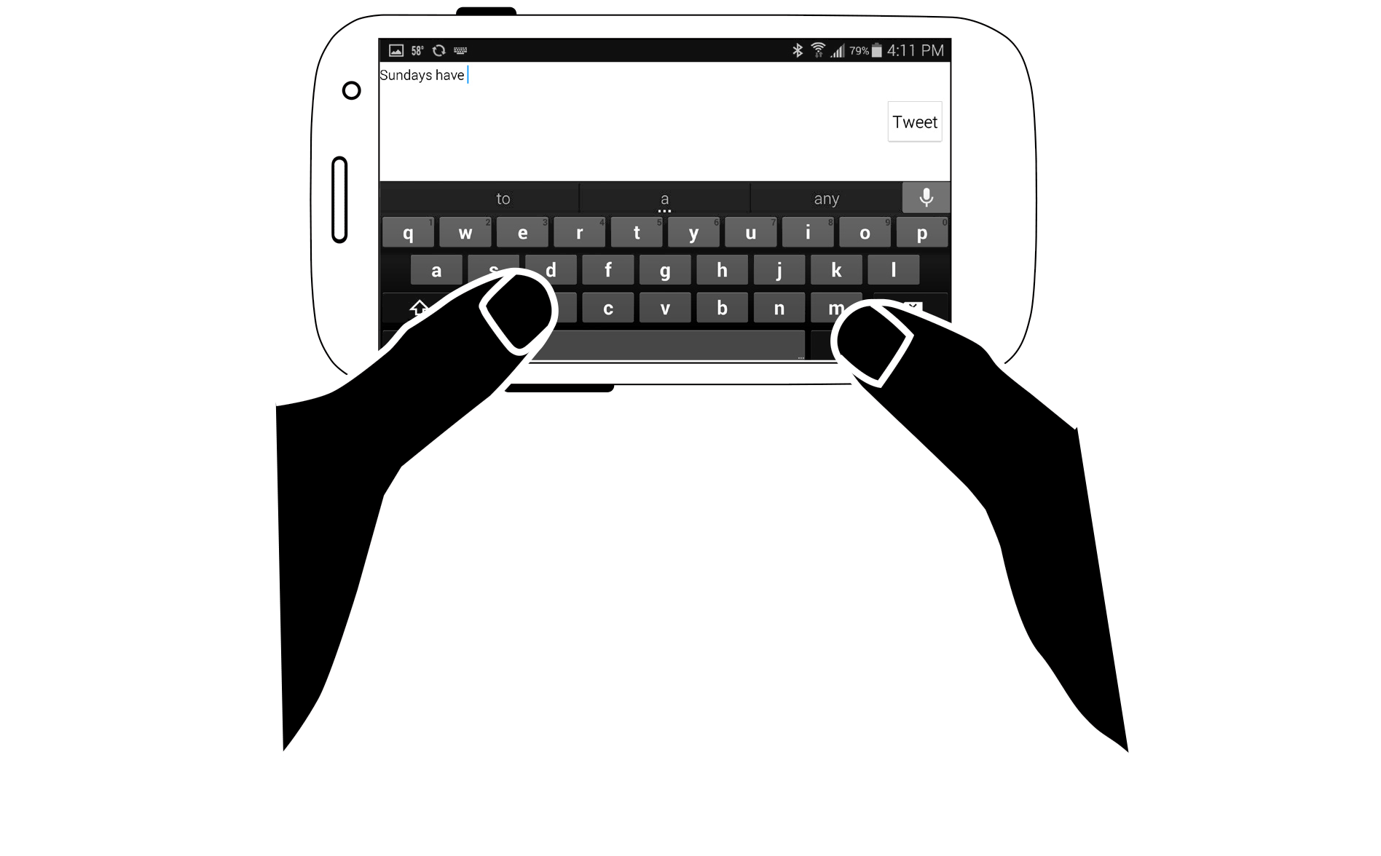
Notes:
And it’s contextual. Hardly anyone holds their phone with two hands. Except when they type. At which point they shift their grip and over 40% of people use their phone like this.
People shift their grip, and change to suit their needs, and their external contexts.
Be VERY careful quoting me, or quoting Luke Wroblewski quoting my figures on this, as It Depends a bit.

Slide 5
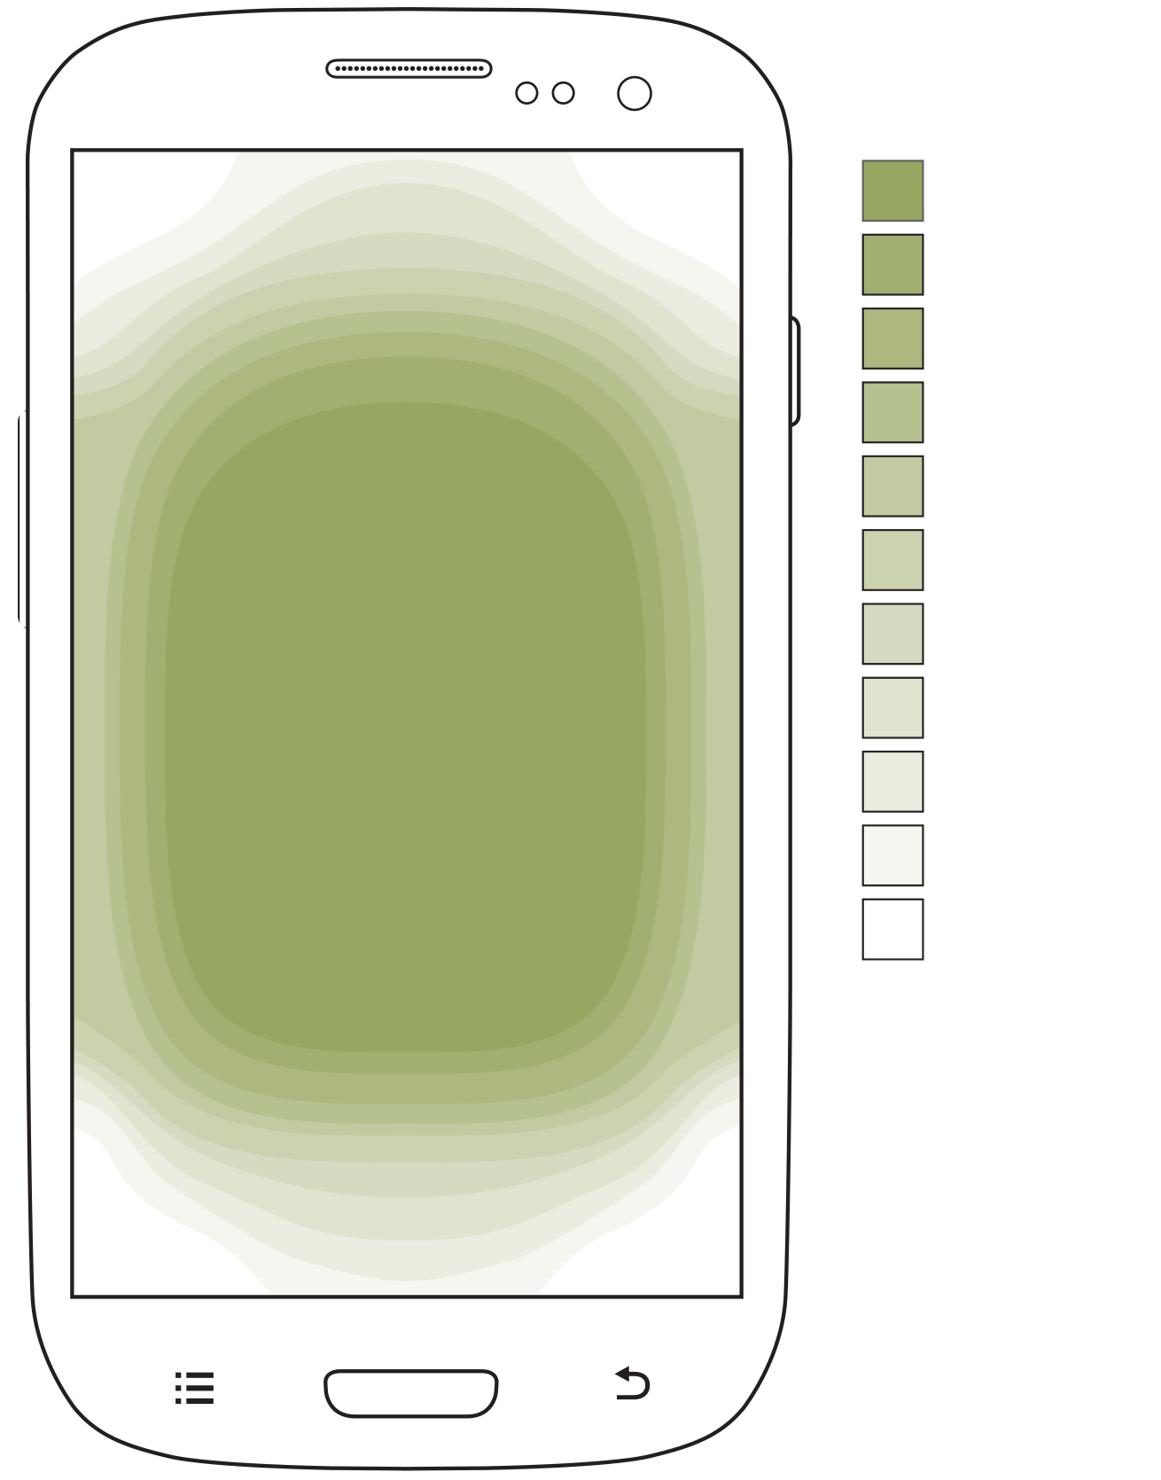
Notes:
People can and will touch any part of the screen. Yes, even on large phones and phablets. Don’t pay any attention to the lamentations that the iPhone 6 and especially the 6 Plus are too big. It doesn’t matter, and we know how to design for large screens.
Fully a third of smartphones sold this past year are Phablets.
We know that people are more accurate at the middle of the screen and they prefer to touch and view there as well. As we talked about in the last video, adjust the sizes of your targets to account for the position on the screen. Larger at the edges than the center.

Slide 6
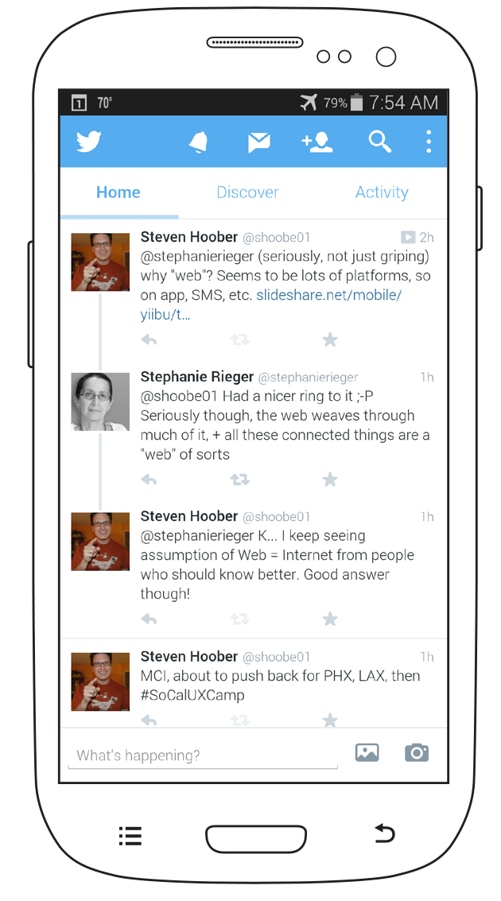
Notes:
Check for proper spacing by measuring between centers. Center the size target in the tappable area [CLICK], and if anything else is in the circle, that has a chance of being tapped by accident.
These top icons are a bit too close together, [CLICK] and the tabs are far too short, so you can tap the action buttons or a tweet by accident.

Slide 7
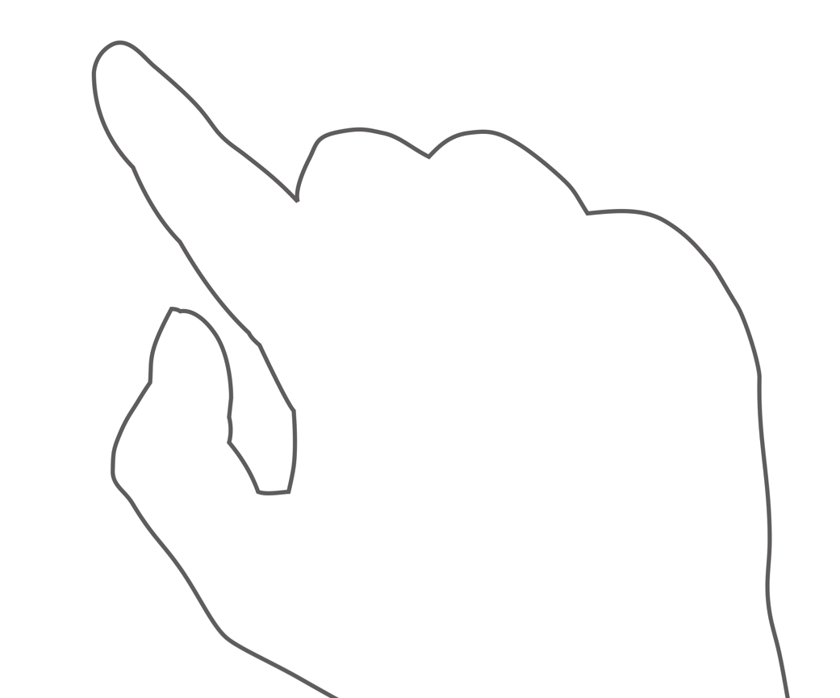
Notes:
Touch targets need to be visible. All the time. Even when you are tapping on them.
[CLICK} When you click a whole row, and especially one multiple lines long like this, that works great
[CLICK] Little icons like the retweet are too small, so the user can’t accurately target them, can’t confirm which one he selected, and can’t see that the selected state changed on tap so cannot be sure he tapped it at all.
Provide large enough targets to make sure that people can see the target, see the label, and see the clicked state, even when their finger is actually on top of the target.

Slide 8
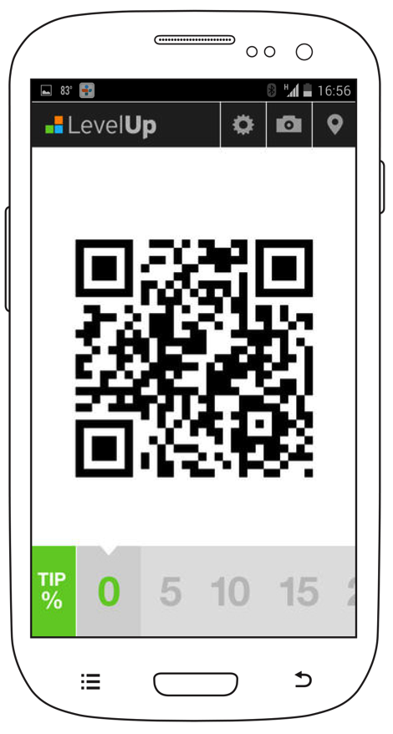
Notes:
Measuring is great, but just try to always provide the largest practical touch targets.
[CLICK] Don’t just code the word or icon as a link…
[CLICK] But like these guys do, make the natural boundaries in your design (boxes, buttons, whole rows) the selectable or linked area also. Tap anywhere near the word or icon and you hit the target.

Slide 9
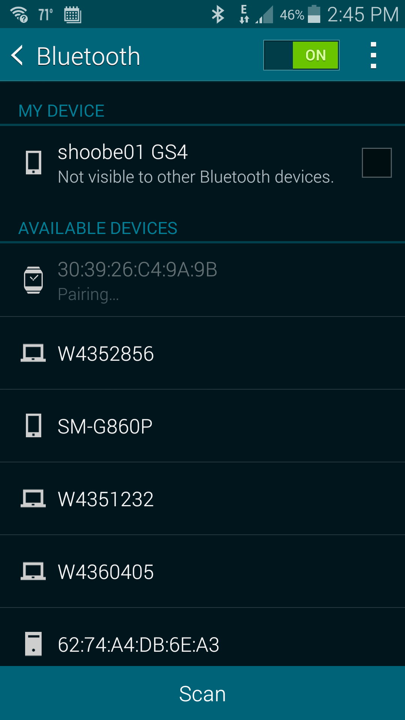
Notes:
Look around and you’ll see this is a known best practice [CLICK]. The Google drawer menu isn’t as small as it appears, with just the little arrow or menu icon [CLICK]. A default implementation also opens it on selecting the branding, so is much easier to tap than it appears.
Lots of hybrid apps don’t notice this, and code it wrong.
Sadly, Google seems to have done it by accident, and in Android 5 it no longer works. This is a noticeable issue.

Slide 10
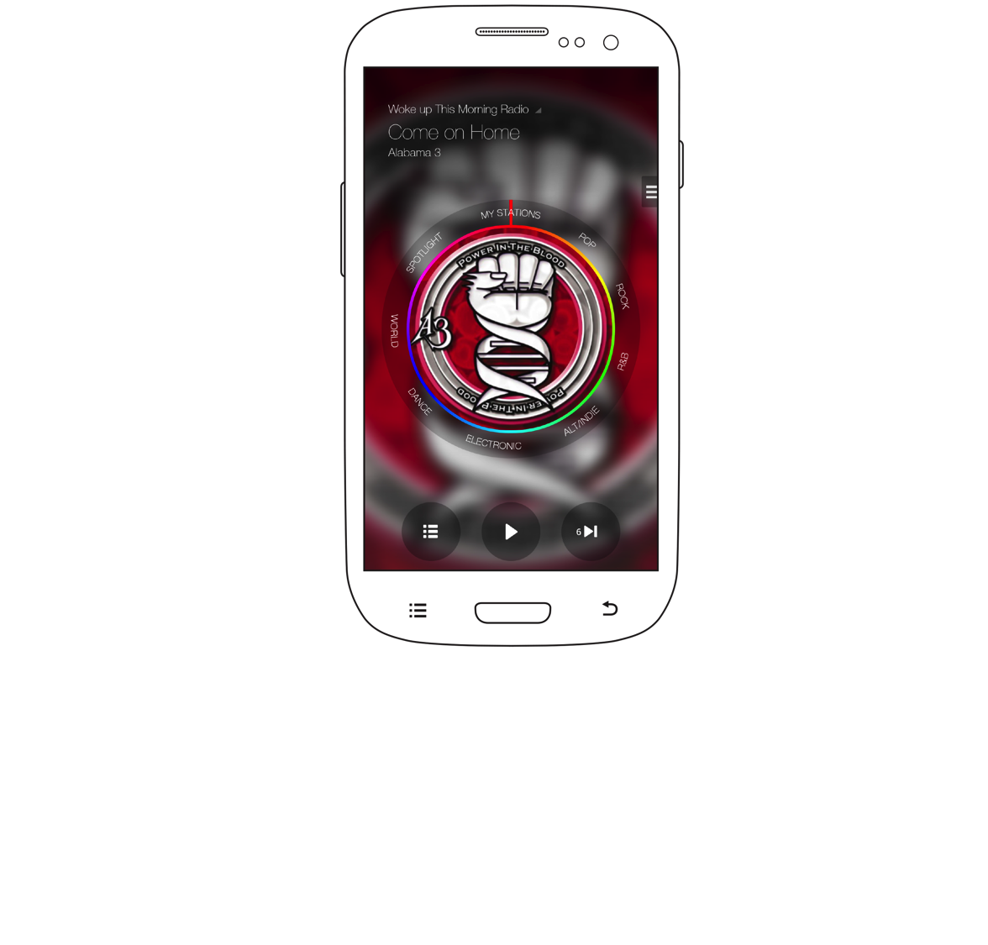
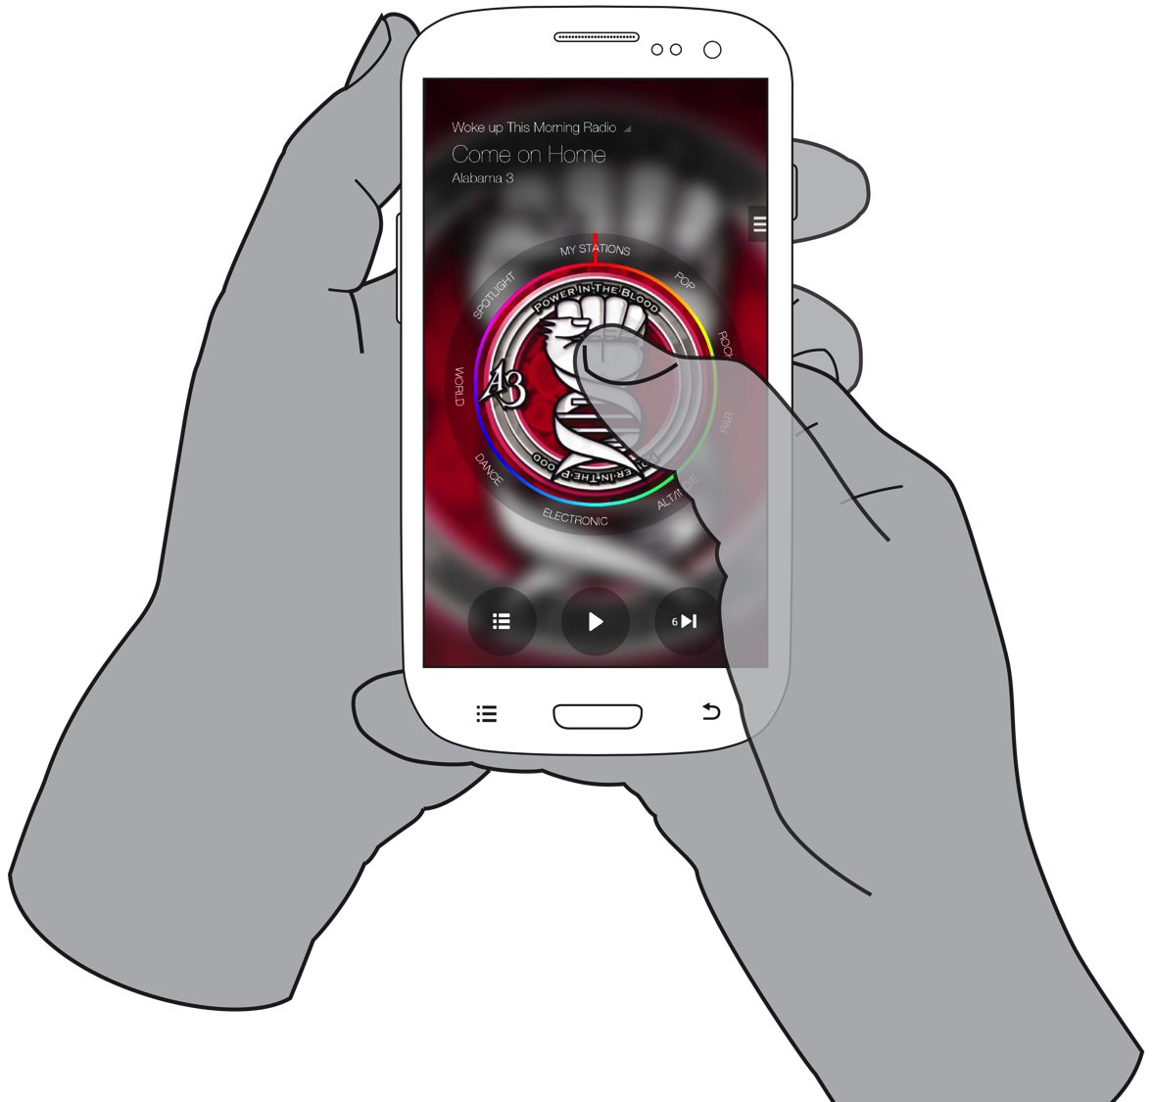
Notes:
Make sure selectable items are clearly selectable. I haven’t done a study specifically about this, but I am seeing enough observations on other research, and for usability studies for clients I am comfortable saying what seems obvious:
If it doesn’t look clickable, people don’t know it is. Underlines aren’t bad for text, inline, but especially for apps you mostly need to bound items. That doesn’t mean everything has to be a bold box or default button. Here, translucent backgrounds on the menu and controls [CLICK], and a sort of circular tab strip suffice to define them as functions.
I am starting to see that any bound item Is considered selectable. If a visual designer had boxed the title element [CLICK] for visual “consistency,” people would assume they can tap it to get more details. This is better; it’s differentiated by a distinct style, and combined with a few typical icons like play clearly say “these are clickable.”

Slide 11
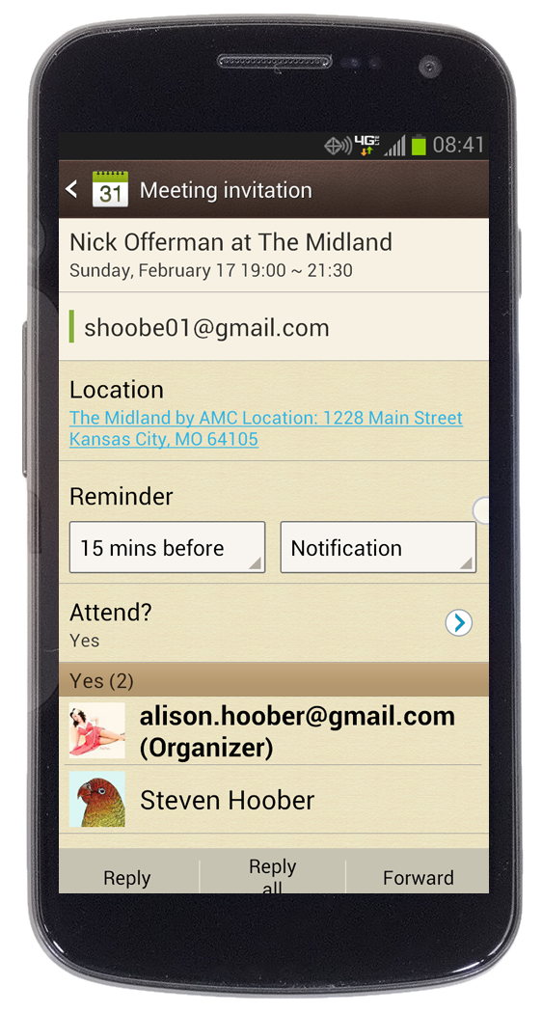
Notes:
Clickable items need to not just afford their action (making it clear what it does) but do so consistently.
Someone tell me why my calendar name [CLICK], attendance and the participants are selectable rows, but the location [CLICK] is a link and I have to click exactly where the link is. Be consistent, and make whole contained areas (rows, boxes) selectable as that is what is expected.

Slide 12
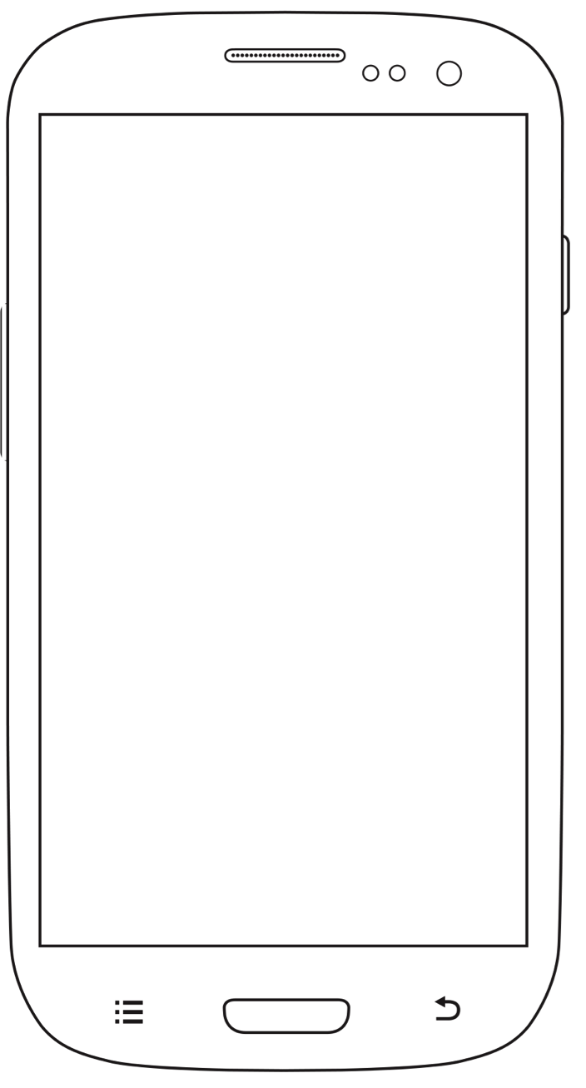
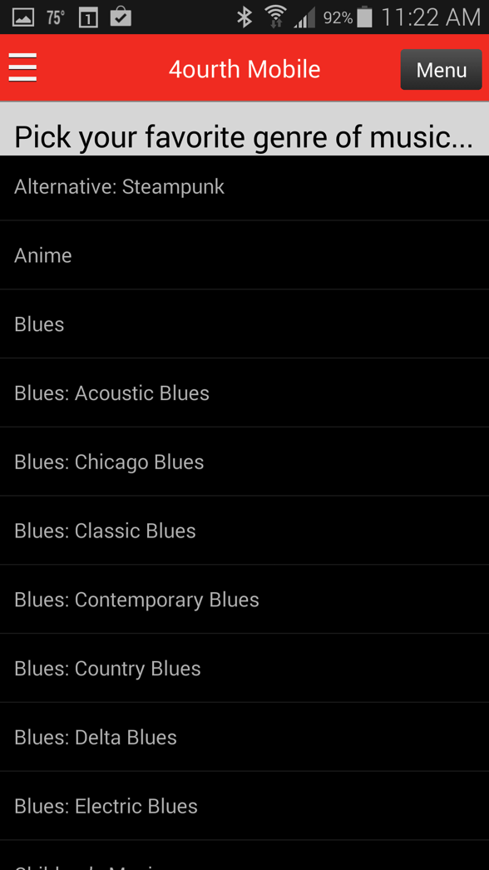
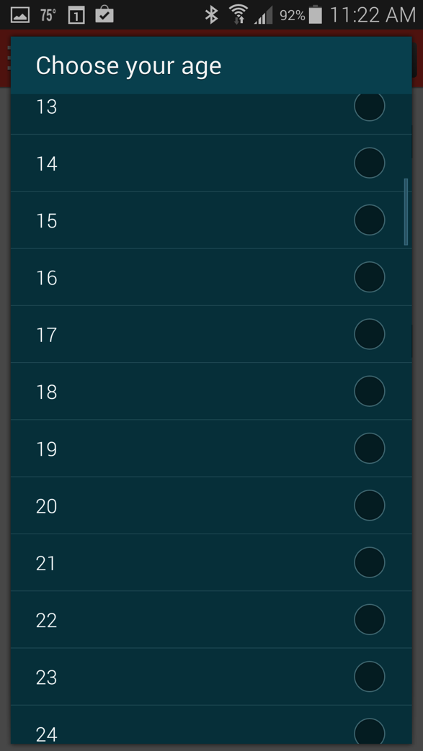
Notes:
BREAK
People tap where there are words and icons, but generally scroll where there are NOT. They will scroll in the center, but only when the labels are short. Long labels like on the right make people try to avoid the text, so they scroll more to the side to get away from them. Make sure your design isn’t so packed in there is no place for people to comfortably gesture.

Slide 13
Notes:
Yes, this also varies a bit based on device size. On tablets, your content might be shorter so there’s more room. (I normalized the data to the handset so you could compare it more directly here).
You might think that users would stick to the edges on tablets, because they are bigger. Of course people can’t reach the center. But wrong. They are Always inclined to tap the center of the screen, so when room is available to confidently scroll without covering content, they will move their finger, thumb or stylus over there even if it’s a reach, or requires repositioning their finger or their device.

Slide 14
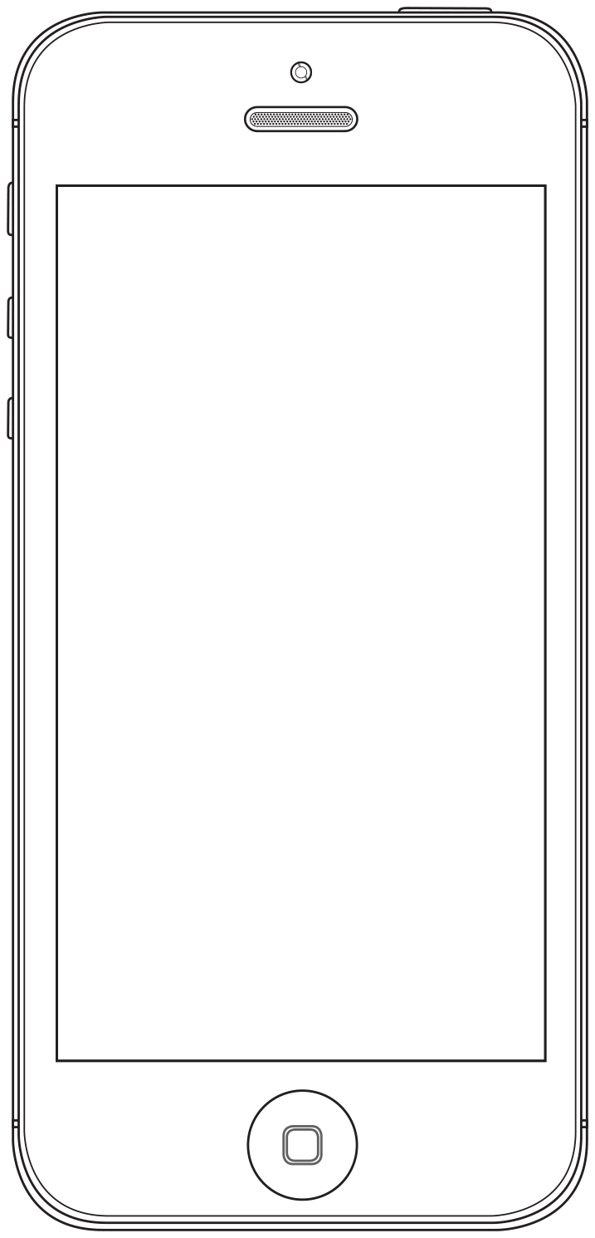
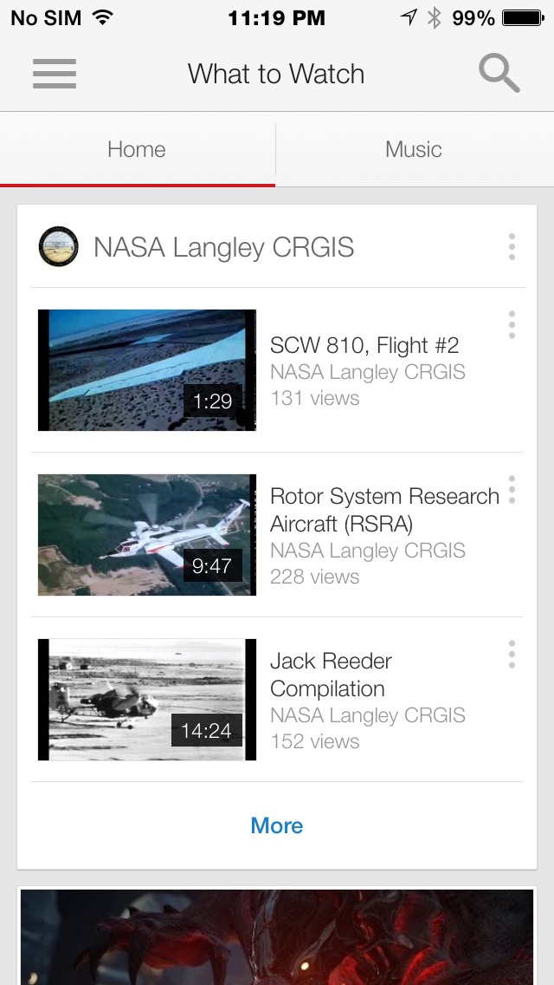
Notes:
You are probably all familiar with YouTube, and they are pretty successful at driving people to other content. But let’s look at their list views with these scroll use rates.
CLICK
Text is likely to be obscured, which could be critical to finding the right content. Think about what you want people to click on, and what you want people to read, when making your list views.

Slide 15
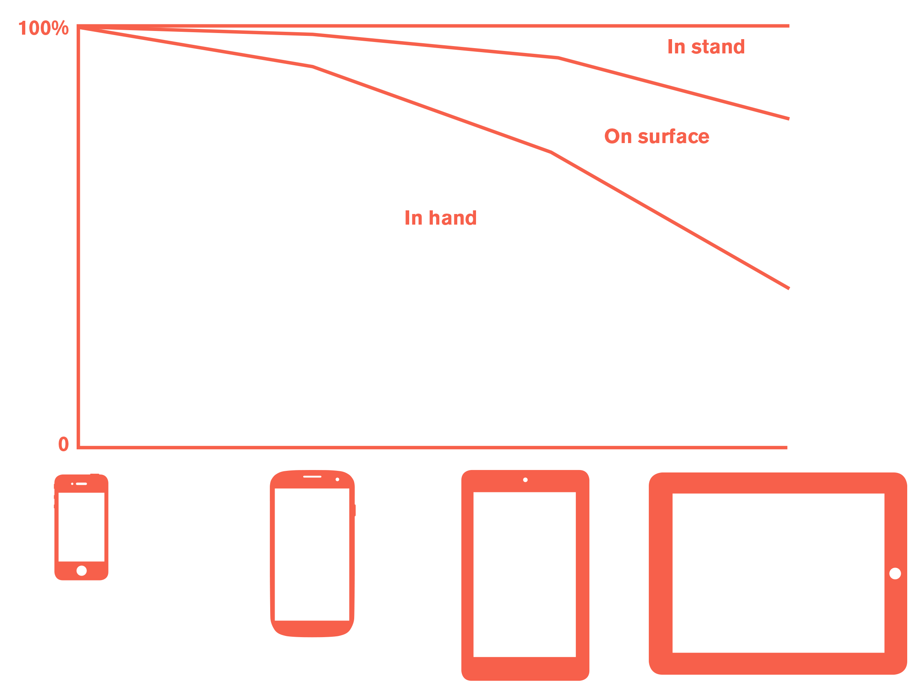
Notes:
As I said before, in general, as devices get larger, they are used less and less held in the hand.
But we can get more information from this. We also know how they are used, and can surmised distance from the eye by device class.

Slide 16
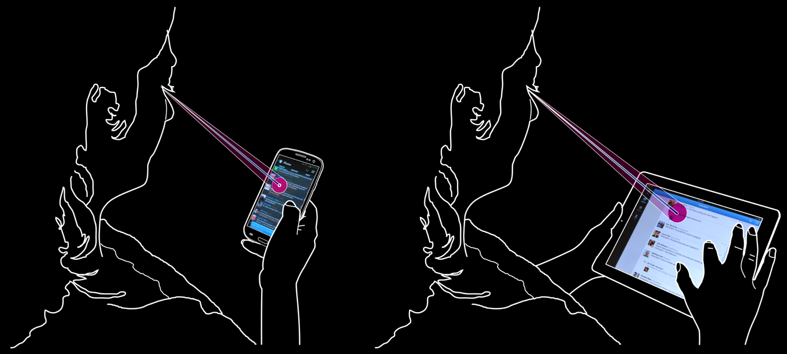
Notes:
This is critical partly because we don’t view anything based on size, but on resolution at our eyeballs. And the relationship between this and that is called angular resolution. Which we can calculate…
(For more on this, and the math from the next slide, start with http://4ourth.com/wiki/Human%20Factors%20%26%20Physiology)

Slide 17
(3438)(l)
V
=
d
Notes:
This is actually the simple version of this formula. To get the 3438 number requires knowing the size of the sensors in your eyeball, and so forth.
Don’t take a screenshot of this formula and break out the calculators. I’ve done the math for you.
Visual Angle (minutes of arc) = (3438) * (length of the object perpendicular to the line of sight) / (distance from the front of the eye to the object)

Slide 18
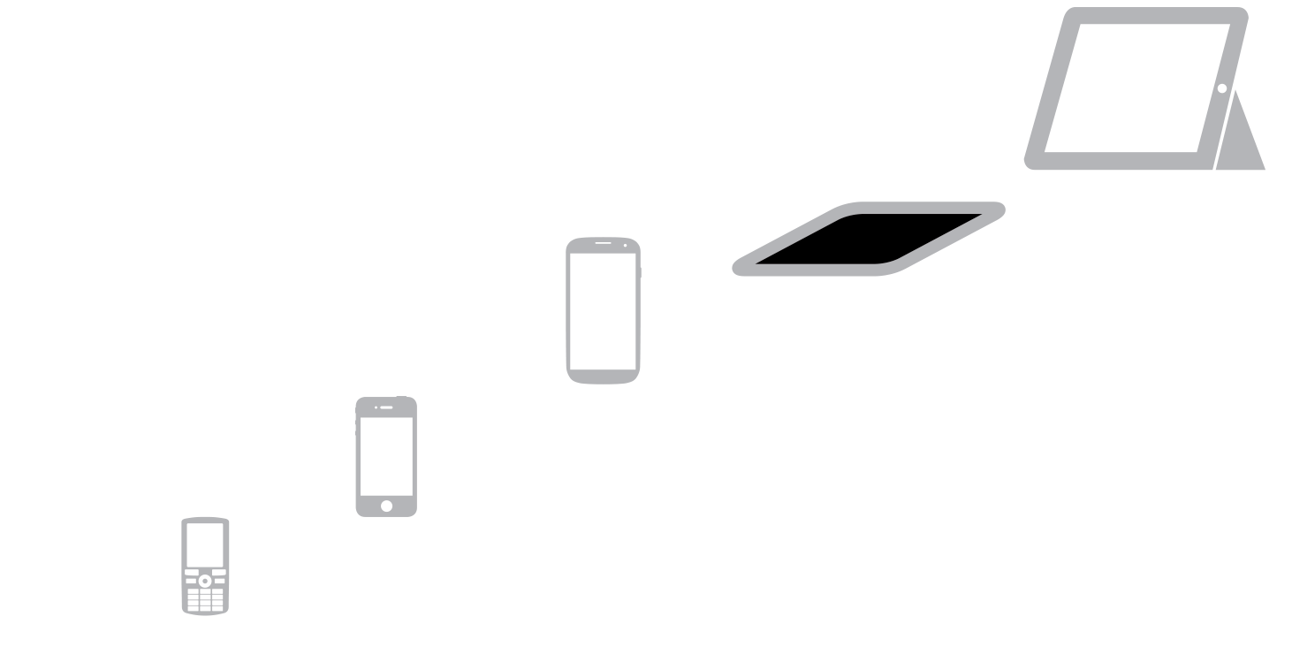
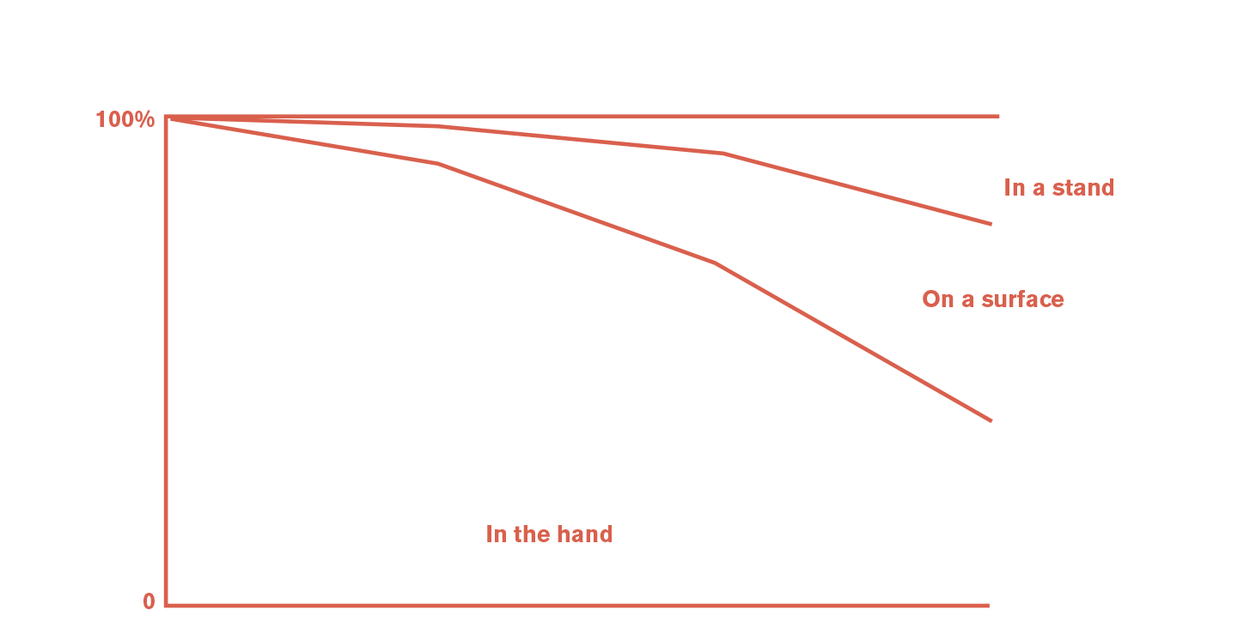
In Stand
10 pt
8 pt
7-10”
7 pt
5”
6 pt
3.5”
2.5”
4 pt
Notes:
The larger devices get, the further away from the eye they are used. [CLICK] Small handsets are held very close to the eye, larger ones and phablets further away, and tablets at approximately desktop distance since so many are in stands, with keyboards.
[CLICK] Minimum text sizes vary from 4 point for small handsets, to 10 points for devices set on tables or in stands. Yes, this really depends on the actual context, but we can make very good guesses based on device class. Never forget these are physical units of measure, in typographers points. Adjust as much as you can to device measures, such as pixels, dp, sp and iOS points.
And these are MINIMUMS. At least 30% larger for almost all actual uses like body copy. Even larger for more readability, for active environments, and for older populations. The smallest sizes are okay for things like labels under icons, though.
Icons and other elements follow these same scale rules, and can roughly follow about these actual sizes. They have the same concerns of readability as text.

Slide 19
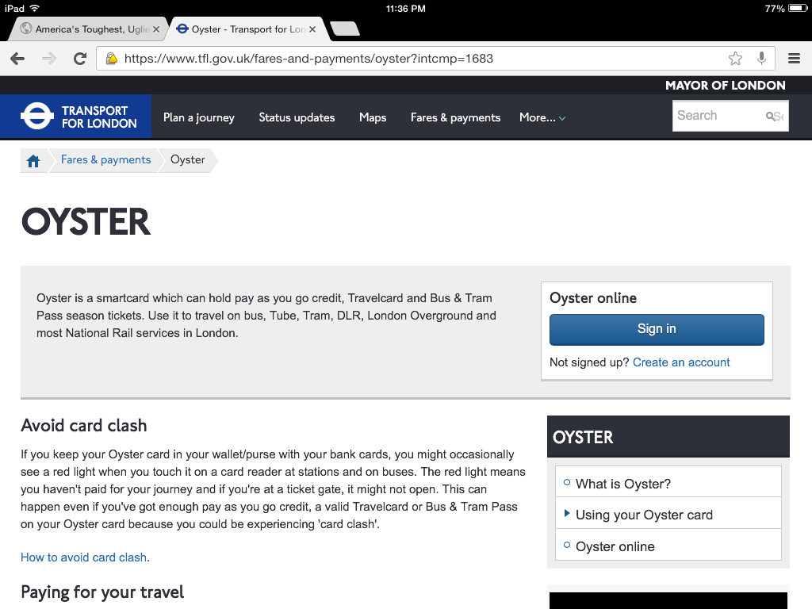
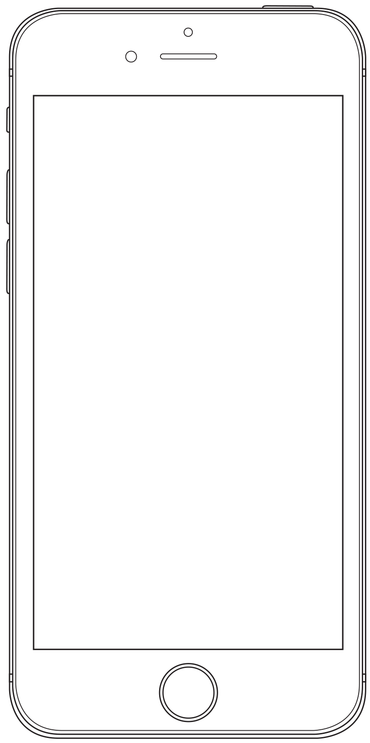
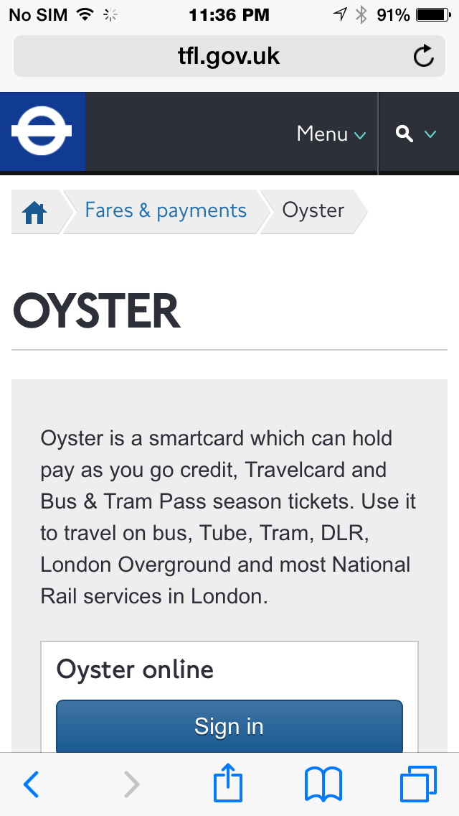
Notes:
Most sites that pay any attention at all to being specifically designed for mobile And tablet make the text on the tablet somewhat larger.
But, not big enough. In an attempt to make the tablet based on desktop design, they try to fit everything in there. Sidebars are generally a good hint you are doing it wrong.

Slide 20
Notes:
Because when you account for typical distance, handsets and tablets look more like this at the eye.
That tablet type is not big enough, so your viewers lean, peer or just have lower readability.
Design for the way people actually use their devices.

Slide 21
Design for Thumbs and Eyes
Size, space and distance:
Don’t believe myth, or let personal bias influence your design.
People grip in multiple ways, and change by context.
Make touch targets as large as you can.
Provide room to gesture.
Estimate use by device class.
Adjust text, icon and form sizes by how far away from the eye it is.
Notes:
However they use them. That means designing for the way people really hold and touch their phones, not the way you use yours.
That we design interactions, and even controls based on patterns of use by device class. Tablets are not the same as handsets or computers.

Slide 22
In Part 11:
Input & entry
Forms, but not really.
Avoiding user entry.
Using mobile-friendly inputs.
Designing around input and error.
Input types and pitfalls.
Error correction.
Architectural impacts of your choices.
Notes:
In part 11 I’ll talk about making sure input is easy, error free, and maybe even fun.

