Slide 1
TIMING/VIDEO
Remove auto-advancing after creating a video version:
On/Off:
In the tabs (not menu): “Slide Show”
[X] Play Narrations
[X] Use Timings
[ ] Show Media Controls
Clear the timings completely:
Select all the slides
Right click a slide > “Slide Transition…”
In the “Advance slide” section uncheck “Automatically after”
The complete guide to Designing Mobile User Experiences 10) Interactions & Touch Resources
@shoobe01
4ourth.com

Slide 2
Interactions & Touch
Read More:
This is more where I have most of the basic info from my own wiki or book, and from articles and presentations about touch.
For something more fun and engaging despite the math, the Bad Astronomy article is really worth a read.

Slide 3
Resolving the iPhone resolution
http://blogs.discovermagazine.com/badastronomy/2010/06/10/resolving-
the-iphone-resolution/#.VD10nNR4r8ET
Discussion of whether Steve Jobs lied (gasp!) when he said the original Retina display was unbeatable and you couldn’t see the pixels.
Great discussion in general about resolution, way past what most people talk about. You will never look at a pixel the same way again.

Slide 4
Human Factors & Physiology
http://4ourth.com/wiki/Human%20Factors%20%26%20Physiology
This gets into some of the physiology behind what is happening when people touch and look at their phones.
Remember this, even if you don’t remember the numbers: people do not change. Our bodies and brains are the same, so fundamental behaviors are not going to change. Adapt your technology instead.
Yeah, same as the link as the previous resources, if you’ve been reading them all.

Slide 5
Readability and Legibility Guidelines
http://4ourth.com/wiki/Readability%20and%20Legibility%20Guidelines
Everything about caps, italics, line length alignment and everything, in one place.

Slide 6
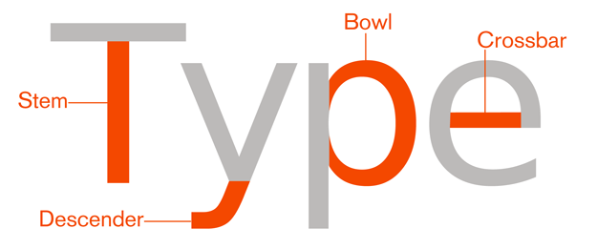
Typefaces for Screen Display
http://4ourth.com/wiki/Typefaces%20for%20Screen%20Display
If you say “font” and have no other word for that, expand your horizons and start getting used to type, typeface, etc. There are many words here, and it’s pretty important to understand them so you can pick good types for your project, and exploit them properly.
For even more terms, read this intro. It has pictures even.
http://4ourth.com/wiki/Introduction%20to%20Mobile%20Typography

Slide 7
Raster Design Tips
http://4ourth.com/wiki/Raster%20Design%20Tips
I use this page for my own work almost daily. There’s a lot to remember about scaling, and if you get it wrong, you get fuzzy images.
Someday soon we’ll get out of raster images for every icon, but today, if you export images by hand you need to read this or have a similar guide to assure your icons and other images look good.

Slide 8
FINGERS, THUMBS, AND PEOPLE
http://interactions.acm.org/archive/view/may-june-2015/fingers-thumbs-and-people
Summary of my research in the June 2015 issue of ACM Interactions magazine.

Slide 9
Designing for Touch
http://4ourth.com/Touch/index.html
All my touch stuff is summarized here. Links to all the videos, PPTs, and articles ever written, plus a summary on the page itself.
When I say to use the right type size, touch size and spacing, this has the most up to date guidelines on it, always.

