Slide 1
TIMING/VIDEO
Remove auto-advancing after creating a video version:
On/Off:
In the tabs (not menu): “Slide Show”
[X] Play Narrations
[X] Use Timings
[ ] Show Media Controls
Clear the timings completely:
Select all the slides
Right click a slide > “Slide Transition…”
In the “Advance slide” section uncheck “Automatically after”
NOTHING LONGER THAN 20 minutes!
The complete guide to Designing Mobile User Experiences 9) Interface Design by Zones
@shoobe01
4ourth.com
Notes:
Now we’re getting into the meat of the app or website. We have the scope, know all the pieces we need, and how they relate to each other. Now we’re going to progress from Information Architecture to Information Design.

Slide 2
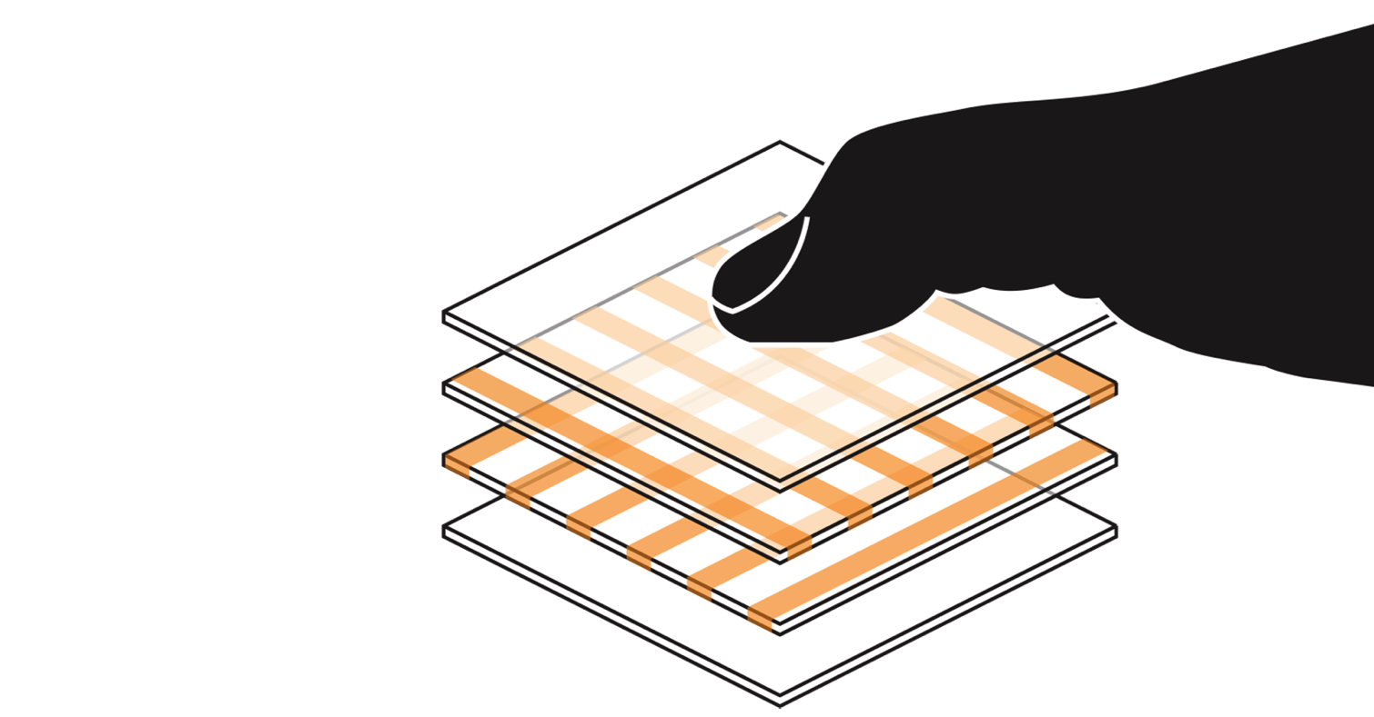
Notes:
And today, designing for touchscreens mostly, we care a great deal about how people touch the screen.

Slide 3
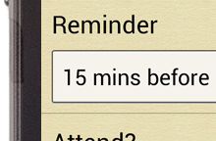
@shoobe01
#mwux14
CEP R95
3
Notes:
When you tap a target , you are never, ever perfectly aligned. [CLICK] There is no such thing as perfect accuracy, so the user misses. Accuracy is relative, and we define it with the Circular Error of Probability, or CEP which is just a mathematical representation of how much you miss a target. [CLICK]
When everything is imprecise, we stop calling these errors, and refer to tolerances instead. As I said earlier, we need to plan for imprecision and problems as part of the process. And that’s all the way down to making buttons.

Slide 4
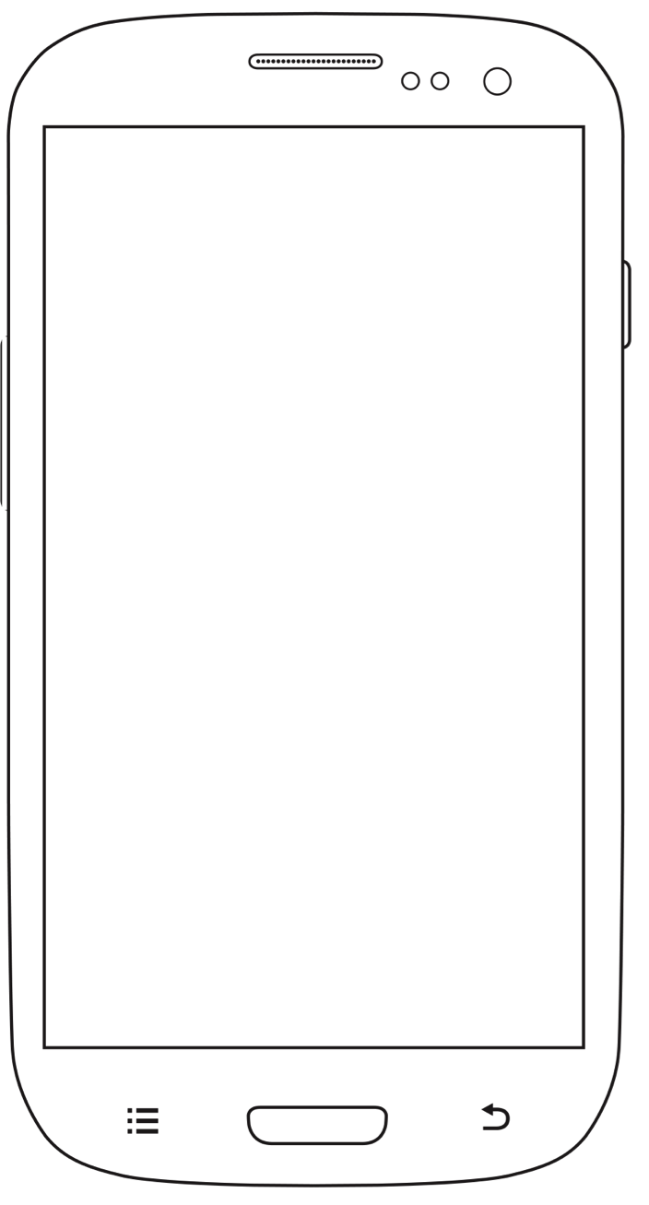
Notes:
But let’s back up and look at the whole phone again. When you account for content position and different devices, you find that most taps are in about the center half of the page.
CLICK
If you wonder about tablets, they are surprisingly similar so that data is embedded into this data viz.

Slide 5
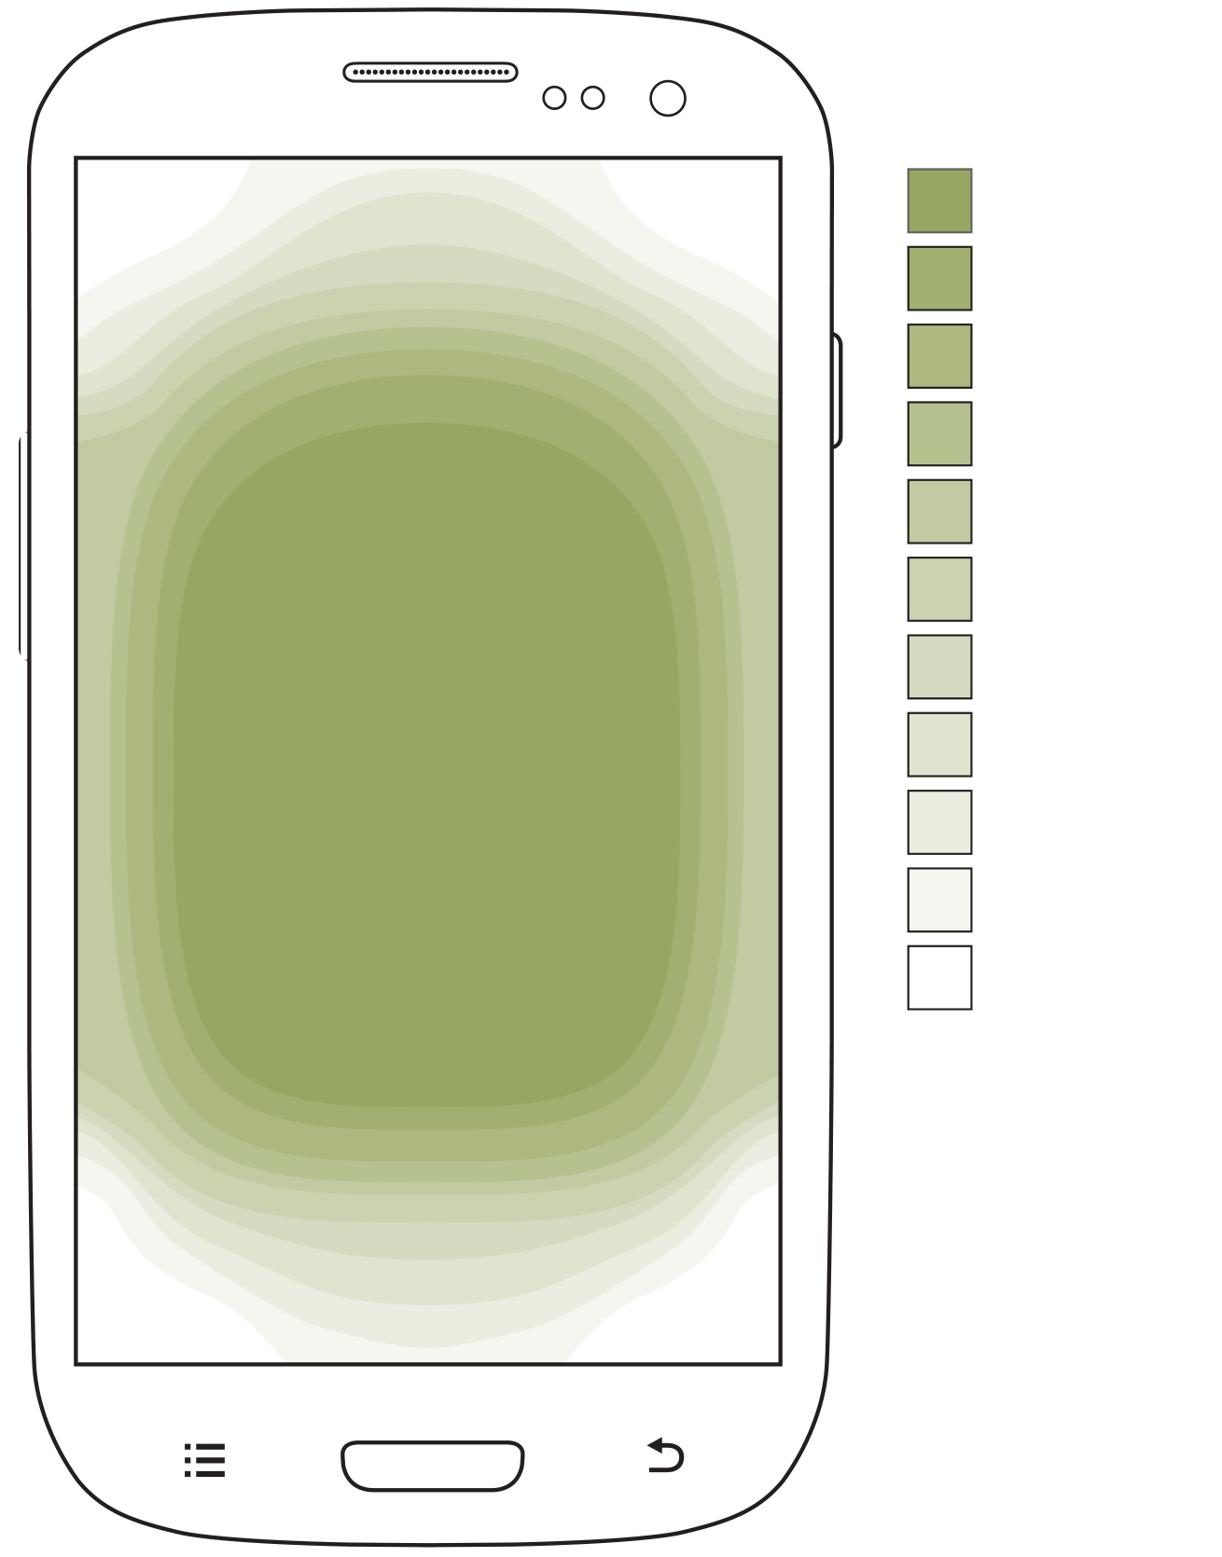
Notes:
And on top of this we know that people are more accurate at the middle of the screen. And we mean pretty much any screen, any way they hold their phone or tablet. They also subconsciously know this — or it may be tied to their preference for reading in the middle — so are more confident at the center, but will slow down to tap corner or edge targets.

Slide 6
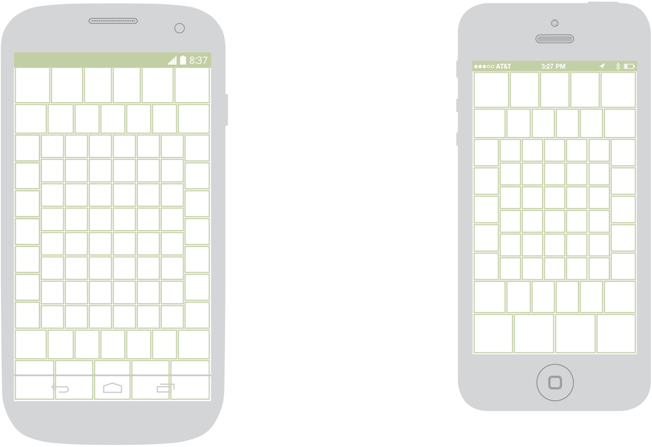
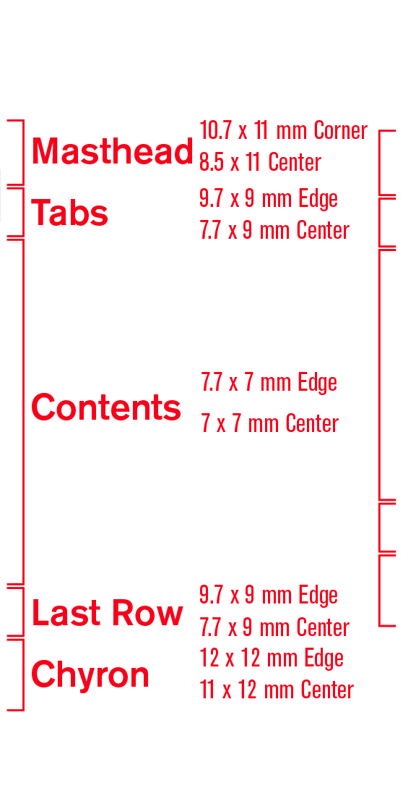
Notes:
If we map that research differently, we can see how much more room is needed between items in various parts of the screen. [CLICK] The sides are a little worse than the center, [CLICK] but the top and bottom require much more room, [CLICK] and corners are the worst.
Now, I want to go over each of these sections in turn.

Slide 7
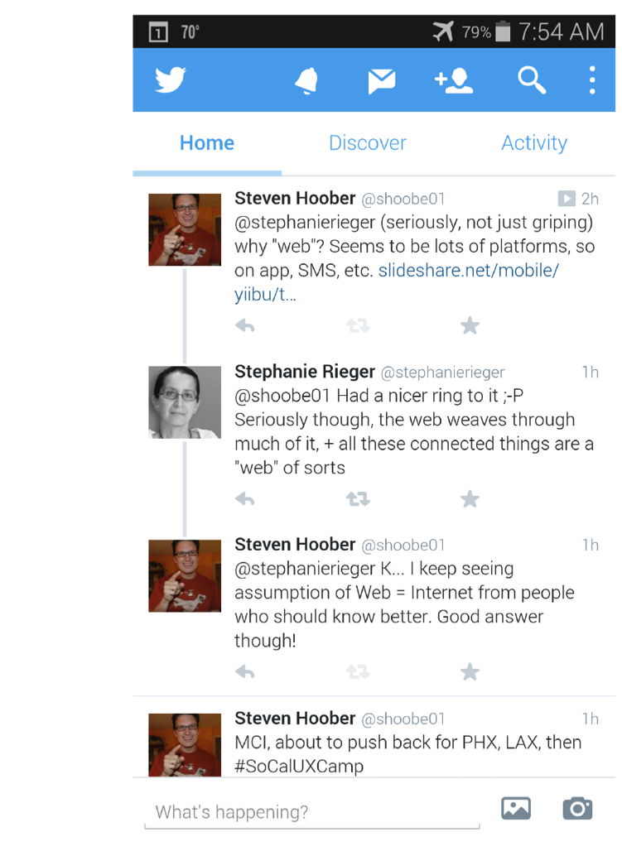
Notes:
And going by importance, you might think the top CLICK or if you are an iPhone fan the bottom CLICK, but weren’t you just listening? The center is where people tap, scroll-to and view whenever given the choice.
Hey, look at this very typical app design. All the info is actually in the center already! CLICK Don’t be fooled by terms like “primary navigation” anymore. The primary functional and display area is the middle of the page. You know this, we just always forget it.
These items can be quite close together, with space between targets as small as 7 mm.

Slide 8
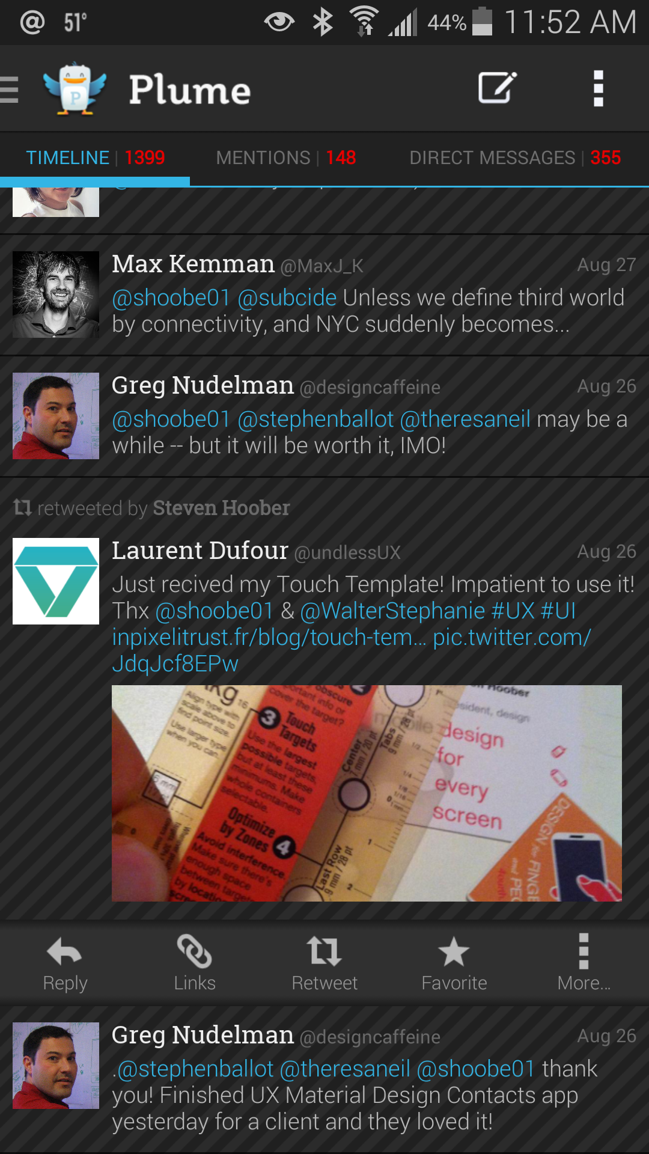
Notes:
If you design in lists — and many, many mobile apps and websites work off lists — then you need to know that the sides are less accurate, and less-preferred to touch. They also get covered up and generally are not seen as much.
CLICK
My preference is to simply make the whole row tappable. Click it to get options presented below, like here.

Slide 9
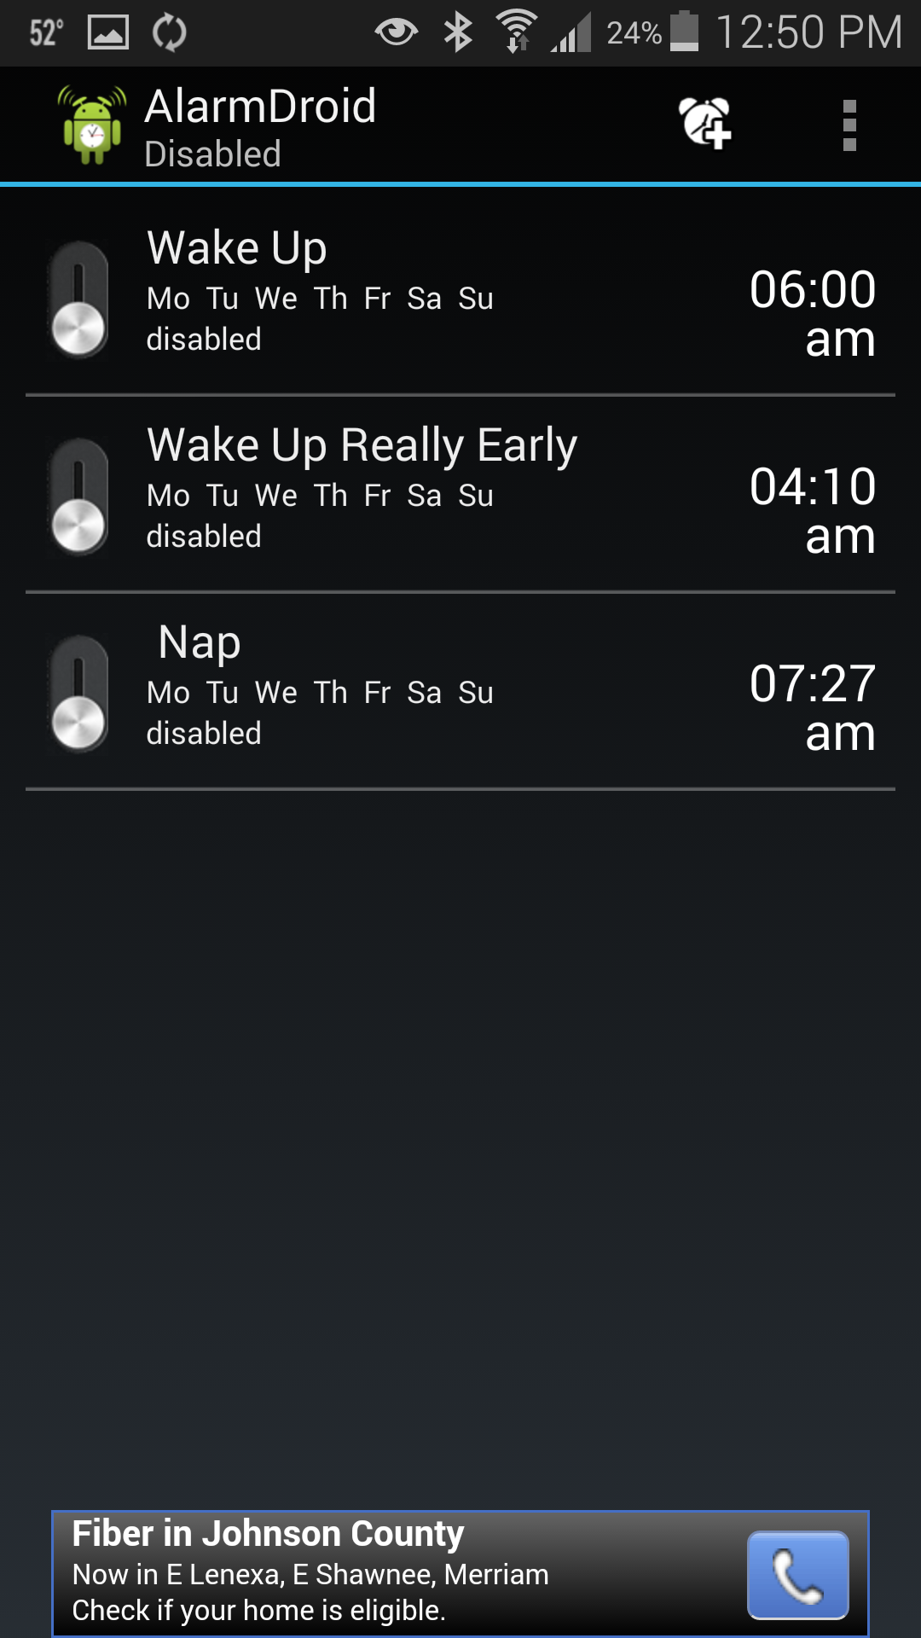
Notes:
But if you must put checkboxes on the left and trashcans on the right, or worse yet controls like these little switches, then you have to provide enough room. Your row height has to increase to account for these items, so each row has to be at least 8 mm tall now. Preferably 9-10 mm.
This is not a good example, because none exist. These are too small, too close together, and I almost never am able to accurately activate the right one.

Slide 10
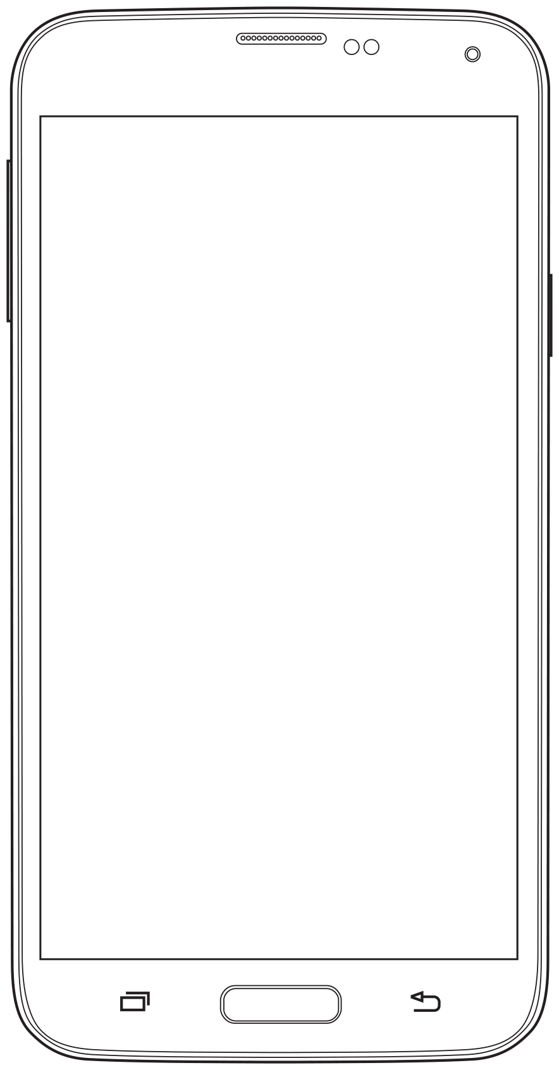
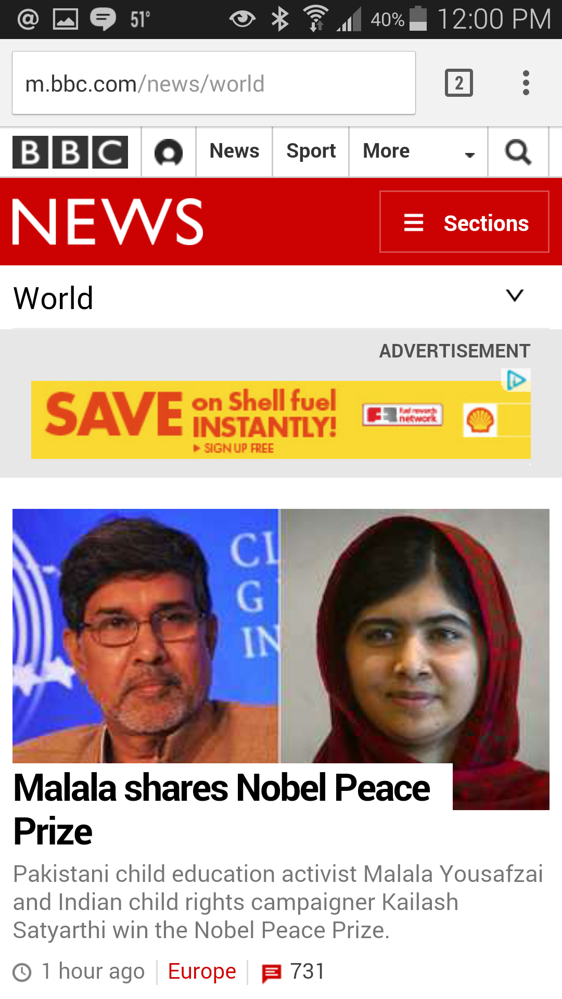
Notes:
The top has special problems. For the Web, you don’t always have access to the top. While it often disappears, the browser chrome takes up the true top space, so your site masthead is pushed down in prominence. Because of this, I’d avoid very big mastheads. CLICK And I can never condone the topmost strip of tiny global functions. That’s directly in opposition to people’s ability to touch and is just an artifact of your desktop website. Stop it.

Slide 11
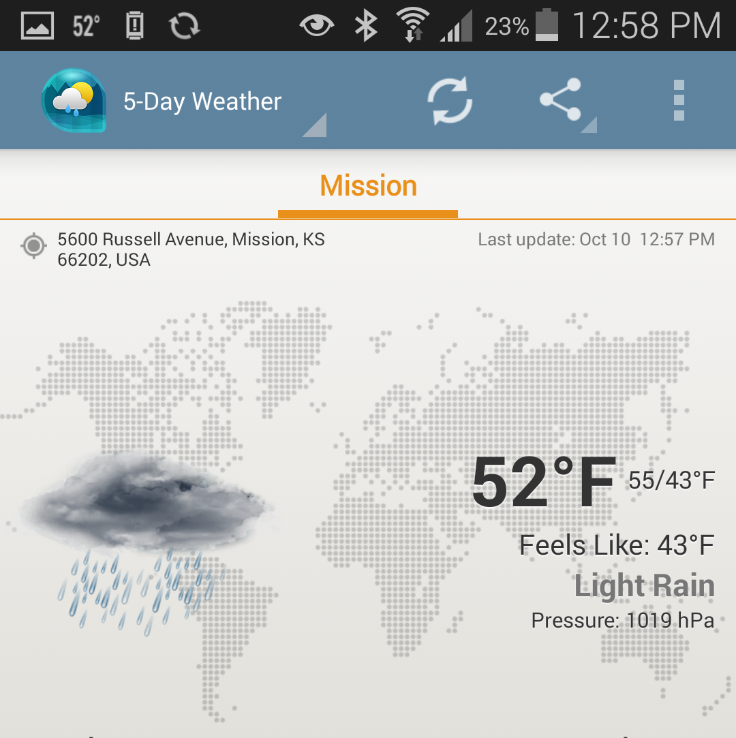
Notes:
For apps, or if you are dedicated to simulating an app with your website, the top has to be kept loose. For smaller phones like the iPhone up through 5, more than about 4 items is getting too tight. Items need about 12 mm spacing on center. Even on large phones, more than 5-6 is risky just on tap spacing.
Branding and menus — which we’ll talk about later — are almost always up here. Lately, there has been a rather effective trend of putting actions up here as well. Items that can be done in the current context, CLICK like refresh and share. Try to limit to a handful of these. Even if it’s a tablet with plenty of room, a sea of icons is hard to scan, so keep it to 2-3 at most.

Slide 12
Notes:
Tabs are a problem. If you expect people to actually touch them, at least. They are ALWAYS made very, very narrow, but that doesn’t provide nearly enough room for them to be tapped. People will hit the title bar items all the time.

Slide 13
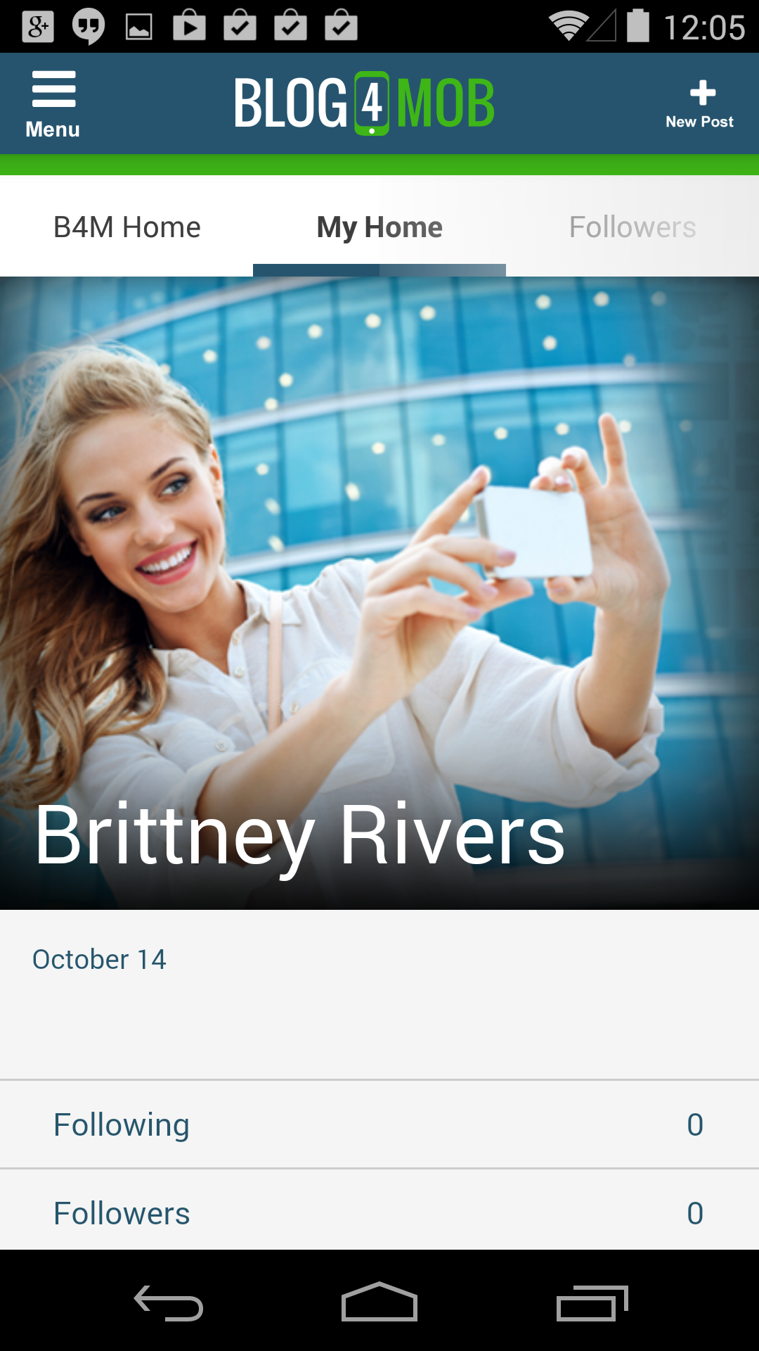
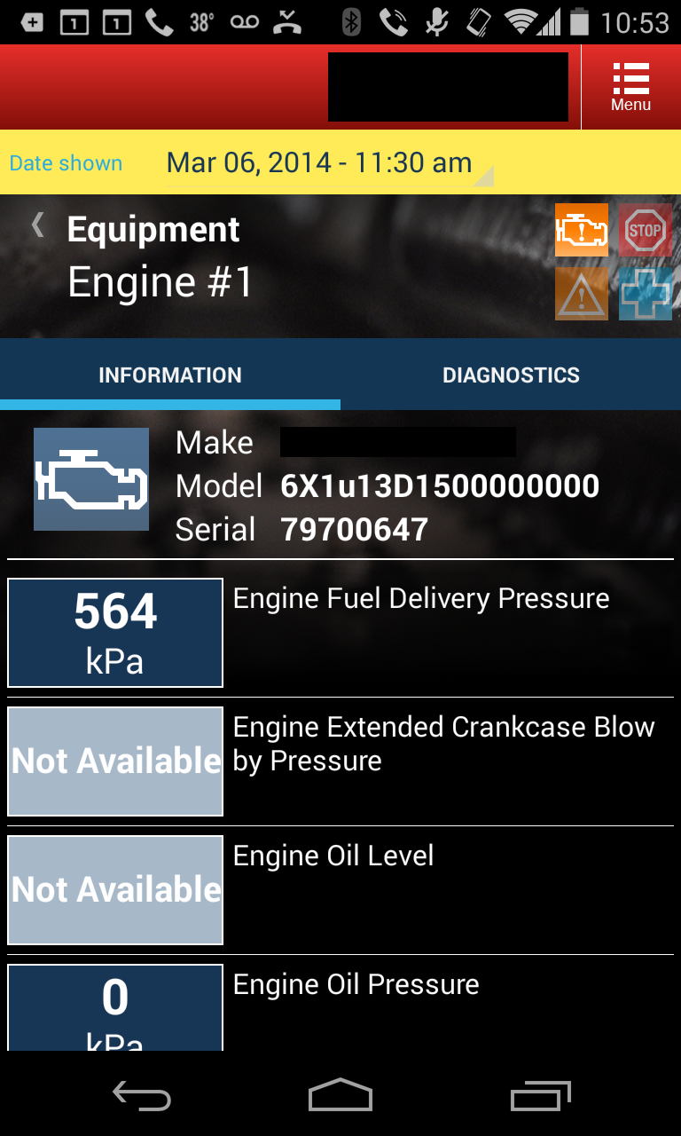
Notes:
This is the sort of thing I do, and which is becoming the trend anyway. Make the tabs taller. Or push the tabs to another part of the page. Even a little bit of padding between the masthead and the tabs helps a lot.

Slide 14
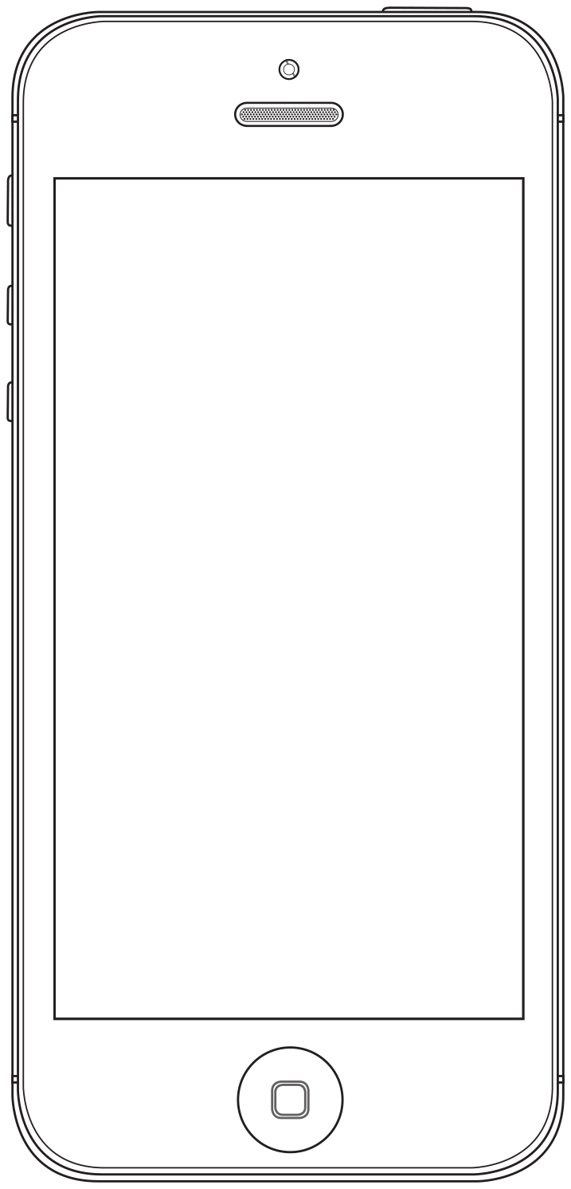
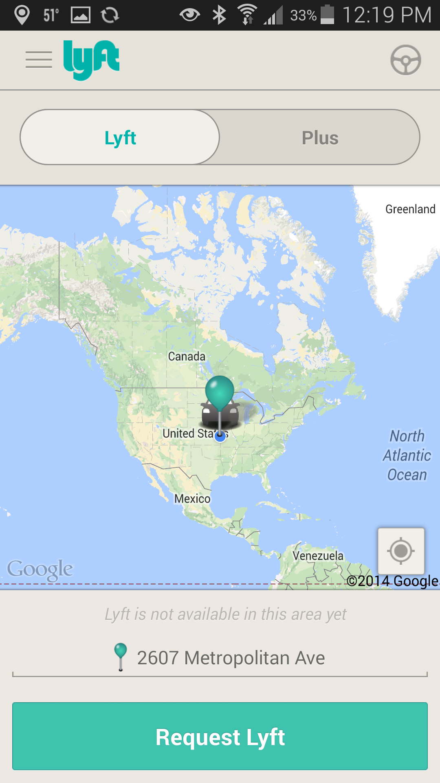
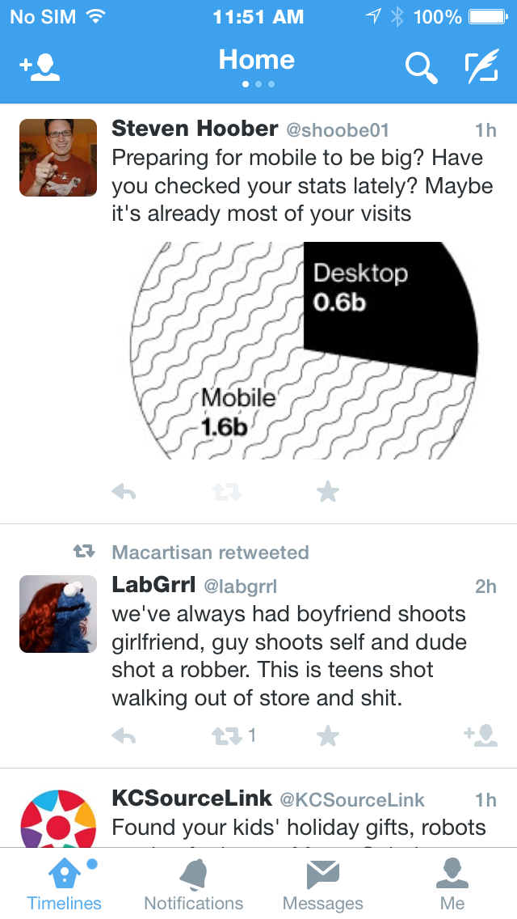
Notes:
iOS officially thinks the chyron (the bottom strip always docked to the edge of the viewport) is their answer to tabs and the primary navigation level. But you don’t have to use it like that. Many apps use this for actions, and have tabs sort of faked with gesture only. [CLICK] See the three dots under the Home title here in Twitter? That means you can tab inside the Timelines section also. It’s okay, but tabs on tabs can be confusing. Your Task Flow document step should help prevent confusing organization like this.
If you don’t like the bottom items, or just aren’t on iOS where it’s not expected, you can also put advertising there. I like to do stuff like Lyft did here [CLICK] and often add buttons there. Buttons below forms are pretty natural (like signing your name to the paper is at the bottom) so I like big buttons down here as well.
I would pick only ONE thing at the bottom. If you are making a classic iOS app with a tab bar, don’t have a button or ad unit right above it. It reduces screen space, devalues your second bar, and increases the chances of accidental clicks.
And size-wise, you need about 12 mm between items, so your iPhone navigation should have four items only. Even 5 is risky.

Slide 15
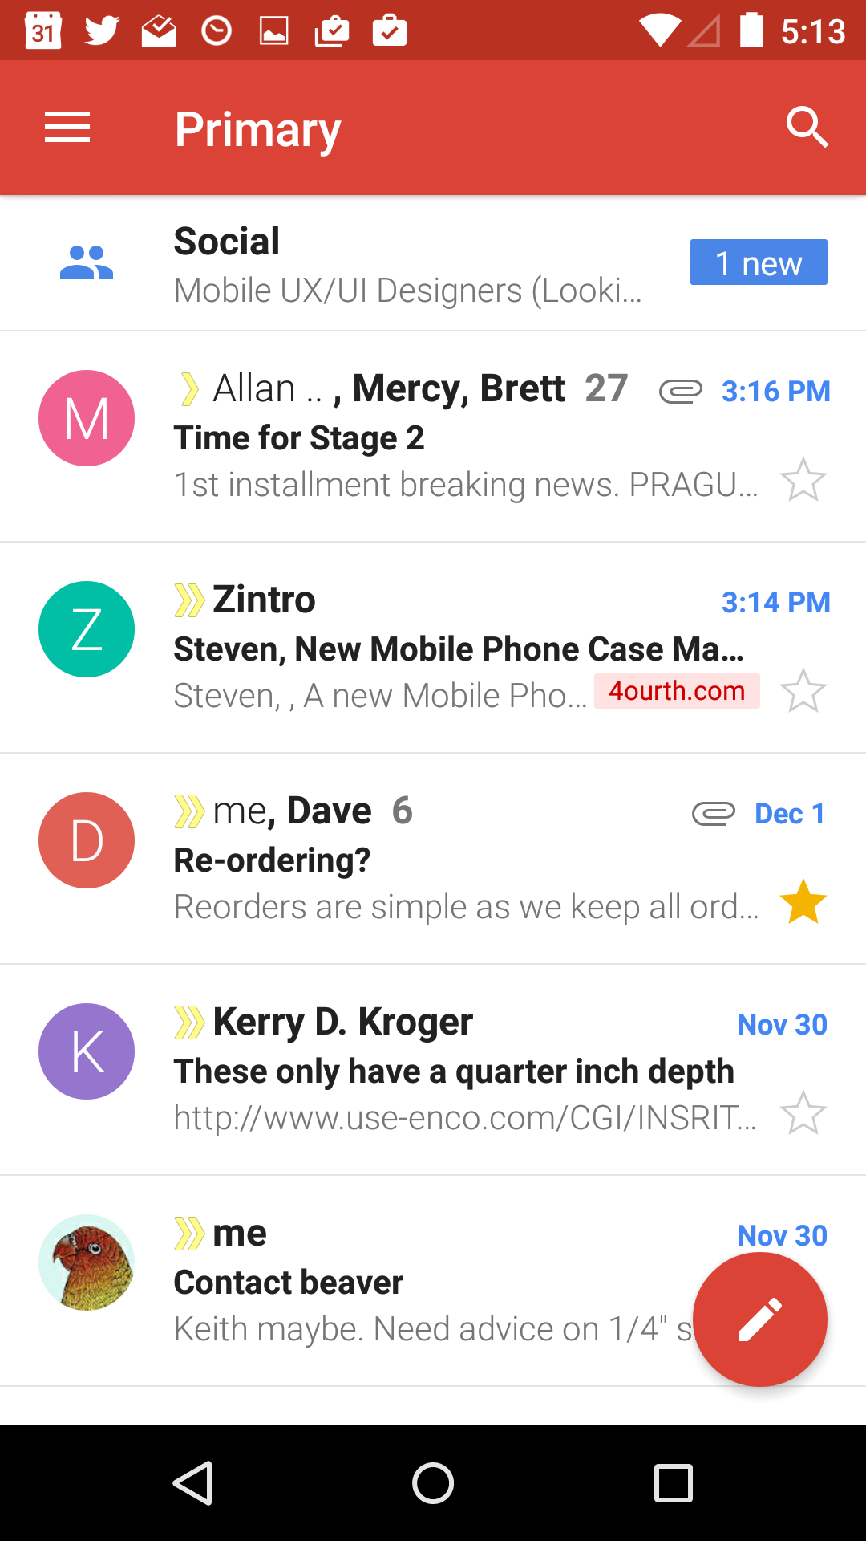
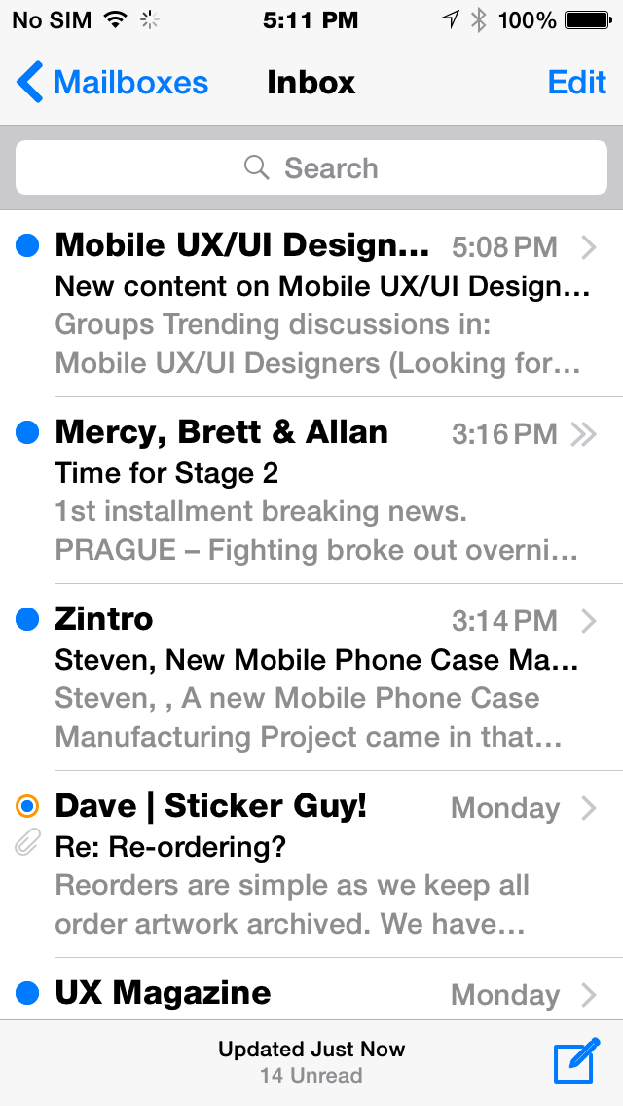
Notes:
The trend is suddenly, surprisingly positive though. Android at least is supporting actions off the bottom of the page, so things like compose have moved from the very, very edge to up here.

Slide 16
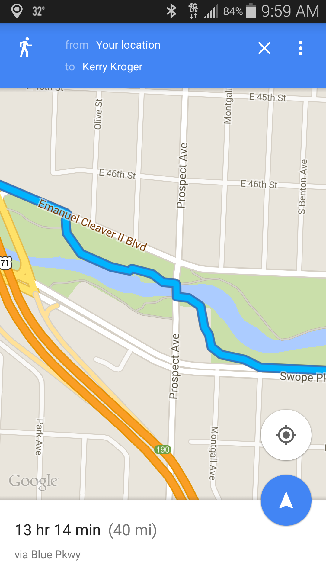
Notes:
And this is even better in other apps. Even just Google Maps is placing controls like centering no longer in obscure corners, but somewhat over the map, and larger. These are much easier to use, and I hope this trend continues, is embraced by app designers, and maybe spreads to other platforms.

Slide 17
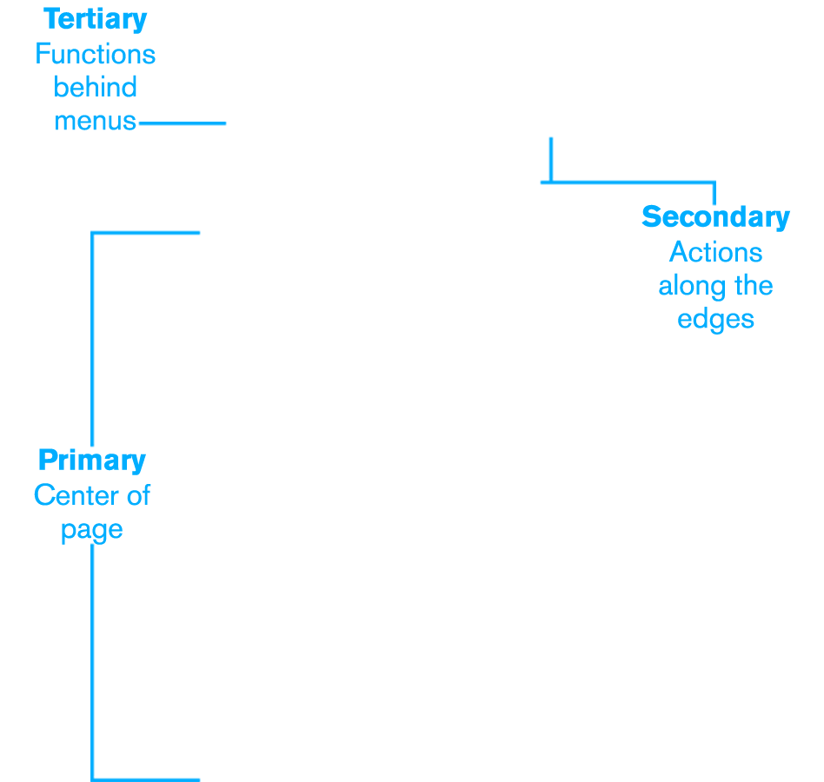
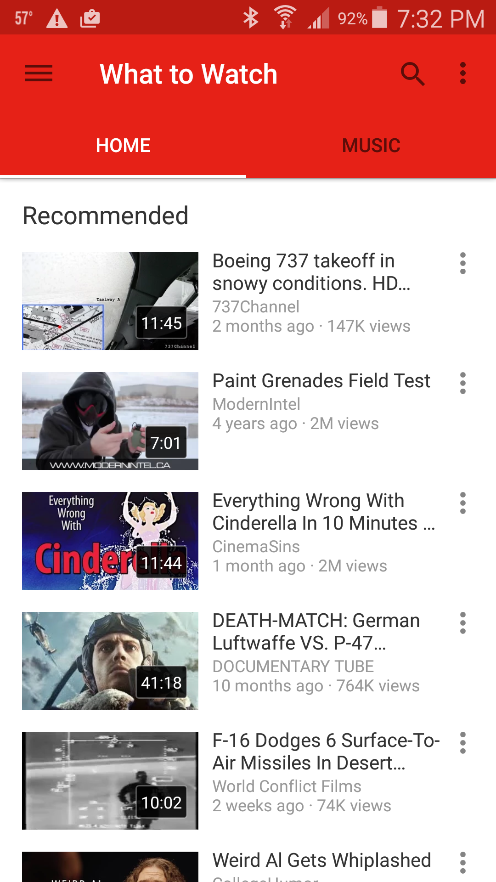
New
Notes:
Let’s turn this into a single, simple guide for how to design: design from the center outward.
Decide on a hierarchy of tasks, then stick to it. And make the user interface reflect the hierarchy.
First, give them information—front and center. Place one primary task or function in the middle of the page. One doesn’t mean one thing, but one TASK. A list of tweets or videos is a single task as the user selects ONE of them at a time.
If your tool requires it, make two or three secondary tasks immediately available along the edges. Again, not 2-3 links, but tasks. You can have actions on the page AND a tab to switch views.
Stack all of the tertiary functions in a menu of some sort. If you pick the right functions, people WILL find them. In my research, I have never, ever had someone fail to find a task I put in a menu. 100% reliable.
Most importantly, design for actual devices and users. Don’t hold onto old assumptions or standard practice from other environments. Don’t try to turn your Web site into something mobile friendly simply by changing its navigation bar into a menu. Instead, re-architect them, and design solutions that work for users experiencing the unique user interfaces of tablets and mobile handsets.
What to do? Most of the apps and sites we use lead with the key information, then put secondary functions off to the side. For example, both Twitter and your email client show the most recent messages, and a single icon at the top or bottom edge of the screen lets you compose your own.
Icons or links on title bars or at the bottom of a screen and small sets of tabs are the most common ways of providing secondary functions on Web sites for mobile devices and in mobile apps.
The Weather.com mobile Web site organizes information by importance, as shown in Figure 4. The most important information to which the user has navigated is in the center of the screen. Secondary functions are along the edges. Plus, there’s a button at the end of the list to load more times and a search function to change locations at the top of the page.
Figure 4—A central list dominates the hourly forecast page on Weather.com
Android Material Design apps, such as those shown in Figure 5, use a new, even more robust method of making secondary functions more visible, while they’re still to the side, so clearly secondary.
Figure 5—Note the location of the compose button in Gmail and the center and direction buttons in Google Maps
I consider functions that people use even more rarely to be tertiary. These can reside on a menu, where getting to them takes one more level of difficulty, but the likelihood that the user will deliberately seek the functions is also reduced, so it’s fine.
YouTube is filled with information—people add 300 hours of new video each minute. With categories, channels, ads, and more, YouTube clearly has a very, very complex product. But you wouldn’t know it by how focused and simple the core user experience is. As Figure 6 shows, its primary function is to present a recommendation list on the home page.
Figure 6—YouTube, a list, with secondary functions at the edge, and tertiary functions in a menu
Since I don’t work for YouTube, I don’t know for sure what their business model is, but I think it’s safe to assume that most viewing is from casual use and recommendations. Look around the edges. There’s a Music link for a new service they’re pushing, then search, and some menus on the title bar.
This layout should be familiar to anyone who designs apps or Web sites—or even optimizes them or manages projects. Search is important. We can assume that YouTube’s second highest rate of discovery is via search, can’t we?
Architect Your Solutions
That last principle of mine could be better stated as:

Slide 18
New
Notes:
A few others have taken this even more to heart. Daniel Fisher, who I do not know and have never talked to, interpreted some of my older research the same way, but even tighter.
He’s placed a simple, small set of functions along the bottom third of the viewport on his music app, and uses the top to display information on the song, album or artist.

Slide 19
Design by Zones
Account for inaccuracy, design for tolerances:
Primary content in the center.
Design in lists and large boxes.
Avoid actions along the edges of lists.
Secondary actions along the top or bottom.
As few buttons as possible in the top or bottom.
Increase height of tab bars.
Notes:
That was a lot of information, and there’s much more to dig into but just try to remember these points:
Put primary content and functionality in the center, usually in a list view.
Avoid actions along the sides of the lists.
Put your secondary actions along the top or bottom, or both.
Keep edge items well-spaced, so use as few as possible.

Slide 20
In Part 10:
Interactions & touch
How people hold their phone, and change their grip.
Designing touch targets to avoid interference.
Reducing consequences from mistaken entry.
Visibility and consistency of touch targets.
Angular resolution, and text/icon sizes per device class.
Notes:
In the next part we’ll continue this discussion by getting more detailed about how people hold, touch and see their phones, and tablets and how you can take advantage of this information to design better mobile interfaces.

