Slide 1
TIMING/VIDEO
Remove auto-advancing after creating a video version:
On/Off:
In the tabs (not menu): “Slide Show”
[X] Play Narrations
[X] Use Timings
[ ] Show Media Controls
Clear the timings completely:
Select all the slides
Right click a slide > “Slide Transition…”
In the “Advance slide” section uncheck “Automatically after”
The complete guide to Designing Mobile User Experiences 9) Interface Design by Zones Assignment
@shoobe01
4ourth.com

Slide 2
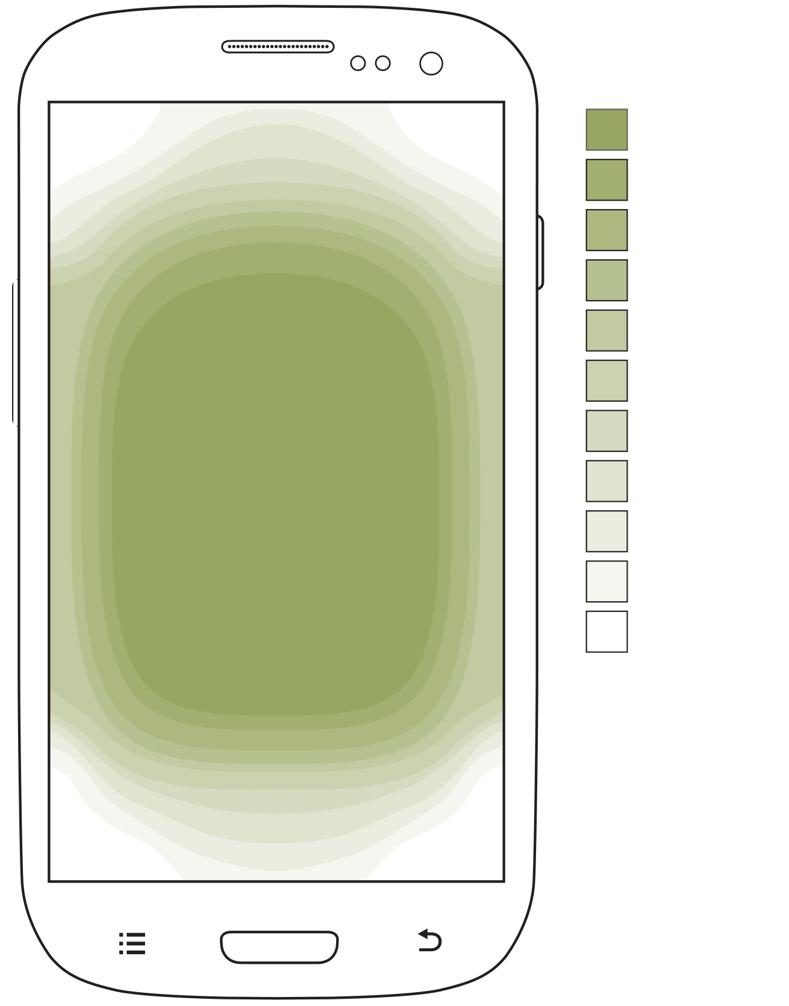
Interface Design by Zones
Now we'll get to the interaction and interface of individual components. Follow the guidelines from the presentation directly.

Slide 3
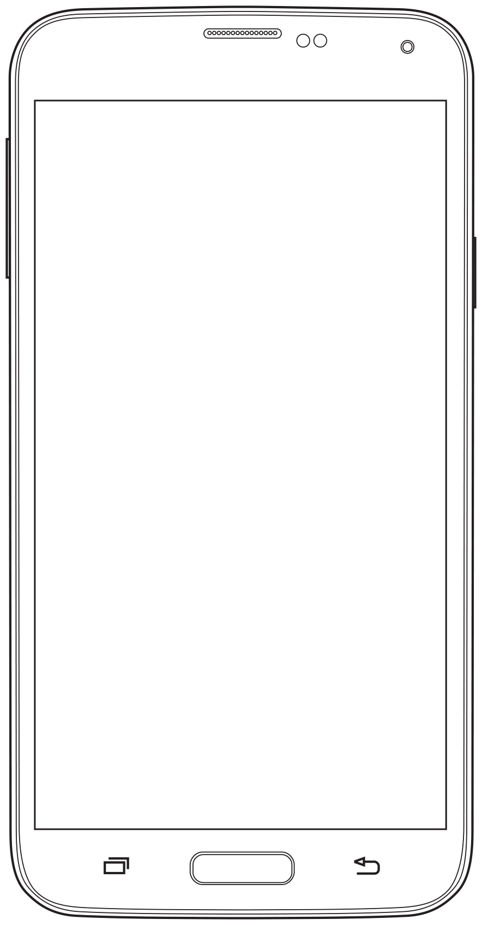
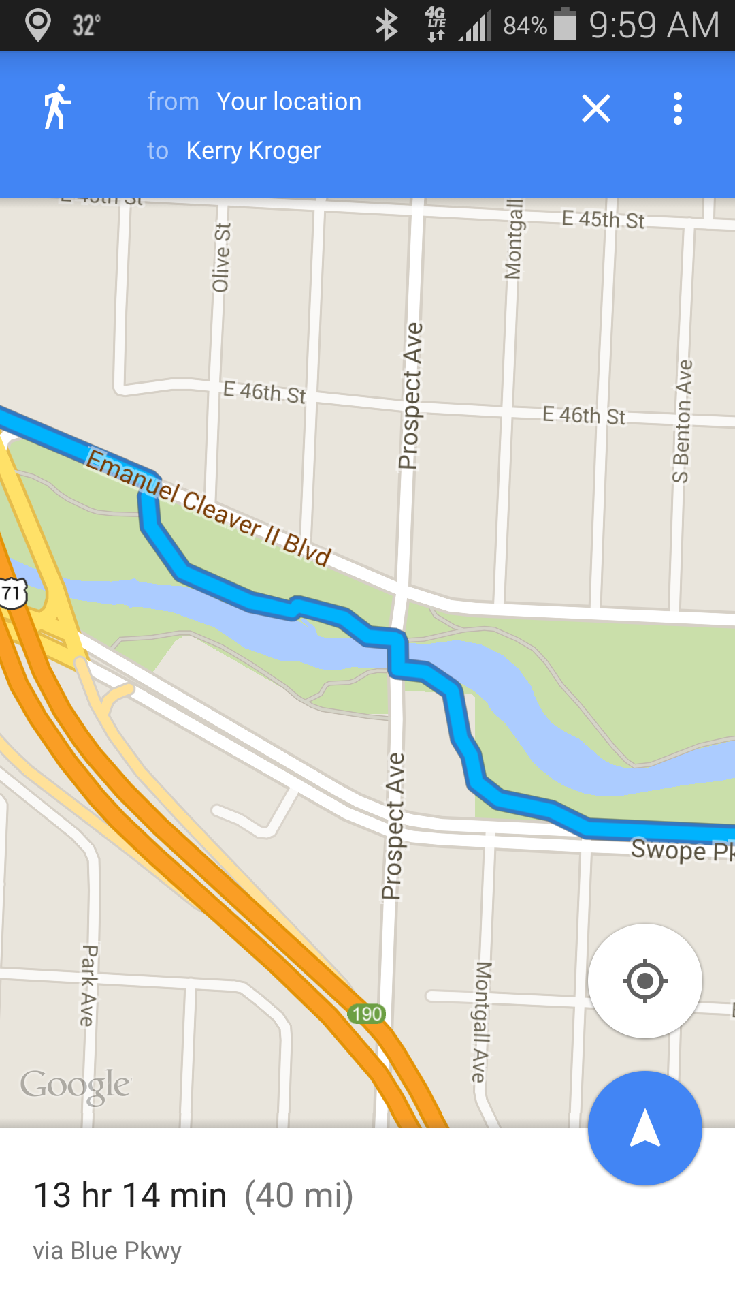
Interface Design by Zones
Is your key information in the middle of the page?
Don't fall for top-to-bottom layout and put too many actions along the top edge, or hidden behind tabs. That's desktop thinking.

Slide 4
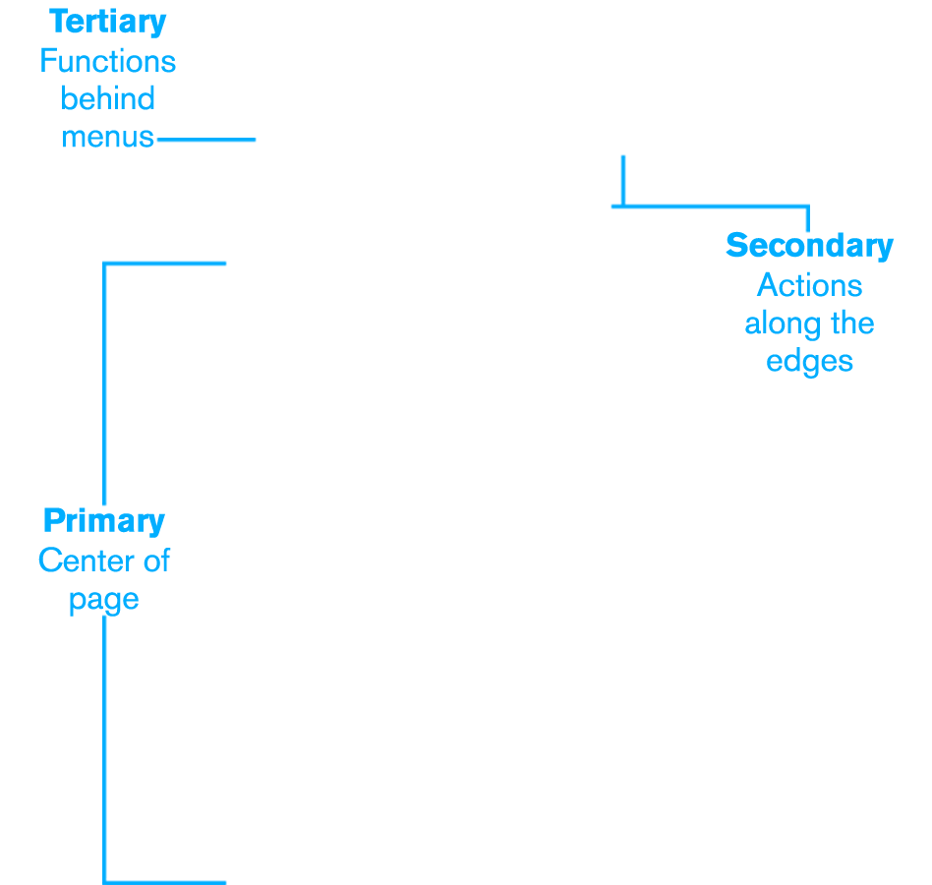
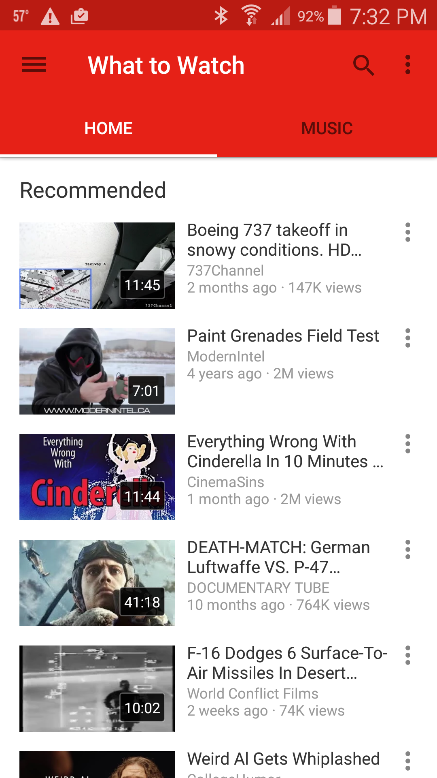
Interface Design by Zones
Now put the rest of it in the design:
Put secondary information in action bars, tabs or otherwise along the edge of the screen.
Put tertiary information in menus.
New

Slide 5
Interface Design by Zones
For lists, do you have lots of actions per row, or is the whole row clickable?
Check out the Plume example for a way to offer multiple actions per row without cluttering the list itself, or making new pages and boring dialogs.

Slide 6
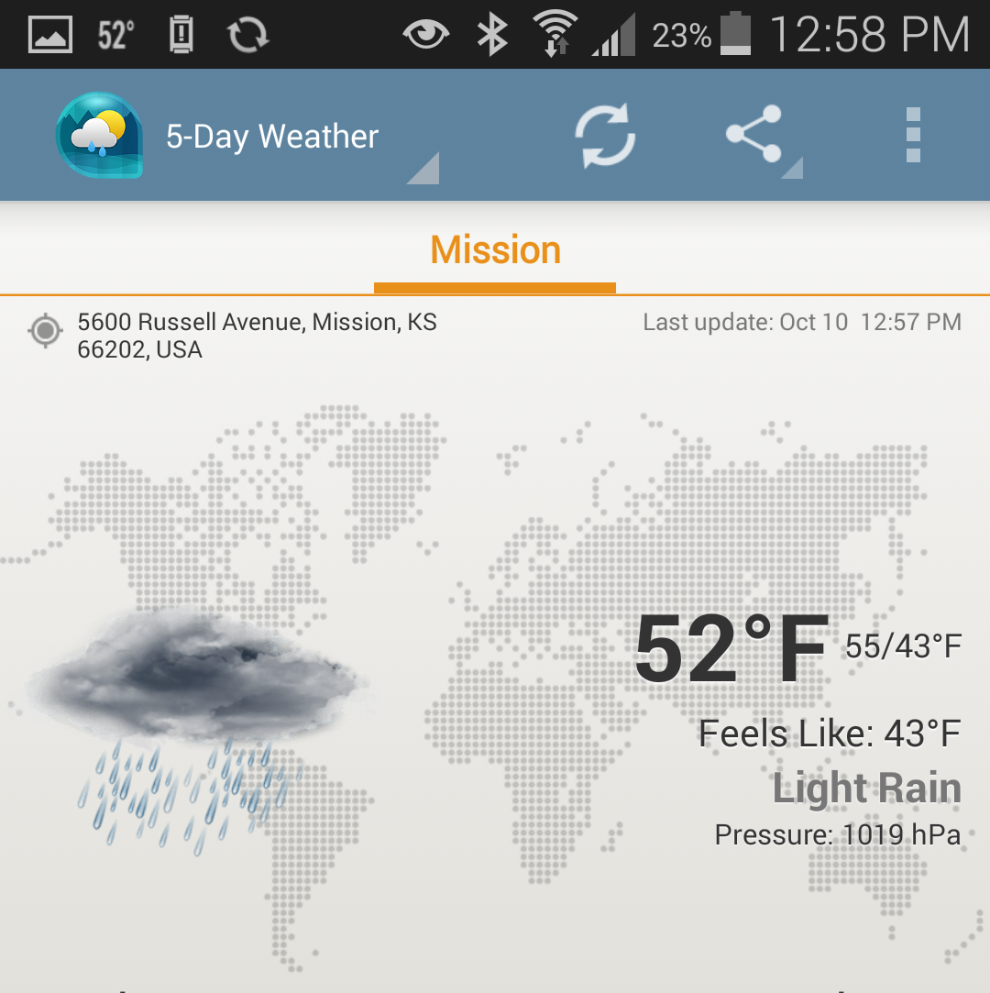
Interface Design by Zones
Is there enough room between the icons along the top and bottom edges?
More than about 4-5 for any phone is too many.
Fewer is always better so see what you can narrow it down to.

Slide 7
How Do You Label?
Icons only? Text only? You probably need both.
Icons can be ambiguous.
People don’t use your app as much as you think. They will not memorize them.
Standard icons become standard, so use those when you can.
Icons orient well. Best tap accuracy and speed is from icon + label.
Icons help a bit with internationalization (confirm those who only sorta speak the language), but do try to actually customize language for every use.
New

