Slide 1
TIMING/VIDEO
Remove auto-advancing after creating a video version:
On/Off:
In the tabs (not menu): “Slide Show”
[X] Play Narrations
[X] Use Timings
[ ] Show Media Controls
Clear the timings completely:
Select all the slides
Right click a slide > “Slide Transition…”
In the “Advance slide” section uncheck “Automatically after”
NOTHING LONGER THAN 20 minutes!
The complete guide to Designing Mobile User Experiences 8) Back & the Stack
@shoobe01
4ourth.com
Notes:
So, now that we’ve talked about how to conceive of the architecture of your website, app or hopefully multi-channel service, how do you turn that into a digital product?

Slide 2
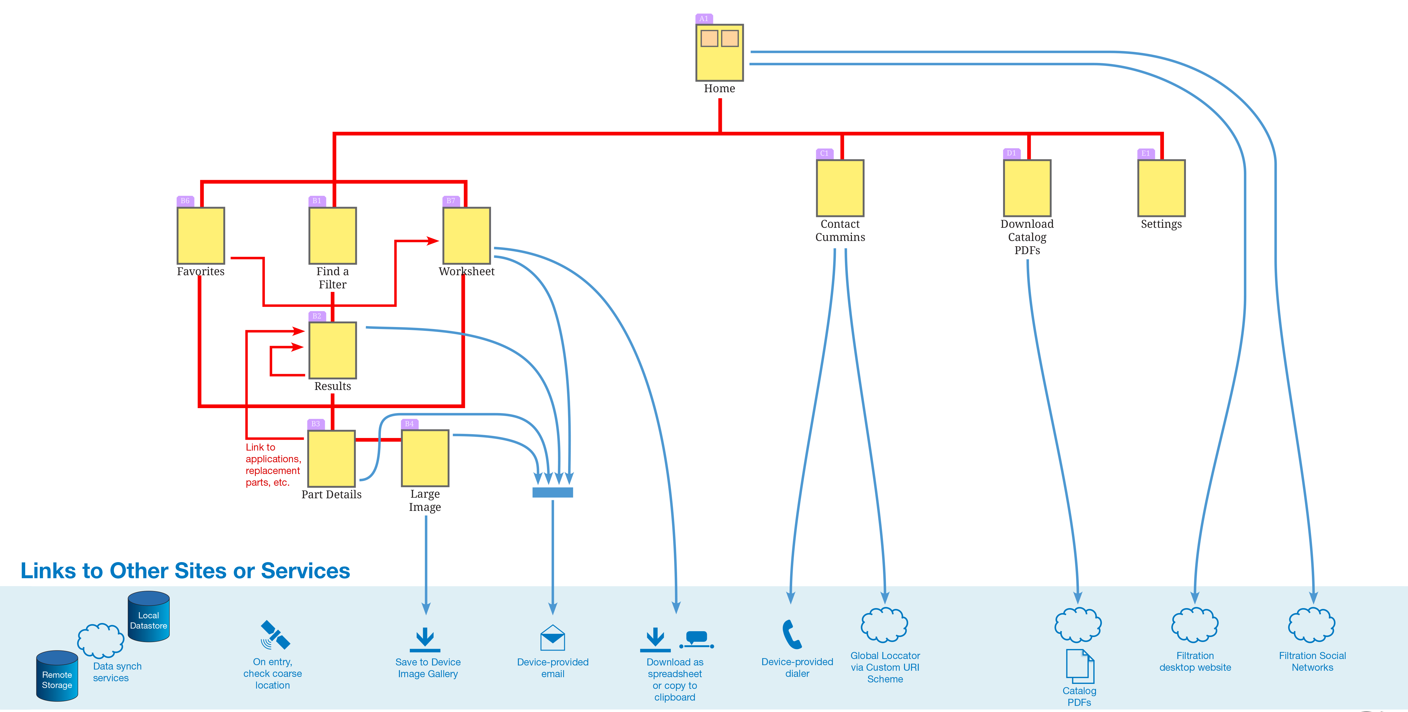
Notes:
First, we take a sharpie marker to it. I sometimes literally do this, taking the platform-agnostic user task map and scribbling on it for each platform we’re building.
Pick each element that applies to the platform you are on, and you will end up with a diagram that is very similar, but is now about the specific platform you are designing for, an app or mobile website. Cross out CLICK the parts that don’t apply. Apps don’t do well with classic portal-like home pages, so we got rid of that, and contact forms aren’t needed because we can just send you to the email app.
I do like to design by components, but we’ll make it simple and assume everything you make for now is a page, or a View State that you can pretend is a page because it occupies the entire viewport, or maybe a little more as you scroll through it. So now you can say this CLICK and this CLICK and this CLICK and all these are pages which need individual views.

Slide 3
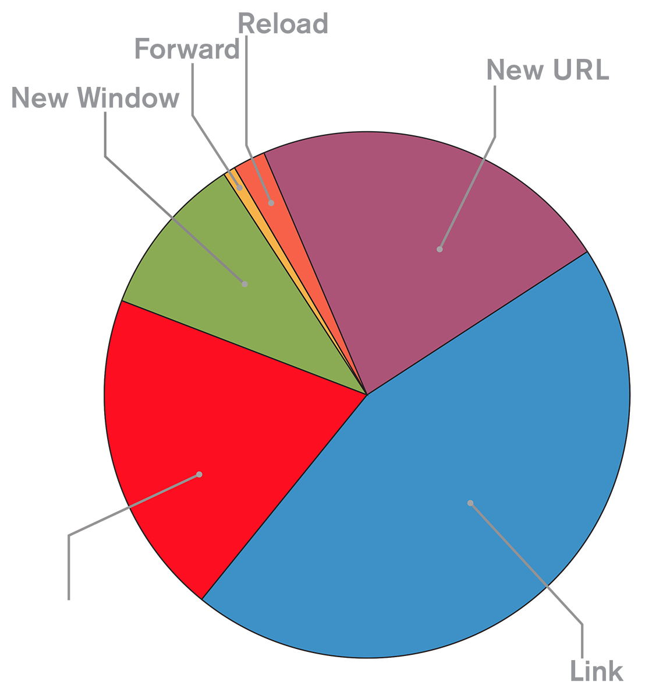
Notes:
And one of the key things to start considering is how much people love to click Back.
As we’ll talk about more soon, most interactions are in the body area, but about as common as starting a new task is going Back from where you are.
This data is from the browser, but similar behavior is observed in apps. Back is the one thing people live and die by.

Slide 4
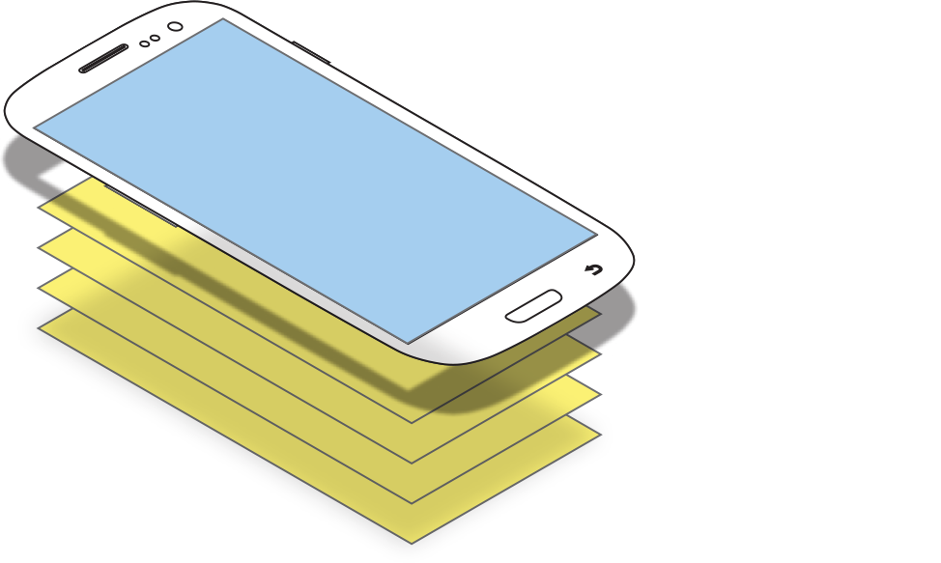
Notes:
And so you should start to conceive of your interaction using the Back Stack model. This is formally something you deal with in app design and development, but browsers act much the same way so it works well as a design concept for both of them.
A stack of views (or pages if that helps) exists. The user builds the stack by clicking links or opening new functions from the menu, etc. When you go Back, you destroy the current view, and display the previous view or the next one down in the stack.
This is usually called History on the Web, but I am going to keep calling it the Back Stack here, as the concept is slightly more interesting on apps, and history isn’t /quite/ the right metaphor there.

Slide 5
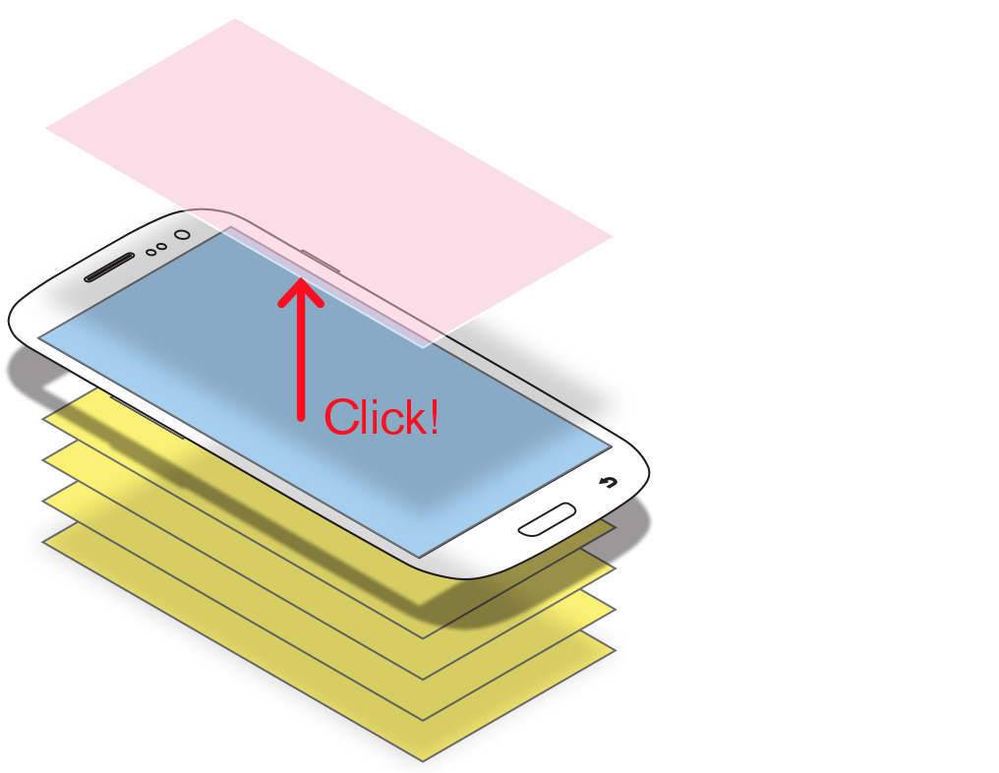
Notes:
When you click an item you open a new view and add to the stack.

Slide 6
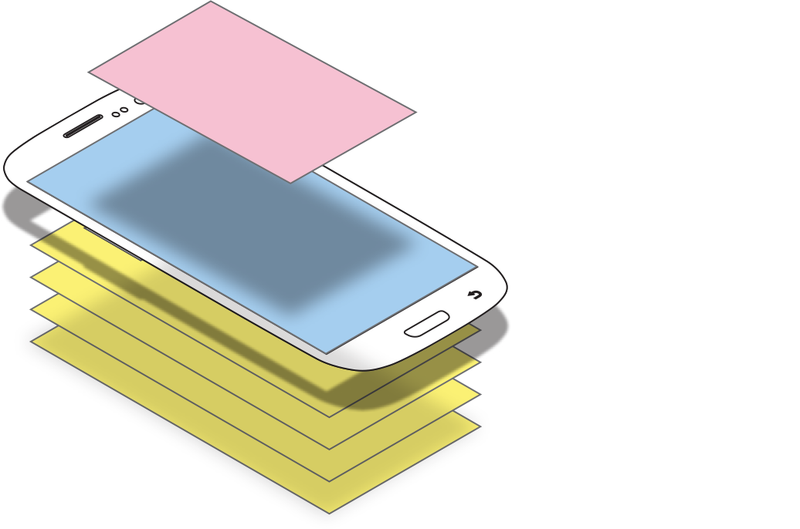
Notes:
This concept is one reason dialogs work so well. The temporary condition is explicitly “on top” of the page. Because new views appear on top, and the reduced size indicates that it’s just a temporary condition, but the previous view is waiting for you.
NOTE: Don’t call dialogs “modals” unless they are actually modal. There are modeless and semi-modal dialogs also. They all have their good sides, so be very explicit when saying what you want built, instead of assuming or implying everything is a modal dialog.

Slide 7
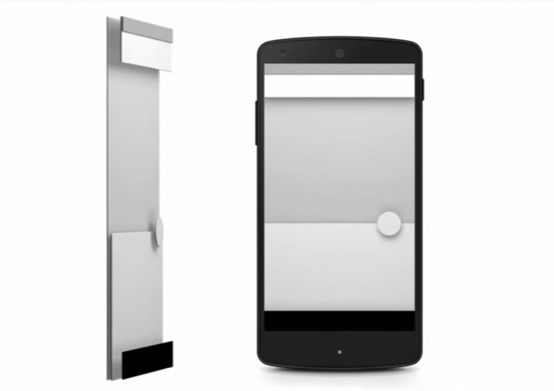
Notes:
Google is now explicitly talking about this as as a UI consideration in Material Design. Elements are loaded as layers, the user can perceive as they move through the system and interact with items on the page.
I have seen accusations that this is pretending to be paper so is skeuomorphism returned (which is apparently uniformly bad). But as I showed, things really are in layers, so expressing that is just Good Design practice, using the medium in which we work accurately.

Slide 8
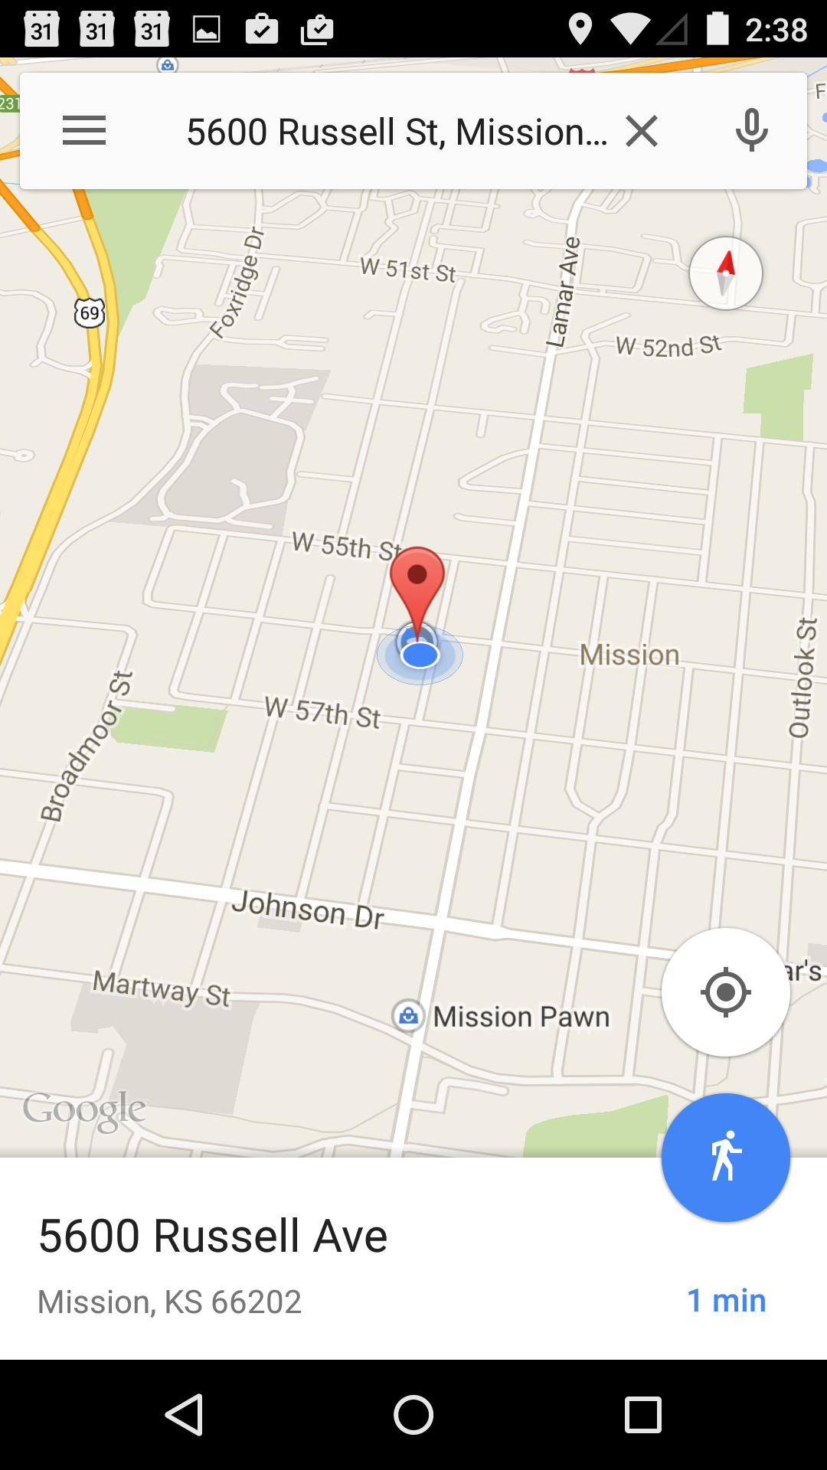
Notes:
There aren’t a lot of apps really taking advantage of this even from Google, but I love the Maps implementation, not just because it uses that action button circle thing as a separate layer, but because they default to the map being at a bit of an angle, like that’s a viewport onto the real world. Which, it sort of is.
Can your app act this layered at it’s core?

Slide 9
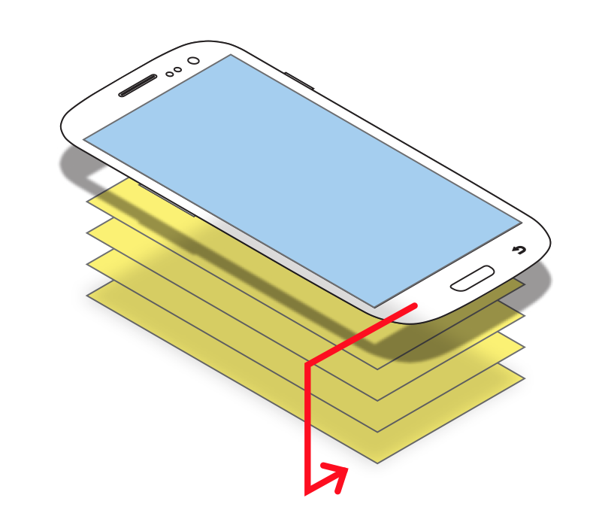
Notes:
For the web, be sure you support back very robustly. Don’t be someone who builds “please don’t press back” dialogs. Make your website support complete history use because the web doesn’t give you an option; the browser always makes it available.
Apps do have options. You can jump back several steps, destroy views in the stack at will and so on. You can imagine where this might be useful: You have a checkout process where each step is committed, and then results in the next step. But be VERY CAREFUL. The user expectation is still for the complete stack to be made available. If you skip past the process the user has lost their ENTIRE entry.
Cancel guards maybe? A dialog that says “are you sure you want to stop checking out?” Still so unexpected the result isn’t going to be clear. If at all possible instead design your app to support a complete and simple stack the user can understand.
And be sure to define it clearly for your developers, so they don’t dream up something else in the end.

Slide 10
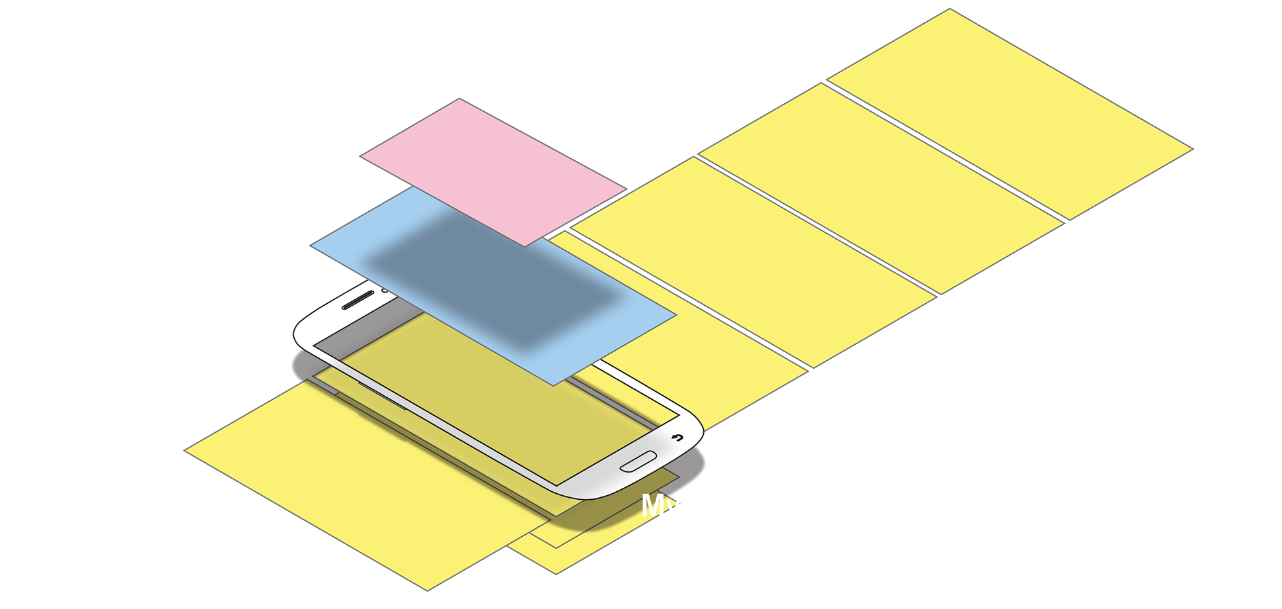
Notes:
Apps also have another interaction that can confound the back stack: The Tab View.
These are built into many OSs, but regardless of their ease of implementation make perfect sense. The handset is a small view into a huge realm of information, so sliding sideways to see more logically follows. And it does so in the same logical space the stack exists.

Slide 11
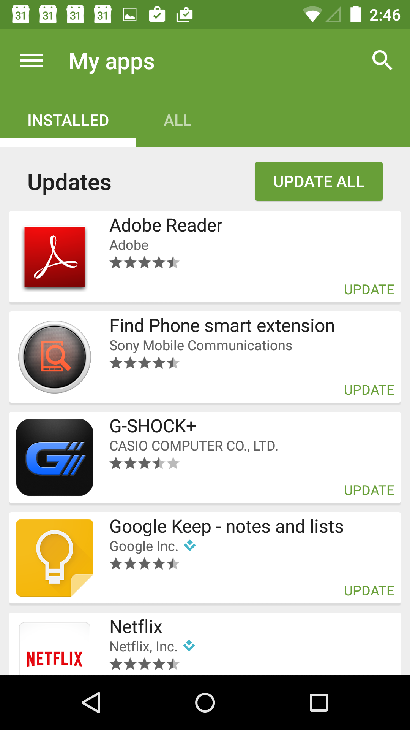
Notes:
A set of tab views are logically at the same level. Switching between them is not a “backable” function and either no Back button appears or pressing back takes you down one level in the stack, not to a previously-viewed tab. Switching back to a preview view requires explicit action, moving to the other tab view again.

Slide 12
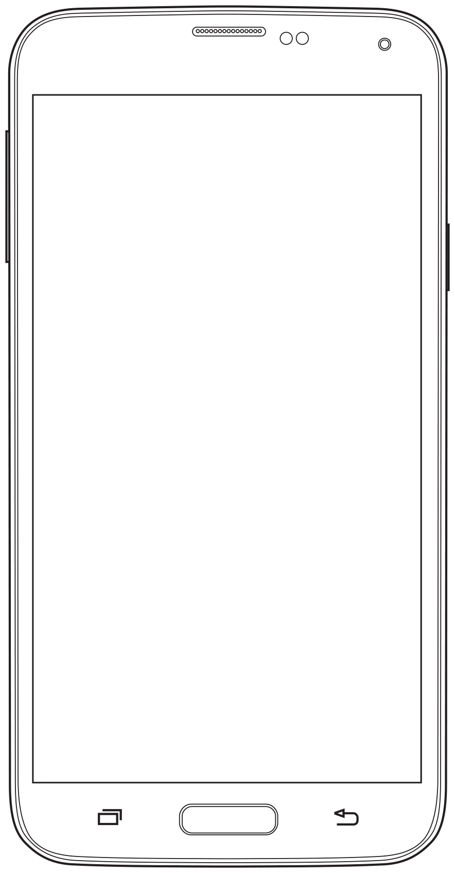
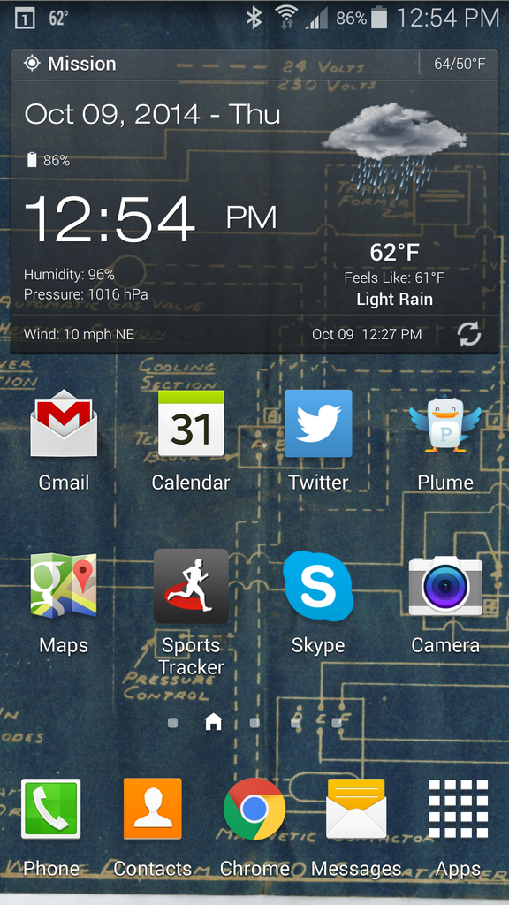
Notes:
When your tab view is the first thing your app shows, what does back do then? Well, that brings up another thing that confuses many designers, developers and especially product owners. When you are at the lowest level of the stack for your app or website, pressing Back again leaves the website or app. You get, if you want to think of it that way, into a higher level stack. You return to the home page of your phone, or the previously visited website (or the app that sent you to that site, or whatever the stack says).
That’s not a bug. It’s not even a bad thing. This is expected behavior, so let it happen. Rarely is it important to stay in the app or on your site. If, for example, you will loose the session and they have to log in and type everything again, do NOT add an exit guard dialog warning them of this. Fix the fundamental problem and keep it running in the background, save their session, and so on instead.

Slide 13
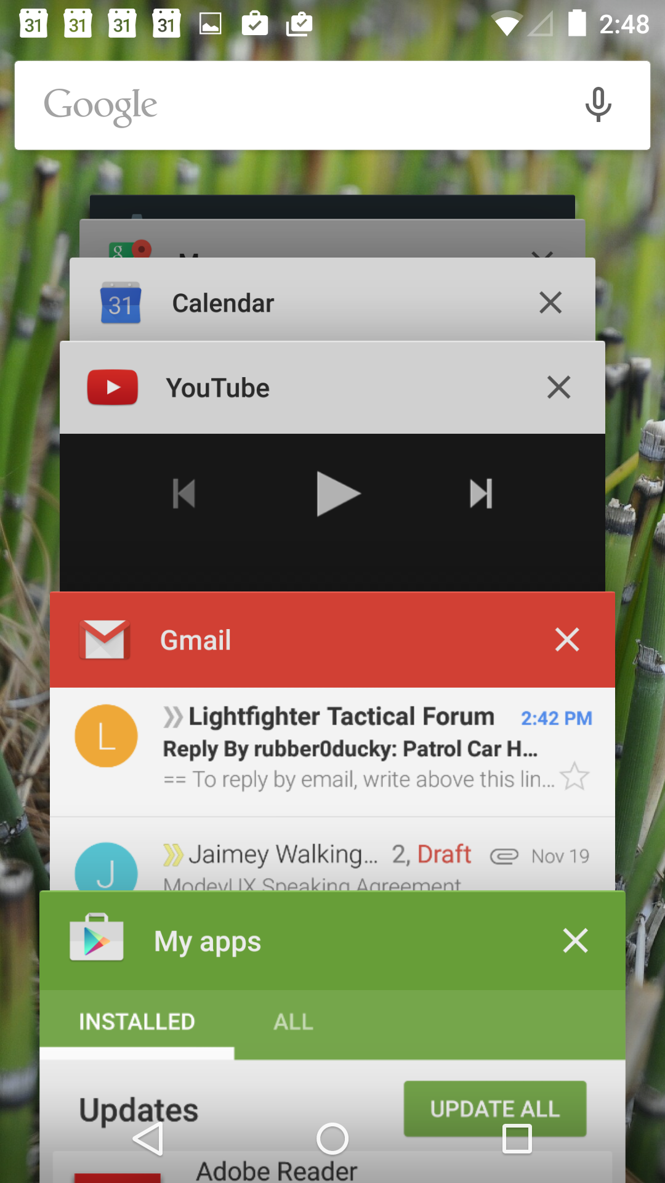
Notes:
And that’s because we have to support user behavior and needs, not make them bend to our will. People exiting generally want to exit. People switch also. A lot. They may even be deeply using your app but in a way you didn’t expect, so are copy from your app or site and pasting into another tool.
If your app refreshes, or starts over when they return to it, this is bad. If your app or site doesn’t support switching well, fix it. If you don’t, people will stop using it.

Slide 14
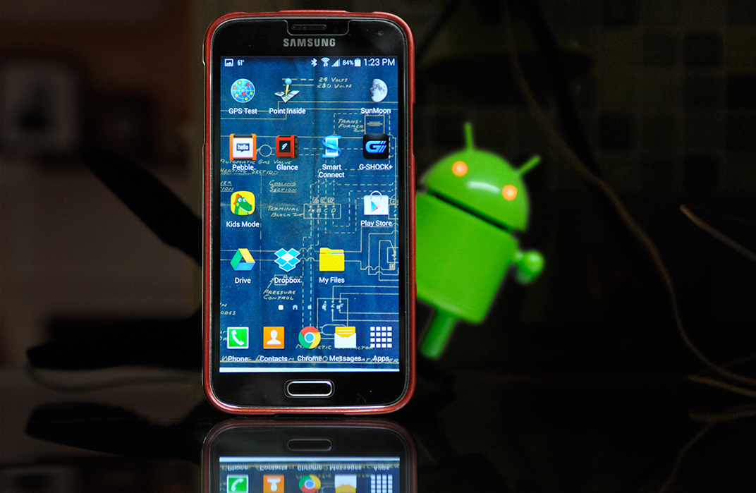
Notes:
Apps can also run in the background, and many should. At least, they must suspend, and not exit when backed out of.
This is because mobiles are about the user more than your app. They are about interruption and task switching. They are personal, and aware, so if every time you launch an app it asks who you are or waits a while to decide what the world is up to, people will be annoyed.
If your app does something more dynamic — if it’s about ongoing status, control of remote systems like a wearable, or has information regularly updated from the internet, it should actually run in the background. This also allows it to push notifications to you, which may themselves be the primary UI, or can remind the user to go look at the app.
Websites can also run in the background. What magic is this you might ask?!?! Well, none. It’s all about frames of reference. You have a webserver and that runs all the time. Your server can easily do stuff related to a user when the user doesn’t have an active session and isn’t clicking. Don’t think of logged off users as lost to you; remember you can send them messages via email and SMS at least, to give them information, update their status or entice them to visit again.

Slide 15
In Part 9:
Interface design by zones
Touch, inaccuracy and tolerances.
Center preference.
Touch accuracy by zone.
Lists and center components.
Title bars and action buttons.
Chyrons and tabs.
Error-avoidance and scrolling.
Notes:
Next we’ll get into interface design by discussing what sort of items you should place in each part of your page and in each layer.

