Slide 1
TIMING/VIDEO
Remove auto-advancing after creating a video version:
On/Off:
In the tabs (not menu): “Slide Show”
[X] Play Narrations
[X] Use Timings
[ ] Show Media Controls
Clear the timings completely:
Select all the slides
Right click a slide > “Slide Transition…”
In the “Advance slide” section uncheck “Automatically after”
The complete guide to Designing Mobile User Experiences 8) Back & the Stack Resources
@shoobe01
4ourth.com

Slide 2
Back & the Stack
Read More:
The details of this interaction vary by platform on apps especially. These resources are especially useful if your developers don't believe you, or want to do something else and ruin your design.
Be able to quote the right standards, the research, and be able to send them to examples they can use. It works.

Slide 3
Web Page Revisitation Revisited: Implications of a Long-term Click-stream Study of Browser Usage
http://www.l3s.de/~herder/research/papers/web_page_revisitation_revisited.pdf
Yes, this is older, and desktop, but I don’t have as big a study available on mobile behavior. The bits and pieces I get from other studies correlate well to this. Back is hugely important.
PDF. As it’s a real research paper and they haven’t figured out HTML yet.

Slide 4
Is a back button a good idea for mobile?
http://ux.stackexchange.com/questions/50688/is-a-back-button-a-good-idea-for-mobile
Series of answers that well cover the difference in platforms, and that browsers have their own back button, so adding one to a website is stupid. With illustrations no less.

Slide 5
When designing for Android, forget iOS
http://depts.washington.edu/ux/2013/04/when-designing-for-android-forget-ios/
Starts with the Back button differences (from 2013 sadly) but good overview in general of how the platforms are different, and you cannot just port over the design from one to another.
I have seen this in user testing. iOS back, and not supporting the OS back on Android is a 100% failure. No one can use iOS paradigms on Android apps. Design for your platform.

Slide 6
Tasks and Back Stack
http://developer.android.com/guide/components/tasks-and-back-stack.html
Terrific overview of how the Back Stack works in Android, with useful illustrations. If you don’t know this (really know it) then you should not be designing or developing Android apps.

Slide 7
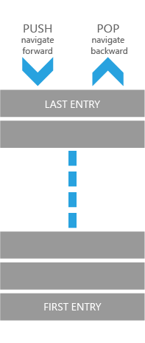
How to navigate using the back stack for Windows Phone 8
https://msdn.microsoft.com/en-us/library/windows/apps/hh394012(v=vs.105).aspx
Yeah, we don’t build for Windows anymore, because who cares about their 2% installed base (and dropping). Still a good overview of the concept, with good diagrams.
Apple doesn’t really have a good page for this, but it’s not totally unlike the Android and Windows concepts.

Slide 8
Android: Clearing The Android Activity Stack
http://plasticsturgeon.com/2011/10/android-clearing-the-android-activity-stack/
Simple little code for what it says. Old, but Android fundamentals like this haven’t changed.
If you must clear the stack, and the developers say it’s impossible: it is not. It is simple.

Slide 9
Pop-Up
http://4ourth.com/wiki/Pop-Up
My chapter on Pop-ups from the book. This is important for one thing: If you call dialogs “Modals” you are wrong. There are three types of modality. Find out what they are and use them properly.

Slide 10
Best Practices for Background Jobs
https://developer.android.com/training/best-background.html
Official android page on this. What runs in the background of your app? Nothing? Probably wrong and I’ll bet you can do some synch and so on. Everything? Also probably wrong.
Read this, think hard about it when designing your next app.

Slide 11
Background Modes in iOS Tutorial
http://www.raywenderlich.com/29948/backgrounding-for-ios
Again, Apple is a bit light on official documentation about this, but the article here covers the same stuff for iOS.
…here’s a quick overview of the five basic background modes available in iOS:
Play audio…
Receive location updates…
Perform finite-length tasks…
Process Newsstand Kit downloads…
Provide Voice-over-IP (VoIP) services…
I would not be surprised if this changed, but this article is still a good intro and overview.

Slide 12
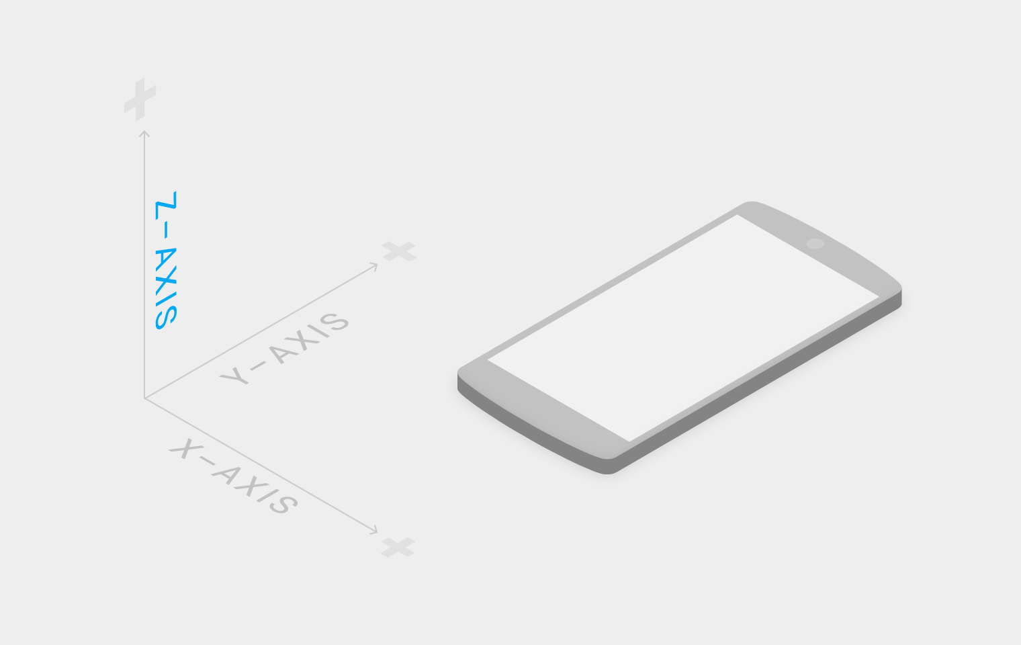
Material Design
http://www.google.com/design/spec/material-design/introduction.html
Material design is NOT NEW but just leans into the layered principles Android has always used. It’s very authentic digital design really.
This is not a page, but a microsite. Read the whole thing if you have not previously done so, or only did when it was first announced.

Slide 13
Visual Guide to Android L Material Design: 7 Insights Every Serious Designer Needs to Know
http://www.designcaffeine.com/articles/visual-guide-to-android-l-material-design-7-insights-every-serious-designer-needs-to-know/
Greg Nudelman’s overview of the key designer-centric bits of material design. Well done, and somewhat easier to read than the official Google one which breaks it down too far so is slow to consume.

