Slide 1
TIMING/VIDEO
Remove auto-advancing after creating a video version:
On/Off:
In the tabs (not menu): “Slide Show”
[X] Play Narrations
[X] Use Timings
[ ] Show Media Controls
Clear the timings completely:
Select all the slides
Right click a slide > “Slide Transition…”
In the “Advance slide” section uncheck “Automatically after”
NOTHING LONGER THAN 20 minutes!
The complete guide to Designing Mobile User Experiences 7) Outside & Between
@shoobe01
4ourth.com
Notes:
I want to keep talking about Information Architecture, in principle, but let’s explore a little of what you can do outside the app or website, and how to link it so you don’t rely on people tapping your icon or searching for you.

Slide 2
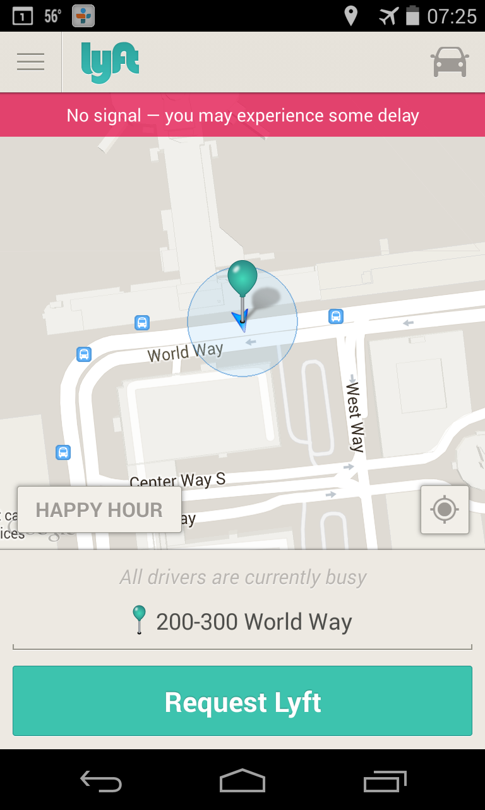
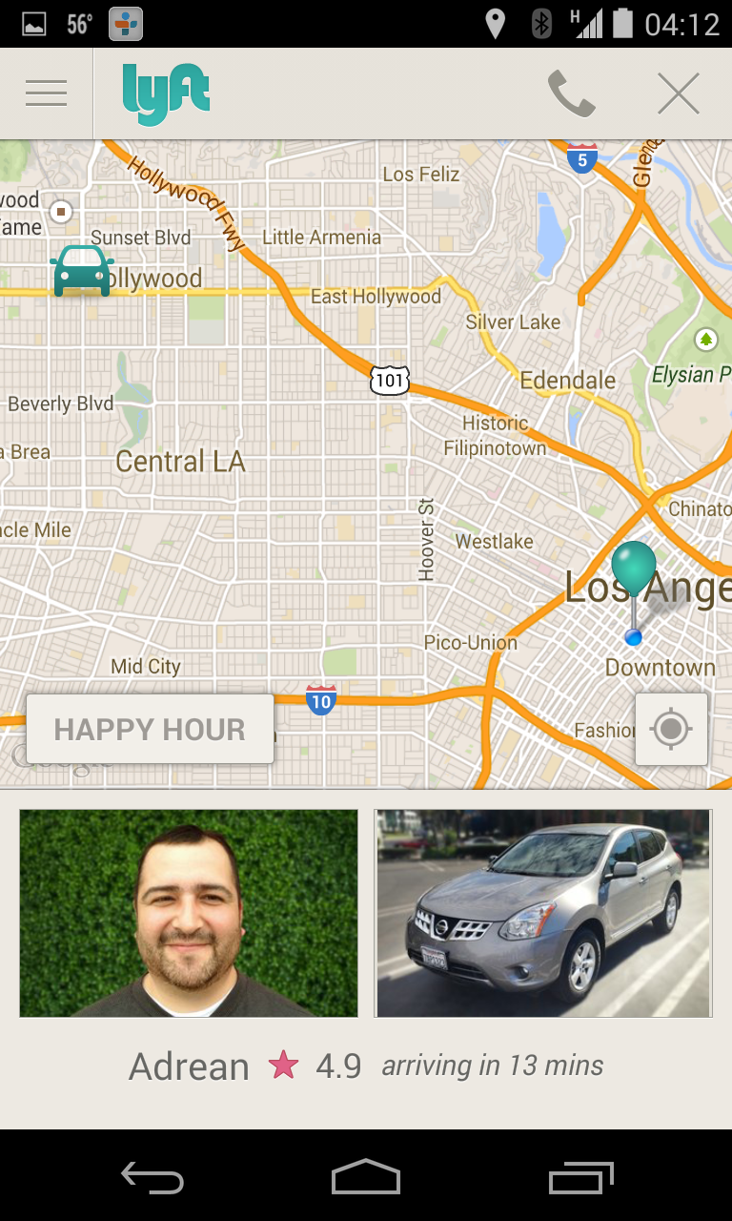
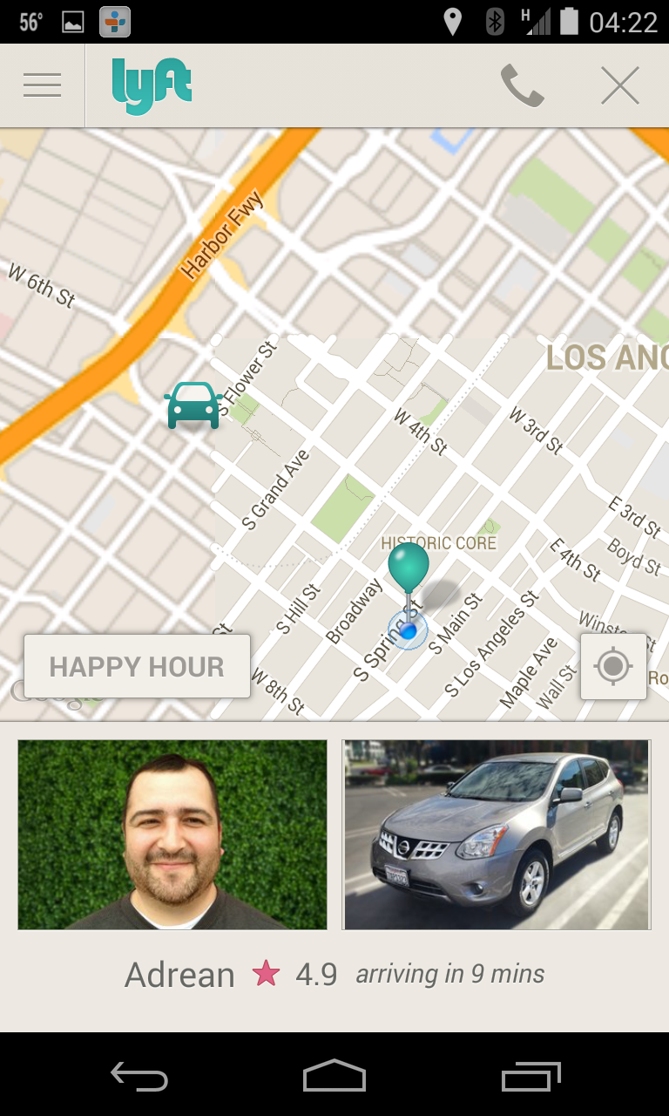
Notes:
And let’s start with an example.
Lyft is what I prefer to use over Uber because they are a little less evil.
It’s an app. It uses location so you can link the real world to you through your mobile. You get to call a car to where you are without typing or anything. A few button pushes, and you are watching a guy in a car drive to you…

Slide 3
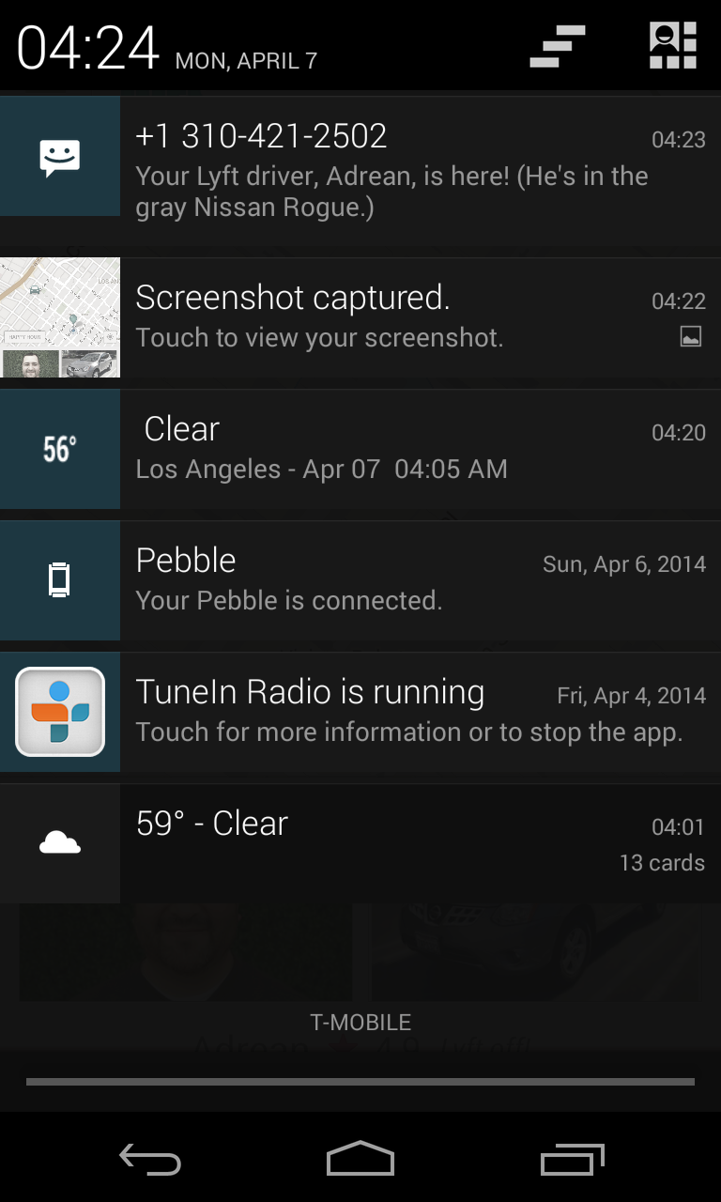
Notes:
…but also it sends SMS messages to remind you. Not application notifications, but text messages because that is absolutely reliable, with most delivered within seven seconds. And people read text messages on average within FIVE SECONDS.
Apps that are successful cannot be about themselves, but about the real, messy world you and your people live in. Lyft, and all the car services, as well as things like AirBnB, tie real world services to you through the mobile device, and use intrinsic features about it to do this. Location, and messaging.

Slide 4
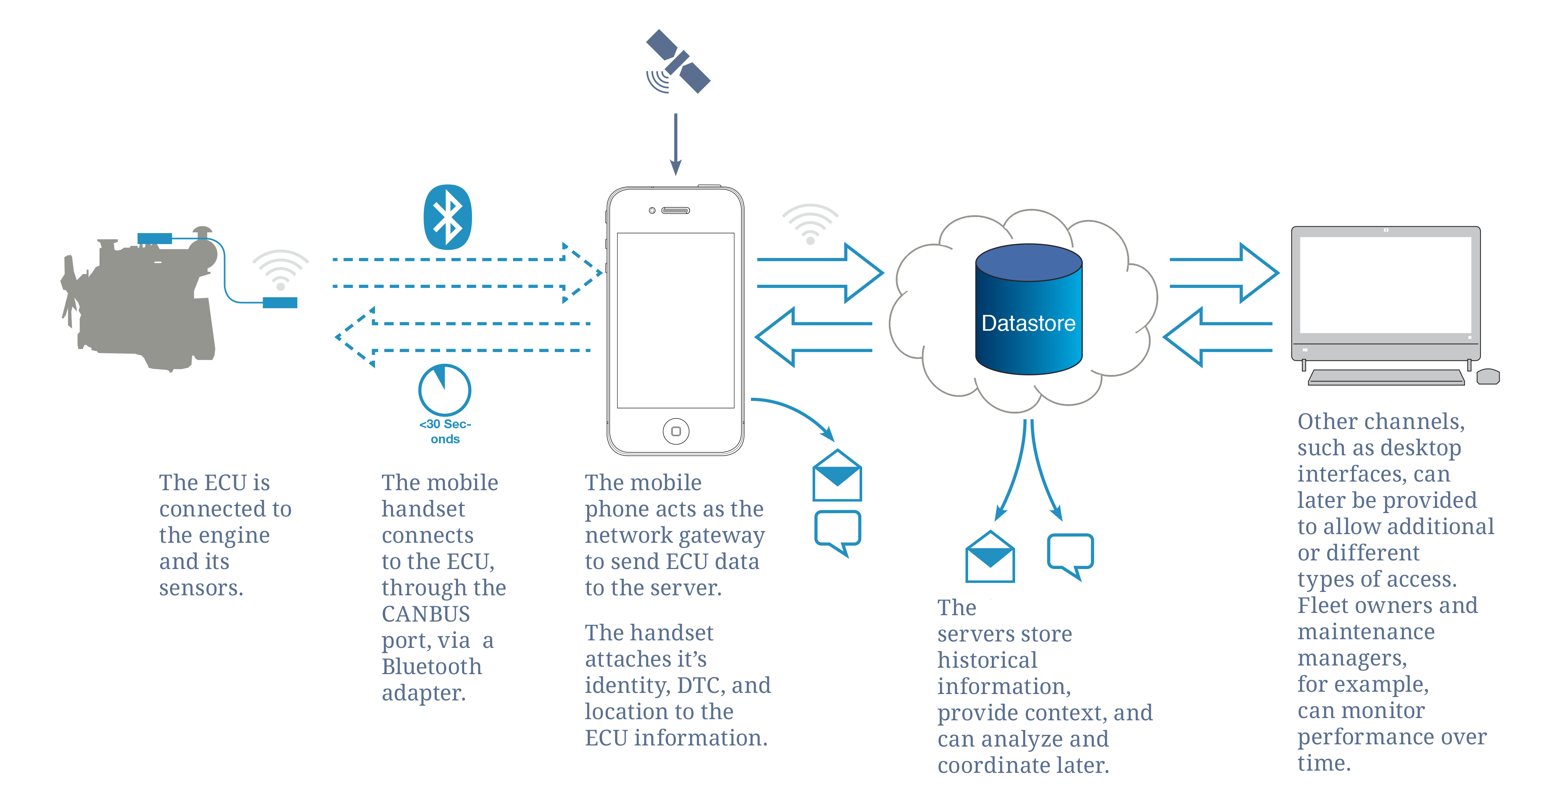
4
Notes:
When you get to drawing IA diagrams, don’t forget these outside services, or technologies. Many, many IoT devices I have used are just…well, unusable. I have a couple smartwatches that never leave the top of my dresser because they are so very poorly integrated with the app on the phone, and the app is so poorly integrated with other parts of my phone.
At the data model level I find lots of developers missing out on doing deliberate design, and assuming things that may not be the best choice.
This diagram describes an integrated system, with synching to remote servers, and using the capabilities each device type has properly, and as much as we can.

Slide 5
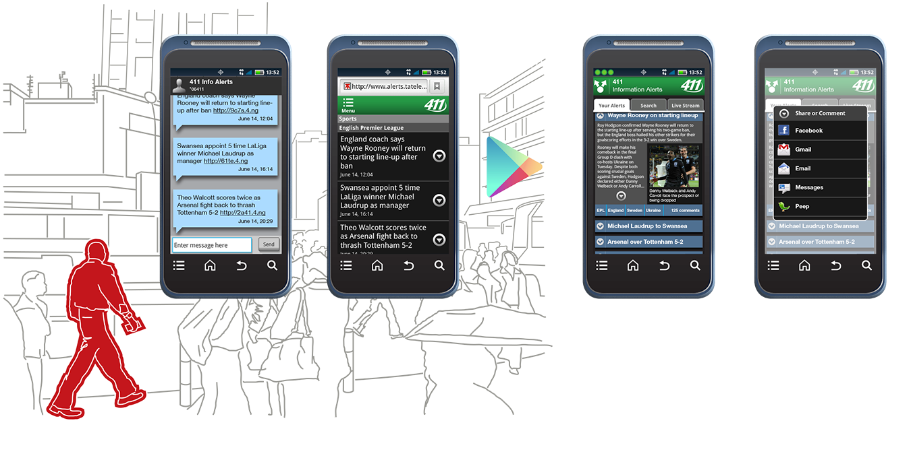
Notes:
Remember this when designing services. Remember user context.
And remember you are always designing services, not apps or websites.
When you get out in the world and design your next product, remember to think of this step in the process as an extension of the previous drawings you did.
Up here, the user is shown walking down the streets of Nairoi. And it’s not all the app. The first screen is SMS, then he goes to the Website, where he’s enticed to download the app. You can show flows and interactions and user context both to understand it yourself, and to communicate to clients, and developers early in the process.

Slide 6
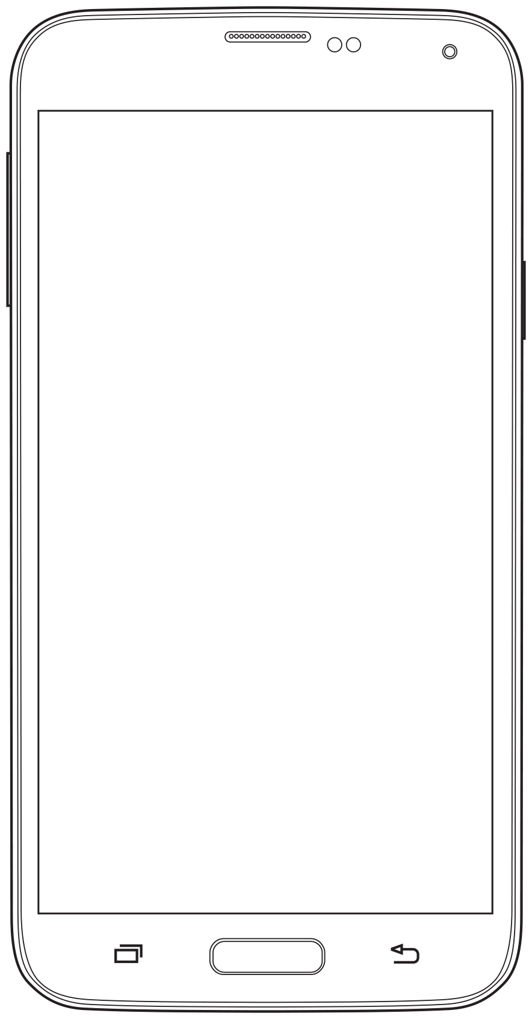
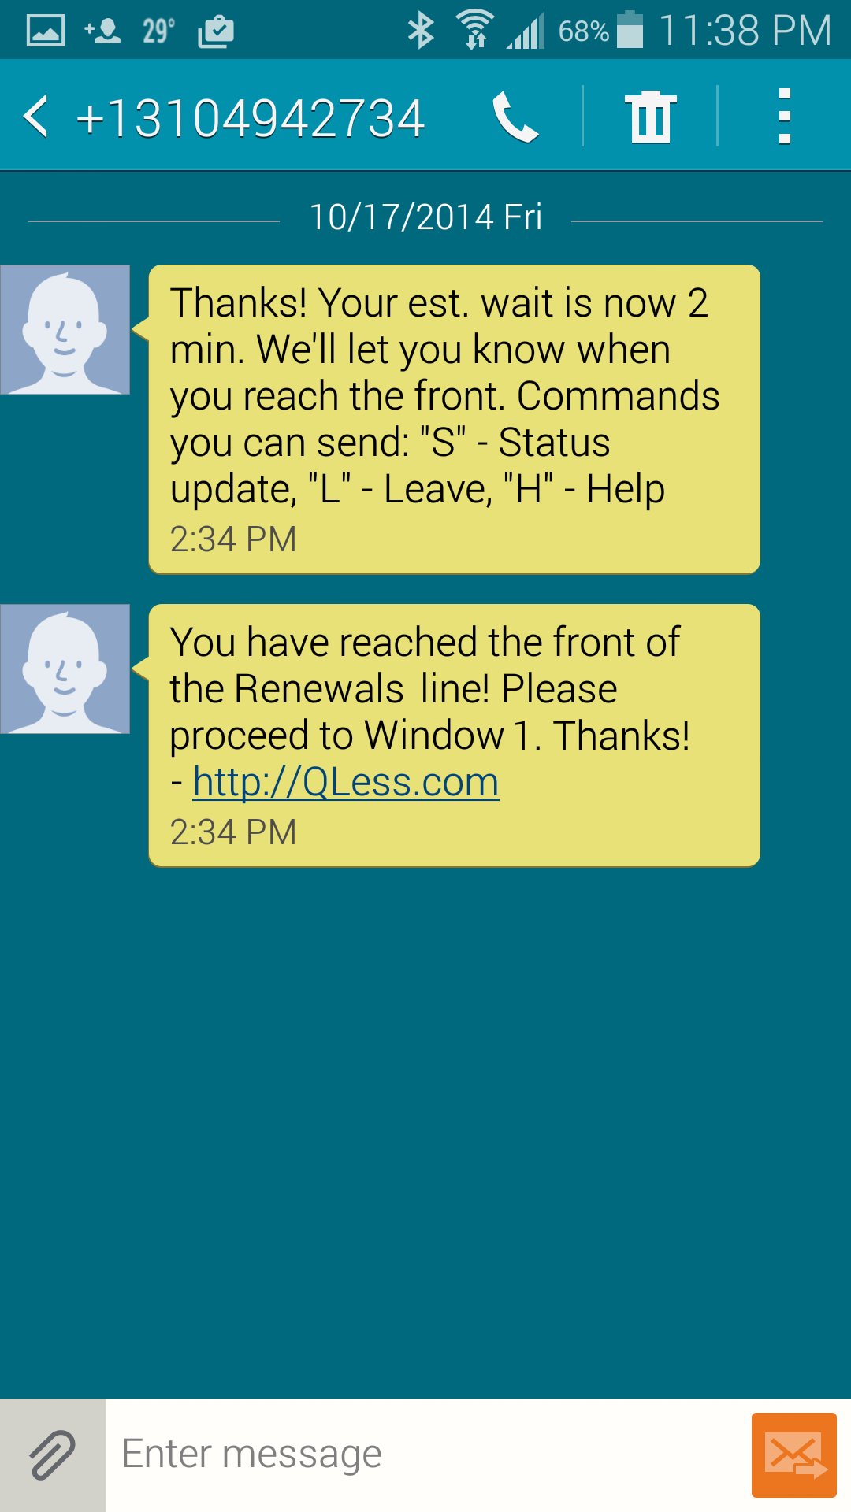
Notes:
Text messaging is one of my favorite things. It’s highly universal: almost every phone on the planet can send and receive them. It’s impossibly reliable: even in places where you cannot make a phone call, you can get SMS. I have used it as a backup method to assure that people took their pills. When the app went down, it didn’t send a message back to the server and we sent out a text message reminder.
And that’s what I love about SMS: it’s universal, server-side Push Messaging. If you absolutely need notifications, you don’t need an app but can just send text messages.
What do you send? Almost anything you want. You can stuff a link in there, and launch websites, applications, reset passwords and generally use it to link up your service to more robust presentation layers. You can even make it interactive, and let it send dynamic data to your users on request. This is something you can use to wait in line at the DMV without actually being there. I’ve designed systems for banks where you can see your account info, transfer money, and more. All through SMS.

Slide 7
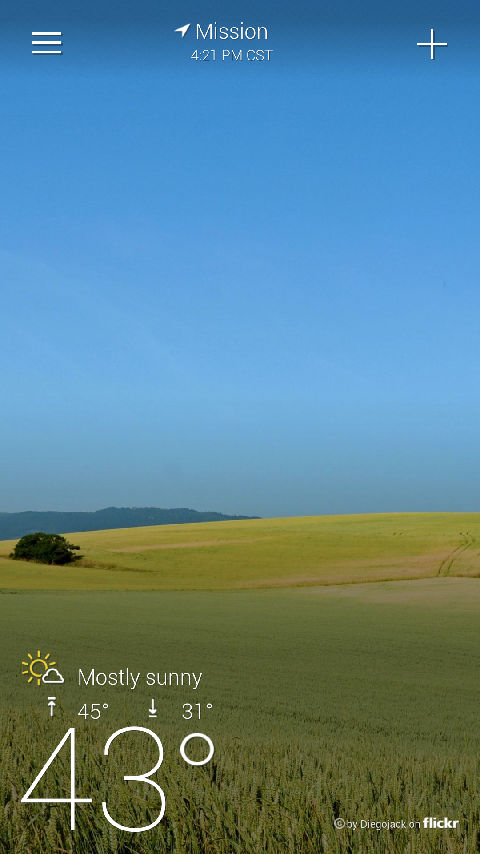
Notes:
But let’s get back to shiny, pretty stuff.
Take something dirt simple like the Yahoo! Weather app. They make this available as a free standing app so you don’t need to download some giant, bloated Yahoo! App To End All Apps, which no one would get of course. Instead you get just this one little bit. But a funny thing happens when you click the menu…

Slide 8
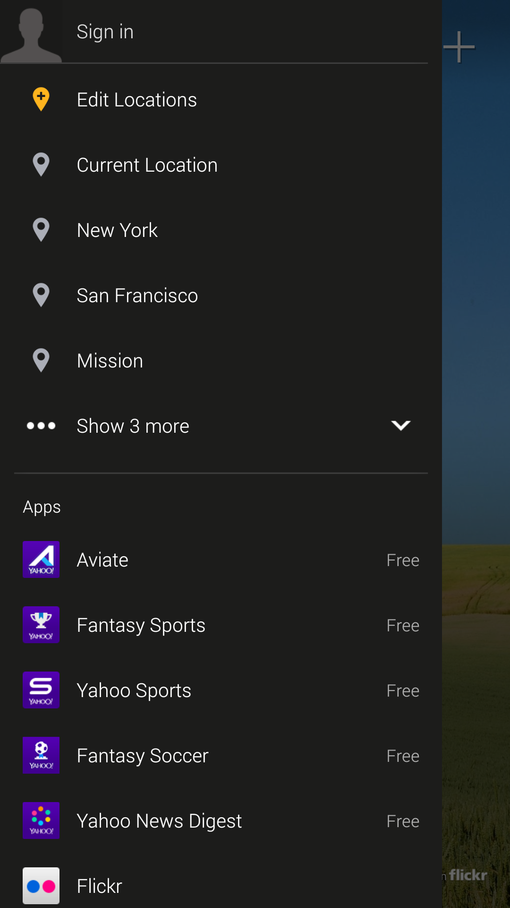
Notes:
You see, under some typical menu items for the app itself (like authentication which for some reason I haven’t done here) there’s a list of ALL of the others Yahoo! Apps.
They don’t all have this, but it’s their goal. I talked to a senior Yahoo! guy and asked about it so I have the inside story here, and it’s very on purpose.
So anyway, you click something like Flickr, which I use all the time so great, because what happens? … You go to the Play store? The Website?

Slide 9
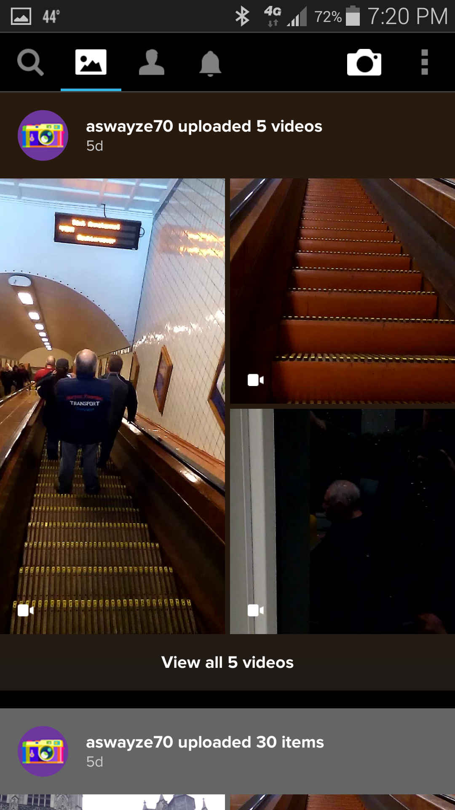
Notes:
No, they use Custom URIs and since I have Flickr installed, I can go straight into the other app.
So, there IS a giant One Yahoo! To Rule Them All app. It’s just delivered in bits.

Slide 10
<intent-filter>
<action android:name="android.intent.action.MAIN" />
<category android:name="android.intent.category.DEFAULT"/>
<category android:name=”an.yahoo.com/flickr"/>
</intent-filter>
Notes:
They do this with a little snippet of code called a Custom URI.
Remember how I said one of the key advantages of the web over apps is that it’s on the internet? You can link to it directly? Well, you can sorta link to apps also.
This is a great reason you need to have a website supporting your app, or better yet doing most of its functionality. When the app isn’t installed, the URL string goes to your browser, then to a website. No problem.
But when the app is installed, it tells the OS to watch out for web addresses for you, then it sends it straight over when found.
This is neat as hell to me and a way to make your service look like magic, cheaply and simply.

Slide 11
Notes:
Okay, when I started talking about SMS, I even mentioned it’s a poor-man’s app Notifications so you’ve been waiting for me to talk about them. First, I have to say the name Push isn’t very helpful, so stop calling them Push Notifications. SMS is also a push service, and you can set up webservices without polling anymore also.
But let’s say “App Notifications” are very interesting tools. They make noise! They can make the LED blink, and you can pick the color and sound. They appear as individual icons, for your app, on the annunciator row. They can even do stuff like show status, that I have a Pebble connected, GPS tracking on, and the outside temperature.

Slide 12
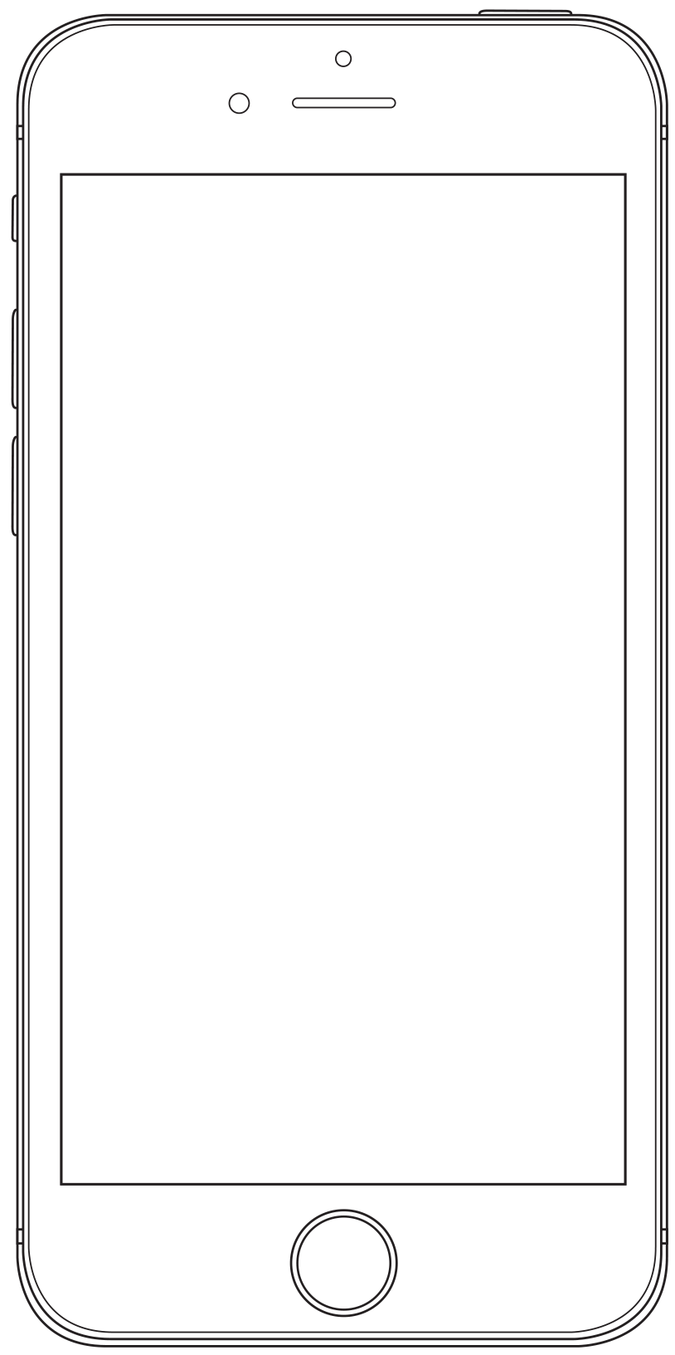
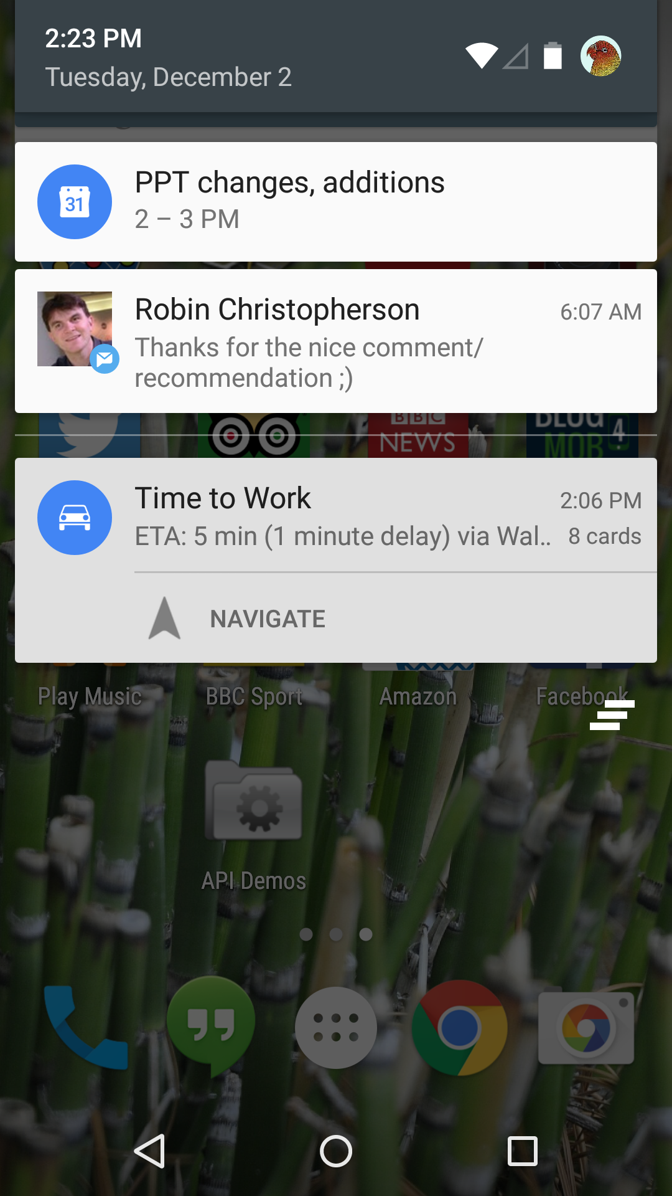
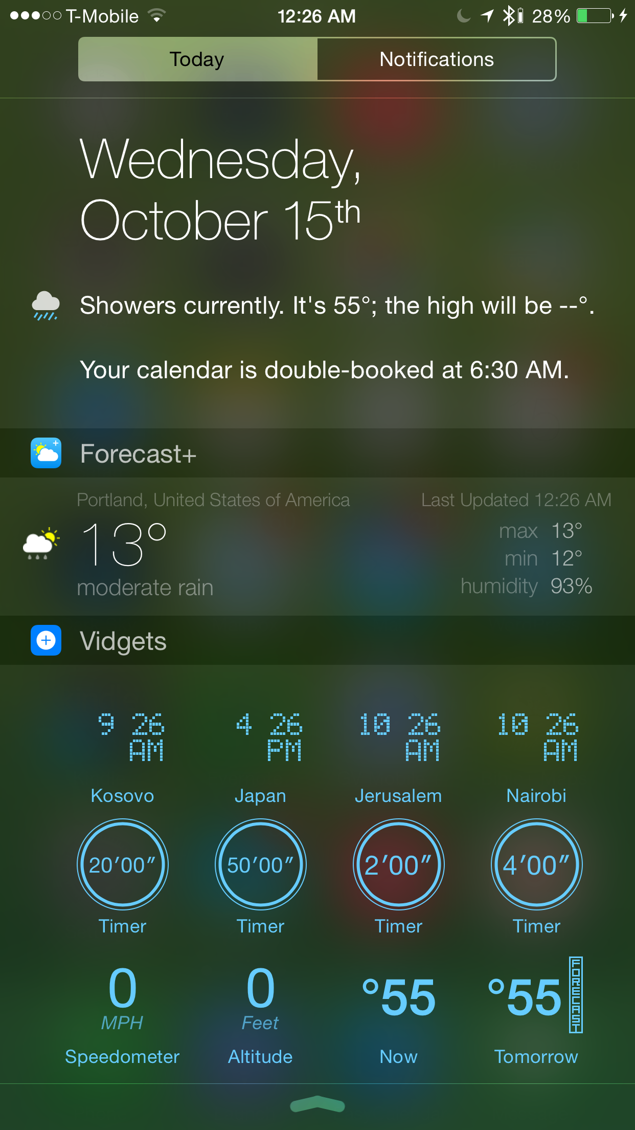
Notes:
And more details are just a tap away. But, what details?
Well, your app icon appears here, so this is a good example of why you need to make sure you have a good icon. It’s the only way for users to tell what fired the notification.
Make sure the message is clear, and to the point. Give them the info they need, nothing more.
And I love the principle of putting extra functions into your notification. Tapping the whole thing opens the app, but additional buttons allow you to do specific actions. Here, jump from map view to navigate.

Slide 13
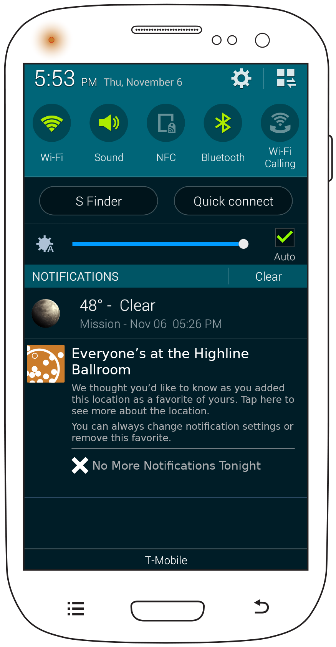
Notes:
Worried about bugging people too much with notifications? Go ahead and be worried, but don’t not do them!
Aside from lots of other tactics, often specific to your content and user needs, I like to put a button that lets the user cancel further notifications (or here, temporarily cancel them) with just one click. It’s one thing to have a setting for something, it’s another to offer true user control.

Slide 14
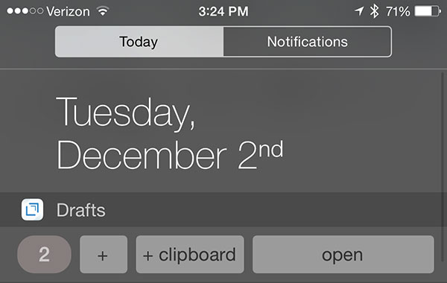
Notes:
Of course, Android let’s you do that pretty freely while Apple cannot decide if they want you to or not.
Pcalc was featured as an awesome app by Apple, then banned, then unbanned.
Drafts, the one at the bottom here, is still (as of December 2014) banned for the same reason. Because it puts buttons in the Notification Center. I assume this will come back as Apple figures out the value of it, but be careful what you do with notifications in some OSs for a bit.

Slide 15
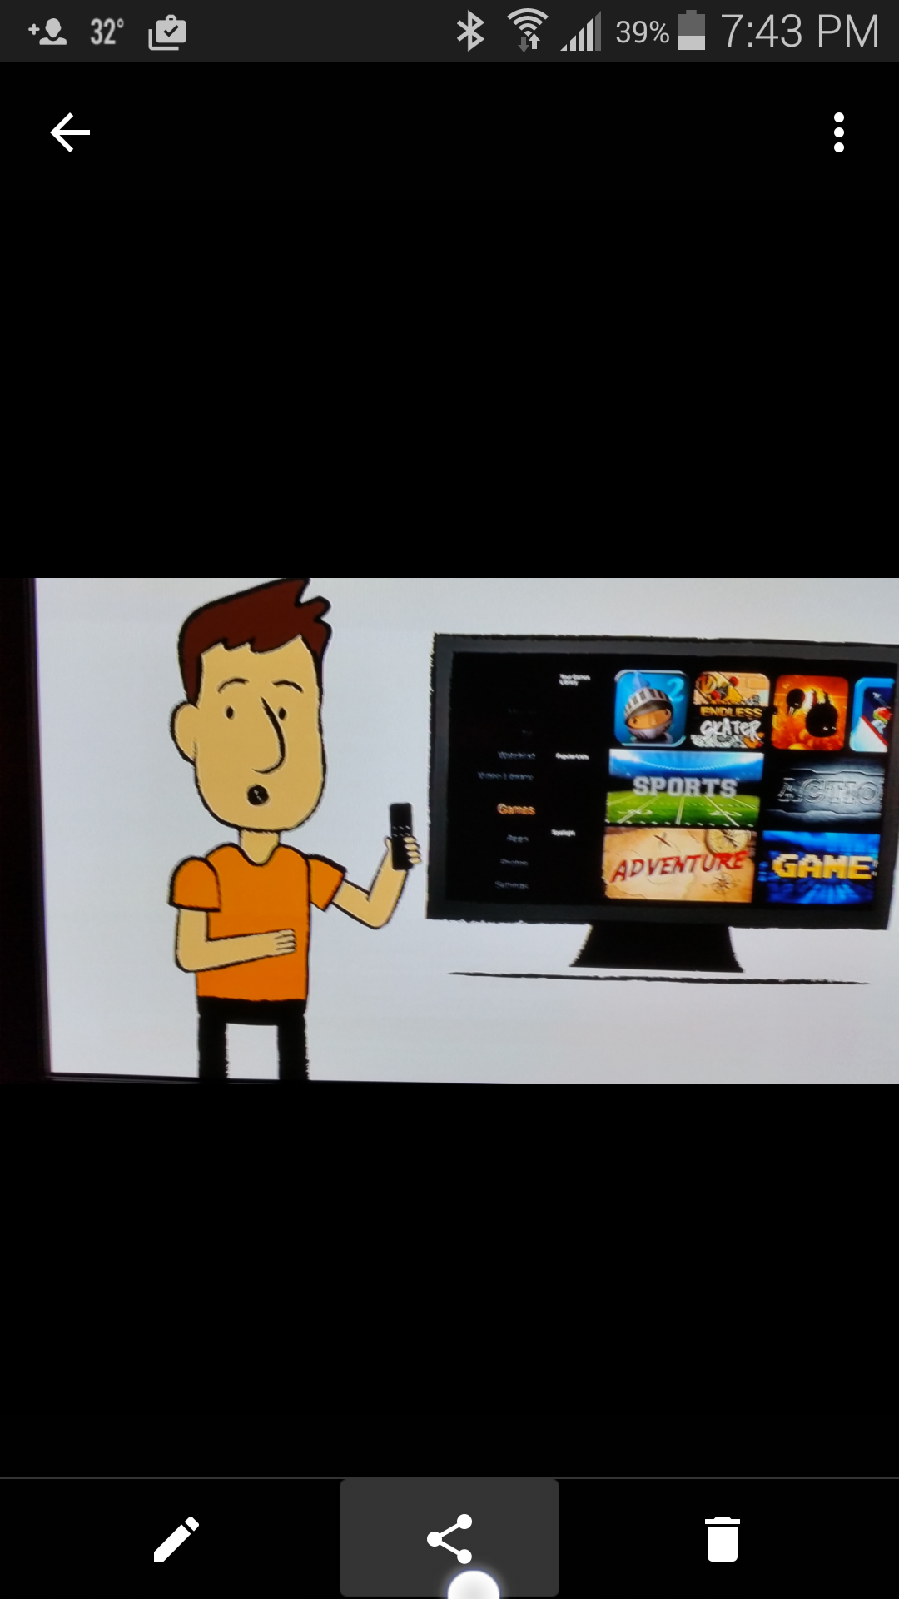
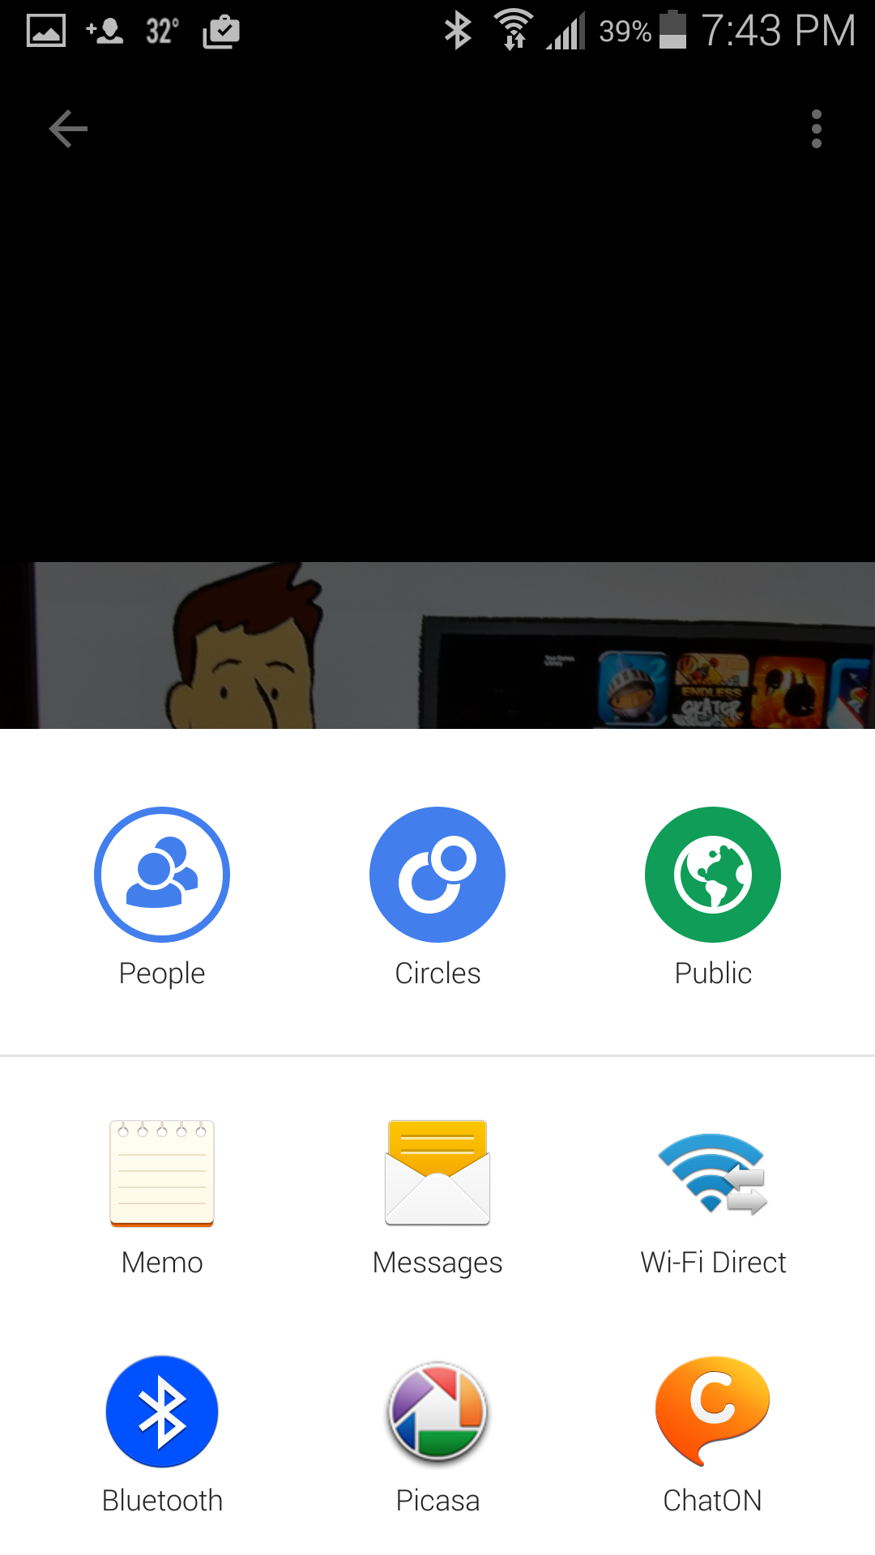
Notes:
There’s nothing quite like a push notification on the desktop. That’s one of those things that makes mobile better than “traditional computers” to me, and not limited, but natural and powerful.
We all know about the sensors devices have, and they get some press along the same lines: this is stuff your computer doesn’t do.
So, on your computer when you want to share an image, you go to the tool you want to share with. Launch Twitter or go mail.google.com and then attach the file. But on mobiles, you just press the little share icon.
CLICK
And it loads an Intent. Your app (or with limits your website) can just say “I would like to share this” and the OS offers up apps that can handle it. This may sounds suspiciously similar to the way the OS monitors for Custom URIs, and that’s because it is.

Slide 16
Notes:
This works for lots of tools. Assume you are building a tool that, like Twitter, allows you to attach images. You can integrate camera controls… but why bother?
Just add an image intent.

Slide 17
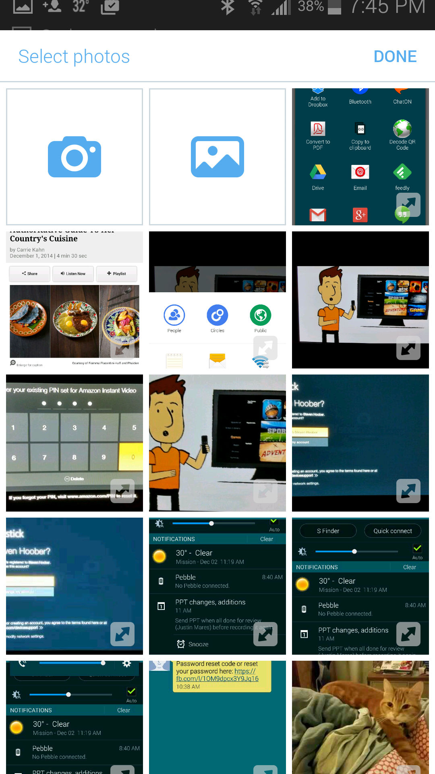
Notes:
And it pops up a function to select photos, or take a new one.

Slide 18
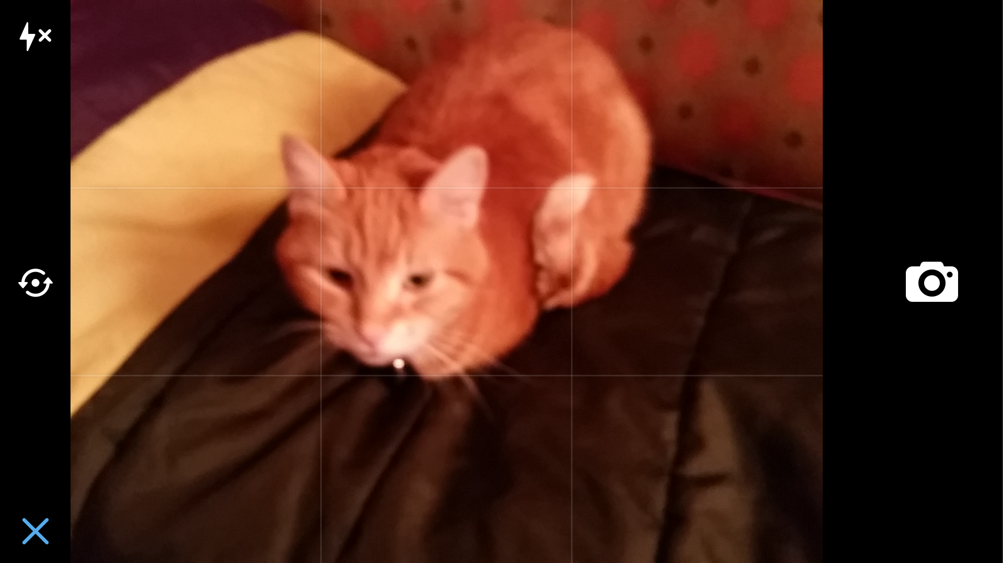
Notes:
There’s no learning curve, and massively less for you to actually build and test.
These tools are well designed to support these alternate use cases. Notice the X in the corner here to abandon the task?

Slide 19
Notes:
Or the checkmark? You can retake, abandon or approve this for inclusion. Not part of Twitter, but of the camera app itself.
When done with an intent like this, it generally takes the user back to the parent app, so no worries about leaving either.
Lots of tools do this. I like to often talk about email forms. Great on your website, but for mobile web and apps, that’s just wrong. You link to installed applications because that’s the expectation and method of operation of mobiles. For email, when the user clicks to send feedback, they get their native email client (or a choice of them first), pre-populated with whatever information you want to load. But they can use their device the same way they do any other time.

Slide 20
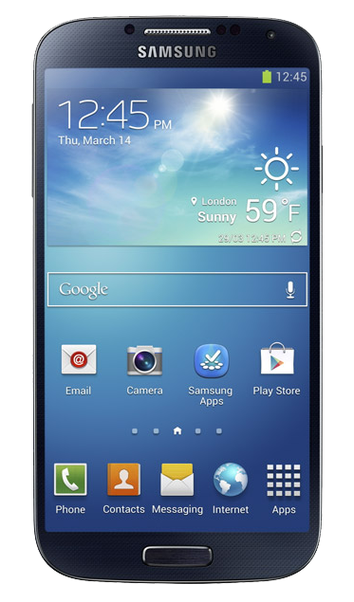
Gesture
Proximity
Light level
Light color
Capacitive Touch Screen
Cover sensor
Gryosensor
Accelerometer
Notes:
Don’t forget that our phones are full of sensors, functions, tools and applications. Use them.

Slide 21
Close Gaps in Interaction
Design for ecosystems, not websites or apps.
Devices are always aware, always on, always present.
Message and notify.
Link and cross-link apps.
Use intents and leverage device capabilities and features.
Websites can play, too.
Notes:
I’ve said it before, and I am going to say it again, and again: UX is not UI.
Think about how you can link up your entire experience, how you can use other channels to help the user, and how you can leverage existing device features and capabilities to make you app or website behave seamlessly.

Slide 22
In Part 8:
Back & the stack
Back usage
Back history and stack functions
Dialogs
Tabs
Background and suspended states
Notes:
Next we’ll start to talk about the relationship between IA and navigation, and how the structural decisions you make impact the design of your mobile application or website.

