Slide 1
TIMING/VIDEO
Remove auto-advancing after creating a video version:
On/Off:
In the tabs (not menu): “Slide Show”
[X] Play Narrations
[X] Use Timings
[ ] Show Media Controls
Clear the timings completely:
Select all the slides
Right click a slide > “Slide Transition…”
In the “Advance slide” section uncheck “Automatically after”
The complete guide to Designing Mobile User Experiences 7) Outside & Between Resources
@shoobe01
4ourth.com

Slide 2
Outside & Between
Read More:
You need to dig into this, to understand the capabilities of the devices and how notifications work, especially. There are tricks and pitfalls and gaps that don't allow you to work off a surface understanding or cheat sheet. Read up on those you plan on using, and understand how some work on the Web, but not as well as with apps.

Slide 3
Leverage Existing Device Capabilities
http://4ourth.com/wiki/Leverage%20Existing%20Device%20Capabilities
Let’s start with some examples of how complex this can be. This is a page of some ways to use device features (custom URI, links to email, maps…) and some testing of how what works on one does not on others.
I’d love to have a better overview of this, but apparently will have to write it. No one really talks about this without getting into technical details way too fast.

Slide 4
SMS MARKETING STATISTICS
http://blog.oxygen8.com/resources/sms-marketing-statistics/
Consolidated from many sources and I guess updated regularly, some neat stats (though sadly in animated graphics so you’ll have to screenshot them) of how people react to SMS from a sales and marketing POV.

Slide 5
A breakdown of the demographics for each of the different social networks
http://www.businessinsider.com/update-a-breakdown-of-the-demographics-for-each-of-the-different-social-networks-2015-6
Or maybe you want to promote, share, or link back and forth between your social media presence. Pick the right one for your audience, not what you use. Some good data here, though outside the US it gets even more complex.

Slide 6
Best Practices
http://www.mmaglobal.com/documents/best-practices
The Mobile Marketing Association is exactly what it sounds like, and has a surprising amount of influence. They standardize things like what sizes banners are, and no one really deviates from these.
This is not an article but a page of links to their own best practices in various categories.

Slide 7
Dueling Banjos: Inter-app Communication
http://www.slideshare.net/mobilemarch/dueling-banjos-interapp-communication
About the detailed vagaries of intents. Really, you are launching another app, and sending data between them.
Gets very technical, very fast. But if you want an intro to actually implementing this stuff, I’d start here.

Slide 8
We Suck at HTTP
http://gadgetopia.com/post/9236
Mostly griping and lamentation the way I like to do it, vs. actual solutions, but really good stuff. Interesting to compare to the Web-will-solve-it-all screeds previously posted.
And it’s not just URLs. HTTP status codes exist for a reason too. Did you know that there are a lot of them? N act, there’s one for about everything that could happen for a web request. Did you know there’s a difference between 404 and 410? 404 (traditionally “Not Found”) means it was never here. 410 (traditionally “Gone”) means it was once here but is now gone. Big difference.
Anything broken on the internet, we all broke. Work harder!

Slide 9
Web-to-app interoperability: Launch your Android app from the web
http://www.techrepublic.com/blog/software-engineer/web-to-app-interoperability-launch-your-android-app-from-the-web/
Custom URIs, explained well and plenty of words before it gets to code. Even if you do not do software development, skim this and see what sort of capabilities are offered.

Slide 10
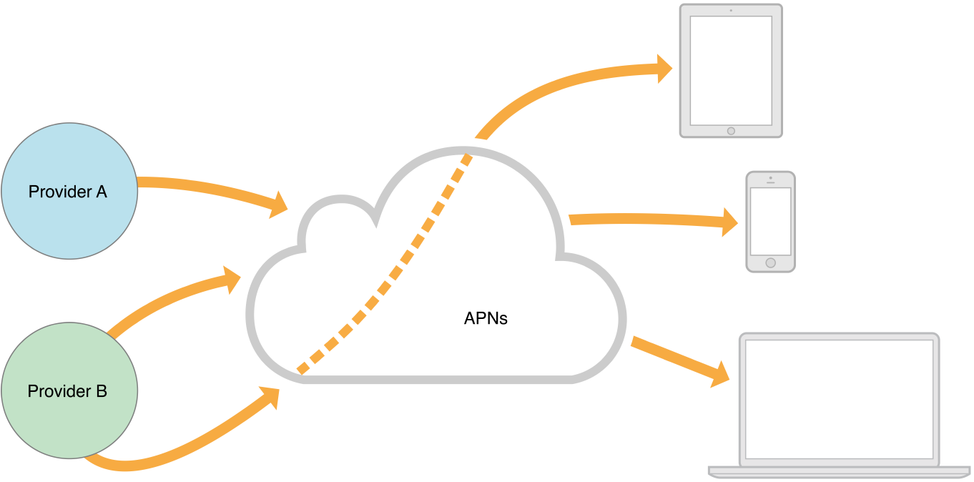
Apple Push Notification Service
https://developer.apple.com/library/ios/documentation/NetworkingInternet/Conceptual/RemoteNotificationsPG/Chapters/ApplePushService.html
Apple’s official page on push notifications. They have always been surprisingly good at providing basic explanations of their stuff, before they make you drill into the code.

Slide 11
Apple tells developer to kill iOS app widget after the company promoted it
http://mashable.com/2014/10/29/pcalc-widget-ban/
On the other hand, and as we all know I think, it’s Apple’s way or the highway. Here, they banished the pCalc app I mentioned in the deck after they promoted it themselves. They did the same to others, like the Drafts widget so it’s not unique.
So, understand what is possible is not the same as what is allowed when it comes to controlled ecosystems, whether app, or SMS. Yeah, carriers can kick your SMS out of the system too.

Slide 12
Don’t Be Pushy: 10 Useful Tips for Awesome Push Notifications
http://blog.parse.com/2012/11/26/dont-be-pushy-10-useful-tips-for-awesome-push-notifications/
Not just tips, but specific ones, with features you might have known existed.
don’t risk waking up over 1/3rd of your customer base. If you set your push notification to send at 9 AM in the mobile device’s time zone using local push, you don’t run the risk of annoying your customers with an early morning push notification in Beijing
Annoyed people are not your customers for long.

Slide 13
Android Intents with Chrome
https://developer.chrome.com/multidevice/android/intents
Google has been getting better at developer and designer documentation also. This one is a weirdly clear explanation of intents. Code is specific to Chrome and Android, but the concepts are universal.
Sadly, no pretty pictures for this one.

