Slide 1
TIMING/VIDEO
Remove auto-advancing after creating a video version:
On/Off:
In the tabs (not menu): “Slide Show”
[X] Play Narrations
[X] Use Timings
[ ] Show Media Controls
Clear the timings completely:
Select all the slides
Right click a slide > “Slide Transition…”
In the “Advance slide” section uncheck “Automatically after”
NOTHING LONGER THAN 20 minutes!
The complete guide to Designing Mobile User Experiences 5) Adaptive or Responsive?
@shoobe01
4ourth.com
Notes:
Last time we talked about the choices you have to make when you’ve settled on making an app. This time, we’re going to talk about the parallel path: What your options are when you’ve settled on making a website.

Slide 2
Responsive vs. Adaptive
Not actually at odds with each other.
Adaptive | The principle of making presentation suitable for the platform and user’s context.
Responsive | A subset of adaptation concerned with making content fit the screen size.
RESS | Basically adaptive from the POV of responsive.
Adaptive
Responsive
Notes:
The big choice to me is between Adaptive and Responsive design. There are some false choices, but I’ll talk about those later.
Responsive is the word you probably hear the most. It’s buzzy, but not necessarily the best choice. Responsive Web Design is a subset of Adaptive Design, which is a larger set of principles and practices to make the presentation of your digital content — any digital content, or maybe any content at all, not just the web — work well for the user’s device, medium, context and needs.

Slide 3
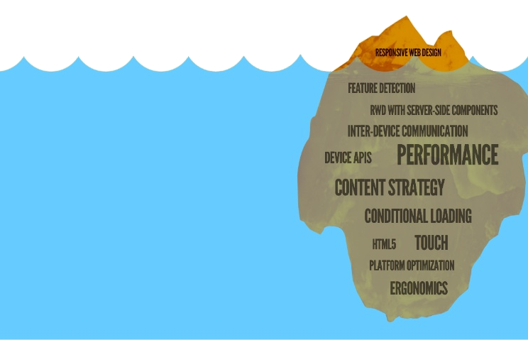
Adaptive is Everything
There are many features to address:
Not limited to the presentation layer.
Part of your strategy, business practice.
Best way to improve performance.
Reduce costs to you, in bandwidth and storage.
Notes:
I like to be super-duper clear on terminology. Responsive is JUST scaling or moving things around the layout based on the pixel size of the display screen.
From a UX point of view alone that should be suspect: there’s a lot more to things than the UI. And indeed, there’s a lot more we can modify based on device capabilities and the user’s known or implied context based on their device, and other information we know about them. Adaptive covers the rest of it.
You can adapt EVERYTHING. Content strategy is a good one, and where everyone from TV Guide to NPR has made their living. You don’t just post an article in different sizes, but post different content based on the device. If your site lives by clicks and readers (and you do) then the improved rates from making right-sized titles alone is worth the extra effort.
I hope things like changing the interface and interaction based on touch is obvious. Not because it’s a smartphone or not, but with feature detection you can determine the individual device has touch. The touchscreen laptops are here, and more are there all the time, so assuming Windows = Mouse is no longer possible. I have one of these windows tablets, and that’s a serious problem to using it as a tablet.

Slide 4
Responsive Isn’t New
That’s okay, but we can learn a lot from past practices:
Flexible, fluid. Percentage tables. RWD is basically these with new html technologies to make them more effective.
CSS Zengarden, 2003.
Mobile-specific device detection is older than much Web work in this area. WURFL launched in 2002 to address what was already a problem with device scale and features.
Notes:
First, it’s good to know where things come from. Responsive design is just a term invented semi-recently by Ethan Marcotte, to encompass some current trends. It reminded me right away of Fluid design from a few years back.
But then I cast my mind back, and remember thinking the same thing in that era -- when CSS ZenGarden became big; that this was cool stuff, but not conceptually different than what we’d been doing for years.
We did percentage tables, and framesets (god help us) from around 1997, in ways that are very, very similar to what is going on today with multi-screen design. As soon as CSS came around, we scaled type, and used background images in weird ways to account for multiple screen sizes. We hacked the system with image replacement principles; guys who contributed slightly to sIFR worked for me.
Hell, I applied for a patent on a funny button made of tables and styles, so we could feed it from datastores, and it would resize depending on the content and interface. Not granted, but we used stuff like this for years.

Slide 5
Device Detection
The key to adaptive techniques is server-side software that detects the device, browser and features.
Several existing options: buy not build.
Well-established. Some are over 10 years old!
Some are free. All provide paid options for support and assistance.
Regular (weekly or monthly) updates, usually for free, keep it automatically up to date.
Does require installation, and software integration.
Will require some CMS to load proper images, if not different text, navigation, etc.
Notes:
Enough reminiscing. It’s important to know this has been around forever, because things like device detection are not new. Luca Passani noticed what we now call fragmentation in the 1990s! Yes, on featurephones. WURFL, the only device detection tool you need, started way back then, and just happens to address the same issues we have today.
Now there ARE other DDRs, but in the last few years WURFL has won. If you dig down into the included device detection with say Adobe CQ or Wikimedia or the WordPress WPtouch plugin, it’s WURFL. So while I know Luca, don’t worry, I don’t get money for plugging his product.
You do have to get software installed. But it’s free, and pretty well supported so no tricks. Corporate, and need guarantees it works? Buy a service contract, as they’ll sell you that also.
The biggest deal is changing or taking advantage of dynamic content adaptation on your side. Use your CMS to full capability and componentize your design — think in features and widgets not pages — to adapt the UI to the situation.

Slide 6
Client Side Adaptation
Feature Detection | Modernizer senses browser and device features directly, but is a limited set and the browser can lie.
Client-Side Device Catetorization | WURFL.js provides limited device detection without the server hosting.
Responsive Images | HiSRC lets you call the proper image without device detection or a third party host.
Notes:
You don’t have to install a device detection repository to be adaptive. You can do it by loading elements based on client side detection. There are some neat things emerging now like a version of WURFL that works via JavaScript, and some image resizers are emerging that allow you to avoid simply squishing giant images.
But Modernizr is a great case, and a great tool. It’s a JavaScript feature detection library. Features are things like whether the device supports touch. With RWD, you set breakpoints, and decide that anything under 640 pixels, say, is a phone and therefore touch and therefore gets this layout optimized for touch.
But Modernizr lets you directly detect the presence of touch, and so you can do things like modify the desktop layout when you detect it’s a touch-sensitive device. Or modify the phone layout when you detect it’s a non-touch smartphone. You just doubled the number of people who can effectively get to your website.
Client side solutions have downsides, but can be a great first step, as you move your flat old desktop website towards the adaptive world.

Slide 7
Separate Mobile Sites
Um… sort of.
One for mobile, one for desktop. Or, more?
Where’s the data come from? Are you sure it’s separate?
Usually adaptive sites, device detection directs to each.
Unless it’s two URLs.
M-dot sites are the devil.
Share a link, bookmark, revisit on a different platform?
Bots, links, other discovery methods?
Usually, send you to one site only, and too often the wrong one.
Notes:
This is much more often encountered as a derisive term for the RWD fanboys, much like everything not Agile is Waterfall. Truly separate mobile sites barely exist in the real world.
Because it’s never totally separate. If you are feeding from the same content repository, that’s adaptive at some level. Often when shown the “separate site” solution by a client, it’s not true, but is a device detection scheme loading a very different mobile version. That’s just adaptive. Maybe badly adaptive, with a default mobile template, but just fix that in design.
These do sort of exist, and that’s when someone makes an m-dot site. Even today this happens.

Slide 8
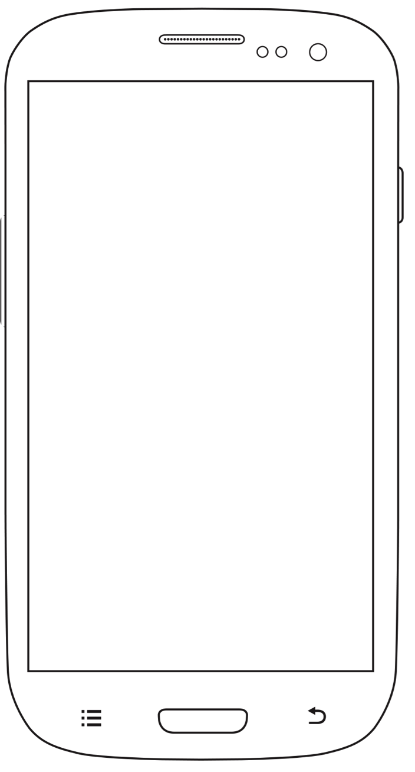
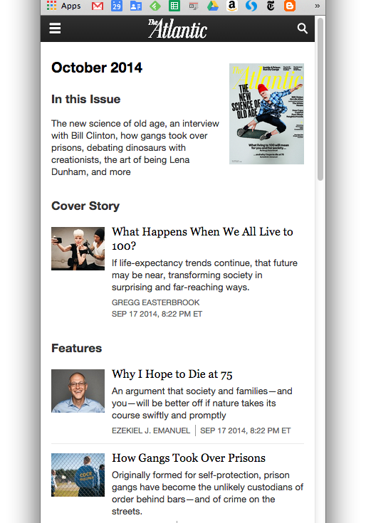
Notes:
I follow a tweet someone posted from their phone to an awesome article on The Atlantic, and it’s the mobile site.

Slide 9
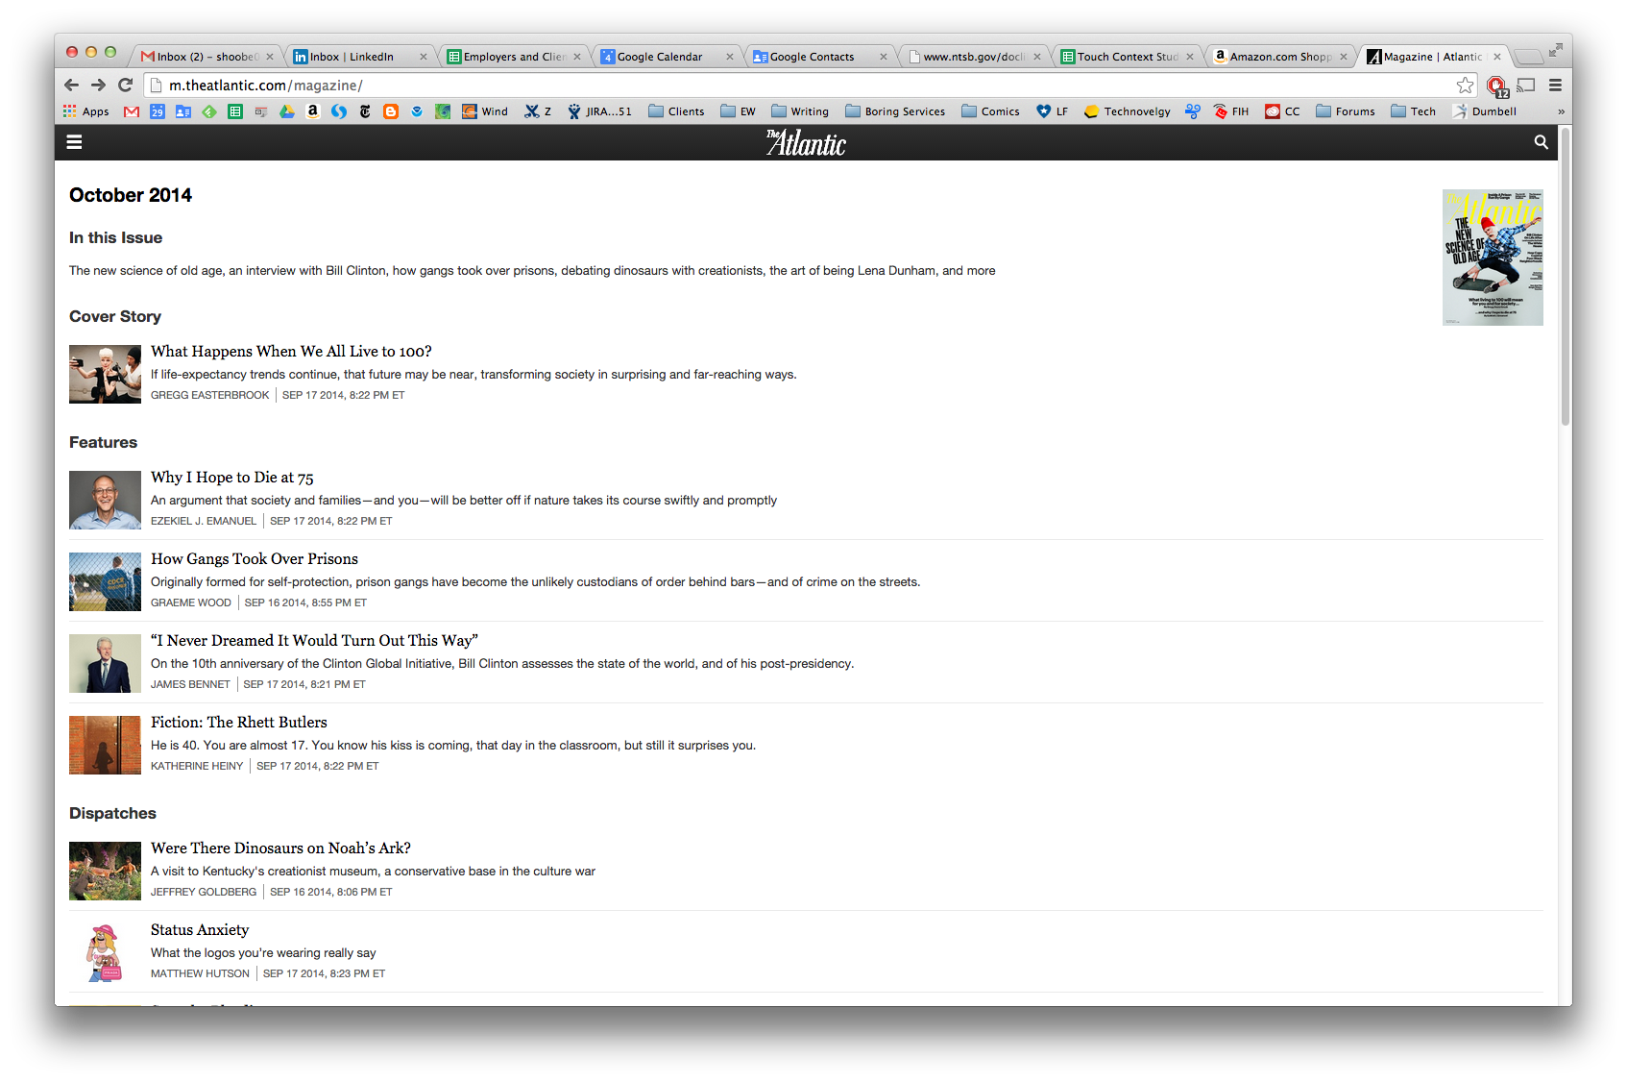
Notes:
But Twitter is cross-platform. I am reading it on my computer and it looks broken. Odd enough it is hard to read. Adaptive isn’t like that, but loads the proper content every time, no matter how you access the site.

Slide 10
Best Practices
Responsive is Fun |  | Adaptive is Best Practice
Anyone can do it. Easy to demonstrate and test. Low cost of entry. Basic maintenance is easy. |  | 82% of the top 100 sites, worldwide, use device detection. In 2011. Many more now. Optimised performance and best experience.
Inefficient to build at scale and can degrade over time Really, pixel scale only. Performance issues arise from unused code and image scaling. |  | Some initial investment Software maintenance. Weekly or monthly updates to DDR. May require subscribing to a paid service.
Notes:
As much as I say responsive is a subset of adaptive, they end up being sold as two approaches. So, to boil it down: RWD is talked about a lot, but adaptive is enterprise grade and makes money.
Responsive is buzzy, and easy to demonstrate. But it’s hard to scale and maintain. It has huge performance issues, and I mean that it’s causing the average page size on the entire Internet to go up, markedly.
Adaptive, on the other hand, drives business. 82% of the top 100 sites are using device detection, and loading different sites or changing out features based on capabilities. Little places like amazon. The downsides are increased initial investment, and having to get the server guys to play nice with the webdevs, but it is much higher performing and is designed for maintenance.

Slide 11
Adapting Appropriately
Adapting to Features |  | Mixed Solutions
Feature detection allows adapatation based on specific parts…. It is an alternative between device detection and responsive. Some feature can be detected with CSS and JavaScript. Features are also a key part of what is adapted to with device detection. |  | Adaptive is a broad approach, not a technique. Device detection loads geneally custom markup (and some content) but each of these can and should also use responsive principles and technologies to fluidly scale to specific screen sizes. Desktop can live with fixed design, but mobiles need all the space available, so responsive display is important.
Notes:
If you haven’t picked up on it already, I say this isn’t quite either/or. It’s a continuum, and an evolution.
Use the features you can get in place, plan for better over time as you have the budget. Don’t leave one behind for another, but build and improve. One thing I remind people of a lot is not to replace responsive with adaptive. You still want each of the adaptive templates to be responsive itself. The sizes of mobiles vary a lot so responding to scale is very valuable, not just a nice to have.
And remember mobile users get accustomed to the way their devices work. Poor or inconsistent use of browser or OS features makes the interaction terrible.

Slide 12
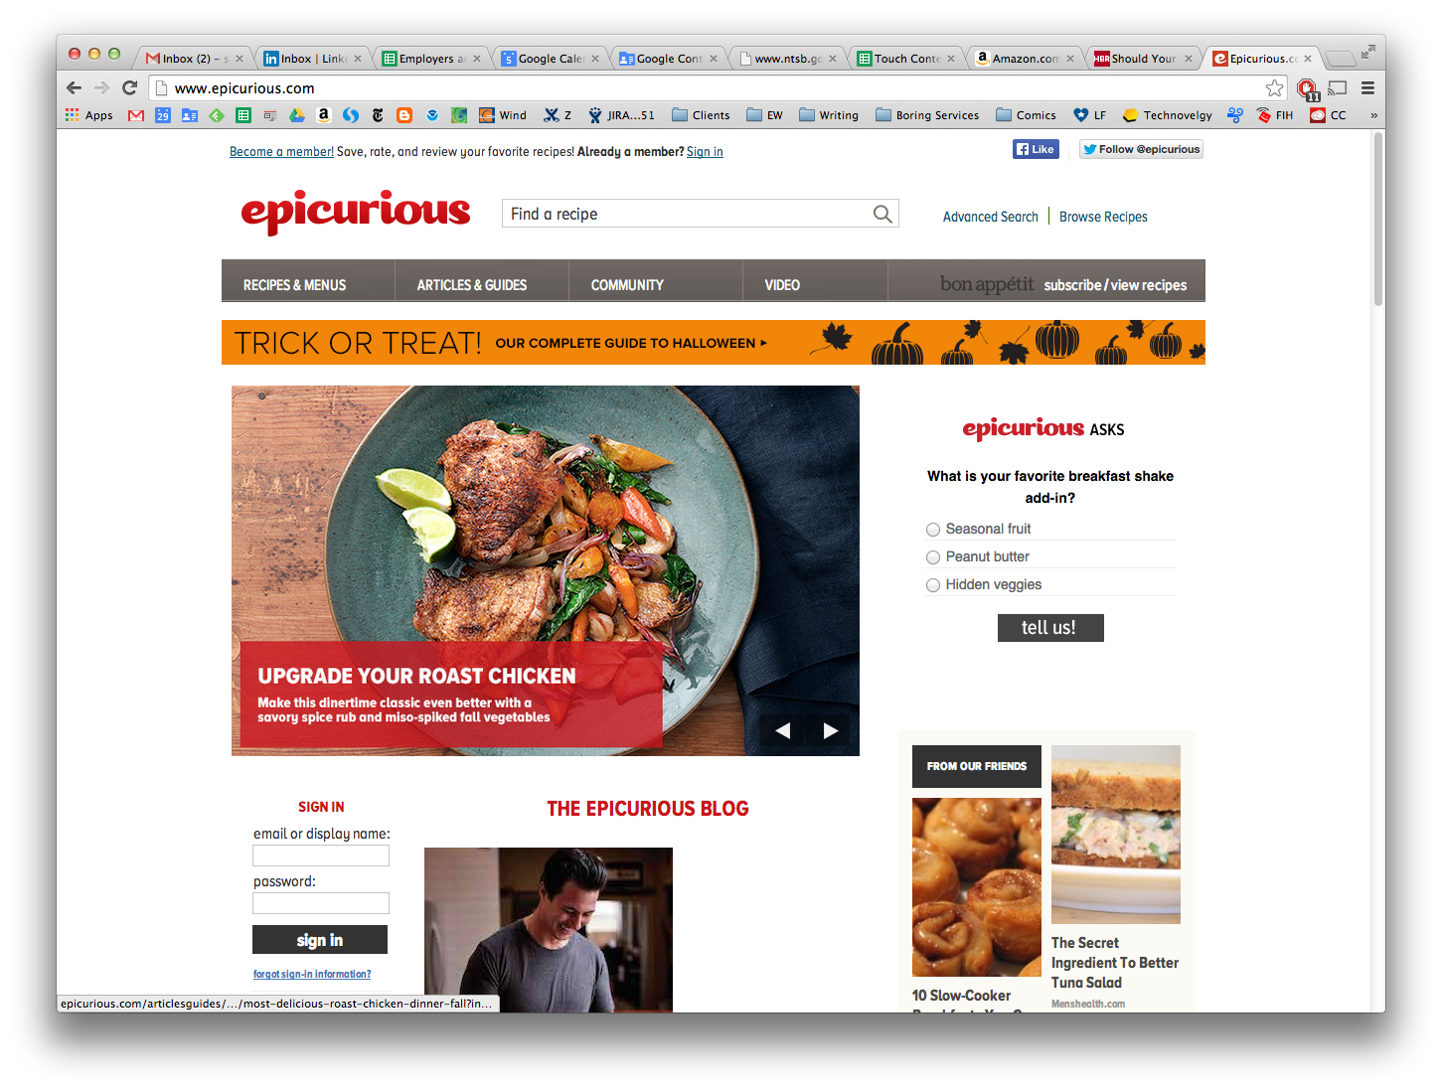
Adapting Your Design
Notes:
Let’s look at an example of an adaptive design. Epicurious has an entirely different look for their mobile experience, changing entirely the way they offer advertising, arranging the navigation, and prioritizing search.
Their home page here adapts content, not just what is presented, but the images and words they use to present it. The big tagline on Upgrade your Roast Chicken is simply gone, and also made more readable by pulling it out from the image to stand on its own.

Slide 13
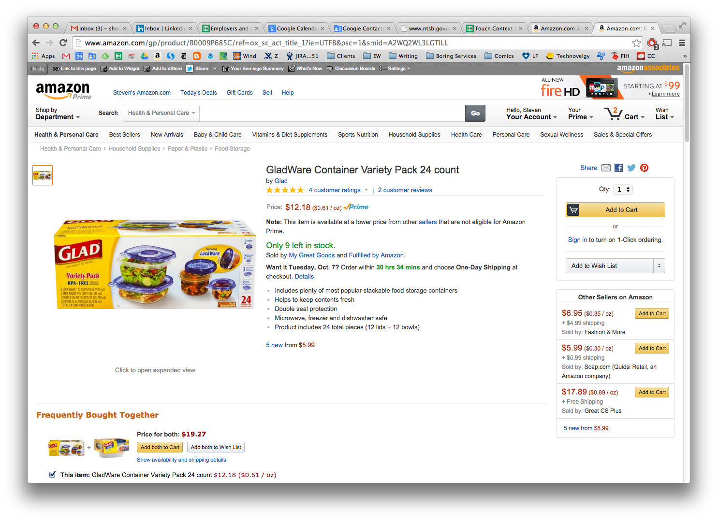
Adapting Your Design
Notes:
And that isn’t just for home pages. Amazon is a good example you probably use a lot. Their mobile site (to use the false “separate site” terminology) is optimized for showrooming. You are going to refer to it wherever you are, maybe in a store, to compare prices and buy from them instead.
It simplifies the site… but not really. It just reduces the content and choices you /first/ see. An image, the title, the rating, the price. They recognize the content area is more important than their navigation, so most of it is in the footer. Every bit of information about the product, and every navigational link is available if you scroll.

Slide 14
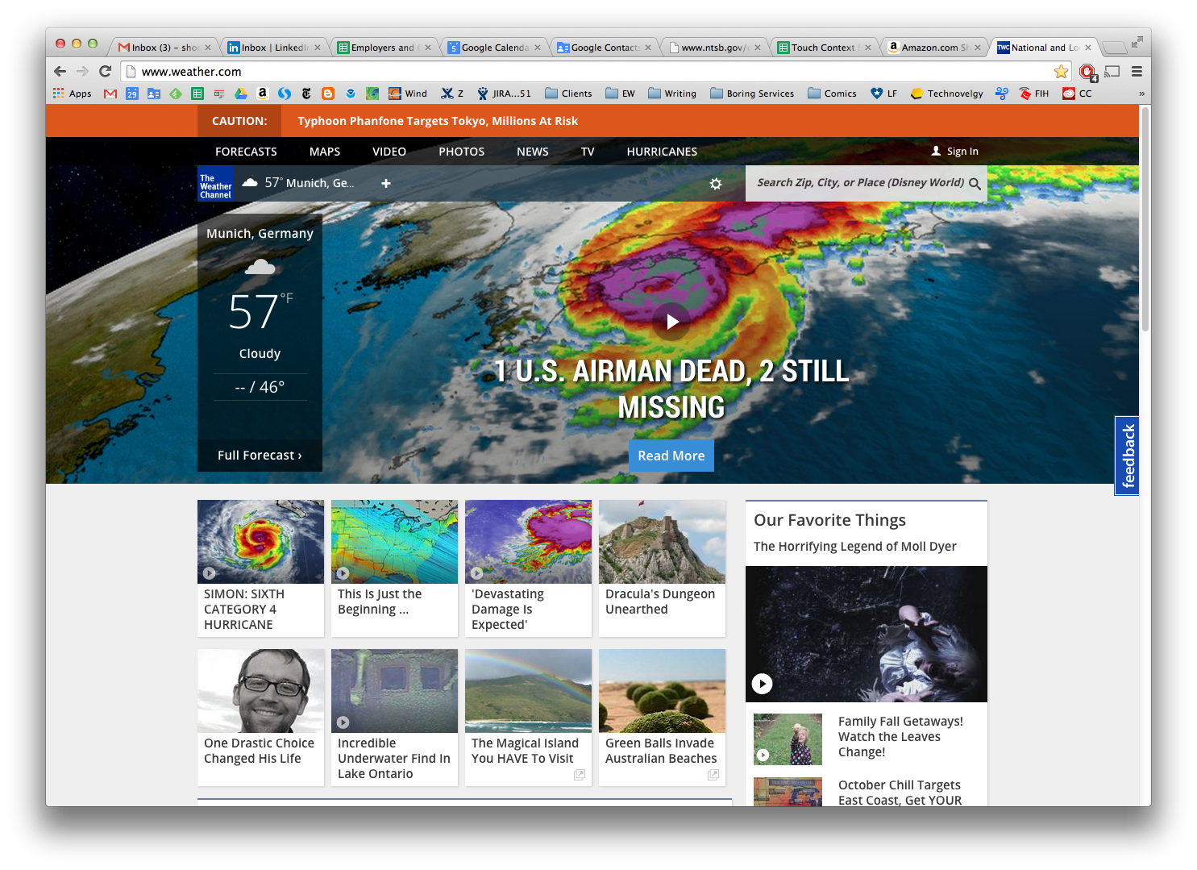
Adapting Your Design
Notes:
Adaptation really shines for the end user in using device features. Weather.com on the desktop has a home page. News, videos, info. A little weather box that shows me weather in a random carousel of cities. Munich? I am in Kansas, so they aren’t even risking IP location apparently. If I customize it, cookies remember me, but that places the burden on the user.
On mobile, it uses the location service to focus on what you want anyway, but especially need when on a mobile: your weather, where you are now. Scrolling down, again if you see the pattern, gives you the rest of the home page content, but the first thing you see is content adapted to you, where you are and what you are doing now.
It even passes this locational information to their advertisers, giving more customized information, and giving them more revenue.

Slide 15
Features != pages
Responsive and adaptive often cause problems for development organizations used to the Web.
Estimation, design, specification and development must change back to software-style methods that account for multiple states, instead of page-centric design.
Analytics must log device and the loaded view.
Test and error reporting need to account for which view is used or bugs will be hard to track down.
Notes:
What you’ve seen, I hope, is that adapting your content is about changing what exists.
No matter how much we progress, the Web 1.0 world keeps us down. If your product owner puts a feature into the requirements document, the most likely result of this without any design intervention is a page or dialog providing that feature. This is, I think, where the “separate site” terminology comes from so much. Any change past reflowing from three columns, to two, to one feels to a lot of people like it needs to be a different page.
That’s not how adaptive web design should work. Change widgets, components, content. And arrange your whole product development program to understand that, from conception, to test, to devops.

Slide 16
In Part 6:
Information architecture
Information architecture.
Resilience engineering and design.
Navigation.
User task flows.
Notes:
In the next part I’ll talk about designing the system, and not just the website or app, but your service, from the user’s point of view.

