Slide 1
TIMING/VIDEO
Remove auto-advancing after creating a video version:
On/Off:
In the tabs (not menu): “Slide Show”
[X] Play Narrations
[X] Use Timings
[ ] Show Media Controls
Clear the timings completely:
Select all the slides
Right click a slide > “Slide Transition…”
In the “Advance slide” section uncheck “Automatically after”
The complete guide to Designing Mobile User Experiences 5) Adaptive or Responsive? Resources
@shoobe01
4ourth.com

Slide 2
Adaptive or Responsive?
Read More:
Device detection especially is worth looking into and I encourage you to read up on that more. If you think you need some arguments for your team that pure RWD is bad, check out the articles on bloat, and Brad Frost's excellent deck on Adaptive design, especially.

Slide 3
Responsive Design May Be Driving Your Readers Away
http://www.econtentmag.com/Articles/News/News-Feature/Responsive-Design-May-Be-Driving-Your-Readers-Away-102855.htm
BONUS new since the presentation was recorded.
Includes some numbers from surveys, reviews of performance, etc. which prove that the slow speed of responsive hurts your site. Mostly around images, so at least read up below on responsive image solutions.

Slide 4
Select your mobile configuration
https://developers.google.com/webmasters/mobile-sites/mobile-seo/overview/select-config
BONUS new since the presentation was recorded.
This has confused some people. Google seems to say RWD first, and calls DDR-based adaptive “dynamic serving” (which no one else does). They also put red check boxes, and make assumptions so it’s skewed badly. On, and no one does separate-site anymore so why is it on the chart?
Don’t get too confused by this. Read the rest of these articles and make up your own mind.

Slide 5
Responsive Web Design
http://alistapart.com/article/responsive-web-design
The first one. If you never read Ethan Marcotte’s 2010 article, you really should.

Slide 6
RWD Bloat
http://daverupert.com/2014/07/rwd-bloat/
What it got us, more than anything I sometimes think, is bloat. The size of all traffic on the internet has increased markedly. This goes into detail and decides you get around 10% extra junk just from being responsive at all, and tries to talk around how to optimize your site.
Not everyone does this, but please do try.

Slide 7
The "Average Page" is a myth
https://www.igvita.com/2016/01/12/the-average-page-is-a-myth/
The title is because the author is being pedantic about what average means, but it’s all the same thing as the previous slide: page size is climbing, badly.
Now from this you can get some really neat data, and what I get from it is that average page size is huge due to some bad outliers. What to take from that? Well, don’t be that guy. Presumably, much more of the internet than those few is modern and high tech but remains manageable or small.
Set your target sizes (as acceptance criteria for download times) accordingly, and make the developers do a good job.

Slide 8
The Cost of Frameworks
https://aerotwist.com/blog/the-cost-of-frameworks/
I recently delivered a talk at FFConf in Brighton, called "You should use <insert library / framework here>, it's the bestestest!". I wanted to do a write-up of the presentation's content here, hopefully so it can start a broader conversation that I think we need to have, mainly around the cost of modern frameworks on mobile devices.
I don’t get too far into code too much, but this is worth a long treatise sometime. I may write an article on how our over-reliance on frameworks makes things happen fast, but at the cost of being slow, unreliable, not what you wanted, and it takes a lot of time and money to make them work.

Slide 9
You don’t want to hire me
http://www.michielbijl.nl/2016/01/11/you-dont-want-to-hire-me/#main
My point is that in the ten years of my career I’ve never once worked for a company that really cared about their end result…I believe we as developers want to, and indeed need to, value our craft and projects we create. We all want to create beautiful things, and most of us do just that. I would very much like it if all those beautiful creations out there would work for all humans.
The same topic, wanting to make sure we use JS the right way, and maybe getting back to server side code for dyanmic runtime rendering.

Slide 10
How many floppy disks do you need to fit an article from The Atlantic?
https://medium.com/@pete/how-many-floppy-disks-do-you-need-to-fit-an-article-from-the-atlantic-8924a9e057ff#.t1qmms5kq
By the time Safari had crashed, I’d logged 21MB of ads, pixels, and associated scripts that had been downloaded onto my phone. If the main idea was to heat my phone so my hand could stay warm against the San Francisco fall, nice job everybody!
Not that you can’t make a bad website without frameworks. The time it takes to load the site (or for the user to abandon it) is part of their experience. Design it, and remember the user every time you add something.

Slide 11
Device Detection
http://4ourth.com/wiki/Device%20Detection
I couldn’t find a good overview of device detection, for the non-nerd at least, so I had Luca Passani (the inventor of WURFL) write one up for me.
If you want more after reading it, there are plenty of links provided, even to competitors of his.

Slide 12
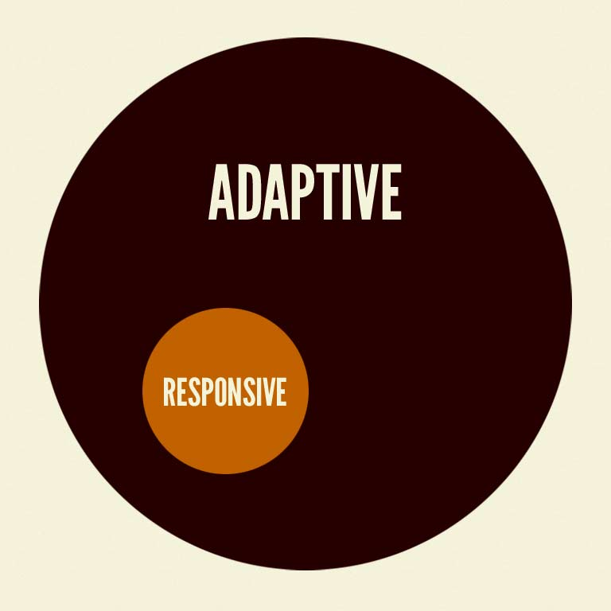
Beyond Squishy: The Principles of Adaptive Design
http://www.slideshare.net/bradfrostweb/beyond-squishy-the-principles-of-adaptive-design-17070713
This is Brad Frost’s excellent deck on adaptive design. I can’t say enough good about this.
The Many Faces of ‘Adaptive Design’
http://bradfrostweb.com/blog/post/the-many-faces-of-adaptive-design/
If you prefer words to slides, this is a pretty good article along the same lines.

Slide 13
Responsive principles: More than designing for size
http://www.slideshare.net/shoobe01/responsive-principles
A deck of mine about using the principle of responding (later, I realized that this was called Adaptive) to make better apps and services.

Slide 14
Server-Side Device Detection: History, Benefits And How-To
http://mobile.smashingmagazine.com/2012/09/24/server-side-device-detection-history-benefits-how-to/
Pretty much exactly what it says, a how to guide. It’s light to inaccurate on the history, but gets to code examples and architecture. So, if you wonder what is involved in implementing this on your site, here’s a good example.

Slide 15
RESS: Responsive Design + Server Side Components
http://www.lukew.com/ff/entry.asp?1392
Not as buzzworthy these days, but a good attempt to make a specific principle around the use of client side software to do things as a result of server side device detection, but avoiding actually serving different templates.

Slide 16
Image replacement
http://www.quirksmode.org/dom/fir.html
A largely technical discussion (by PPK, who always knows how browsers work) on the need for and merits of responsive image tools.
Instead of just resizing a giant image, optimizing images for each client, or class of them, is a way to make RWD more efficient.

Slide 17
Scalable Inman Flash Replacement
http://en.wikipedia.org/wiki/Scalable_Inman_Flash_Replacement
Not super relevant today, but since I mentioned sIFR I figure I should include the reference.

Slide 18
Which responsive images solution should you use?
http://css-tricks.com/which-responsive-images-solution-should-you-use/
More on responsive images.
This is getting old, but I am not aware of a newer one that is as comprehensive. So start here and then read newer topics to see how the state of the art has changed.

Slide 19
Responsive Images
http://blog.cloudfour.com/responsive-images-part-10-conclusion/
Jason Grigsby wrote a ten part treatise on the principles and practice of responsive images in mid/late 2015. Should be up to date for a bit.
You may note how I didn’t actually talk about these much in the video, and that’s because it’s crazy complex, and at the principle level some of the best solutions are pretty adaptive. Shhh. Don’t tell anyone as they love calling it all “responsive” still. Seriously, if you bring this up, it makes people nervous and they might not do it, so be careful what you say.

Slide 20
Server-side device detection used by 82% of Alexa top 100 sites
http://mobiforge.com/designing/blog/server-side-device-detection-used-82-alexa-top-100-sites
The classic study (repeated periodically, and proven elsewhere) that:
82% of the Alexa 100 top sites use some form of server-side device detection to serve content on their main website entry point. As you descend from the top 10 to the top 25 and top 100 sites the percentage of sites using server-side detection falls from 100% to 96% to 82%.
This even came up the other day. A client couldn’t find any competitors or related sites that were responsive. Adaptive is for making money in my book.

Slide 21
Should Your Website Be Using Adaptive Design?
http://blogs.hbr.org/2013/07/should-your-website-be-using-a/
BONUS new since the presentation was recorded.
But, responsive design isn’t the end of the road. It addresses layout problems but doesn’t solve important issues, like mobile performance and device customization. To create truly great mobile web experiences we need to go beyond responsive layouts to fully interactive and functional websites.
Basically, yes. Don’t just be responsive.

Slide 22
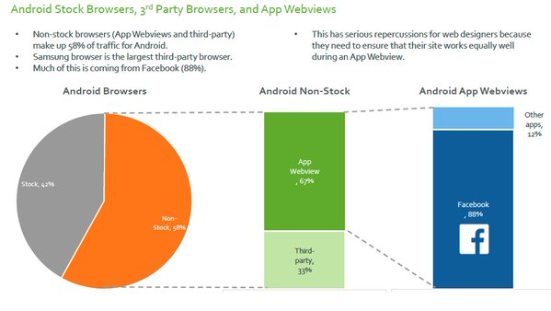
What browser are you designing for?
As part of the MOVR report here:
http://www.scientiamobile.com/page/movr-mobile-overview-report
Jon Arne noticed that stock browsers were not used nearly as much as you’d expect. Building for Android? Better not just use Chrome to test! Buy a Samsung and try it with intents, too!

Slide 23
Android, iOS, and Samsung?
http://www.businesswire.com/news/home/20161116005308/en/Report-Shows-720x1280-Smartphone-Screen-Resolution
More proof of the previous slide now, and all the way to:
Samsung Browser is now the third most used mobile browser worldwide, after Safari and Chrome Mobile
Third! Dominant platforms do that. How long till we see strong numbers for whatever the HuaWei browser is? Are you testing your website on all these? You better be. They aren’t all the same at all.

