Slide 1
TIMING/VIDEO
Remove auto-advancing after creating a video version:
On/Off:
In the tabs (not menu): “Slide Show”
[X] Play Narrations
[X] Use Timings
[ ] Show Media Controls
Clear the timings completely:
Select all the slides
Right click a slide > “Slide Transition…”
In the “Advance slide” section uncheck “Automatically after”
NOTHING LONGER THAN 20 minutes!
The complete guide to Designing Mobile User Experiences 4) Hybrid or Native App?
@shoobe01
4ourth.com
Notes:
In section 3 we talked about the choice between web and app, and how it’s not even always a choice.
First, let’s say for a moment you chose to make an app. Someone should ask how we’re making it. If you don’t, you may be in for a shock later on.

Slide 2
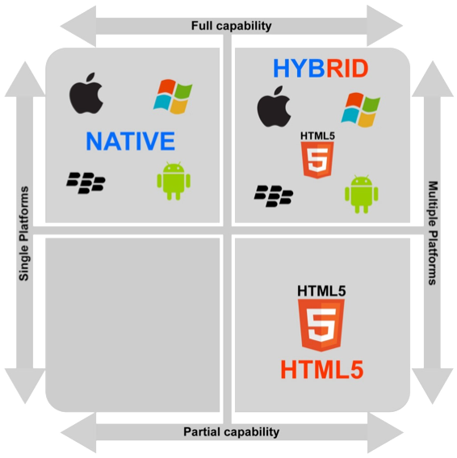
Native or Hybrid?
Actually a range of options:
Native |  | Built with tools provided by the OS maker, and run directly on the OS.
Hybrid |  | Uses a native wrapper, with part or all of the content and UI functions built using HTML technology. The HTML is provided by a local or remote server as needed.
Notes:
At the highest level you can say that it’s a choice between native and hybrid. Some people say “HTML5” for hybrid, but I say they are wrong. Not least because HTML5 is not a single thing, but most of all because it doesn’t actually require that.
Hybrid is a “write-once” solution of any sort. Some or all of the code is in some commonly-interpretable language. HTML is convenient, but it can be other things. If you ever have to update the Adobe AIR runtime on your computer, you have something hybrid on your Windows or Mac desktop.
We’ll get to it in a minute, but the size and composition of that native wrapper part is where things become less of a choice, and more of a continuum.

Slide 3
Hybrid isn’t New
Has been used on mobile for over 10 years. Many information-centric J2ME apps from about 2005 onward were hybrid. Used on desktops near the turn of the millennium for regularly-updated content like help for installed programs. |  | Does not require HTML5. Does not even require HTML. The same principle can be applied with other open data sources, like XML.
Notes:
This history lesson is not just nitpicking.
Hybrid didn’t start with HTML5, and it won’t end there. Embedding other software is convenient if you already have the data in that format, or have limited development resources. You can hire a guy to write a native wrapper or set up your hybrid app, then keep it up to date with html.

Slide 4
Hybrid Tools
Appcelerator |  | Converts to native-ish code to run. Acquisitions providing a more end-to-end experience with servers, analytics, etc.
PhoneGap/Cordova |  | Purely hybrid, few native features available. One version fairly open, but plugins also of varying quality. Others with corporate backing, so vary in price and capabilities.
Sencha |  | Lots of neat UI features, but requires learning a new language, and paying licensing.
Corona |  | Only for iOS, Android and Nook Color for some reason.
Custom |  | Run away
Notes:
There are zillions of these so this is just a small sampling. And there are more all the time as people release new products. And also, fewer, as the big players acquire other businesses, and people like Adobe buy off previously open products.
When picking one, think about your investment in learning the platform (because it is a platform), how much it works with multiple OSs (many only do iOS and Android… what if your company issues Blackberries next year?) and then there’s pricing. Many have trials or are open, but also have paid tiers. The feature you need may require a paid license, so check carefully, early on.
Mostly today I am talking about ideal solutions, but for hybrid tools I want to give a special warning. In the past I was the biggest fan of hybrid development, but today most of the hybrid stuff I work on is fraught with danger. Many of these are because of the many, many proprietary systems (used mostly by terrible overseas outsourcers) which are not open, extensible or even very comprehensible. They use weird codes, have a limited number of available widgets, and are Proprietary. That means if you cut the contract with the vendor, you have to start over from scratch.

Slide 5
Best Practices
Native is Native |  | Hybrid is Easy… and Hard
Best opportunity for good performance. Full access to device and OS features. Adapts to latest device UI and features. |  | Use existing HTML content. Leverage existing processes and development resources. Can immediately update content.
Each platform requires independent code, teams. Management of appstores, OS revisions. Users must update app for new features. |  | Controls never look and act quite native. Often more difficult to customize per platform than promised. Insurmountable security issues.
Notes:
Native is always the goal for app development. There’s no way around that. Well-written apps provide unmatched performance, access to all the device features, and easily or automatically (depending on how you design and write it) update to look like the latest OS release.
To do a good job, each OS you work on has to have at least one dedicated developer. I have met people who are good at several, but don’t bet on finding one of those. You also need to have a team of people to manage the appstore, and keep up on bug reports. Much like you have SEO and devops for the web side… wait, you DO have that, right? You really, really have to plan for this or your app goes nowhere.
And you have to update the app, and push releases to people on a regular basis, and quickly after serious OS changes at least for the way Apple does theirs.
Hybrid promises to solve all these, and at first blush is easy. You have processes to build websites, so can just buy some tool that uses all that. The upsides are therefore pretty obvious. You can immediately update content, but only if you plan for that, so it doesn’t use a local server.
But, it has downsides. Hybrid simply never looks quite right. Maybe you think that doesn’t matter, but users Will Notice. If you go pure-hybrid you should plan on some custom UI as emulating the pure native experience won’t work. It also can get expensive and complex to make it look native on each key platform, almost as much as simply building for each platform. There still is an Appstore release, so you have to handle that the same way, pushing updates and watching for bugs.
There are serious problems with performance, they rarely or never work well in the background and resume operations when you switch back, and there are such bad security problems I know people who consult for the government who won’t even talk to you if you want their help with a hybrid app.

Slide 6
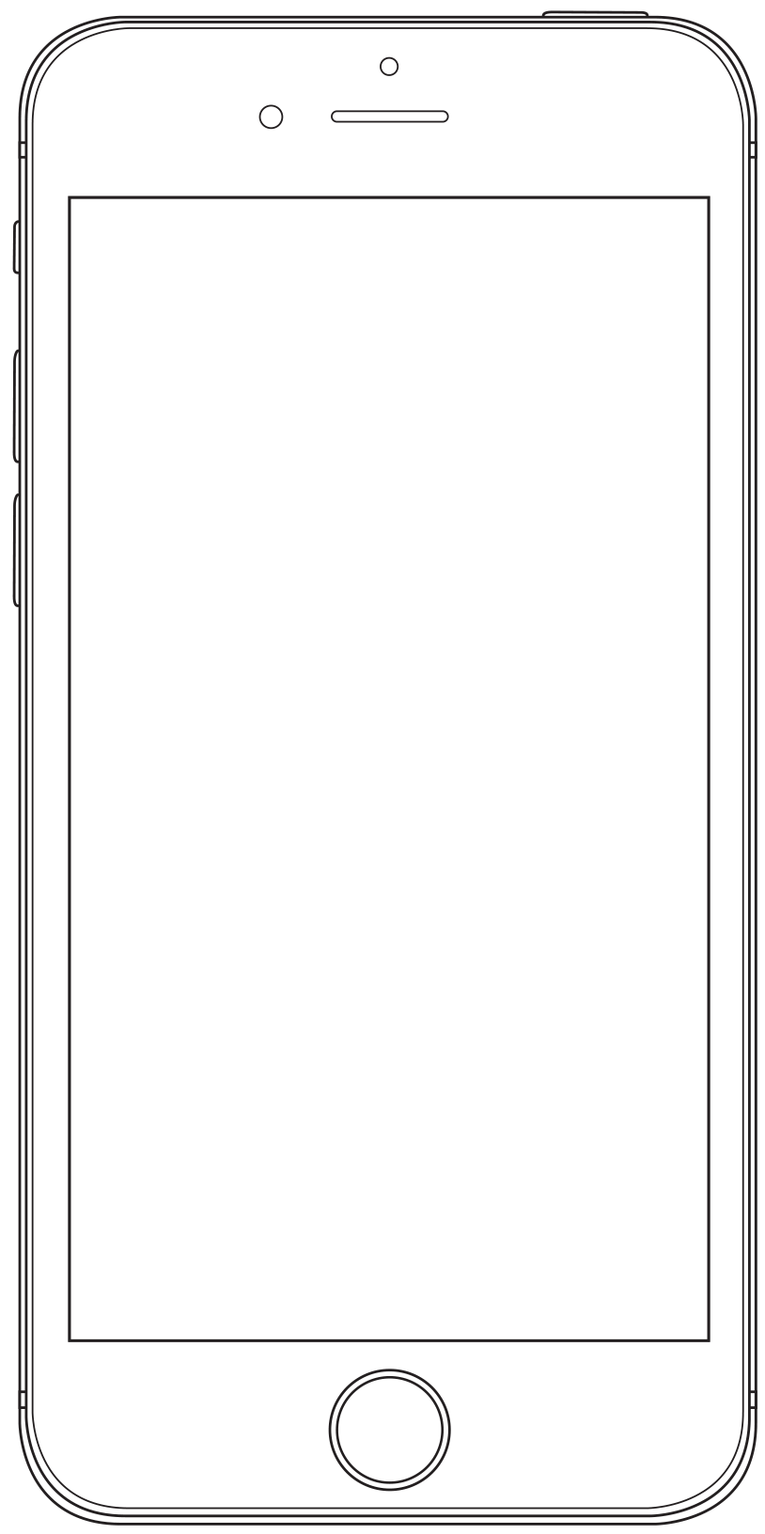
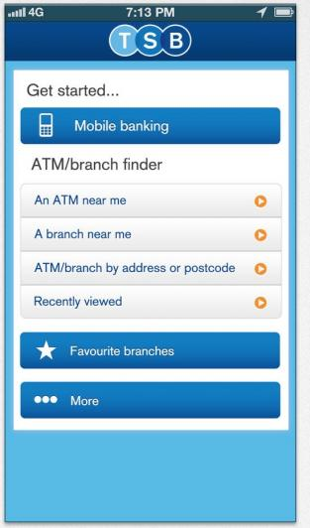
Risks
Notes:
The risk of a poor platform decision is poor execution and limited capabilities. And the risk of that is people notice.
This banking app is bottom-of-the-pile in consumer reviews… yes, consumers don’t just notice themselves, but actually read and listen to friends. This one doesn’t just look bad (and it does for something in 2014) but has no native-like behaviors. Entering your complete username and password? Every time? Not remembering your local bank, or any other preferences? It’s transparently a poorly-designed mobile website masquerading as a poorly-designed mobile app.

Slide 7
Hybrid isn’t One Thing
HTML
HTML5
Look & Feel
Content Only
XML
Web
App
Notes:
But this doesn’t have to be a total condemnation of hybrid apps. I already said hybrid doesn’t have to be HTML 5. And if it helps, you can think of it as not a random bucket of choices, but a continuum, making things more or less native.
At the far left, is HTML, then HTML 5 gives some local caching and has some better inputs available. As you proceed to customize the interface, less and less is in the html, and more in the code. At the far end, all else being equal so you have remote data, you pick up that info as an XML feed or something, and render everything in the app.

Slide 8
Native Code
HTML Webview
Native Code
Notes:
But the other choice is how MUCH of the app is built by the web. Titanium and PhoneGap and all those do the whole thing by default. But you don’t have to.
Webviews are the buzzword here, and they are great. You can insert little bits of HTML to render things in your app. Everyone does it. Everyone. Most apps you use have webviews strewn throughout them.
What if it’s hard to do that bit of text formatting in native code? And if your content is coming from the internet already, maybe there’s no sense in bothering to code it as a data feed and build an API, then decode and format it for your app; just have your web guys make an adaptive (or responsive, but we’ll talk about that in the next presentation) version of the site.
CLICK
As Instagram does, just tear off the masthead and navigation, as at the least you should make sure all the basic wrapper components, dialogs and menus are native controls.

Slide 9
HTML!
Notes:
Don’t believe me? Look. Yes, you should avoid error states, but they are convenient to prove the point here.
Other big people do this also. Uber is pretty shiny isn’t it? Clearly native. But it’s not. The center is a big webview like this.
And this choice does not have to be permanent. The guys at Yelp! use them to quickly roll out products they first release on the web. They then, when it makes sense, follow up with native code. This can even be a good approach for your whole app strategy. Start true hybrid, then add in custom plugins, then switch to a native wrapper, and keep going till there’s no point in switching out from the web.

Slide 10
Hybrid isn’t One Thing
Content Only
HTML
HTML5
Look & Feel
XML
Web
App
Notes:
So, where you fall on this chart very much depends on what your project is, what your goals are, and what your user’s expectations are. There is no A answer for everyone.

Slide 11
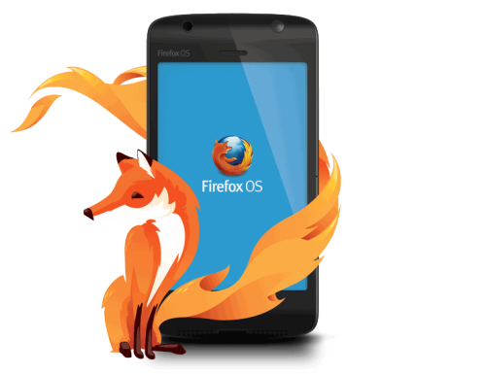
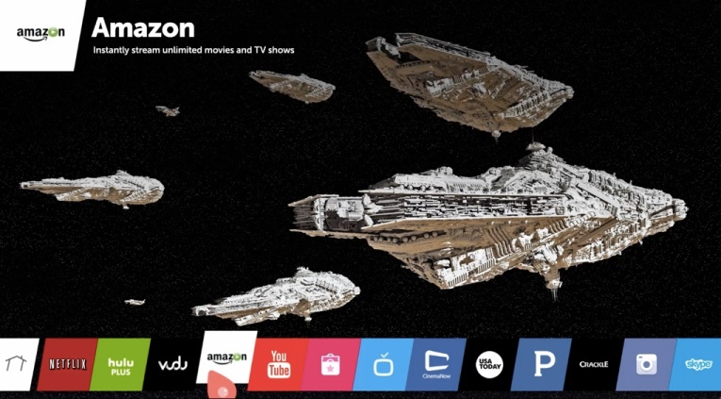
Is the Future the Web?
Firefox OS
WebOS
W3C
Amazon
Niche, or future… for now.
UPDATE
Notes:
A few niche or coming OSs have been or are web based at their core. Native apps will be developed mostly or entirely using HTML technologies, so are in some ways hybrid, with all the advantages of native.
The WebApps I mentioned in the previous section briefly are supposed to be more literally Web Apps in the future. W3C really thinks that, but has implemented caching weirdly, and OS or browser makers keep changing what is an allowed cache size, so it’s hard to build, then hard to plan to take advantage of it. Today you can export an HTML5 webapp to work on the Amazon Fire TV, or some LG smart TVs. I used to talk here about the Firefox OS phone, but there were so few they more or less killed the project.
Despite the pro-web contingent, it doesn’t seem to stick. Things like the death of Firefox OS, or no webviews in Apple TV apps. If it happens, it’ll be later. In general, don’t worry about true web apps right now.

Slide 12
Beware false savings.
Notes:
I touched on the key reasons for this, but it’s a big deal so I wanted to save a special note for it.
Every single place I have worked (in the last 5 years) that used hybrid to develop their app picked it for up front cost savings. Every one.
But they also found that the result was not as cheap. And really not as cheap in the long run. One of my long-term clients asked some very pointed questions about why the app didn’t look or act right, and was coming up so expensive, so sent a team to do some research and estimating. To meet the quality, QA, maintenance and other goals of the company it would be (best case) 5% cheaper to go with hybrid development.
That’s margin of error, so they have a native development decree now. Doesn’t mean no webviews, but not end-to-end hybrid write-once tools like Titanium or SenchaTouch.
Make sure you understand the risks, and especially the long term risks, technical debt and impact on your brand and customers you may incur with a hybrid plan.

Slide 13
In Part 5:
Adaptive or responsive?
Definitions
Adaptive overview
Responsive history
History of device detection
Client-side adaptation
Separate sites
Feature detection, not pages
Examples
Notes:
In the next segment we’re switching back to the web and talking about responsive design, and more importantly introducing the concept of adaptive design.

