Slide 1
TIMING/VIDEO
Remove auto-advancing after creating a video version:
On/Off:
In the tabs (not menu): “Slide Show”
[X] Play Narrations
[X] Use Timings
[ ] Show Media Controls
Clear the timings completely:
Select all the slides
Right click a slide > “Slide Transition…”
In the “Advance slide” section uncheck “Automatically after”
NOTHING LONGER THAN 20 minutes!
The complete guide to Designing Mobile User Experiences 3) Platform Choices
@shoobe01
4ourth.com
Notes:
So far I’ve talked about the scale and reach of mobiles, both globally and to each individual. Mobiles are the pervasive computing platform now.
Now, we’re going to start talking about the range of platform choices you have to make. I’ll give some hints about how to make decisions, and how to work with the now more-common need for multiple platforms at once.

Slide 2
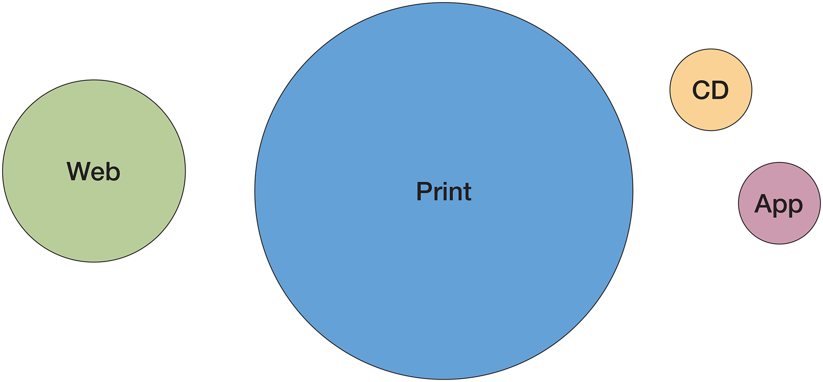
Notes:
When interactive technologies first appeared, it was an offshoot of the traditional information distribution methods, print and advertising.
Websites were not really related, and in many industries (and even NOW in some cases) a “interactive CD” is the digital medium.

Slide 3
Mobile
Web
(Desktop)
Web
Hybrid
App
Mobile
App
Notes:
Today, many organizations are… not much better. They still assume something is king, with all others as offshoots. Of course The Web, by which everyone means Desktop Web is the default. Alternative functions and platforms like mobile Web and Apps are offshoots.

Slide 4
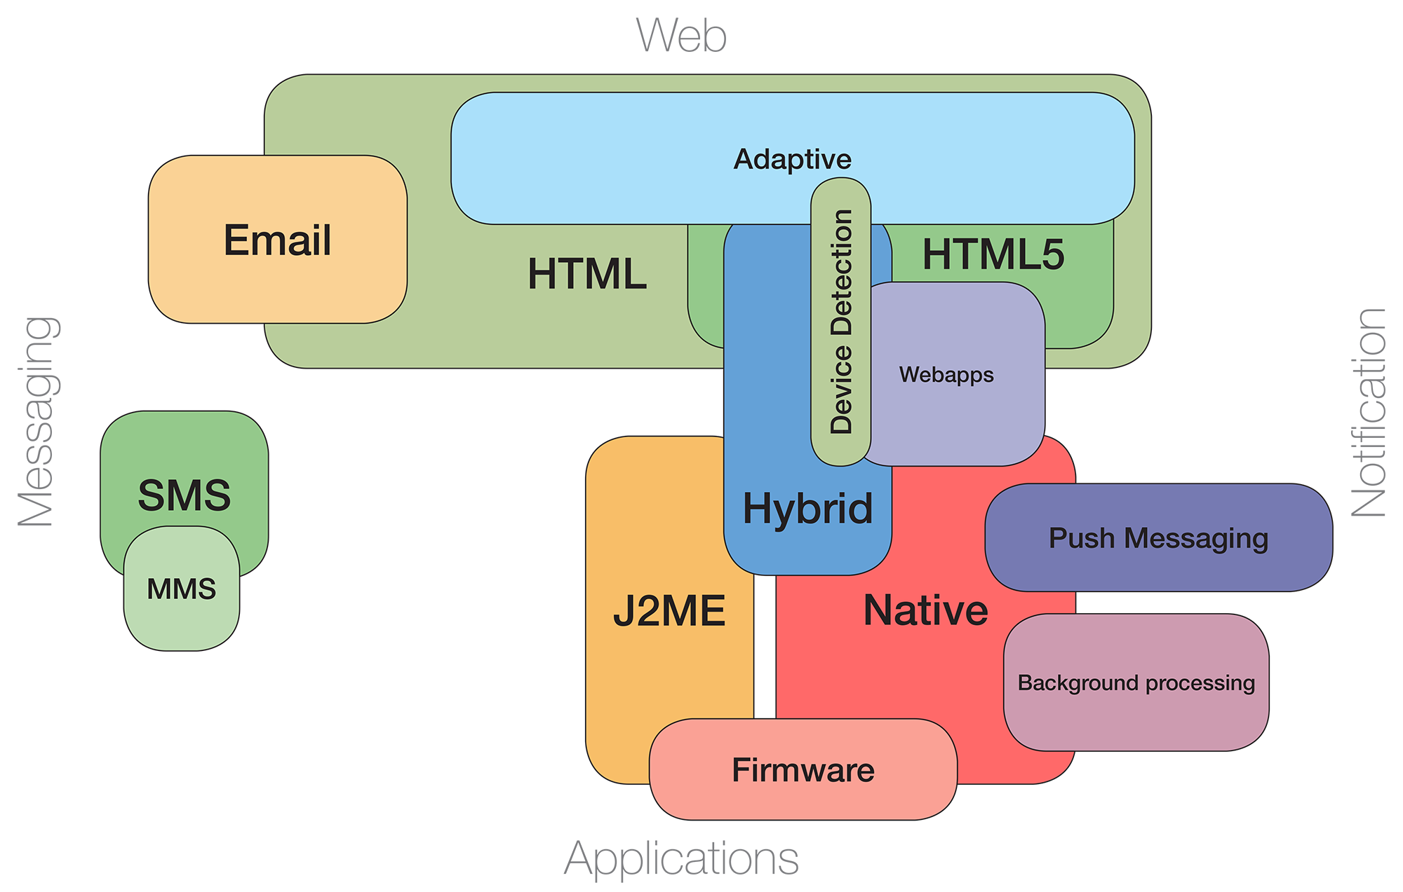
Notes:
Yes, even for many people I have met who build apps only. They assume, as we talked about in part 2, that the desktop is a “normal computer” and Web technologies are the default, and the best we can do.
I think that’s wrong, and we need to embrace every platform, but more importantly it’s way more complex…
Everything overlaps, and choices are not clear. Things like Email (and SMS) that have been used for decades need to be included in strategies and plans.

Slide 5
Web or App?
Notes:
Later we’ll talk more about thinking systematically, but for now let’s run through the decision matrices you will likely encounter.
Now, I DO know we don’t always have a choice. Very often we get a project as “I want an app!” But you need to at least know what the true capabilities and limits of each approach are.
And very often, I can talk people out of their idea, and help them make a better choice. The first of these is Web or App.

Slide 6
Web or App?
Often, both are called for, and complement each other:
Web |  | HTML-based content or functions run inside a browser, run on remote servers.
Webapp |  | Self-contained web product with additional, locally-run functions.
App |  | Locally-stored and locally-run, software package.
Notes:
I often say this is no choice, and you need both. If you have an app, you must have a website for discovery, support, etc.
Websites we all know about. But think of what a website means. It’s got display at the client (the computer in your hand or on your desk), in a piece of software that has to be installed and configured correctly, but loads all information at the moment you ask from a remote server. We take this for granted, but there are a number of moving pieces there.
A webapp, as we can call it now, is basically just an HTML5 website with local caching enabled. That way, any user who has visited the site at least once, reasonably recently, can view and interact with a cached version. It’s sort of a middle ground, but isn’t much used for various reasons, so we’re not going to talk about it much.
Apps you are all used to, and mobile apps are not conceptually different from desktop applications. They are downloaded, installed, and then do everything locally, even if what they do is informed by content from remote servers. But how do you tell when it’s time to build one, or when your product demands an app instead of a website?
(I have to make a note about terminology here, and we’ll discuss some details of this later, but for now, only say “App” or “Mobile App.” Adding “Native” actually has a specific meaning, so make sure that your app is native before you say that…)

Slide 7
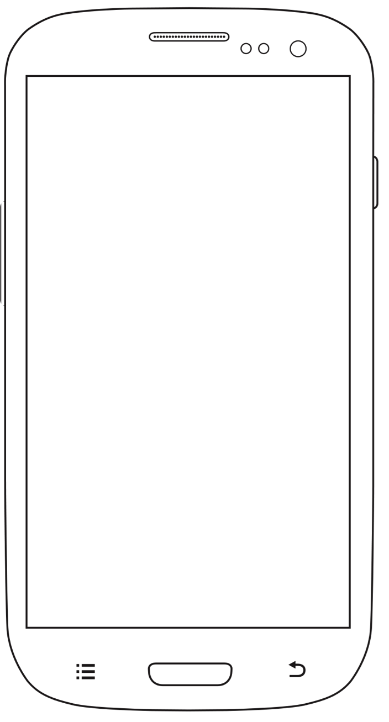
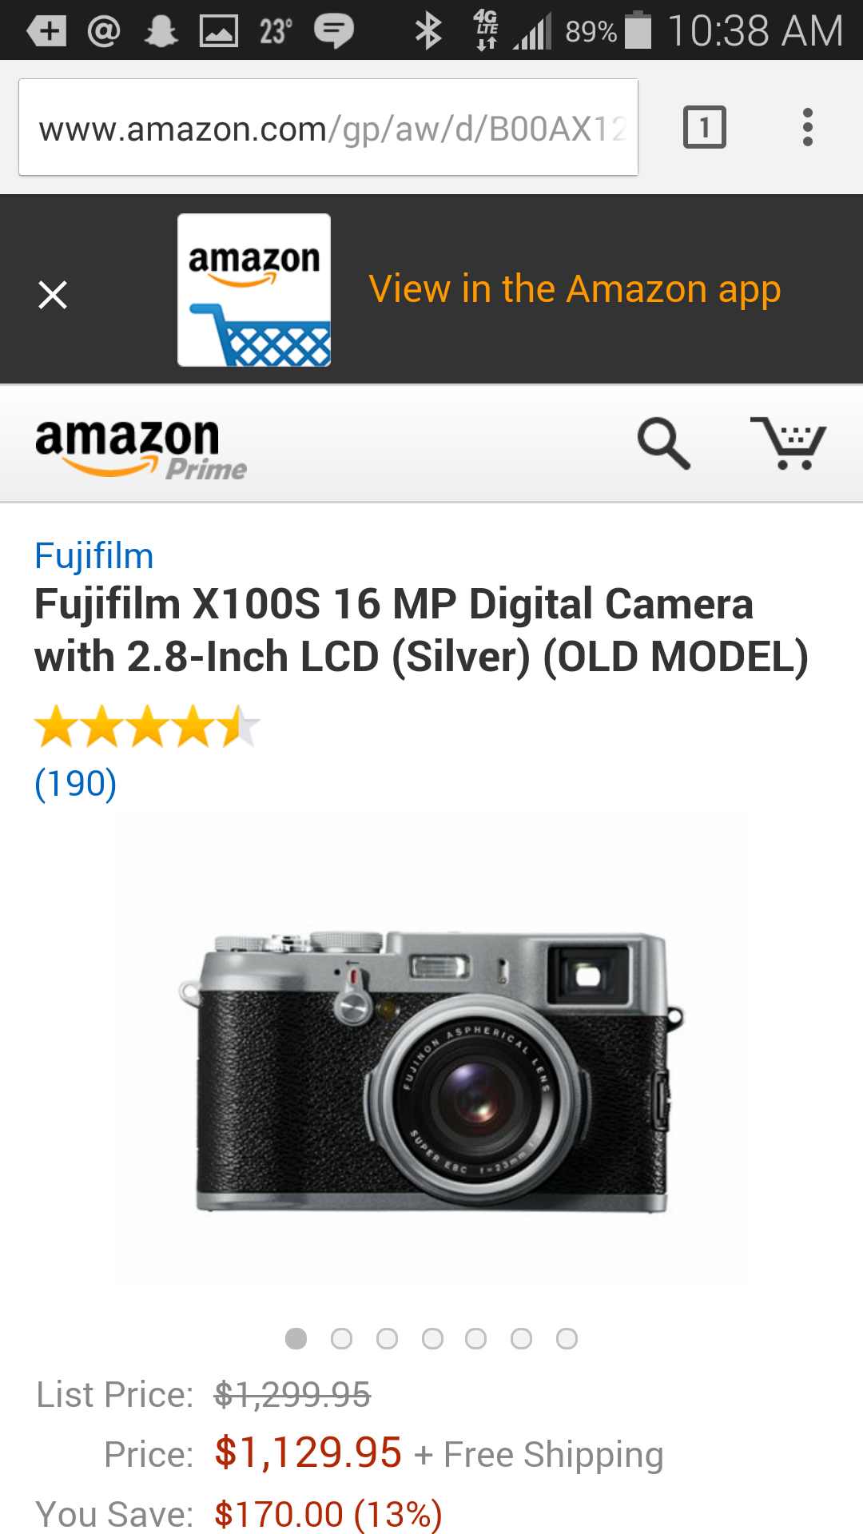
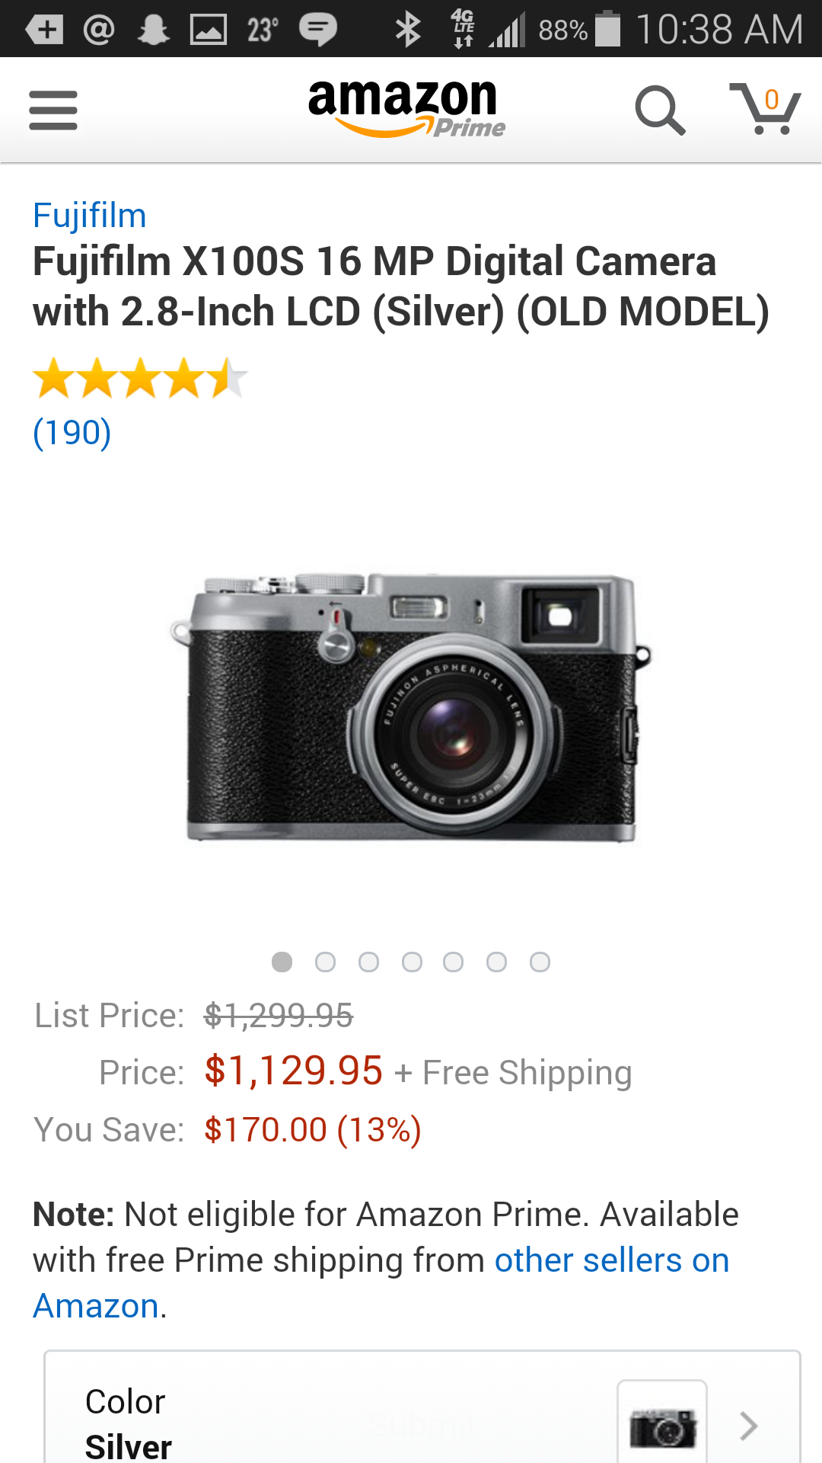
Notes:
Amazon is an excellent example of offering BOTH options. There are good reasons that some people might only be able to use one, and Amazon doesn’t want to miss a sale because they prefer you use their app.
The app is faster, saves your credentials better, can be loaded as an intent, waits in the background, and offers quicker access to every part of the Amazon experience with the menu.
But the web loads when people do internet searches, and works on every mobile device so you can get away without a native app for Windows and Blackberry and Featurephones and so on.

Slide 8
Best Practices
Web for Discovery |  | Apps for Access
Content can be found with search, and sites linked. Easy to build with well-understood methods. Can be made to work on any connected device. |  | Highest performance, best look and feel. Can work without network. Access to all device and OS features.
Requires connection for any use No access to many device and OS features Special considerations required for good performance on a variety of device. |  | Must be installed, cannot be searched for. Content updates can be difficult.
Notes:
Apps have better performance, and access to all those neat phone features. If you are making a game, something with integrated photography, or mapping, or complex gestures, you need to make an app. Also, if you need direct network access, like the control software for your smartwatch. Apps also have local storage, so can work offline, remember who you are, and be waiting in the background.
But you have to build them for each platform, which is expensive and time consuming. Often, you need a dedicated developer for each platform (but maybe only one), as platforms are different enough there are few who are equally good at everything. Users have to find them, through various app discovery schemes which are not really part of the conventional internet search. And with install processes, they have to commit to it, even if your app is free; they won’t be able to use it to read the news or find out when sunrise is for a few minutes, while they download it. And, they will tend to forget to keep using it and to be reminded to keep using them.
The web is great for discovery, just ask Google. Much of the world’s information is available for discovery by just typing. Your website can be found by anyone on the internet, and if you set things up right they will see the mobile version on their phone or tablet.
Websites are generally easier to build, and can easily be made to work at least a little on anything from featurephones to TVs. But, it requires a connection at all times, has more limited mobile-specific features, and can be a performance problem depending on what you are trying to do with it.
Push notification can be done with either one, sort of. Depends on what you want to do with them. Only apps can make things appear in the notifications area on your phone. But your server can send email and text messages, and those can have links which take the user directly to a page (or app, for that matter). These are not the same, but think hard about what you need reminders to do before you hear “notifications” and say “we have to build an app for that!” More about this in part 7.

Slide 9
Notes:
I also want to talk about economics for a bit. Now this will focus on apps, just because they are something easier to measure. Web follows much the same trends, but we’ve gotten used to websites being something you offer for free to get people to pay for a service. Apps are supposed to make you money!
But the numbers do not lie. 96% of app publishers do not recover the development costs of their app. The billions of revenue in the market are concentrated at the top, as it always is. Just twenty publishers make HALF the app revenue in the App Store and Play Store.
This doesn’t mean to get out of apps. It just means you need to think of them like you have the web for a decade or two. It’s just another endpoint to your service. I expect to see more and more free apps, which are gateways to paid or freemium services. Think strategically about your product before you start paying people to code things.

Slide 10
There’s More to Each Choice
No choices are either/or. There are a range of options, and in many cases more than one choice is needed.
Hybrid |  | Blurs the lines between web and app.
Adaptive |  | And responsive methods enable the Web to work on a range of devices more easily.
Messaging |  | SMS, Email, Notifications and so on allow engagement with more users, more rapidly.
Social Networks |  | Integrate with users’ existing communications methods.
NEW
Notes:
Then, it gets even more complex, as you have to choose (or just understand) how to implement each of these techniques. There’s a choice — or at least options, versions and continuums of choice — for each of these categories.
Also, don’t forget those other platforms. What part of the user’s tasks, or your communications with them, are in notifications, text messaging, emails, or even things you mail them. It should all be considered, and as much as possible be an integrated experience. Technically, not just in your design.
And don’t get caught up in false choices and trends. There are those who want to build apps because they are faster… but they don’t have to be. That’s a side effect of poor design of websites due to over-use of tools, or tools on tools. There are also bad ways to build apps, but let’s make decisions based on our actual stack – or better yet improving the software stack for your product.

Slide 11
In Part 4:
Hybrid or native app?
Definitions
Hybrid tool overview and warnings
Continuum of choice
Webviews
Future of webapps
Notes:
In the next segment I’ll continue the discussion of choices and platform options on the app side. Do you build native or hybrid, and what is the difference in capabilities with each?

