Slide 1
TIMING/VIDEO
Remove auto-advancing after creating a video version:
On/Off:
In the tabs (not menu): “Slide Show”
[X] Play Narrations
[X] Use Timings
[ ] Show Media Controls
Clear the timings completely:
Select all the slides
Right click a slide > “Slide Transition…”
In the “Advance slide” section uncheck “Automatically after”
The complete guide to Designing Mobile User Experiences 2) People & Technology
@shoobe01
4ourth.com
Notes:
Last time I introduced you to some of the basics of mobile, especially its scale.
And that extends to the individual. Mobiles are, above all, mobile. So people use them all the time. 1,500 times a week, adding up to over three hours each day.

Slide 2
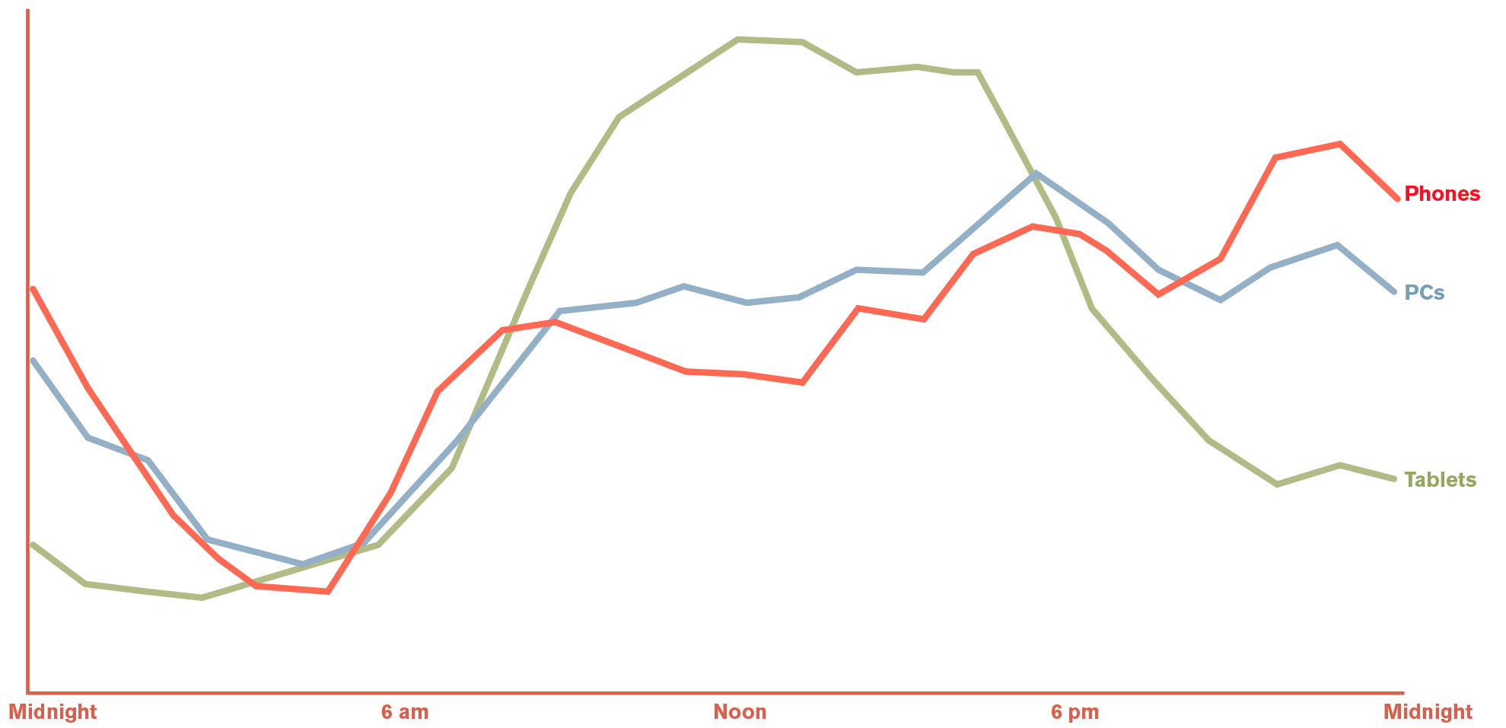
TECHNOLOGY AND BUSINESS ISN’T OPTIMIZED FOR DIGITAL, WIRELESS, INTERNET DELIVERY, AND I WANT TO TELL YOU WHY BEFORE WE GET TO THE TRADITIONAL DESIGN TOPICS, OR TALK ABOUT HTML5 VS NATIVE APP DEVELOPMENT
Notes:
But about, oh, I think it’s been 10 years ago now, we started getting reports from websites that after usage petered out for the evening, it picked up again. Consistently, by time zone. It was people logging off their computers, then picking up their mobile before they went to bed.
And we mostly pick up our phones and start checking before we get out of bed in the morning.
We use devices all the time, but the usage varies by device class, location, task, content, and intent. Know your audience. The Financial Times, for one example, sees HUGE spikes in traffic in the morning, all from mobile phones, and another large spike in the early evening on tablets. You can take advantage of data like this when designing your website, app and services.

Slide 3
Notes:
Google did a really awesome study in 2012, talking to actual people about their use, and needs. This shed a lot of light on the way the world works today and WHY people act like this.
We don’t use one device, but switch. A lot. And we use multiple devices at the same time. Watching TV while using your phone or tablet is the norm now, but is just one example. You use your phone at work, in front of your desktop computer, and so on.
The device we choose to use is driven by our context: where we are, what we want to accomplish and the amount of time needed.
http://services.google.com/fh/files/misc/multiscreenworld_final.pdf

Slide 4
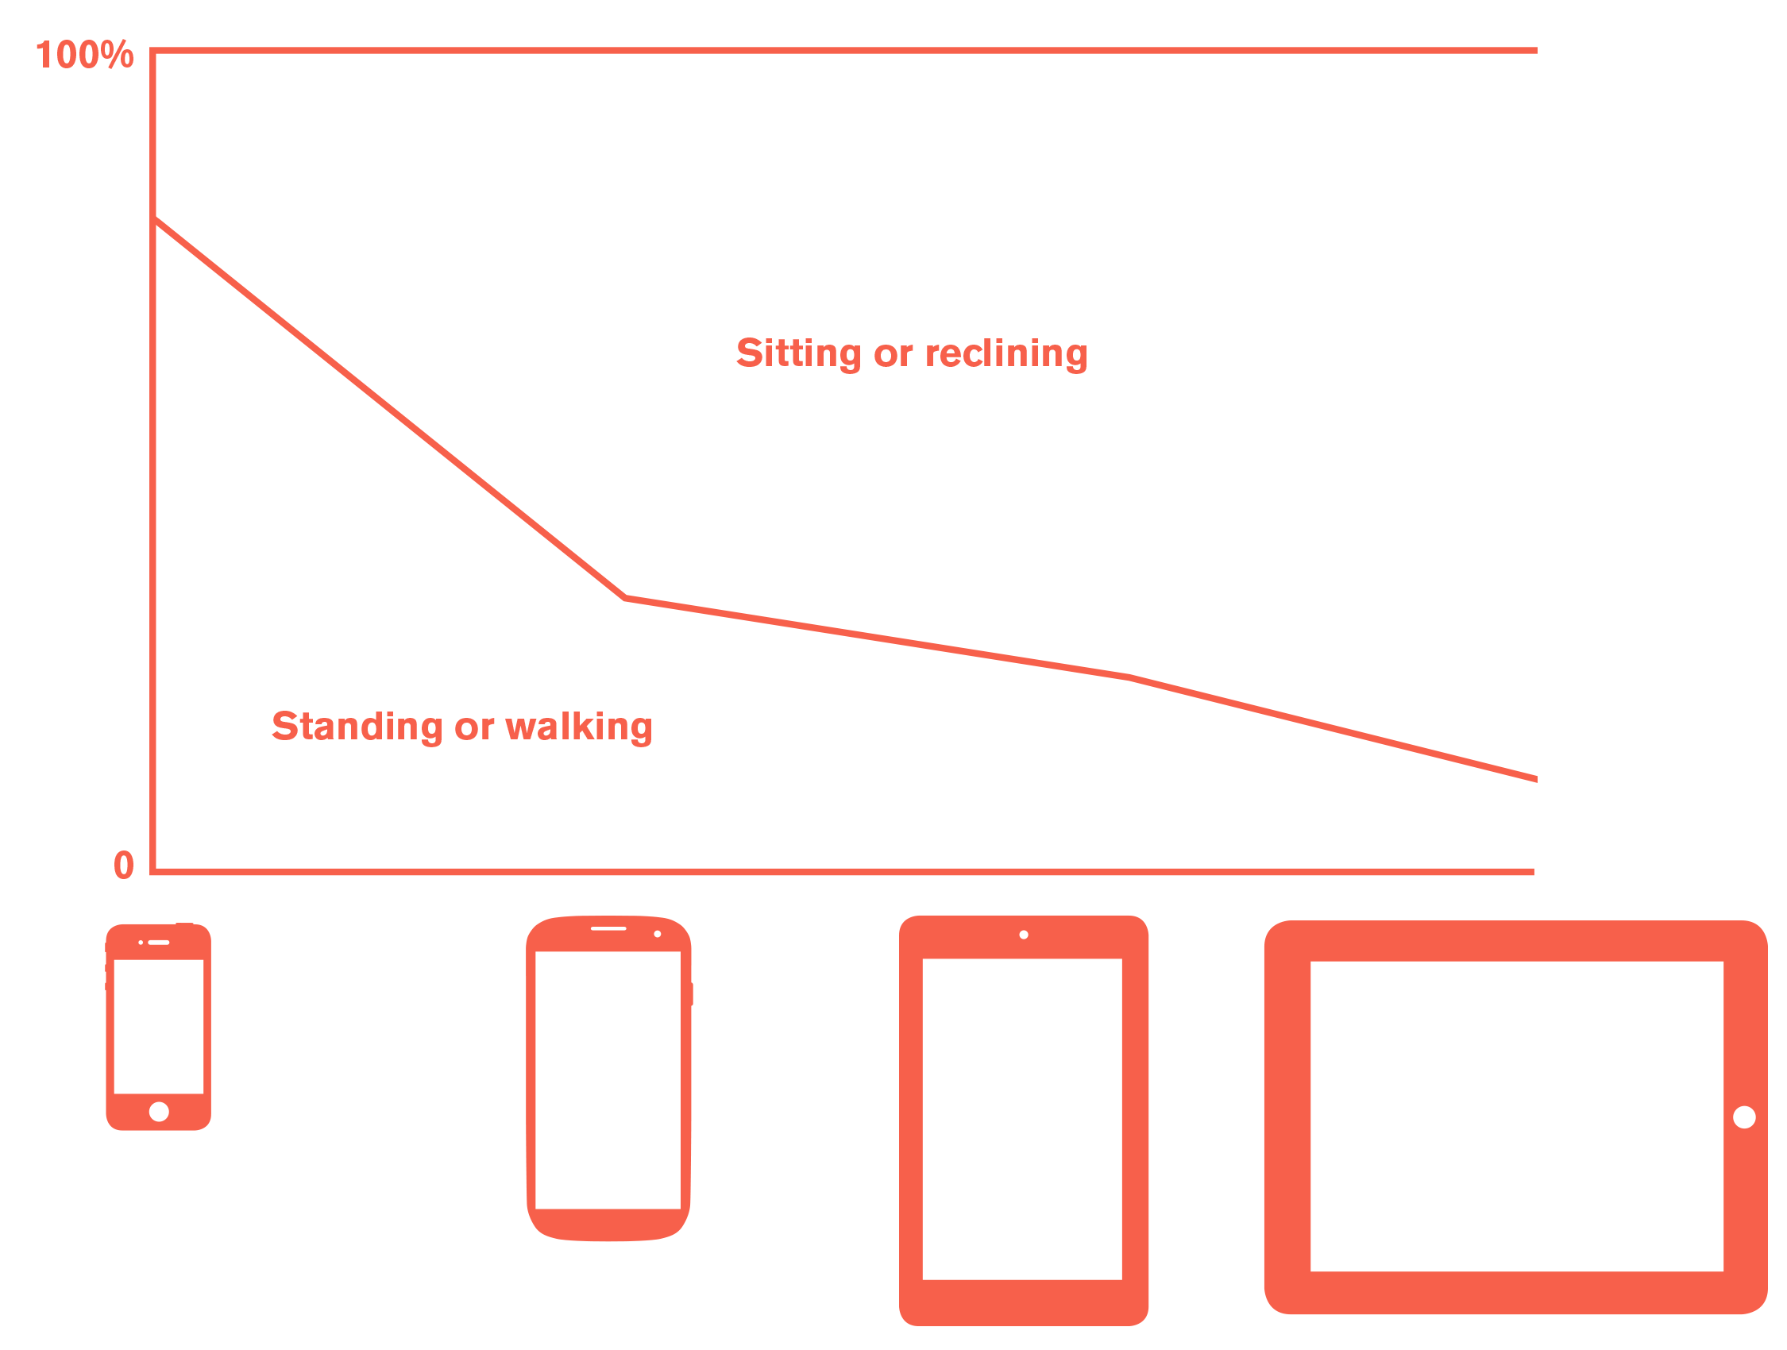
Notes:
We keep finding more and more info. This is from research reports I have worked on, but correlates nicely to the Google information, and lots of other stuff.
We know at the smaller the device is, the more it is used on the move.

Slide 5
Notes:
“On the move” doesn’t mean in busses or on trains, but can just mean when you walk around the house or office. When you can’t find time to go sit down at a desk.

Slide 6
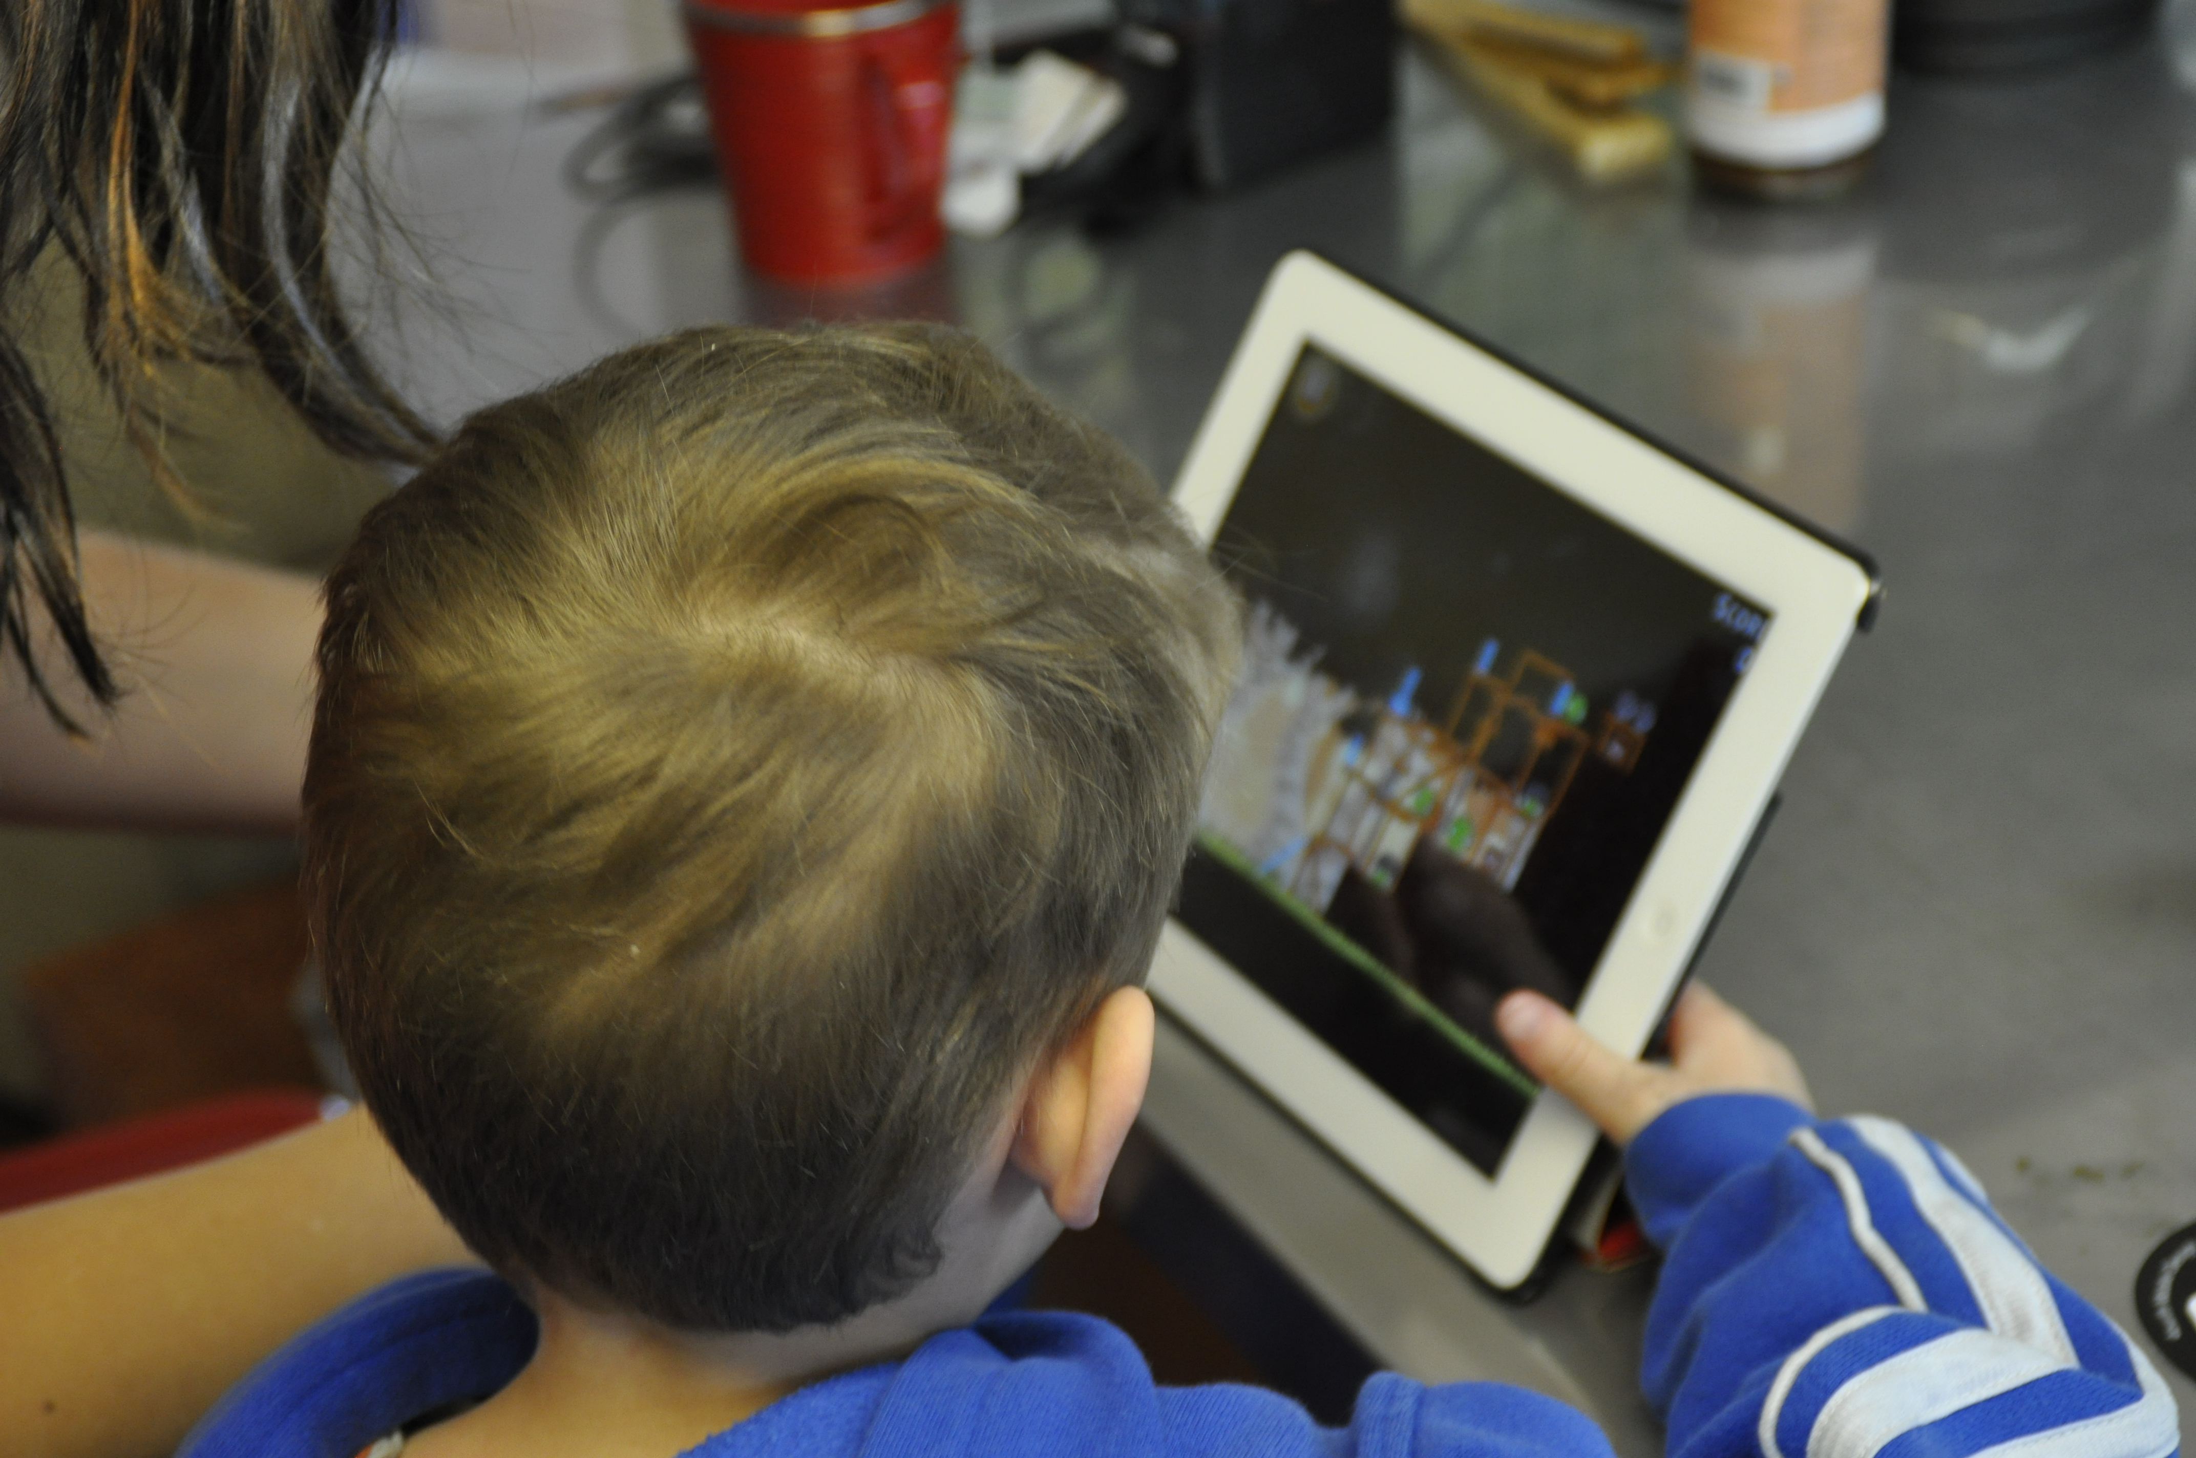
Notes:
Larger devices are used more like computers, most often on surfaces, in stands.

Slide 7
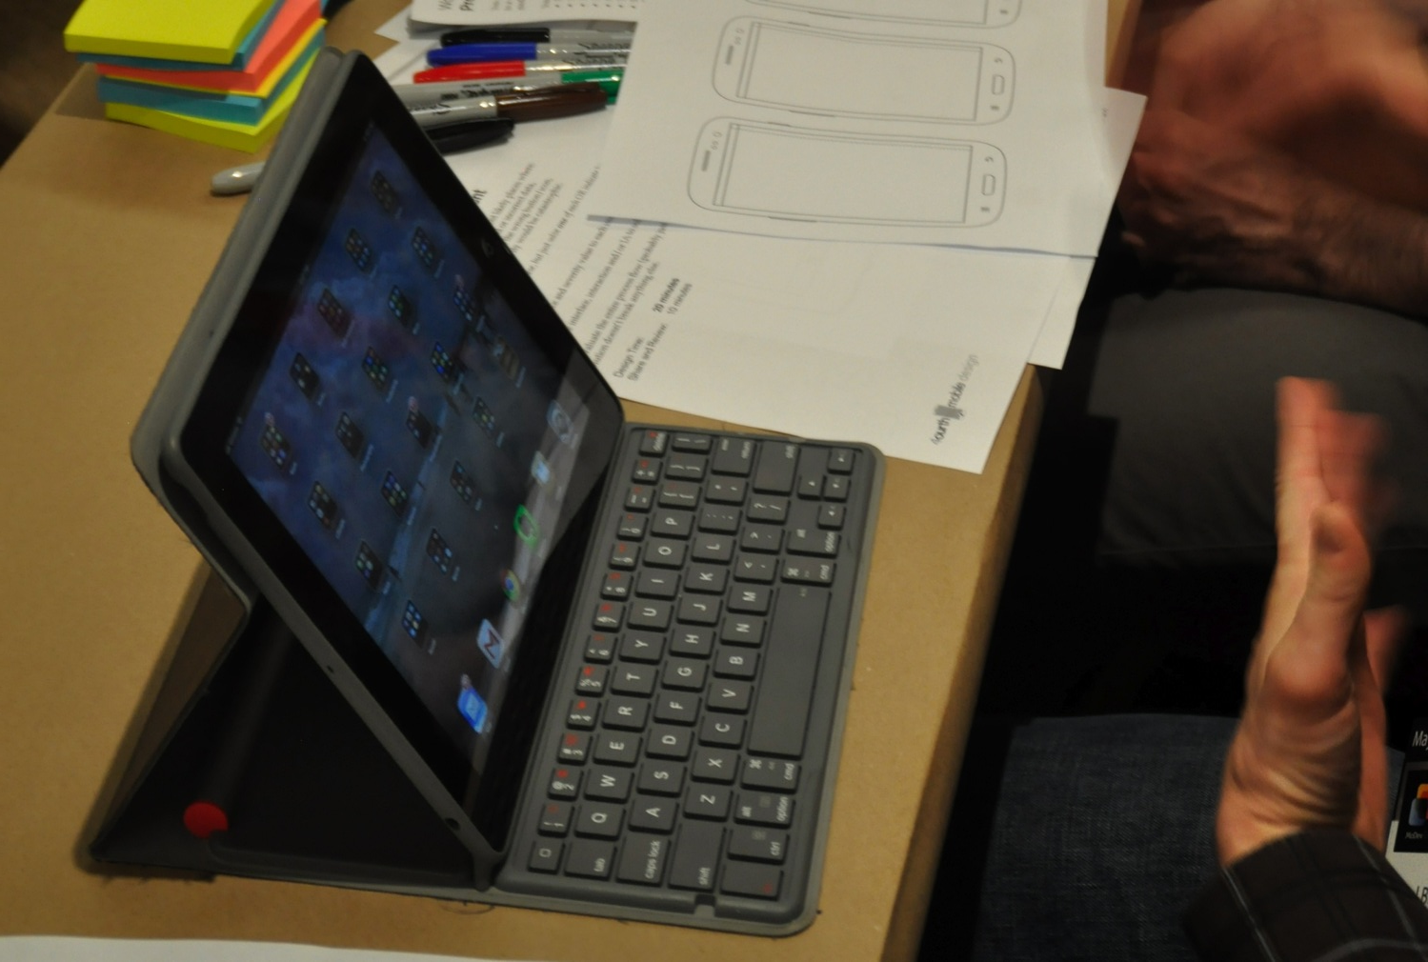
@shoobe01
#mwux14
7
7
Notes:
Sometimes with a stylus. Often with a keyboard.

Slide 8
Design for mobile context:
Always on
Always connected
Personal
Intelligent
Never forget
Notes:
The mobile won out, turning us all into cyborgs with always-on, always connected devices.
Devices also recognize you, and are always waiting for you to use them.
Mobiles are more intelligent than “full size” computers due to their sensors and connectivity, They recognize you, and can predict what you want based on past behavior.
They remember, or offer access to memory so you don’t have to remember.
Keep these attributes in mind as we proceed through the lessons. How can you take advantage of being always on, and always connected? By push messaging, and gathering data for example. How can you leverage intelligence and memory? By avoiding the whole issue of difficult user entry, by having the device not even ask for things it already knows or can derive.

Slide 9
What Mobiles Do
Notes:
… BREAK
How can we use the capabilities mobile devices have to fulfill user needs, goals and expectations?

Slide 10
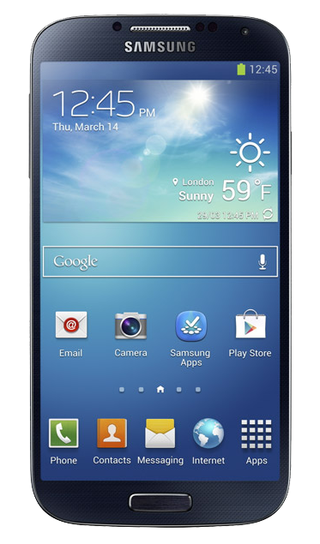
Capacitive Touch Screen
Notes:
I mentioned earlier that we are mostly designing for touchscreens. And that’s clearly important, as phones are pretty much rectangles enclosing touchscreens.
But this phone, and all smartphones, are not just about touch.

Slide 11
Gesture
Proximity
Light level
Light color
Capacitive Touch Screen
Cover sensor
Gryosensor
Accelerometer
Notes:
They have huge numbers of sensors, that make them aware of the user, and the world they live in.

Slide 12
Mobiles are different:
Not smaller, different
Part of the cloud
Full of sensors
Aware, active
Push to you
Notes:
Even today, people regularly discuss how to design for mobiles or wearables or the Internet of Things, vs. “normal computers.” Well, I say there’s no such thing as a normal computer. If you mean a desktop or laptop PC, that’s an anomaly of technology.
Mobiles are not smaller, or less-capable, but different. Better I think. Remember a few years back, terms like Ambient or Ubiquitous computing? Well, we got that with everyone on the planet carrying around an Internet terminal.

Slide 13
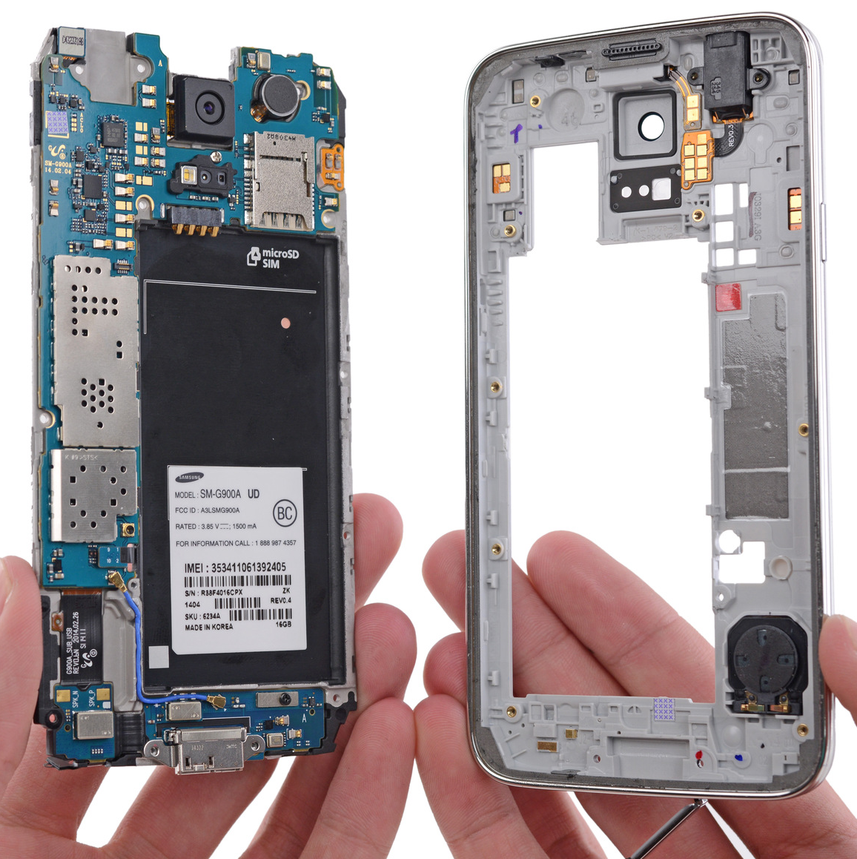
Notes:
Behind everything, there are wires, radio antennas, batteries, sensors, integrated circuits, resistors, films, adhesives and many more components.
You should know that mobiles are not just magic boxes of plastic and glass, but understand why they do what they do.

Slide 14
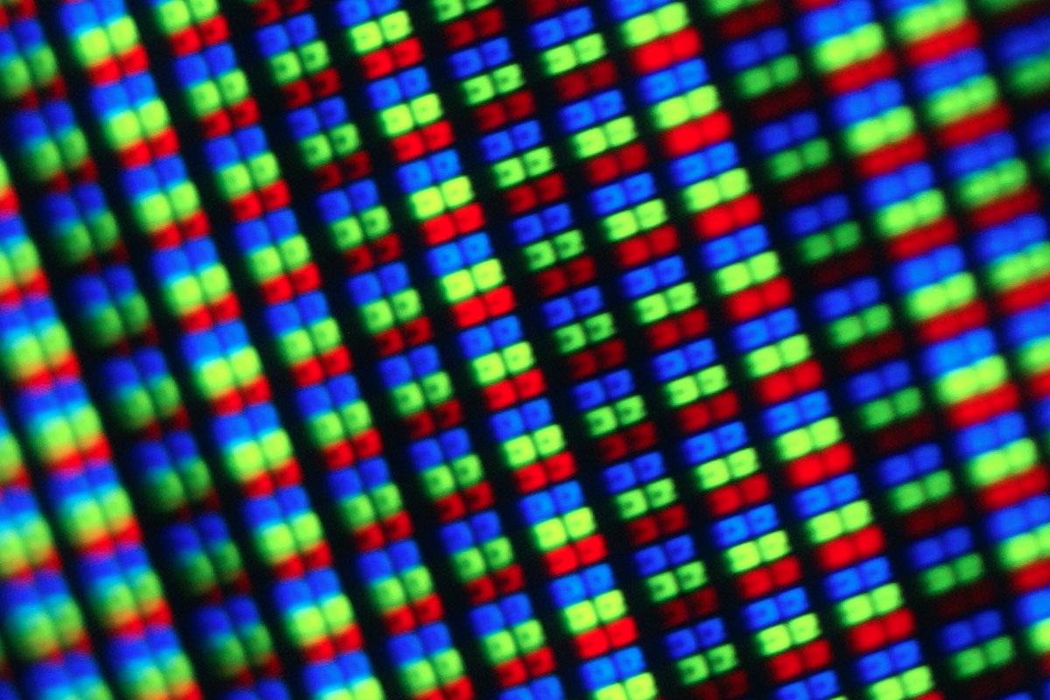
14
Notes:
Let me touch on just a few key ones, to give you a taste of the complexity, and implications of this.
We like to pretend displays are made of square pixels of color, like when you zoom in to Photoshop. But this is what a display looks like. And there are several variations. It can matter which one you are using, not just to make sure graphics look sharp, but to the degree of managing power so battery life is all day, instead of an hour or two.

Slide 15
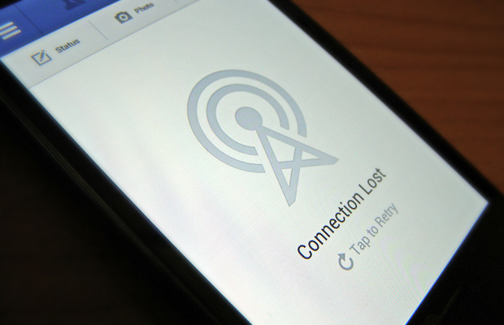
15
Notes:
As I discussed in the previous video, “Always connected” is actually one of those network fallacies. You should know how well or poorly it really works for end users, and plan on small dropouts even in good coverage areas like the middle of New York City, so you never expose the edges of the system like this.
Solve this by caching, or synch information to a local datastore, preferably in the background so whenever they want it the data is waiting for them. At least make sure to look ahead and load what you expect they want to see next, retry for them (so you never make the user “Tap to Retry” like here.
We need to design and build with an understanding of delay, and difficulty. Both technical delays and because of our lives. Users get interrupted, and switch platforms. Networks fail, and stall, and delay.

Slide 16
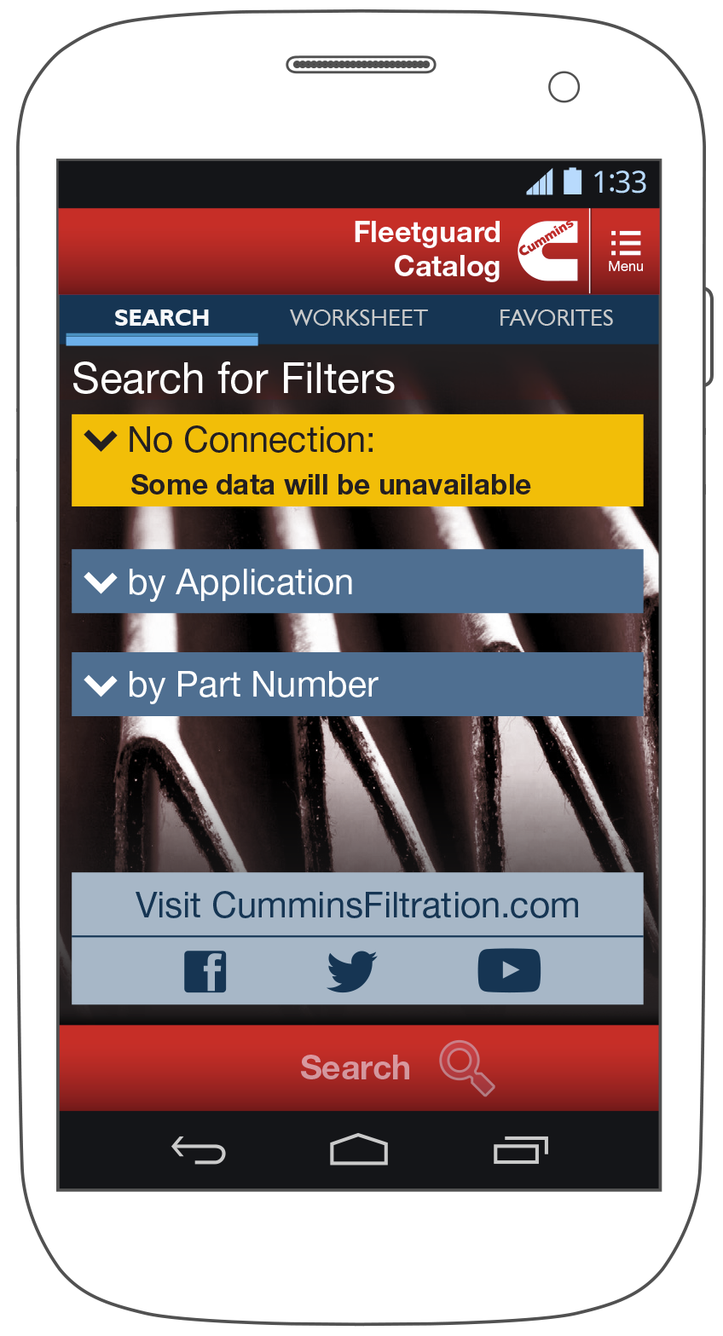
16
Notes:
We have to cache data, allow working offline, build for multi-channel, multi-device use cases. We have to automatically synch, and not cause errors when there are mismatches. We should resume, and encourage sharing so users can continue tasks when they get home or collaborate with friends and family.
This app I designed is all about working globally, even if that means deep in a mine. So the data is all synched and if there’s a connection error we just mention it as an aside. But what we downloaded before is still available, without dismissing a disappointing error dialog.

Slide 17
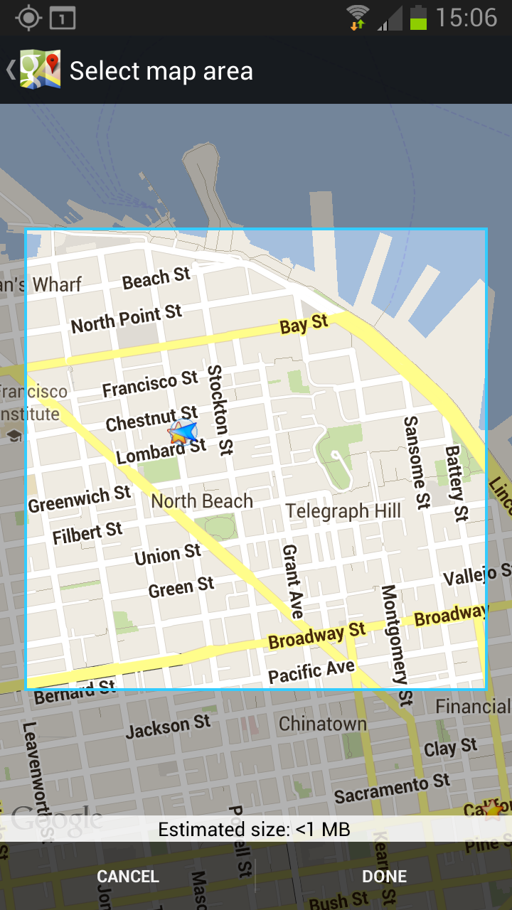
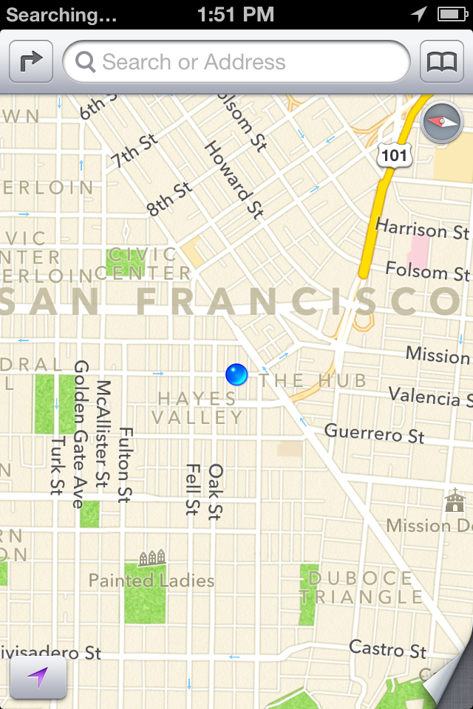
Google Maps, iOS
Google Maps, Android
Apple Maps
Notes:
If you don’t get what I mean, or why, let’s take a specific case, maps.
You might need maps when you are far into the boonies. Or you want to know where you are going next while in a tunnel, in one of the no-network area on an underground subway. This is all real stuff I encountered with network issues biking around San Francisco.
Maps deal with this in different ways, that are useful to illustrate this:
- Google maps on iOS does… nothing. If you are off network, you get a useless blur.
- Google maps on Android does a better job of having a “basemap,” a permanently cached global map, but you can maybe find half a dozen towns per state, and maybe none per country in sub-saharan Africa. They do have a service to manually cache areas, but you have to plan ahead. And can only save so many of these.
- iOS Maps has, despite other flaws, probably the best overall solution: It automatically caches. If you have looked at the area lately, it’ll keep it stored offline. So if you plan your trip, then go there soon enough it’s waiting for you.

Slide 18
Notes:
Connectivity may be such an issue that nothing you do to the website or app can solve it.
This is a diagram I made describing how the only way we can get the needed product to work in Africa is to build (or lease space on) local data centers and get them piped straight into the mobile network operators.
UX is not UI. You may need to ask for specific data storage types, or network arrangements. You may not get it, but you should always think systematically.

Slide 19
Notes:
Location based services: The image here is one of my phones, on a sort of GNSS test app. The circles are GPS, and the triangles are GLONASS satellites. That’s a wholly different network.
Using the term “GPS“ is wrong. Phones can get location from about a half dozen different sources. I won’t go over them but to tell you that the device will generally give you Coarse or Fine location, and the accuracy level of whatever you get. You should not require the user to give more precision than they want, and learn to get by with only the data you need.

Slide 20
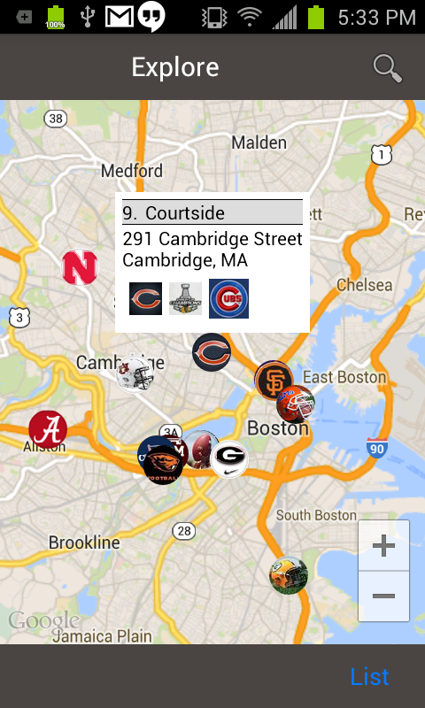
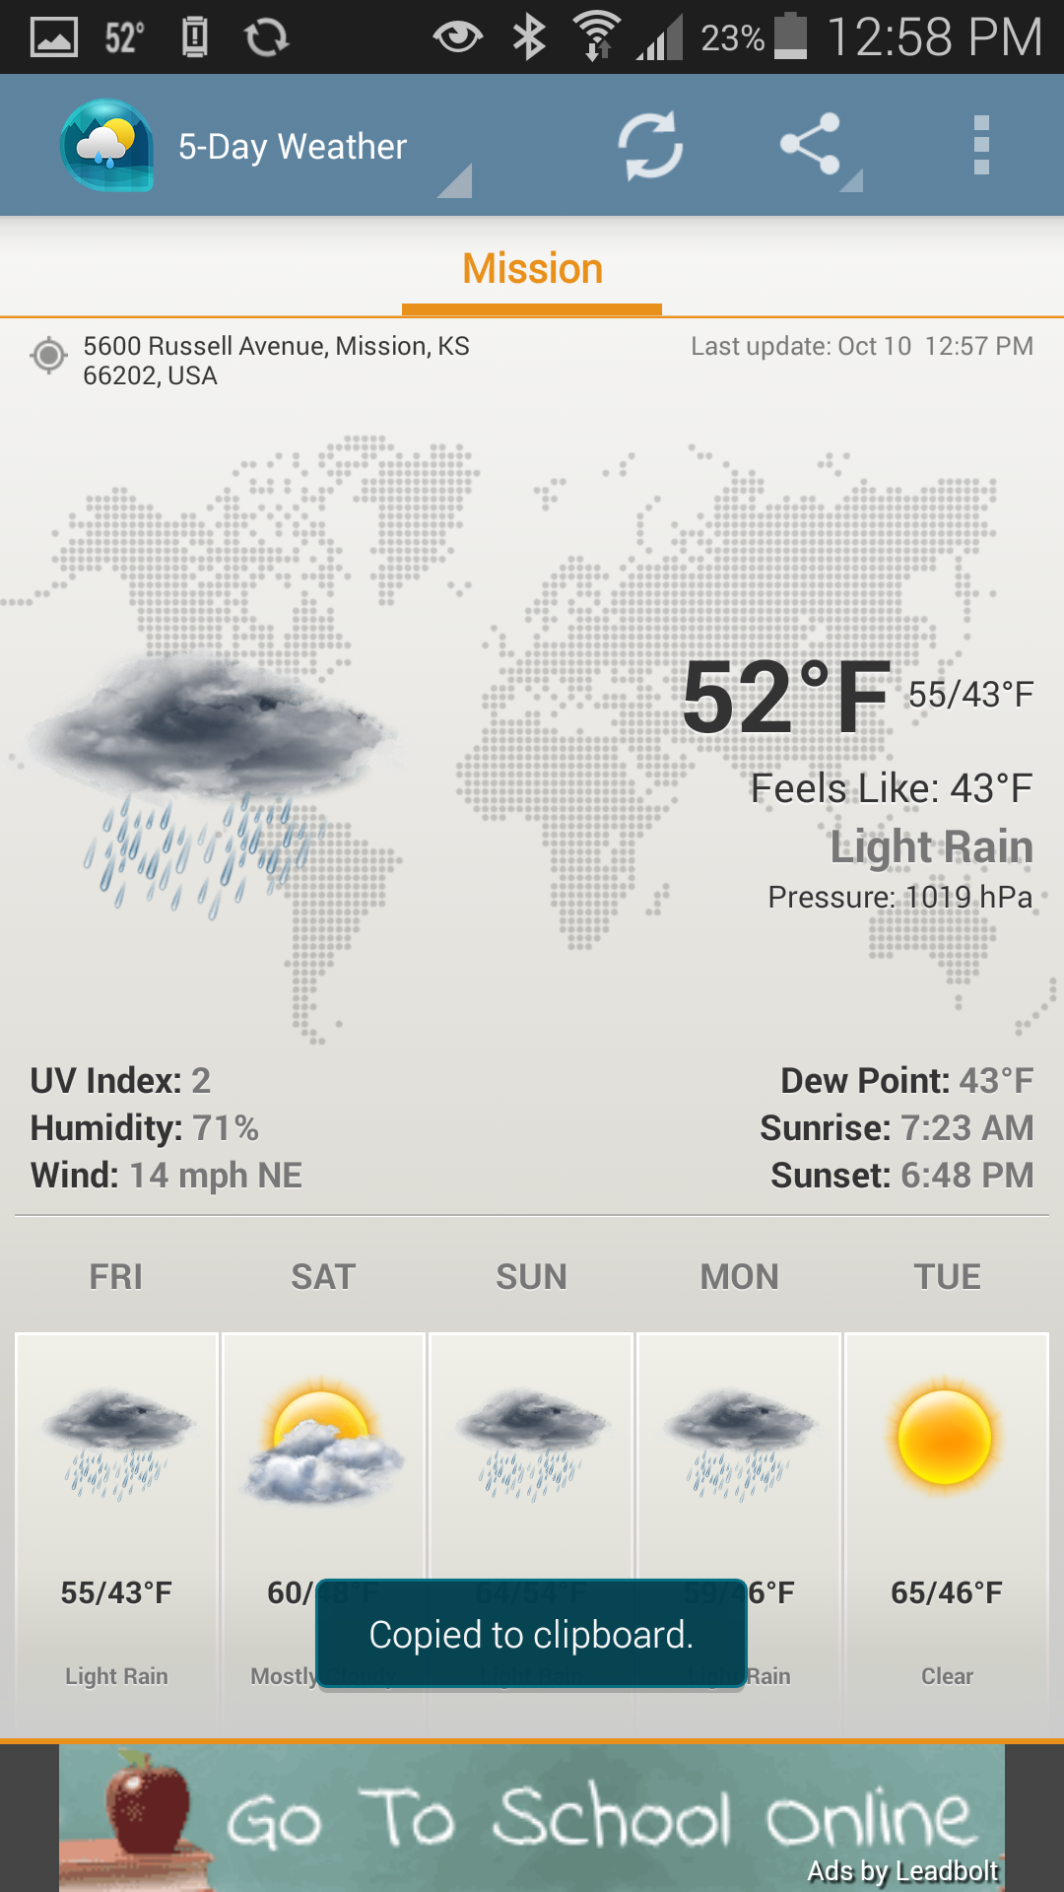
Notes:
Your weather or sports score summary app probably doesn’t need to know with 1 meter accuracy where the user is to present localized information. A few kilometers will be fine. This preserves the user’s privacy, as well as their battery while still automatically giving them relevant information.
Note how the weather app on the right also makes it clear it is vague organically, by showing the whole earth and the weather icon over your part of it. There’s no need to imply pinpoint accuracy when it’s not true.

Slide 21
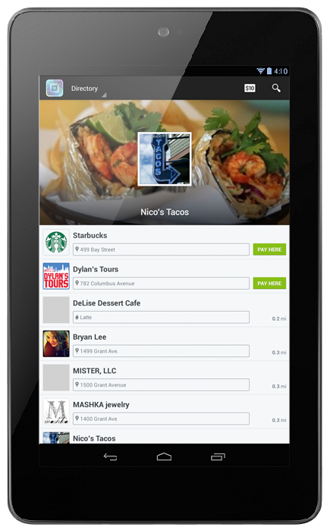
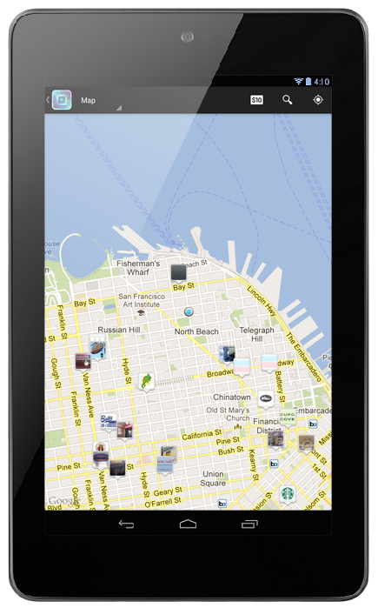
Notes:
On the desktop, IP location is okay, but it’s uninteresting to me because you are in your home. You probably aren’t looking for a new place to live, or restaurant recommendations near your house so we ask what you want.
On mobile we can assume the user is in the location they want to use the info, and since the device already knows, we can much more effectively push the information to the user.
Building a list of local results, or especially a map? Don’t start with a search box, but the list of results or the map itself. When you open the website, app or feature, you get the info like this Square shopping app. I can see relatively to where I am who can take my payment method or give me a deal, with literally one tap on the icon for the app.

Slide 22
“…inequality is where the opportunities/challenges for design really are.”
– Andrea Resmini
@resmini
Notes:
Mobile are different.
Don’t avoid the differences, or try to work around them, to make your website work the way you are used to on desktop. Understand these capabilities, and embrace the differences in platforms.

Slide 23
People & Technology:
Account for user context
Plan for user goals, intents
Accommodate their platforms
Expect switching, sharing
Use device features properly
Only use data you need
Notes:
...by not assuming it’s all screen, not translating keyboard-mouse-monitor into touchscreen, but accepting the ocean of sensors and capabilities.
Remember most of all we design for users. Mobile lets them be away from a desk, living their lives, so accommodate their context, goals and objectives.
Respect their platform choice, and let your product work on as many as possible. Think about how it can work on multiple devices, at once, resuming later, or what happens if someone shares a link.
And support this behavior with the hardware mobiles offer. Not just gestures, but location, accelerometers, proximity, cameras, and the more ubiquitous connectivity they offer.

Slide 24
In Part 3:
Platform Choices
History of mobile development
Scope of platforms
Choosing between web and app
Notes:
In the next segment I’ll start to talk about those platforms, discuss the differences between web and app, and how you can choose which one to use, if you have a choice.

