Slide 1
TIMING/VIDEO
Remove auto-advancing after creating a video version:
On/Off:
In the tabs (not menu): “Slide Show”
[X] Play Narrations
[X] Use Timings
[ ] Show Media Controls
Clear the timings completely:
Select all the slides
Right click a slide > “Slide Transition…”
In the “Advance slide” section uncheck “Automatically after”
The complete guide to Designing Mobile User Experiences 2) People & Technology Resources
@shoobe01
4ourth.com

Slide 2
People & Technology
Read More:
If you need to quote the figures I've mentioned to your clients or boss, I've included them and a few more here. The Google report especially is worth reading in full. I have also included some additional details or further reading on all the other topics, including a few I wrote myself.

Slide 3
How often do YOU look at your phone?...
http://www.dailymail.co.uk/sciencetech/article-2783677/How-YOU-look-phone-The-average-user-picks-device-1-500-times-day.html?ito=social-twitter_mailonline#ixzz3FTEdxnvq
Late 2014 data, but in mass market terms so really easy to quote and consume. Just from the intro blurb:
The average user reaches for their phone at 7:31am in the morning
These users check personal emails and Facebook before they get out of bed
And many of us pick up our phones more than 1,500 times each week
Average owners use their phone for three hours and sixteen minutes a day
And almost four in ten users admitted to feeling lost without their device

Slide 4
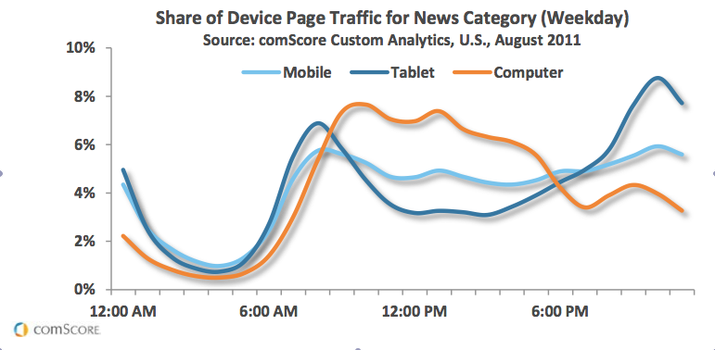
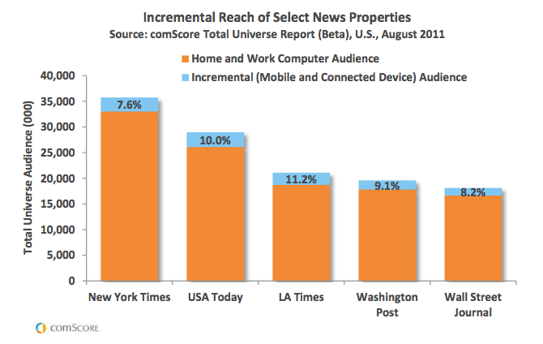
Night owls read news on tablets, as mobile overtakes computer for at-home browsing
http://www.poynter.org/latest-news/mediawire/149113/night-owls-read-news-on-tablets-as-mobile-overtakes-computer-for-at-home-browsing/
Additional data about use rates by time of day. Start here, then try to get stats like this for how your app or website is consumed on different devices. It varies, so you cannot rely entirely on instinct or general stats.

Slide 5
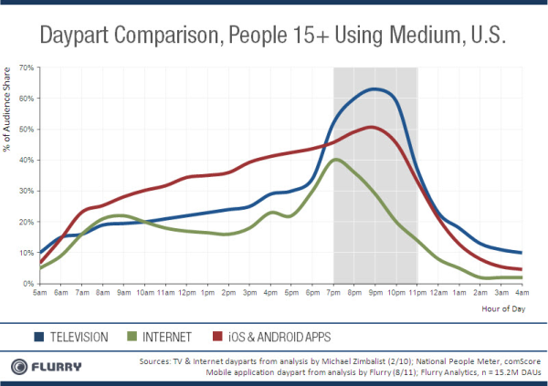
Mobile app usage: active all day, spikes in prime time
https://gigaom.com/2011/09/29/mobile-app-usage-active-all-day-spikes-in-primetime/
Lots of the use data is about websites. This is some neat info on use of apps by time of day instead..

Slide 6
More than half of all Google searches now happen on mobile devices
http://www.theverge.com/2015/10/8/9480779/google-search-mobile-vs-desktop-2015
You think maybe those sites where the majority of traffic is mobile are weird? Wrong. Mass market stuff used by everyone, like Google, are majority mobile now, and mobile traffic use is growing faster than desktop.
today Google now sees more than half of its 100 billion monthly searches occurring on mobile devices. Singhal, who's speaking at Recode's Code Mobile conference in Half Moon Bay, California, defined mobile as devices with screens smaller than six inches.
So, he doesn’t count tablets as mobile, even!

Slide 7
THE FINANCIAL TIMES MARCHES TO A DIFFERENT APP DRUMMER; EMBRACES HTML5, ANDROID, WINDOWS 8
http://tabtimes.com/html5-king-financial-times-publishers-don-t-get-transformational-benefit-5511/
The Financial Times is weird, doesn’t focus on iOS first. Silly? Or maybe just driven by actual stats and analysis.
FT readers seem to have been just as enthusiastic; 25% of traffic to FT.com now comes from mobile, while smartphones and tablets also account for an impressive 15% of new subscriptions to FT.com.

Slide 8
The New Multi-screen World:
Understanding Cross-platform Consumer Behavior
http://services.google.com/fh/files/misc/multiscreenworld_final.pdf
It is hard to say enough about how much you must read this, or pick anything to extract. While a small study, it correlates well to observed use rates, and tells us the user’s context, intent, and needs in a really useful, consumable way.
Read it, quote from it for your projects.
Note, a PDF. There are summaries in HTML, and some article-like versions, but I prefer the content in this one.

Slide 9
State of Connectivity 2015: A Report on
Global Internet Access
https://newsroom.fb.com/news/2016/02/state-of-connectivity-2015-a-report-on-global-internet-access/
Lots of neat data and futurism fodder, but right there in the summary is a great point about how people are connected, or not.
The four key barriers to internet access include:
Availability: Proximity of the necessary infrastructure required for access.
Affordability: The cost of access relative to income.
Relevance: A reason for access, such as primary language content.
Readiness: The capacity to access, including skills, awareness and cultural acceptance.

Slide 10
SOME OBSERVATIONS ON MOBILE BEHAVIOR IN INDIA
http://arpitonline.com/2016/01/21/some-observations-on-mobile-behavior-in-india/
How you use your phone, why, and how are only so universal. Regional and cultural differences abound. If you can’t get out out spend a few weeks on ethnography in other countries (and I can’t either) then read more. This is some general observations from India, and it’s different from the US.

Slide 11
Designing for Touch
http://4ourth.com/Touch/
If there’s one thing I am unequivocally the expert on, it’s how people hold and touch their phones and tablets. This is an outline of it, and links to many articles, videos, decks and about a hundred of references.
Fingers, Thumbs & People
http://interactions.acm.org/archive/view/may-june-2015/fingers-thumbs-and-people
A very short summary of it was also published recently in ACM Interactions (a paper magazine!) so that may look more trustworthy to your boss.
If you aren’t a member of ACM, I’d join it for the reference library as well as the magazines. Totally worth it.

Slide 12
Making mLearning Usable
http://www.elearningguild.com/content.cfm?selection=doc.3315&utm_content=buffer0162c&utm_medium=social&utm_source=twitter.com&utm_campaign=buffer
4ourth.com/Touch
Sorry, paywall here, but I am providing this as sometimes proof works better when it’s more formally presented. This is the same basic content as the last page, but in a very long, formal report, with many charts outlining the results
Want the content for free? I have re-posted to my blog as well:
http://shoobe01.blogspot.com/2014/11/making-mlearning-usable-how-we-use.html

Slide 13
The Social History of the Smartphone
http://4ourth.com/wiki/Introduction%20to%20Location%20Technologieshttp://www.uxmatters.com/mt/archives/2014/07/the-social-history-of-the-smartphone.php
We’re user-centered, but where does that end? People become comfortable with technology due to internal needs and external influences from the environment, and society.
While digital natives are comfortable with technology, the question is: which technology, in which context? There are now more mobile phones on Earth than there are people! And most of these phones have cameras. Yet Google Glass feels invasive because of its ability to record video.

Slide 14
Nine Lies We Tell Ourselves About Mobile
http://uxmag.com/articles/nine-lies-we-tell-ourselves-about-mobile
Congratulations! You are taking time to learn, but many are not, and use personal bias and incidental observations to base their viewpoint on. This article outlines some of the key fallacies I see people hold, and how it influences their design decisions.
We run the risk of spending a lot of time basing our deeply thoughtful design effort on improper foundations—on stereotypes, exaggerations, gut feelings, and personal bias.
The danger with this should be apparent to UXers. We have to get out of our comfort zones to discover and understand the truth about technology, systems, organizations, networks, and markets, not just people.

Slide 15
Three very confusing telecoms terms
http://us1.campaign-archive1.com/?u=f105fd56904428bca9da44a82&id=668b583237
Martin Geddes is a very, very clever guy I used to work with, who consults with telecoms all over the world and rants a lot about how networks are not at all what you think they are.
Sign up for his newsletter, but this is a good intro to the topic. Network speed, and many other things, are a lie. At a conceptual level.
The speed of light is fixed, so networks aren’t getting “faster” like CPUs do. Indeed, there’s no “Moore’s Law” for networks.The idea of “speed” conflates packet (de)serialisation time (i.e. how long it takes to “squirt” the packet over a link) with low contention (due to network idleness). It also conflates “speed of response” (delay) with “speed of download” (capacity).

