Slide 1

The complete guide to
Designing Mobile
User Experiences
1) The phones are here to stay
TIMING/VIDEO
Remove auto-advancing after creating a video version:
On/Off:
In the tabs (not menu): “Slide Show”
[X] Play Narrations
[X] Use Timings
[ ] Show Media Controls
Clear the timings completely:
Select all the slides
Right click a slide > “Slide Transition…”
In the “Advance slide” section uncheck “Automatically after”
V/O:
FRIENDLY!
PERSONABLE!
CASUAL!
@shoobe01
4ourth.com
Notes:
This course is, I hope, exactly what it sounds like. Tips, techniques and strategies for Designing Mobile User Experiences.
Some of what I say is intended to be foundational, some will just tease you to go read the resources and explore more, but I hope much of it can be applied to your work directly, and immediately with actionable guidelines, numbers and best practices,

Slide 2
UX != UI
Field research
Face to face interviewing
Creation and administering of tests
Gathering, organizing, and presenting statistics
Documentation of personas and findings
Product design
Feature writing
Requirement writing
Graphic arts
Interaction design
Information Architecture
Usability
Visual design
Taxonomy creation
Terminology creation
Copy writing
Presentation and speaking
Working tightly with programmers
Brainstorm coordination
Company culture evangelism
Communication to stakeholders
Prototyping
Interface layout
Interface design
Notes:
If you are not a UX practitioner, you might think that we’re going to talk about colors, fonts, icons, and placement of items on the page. But that’s UI.
CLICK
UX is so, so much more, and this course is going to cover the entire range of USER Experience impacting facets, from networks, to phone hardware, to demographics, all the way to information architecture, interaction and yes some interface design, too.

Slide 3
Course Outline
The Phones are Here to Stay
People & Technology
Platform Choices
Hybrid or Native App?
Adaptive or Responsive?
Information Architecture
Outside & Between
Back & the Stack
Interface Design by Zones
Interaction & Touch
Input & Entry
Interaction & Specification
Designing at Scale
Notes:
Most of all I am going to regularly circle back to people, and how they interact with devices, have needs, goals and objectives you have to keep in mind throughout the process of building your app. Or website. Or both.
Individual videos in this course are mostly less than 10 minutes long. If you watch the whole thing end to end, it should take you less than 2 hours. Naturally, I expect you to mostly watch them individually, then refer to the resources attached to each video, explore the topics I covered more deeply and think about how to apply that to your work before progressing to the next lesson.
…

Slide 4
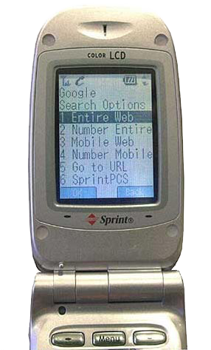
Notes:
I am going to say a lot of things about working with developers, designing for the way people work and the history of technology basically because I am old.
Years after I got into mobile was when the term “featurephone” was invented. I have been doing what we now call UX work since 1996, and mobile design since 1999. Yes there were interfaces on mobiles, and even web browsing on handheld devices years before that.
Yes, there’s opportunity galore today, but I got in at a fun time, and early on got to design the first Google mobile search ever, and work on the first music phone in the world along with it’s accompany music and app store before anyone had one we could copy.

Slide 5
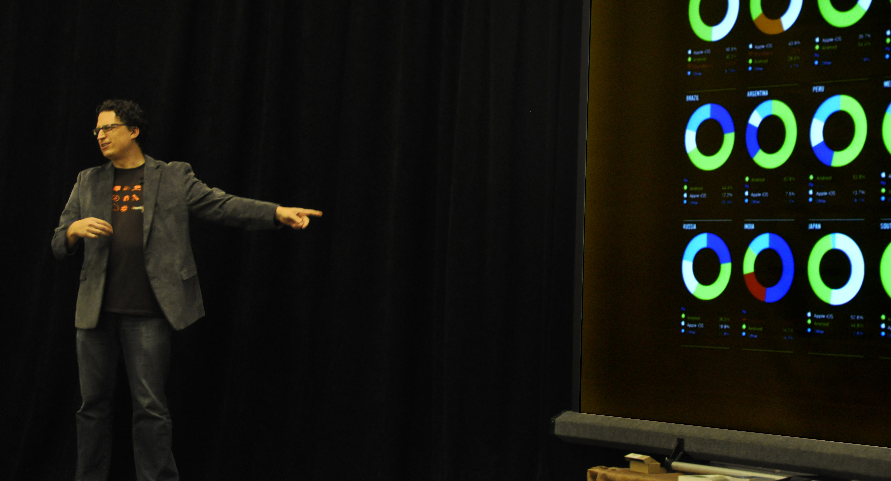
Notes:
Much of what I say comes not from the awesomeness and successes in doing all this, but the failures. Sometimes, bad failures. This is why I share the information: we already know stuff that needs to be passed along and shared to make sure we’re all doing the best possible job designing for our users and clients.

Slide 6
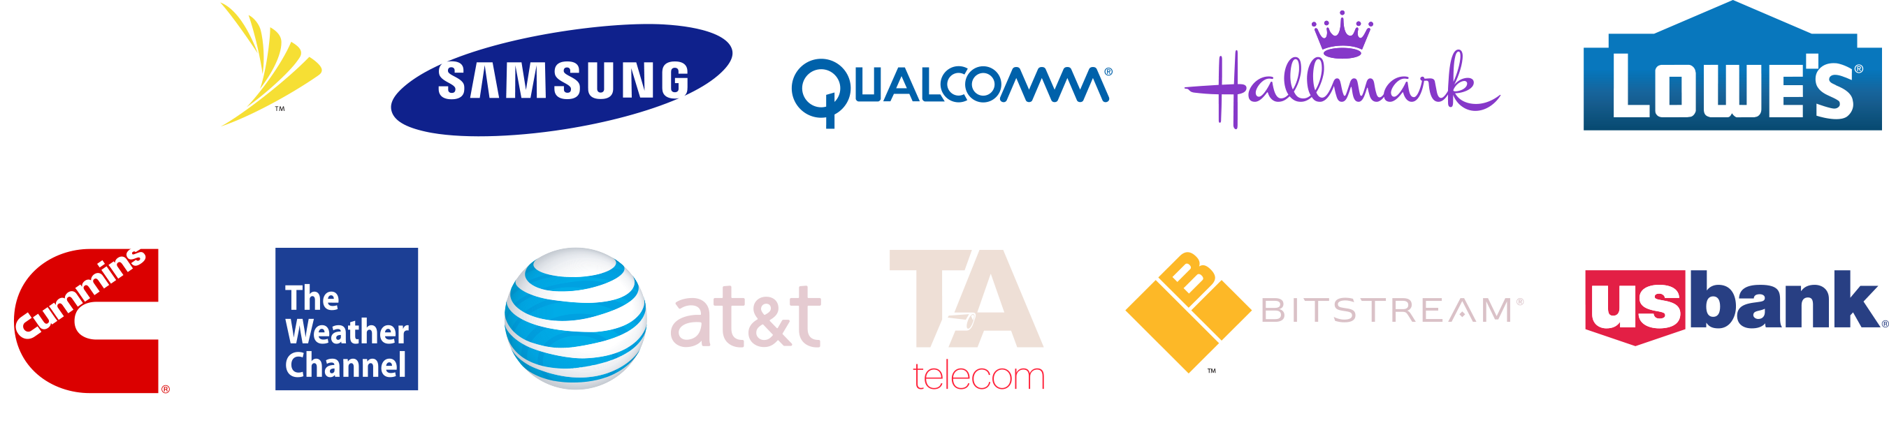
Notes:
Aside from mobile telecoms, I have helped build mobile sites such as Weather.com, and apps for companies like Hallmark, US Bank and Cummins. I’ve designed, at least in part, five mobile browsers. And done stuff for plenty of startups that I am still—or not yet—allowed to talk about.
But I know from this the heyday of innovation is not behind us. There’s more cool stuff to do.

Slide 7
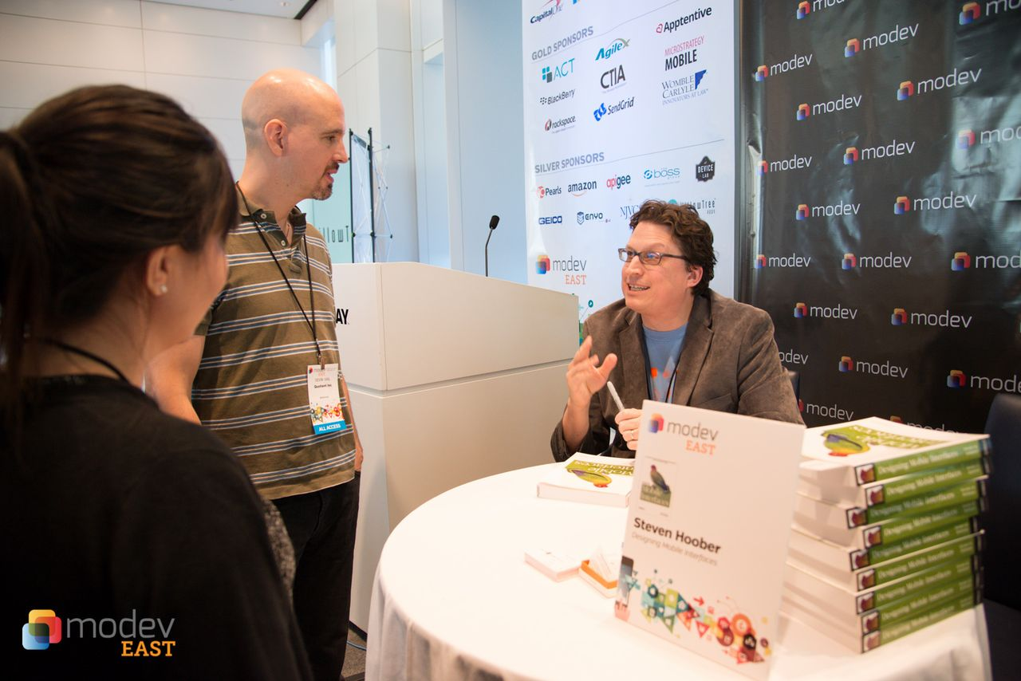
Notes:
I wrote a book on this, have contributed to other books, write a column for UXmatters, and regularly write for UX Magazine and others. So I think about this a lot, and encourage you to not just take one class and call it good, but put together a regular list of twitter accounts, blogs and magazines you like from the resources I provide here so you can keep up on it as you progress in your career.
…
If you are taking this course, you presumably understand that the coming of mobile devices means it’s something you need to prepare to use.

Slide 8

We are outnumbered.
UPDATE
Notes:
But it’s already here. There are more mobile devices than humans. Yes, over 7.2 billion devices in use. That’s around 5.5 billion PHONES used by some 4.5 billion people. 63% of all the people on the planet have a mobile phone.
/Everyone/has a mobile phone. Many fewer Americans over 65 have a mobile, but that’s still 78%.
Smartphones? 2.8 billion of those (UPDATED JAN 2016)

Slide 9
Many more mobiles
than computers.
Notes:
Computer sales are relatively plummeting. PC sales dropped 95% in 2013. Mobiles continue to grow, and for several years now have outsold desktops and laptops.
If you heard that iPad sales are flattening, remember that’s just one device by one maker. There will be more tablets sold in 2014 than desktops and laptops combined.
Expect 2 billion mobile devices to be sold in 2016.

Slide 10
80% growth in use in 2013.
NEED TO UPDATE
Notes:
Even with all this scale in place, mobile use rates continue to grow, rapidly.
Mobile traffic grew 80% in 2013. And this is scale like has never been seen. 5 billion people saw an ad on their phone in 2015. More than any other media type. Whatsapp, just one service, on mobile alone, has a billion active users. And don’t get me started on MMS and SMS use rates; they put Facebook to shame.

Slide 11
Users prefer mobile.
UPDATE
Notes:
Which I believe. Depending on the survey, as many as 2/3rd the people in the US only have a mobile internet device, or prefer to use their mobile over a desktop or laptop—even when one is available in front of them, or in the next room.
You won’t be surprised that the rates in places like Kenya, where connectivity is generally only on mobile networks, are over 90%.
On days when we’re away from home or engaged with family: Thanksgiving and Christmas, over HALF OF ALL Internet traffic in the US is from mobile. And on those days, handsets traffic outweighs tablets 2:1.
You want to make money? Contact your customers? Be in mobile. The old rule of thumb on ad response in direct mail was that 1% is good. Not far off that for email campaigns or banners. But SMS or MMS campaigns? 30% response, usually in a matter of seconds.

Slide 12
Design for mobile.
Notes:
So, design for mobile, adapting to the users’ environment, needs and devices, as you design your solutions on every platform.
Wait, every platform?

Slide 13

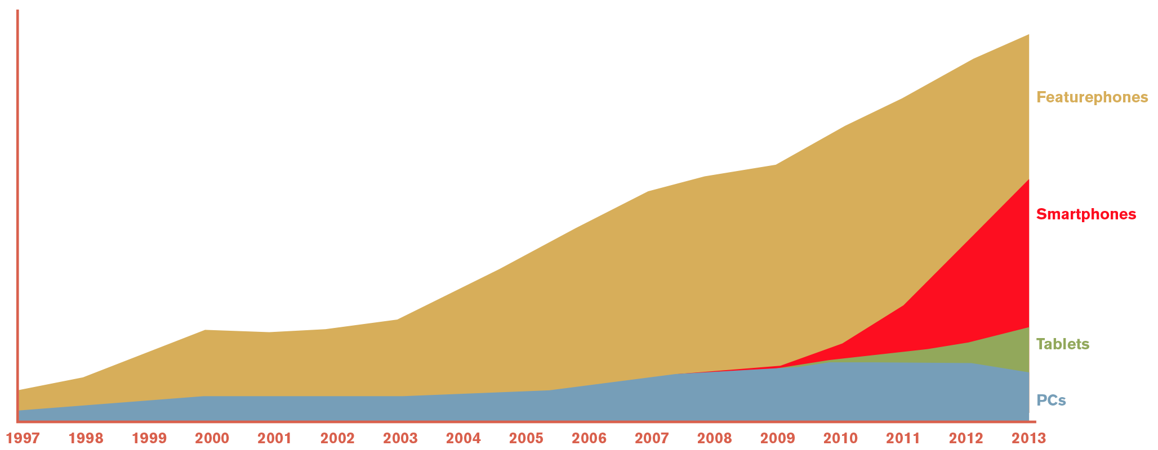
Notes:
Yes, smartphones are taking over — and Android is winning not just in total installed base (where iOS has only about 19% market share now) but in use rates across the board.
But it’s taking over from featurephones. Which still matter, and for which your mobile website will be used.
While we mostly care about this CLICK, we should also know what happened here CLICK, or here CLICK and how what happened in the 1940s, or the 1890s had a huge impact on what we do with mobiles every time we use them today.

Slide 14
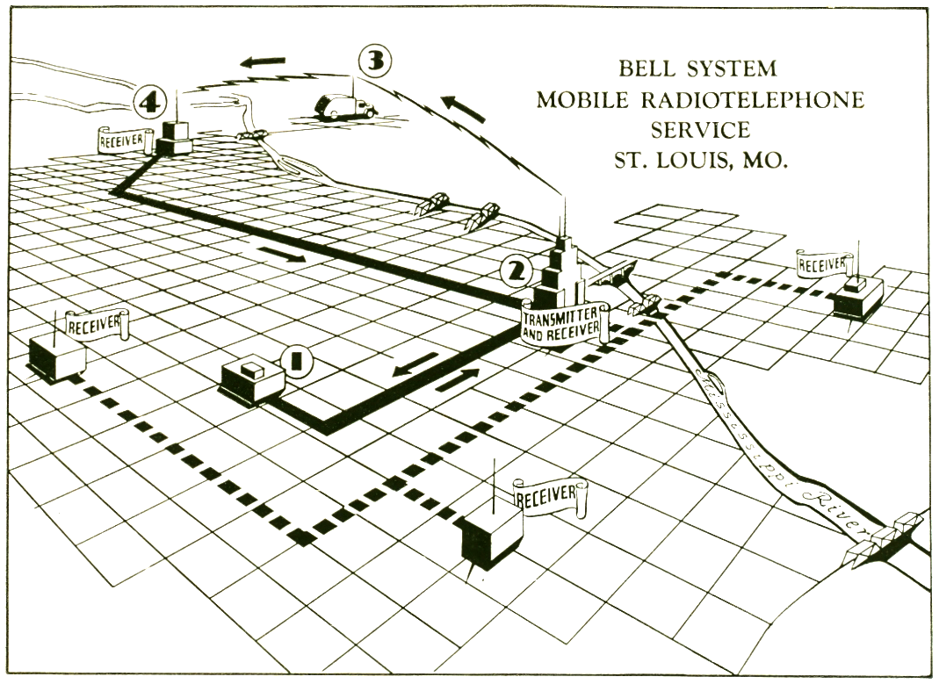
TECHNOLOGY AND BUSINESS ISN’T OPTIMIZED FOR DIGITAL, WIRELESS, INTERNET DELIVERY, AND I WANT TO TELL YOU WHY BEFORE WE GET TO THE TRADITIONAL DESIGN TOPICS, OR TALK ABOUT HTML5 VS NATIVE APP DEVELOPMENT
Notes:
Because the technology of mobile, and the businesses, are not optimized for digital, wireless delivery of Internet content.
It’s all based on dedicated voice, billing per minute, and not incidentally the way mobile networks are Not part of the phone network, so interoperative agreements cause delays in sending your SMS between networks, and make your bill very confusing.

Slide 15
Notes:
Most devices can get a connection with WiFi, but when I refer to connectivity through the rest of this course I will always mean cellular mobile radio. Mostly because it is so ubiquitous that it is replacing traditional methods of communication.

Slide 16
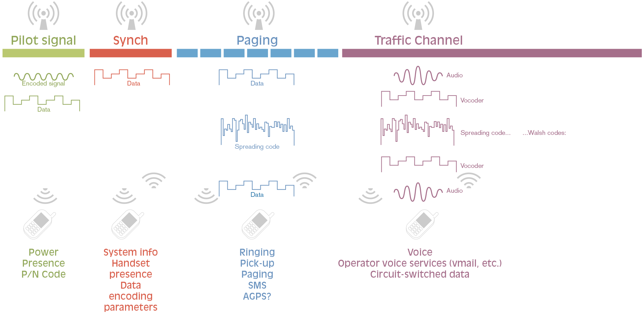
Notes:
But I want to talk about it for a moment because it’s so very different from the connectivity you get in your home or office off wired or WiFi ethernet.
Mostly, that it’s not at all a data network. Much of the world dreams of 3G still, but even if we assume 4G LTE networks, the fundamentals, the infrastructure are based on being mobile phone networks, and the system is run by phone companies. Data is an add on, and the whole network is a private thing bolted on top of the phone company backbone, and only vaguely connected to the Internet and other mobile networks, governed by complex contracts.
The network always knows where you are, at least roughly. You are always tenuously connected so push notifications work great, and are efficient. No need for server polling, as the network can push to you.
SMS, or text messaging, is not data. It works on any system and uses a very efficient and reliable channel so (pretty much) always gets through. MMS, or picture messages, are not. They go back to sending their traffic through the data channel.

Slide 17
Fallacies of distributed computing:
The network is reliable.
Latency is zero.
Bandwidth is infinite.
The network is secure.
Topology doesn't change.
There is one administrator.
Transport cost is zero.
The network is homogeneous.
Notes:
Mobile networks are not very slow. 4G LTE is comparable to typical WiFi speeds. But they are of horrible latency. That’s the time it takes between asking for data from a remote server and getting the information back.
Every time you make a call to the server for that website it takes at least ¼ second to return a response. Your 7.5 MB home page IS too bloated, but what really kills it is that it’s made of 12 javascript calls and 22 images, each of which could take a half second or more to get. CLICK This is intrinsic in the physics of the network topology and way wireless works so won’t get better.
There are many of these assumptions we tend to make about networks which are not true, and we need to account for them all the way through the stack, right up to interactive and interface design.
Latency can be avoided by carefully arranging components, such as embedding CSS, Javascript and even images in the page.
The impact can be reduced on the design side by loading the most visible items first, loading previous content, or at worse delay indicators so the user understands the system is working.

Slide 18
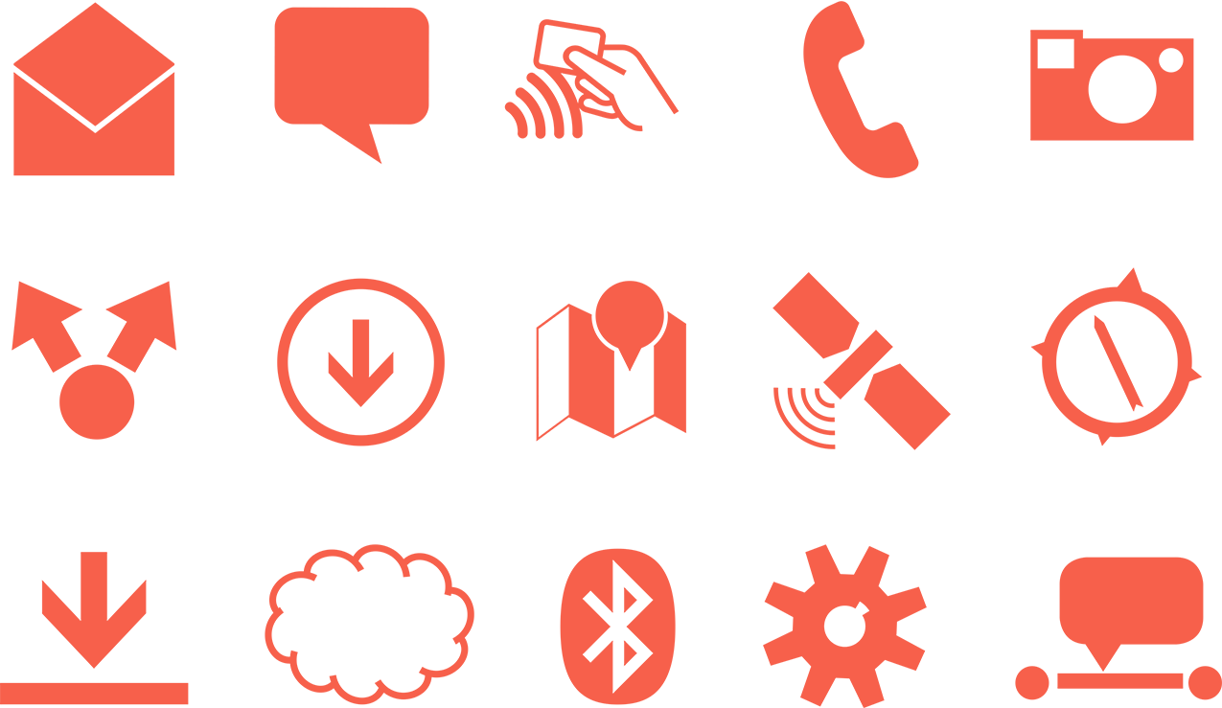
Notes:
We’ll touch one some more of those fallacies as we go through these lessons. But note that every network or radio technology is different from every other one.
Bluetooth works nothing like cellular mobile networks, and BLE is not the same as “classic” Bluetooth. If building services that use these technologies, learn about them to take advantage of the way they uniquely work to assure they meet your needs, don’t waste time and battery, and therefore don’t anger your users and get your company fired.

Slide 19
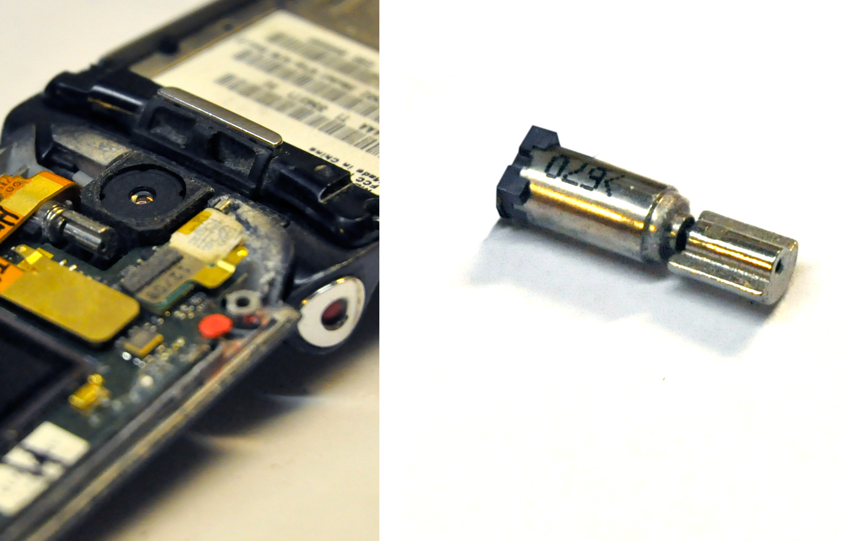
Notes:
Do you know how your phone vibrates? With a little motor and counterweight. It’s very, very inefficient. Even the technology of tiny, seemingly-inconsequential features like this you need to try to understand in order to make sure you don’t do something (like eat the user’s battery) that will result in a bad experience.

Slide 20
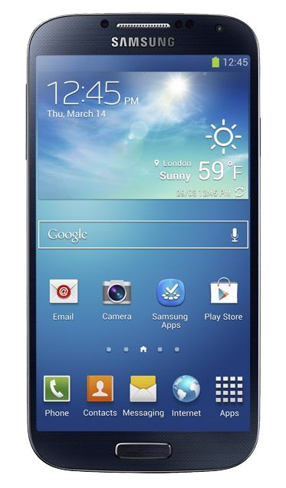
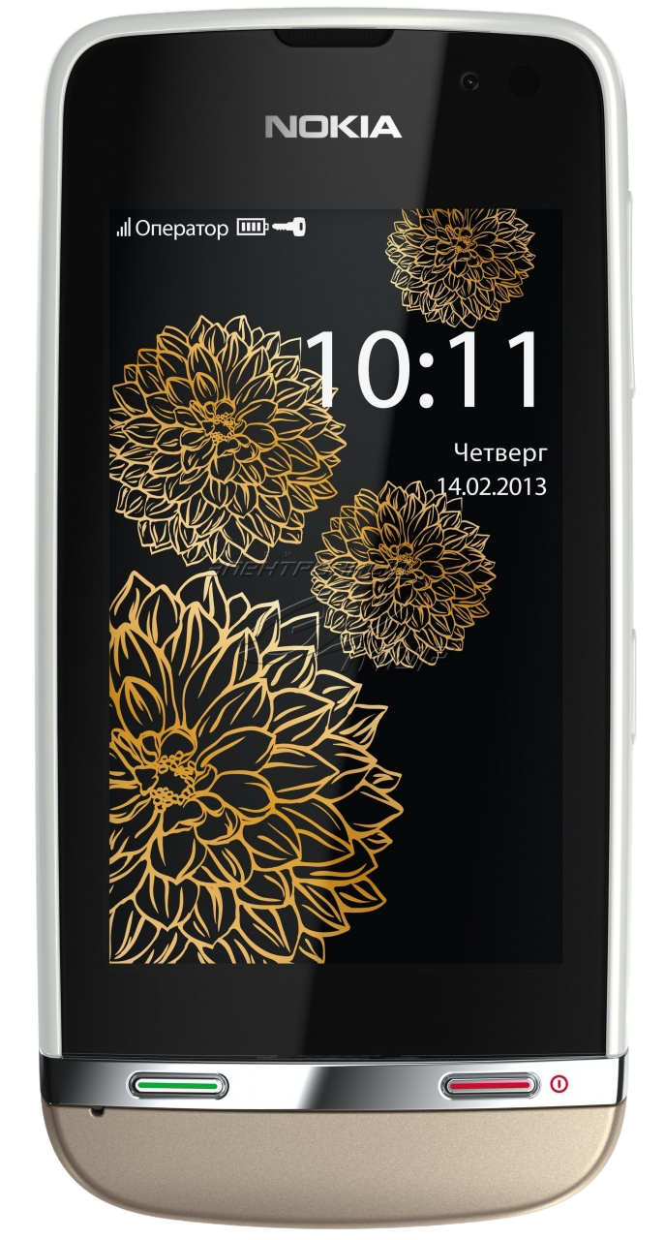
Notes:
I have mentioned the Feauturephone a few times, but you probably still dismiss all those users as hopelessly old fashioned. I would not. First, do call it a Featurephone. A “Dumbphone” is a mobile PHONE, and hardly any exist. A Featurephone has extra features. Like:
A camera, so it can do not just text messages but MMS.
An internet connection to send those messages. Some have 4G LTE.
And a web browser. Generally these days, a good WebKit browser that won’t present you any problems.
They can install apps. J2ME apps, but they do work. A few years ago when Facebook released their stats still, over 80 million regular users were on their featurephone app. I’ll take 80 million users. Most of these devices come with apps like Facebook, Youtube, and Twitter pre-installed even.
They can accept SMS, which has insane response times and rates. 90% of people read text messages within a few /seconds/. Tell your marketing team that.
They GPS and other location services.
Some even have touchscreens, like this one — yes the phone on the left is a featurephone — though this is sometimes used as a Smartphone identifier so it’s hard to get solid numbers on how many of them there actually are.
Featurephones and cheap smartphones are Low End, not old.

Slide 21
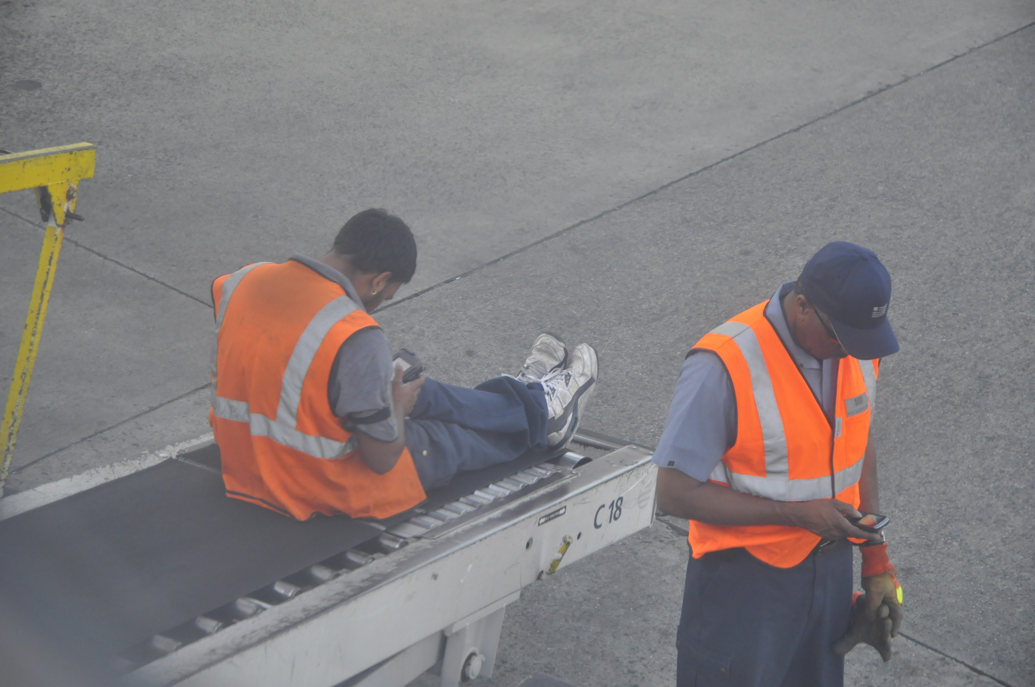
??? PHOTO ???
Notes:
And at the core of everything I say is that—as much as I have talked about technology and will do so more—design for mobile is not about designing for phones, but people. Don’t get caught up in any one platform or technology.

Slide 22
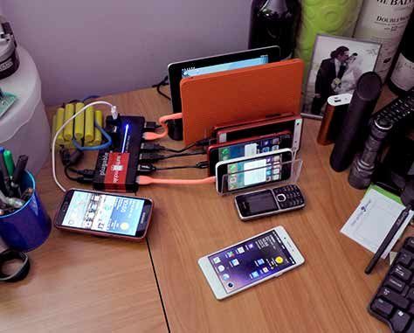
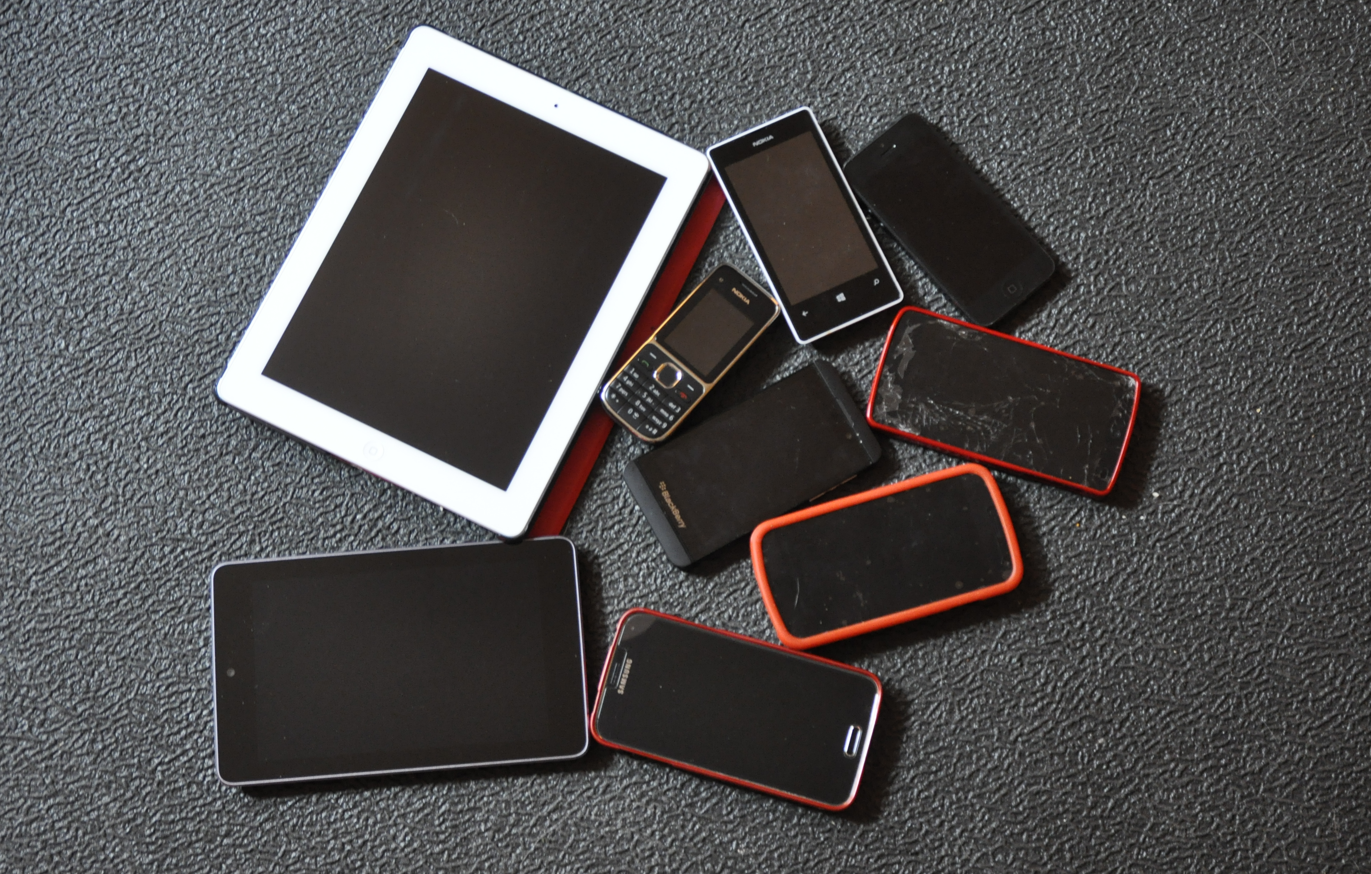
Notes:
One of the most common questions I get is “what phone do YOU carry?” I carry All These. Clearly, not in my pockets all the time, but I am signed into all of them as me, and they are right next to me on the desk, or in my case when I travel. I am not a fanboi or a critic of any platform because it’s important that you design for whatever people actually use. Sometimes, I swap SIMs and try out say the BlackBerry Z10 for a few weeks.
And I have another 50 or so devices in a cabinet, because I have been doing the same for years. They get old and you have to keep up on it.

Slide 23
In Part 2:
People & Technology
Use by time of day
Context and user intent
Device switching, sharing and multi-device use
Sensors
Network falliability
Notes:
Next we’ll start talking more about how people use the varying range of devices they actually carry, and how they interface with the technology of the computer terminals in their pockets.

