Slide 1
TIMING/VIDEO
Remove auto-advancing after creating a video version:
On/Off:
In the tabs (not menu): “Slide Show”
[X] Play Narrations
[X] Use Timings
[ ] Show Media Controls
Clear the timings completely:
Select all the slides
Right click a slide > “Slide Transition…”
In the “Advance slide” section uncheck “Automatically after”
The complete guide to Designing Mobile User Experiences 1) The phones are here to stay Resources
@shoobe01
4ourth.com

Slide 2
The phones are here to stay
Read More:
If you have questions about any topics discussed, please check out the resources here for additional reading, and examples.
Every stat I deliver is backed up by a source, and those are always included here as well so you can read for yourself, or prove it to your boss or client.

Slide 3
Tomi Ahonen
http://communities-dominate.blogs.com/
Tomi is a bit contentious sometimes, but I think is one of the true gurus of mobile, and you should pay attention to the numbers he posts, if not the words he says.
He regularly publishes stats on use rate of various mobiles, mobile services, etc. all from multiple sources, with suitable statistical analysis to make sure they are likely, and with commentary so you understand why they matter.
If you see a blog post with an unlikely sales or use rate number, check with Tomi, at least to see the baseline and gut check whether that is likely to be true.

Slide 4
Careful With Stats!
This is not a reference, but an anti-reference. There are a lot of lies, and half truths in mobile stats.
http://www.globalwebindex.net/blog/1-in-5-now-own-an-iphone
This is a good one that covers the range well. It says 20% of all adult humans on planet earth have an iPhone. That’s wrong on the face of it. Clearly untrue. And a look at any stats and you see that’s impossibly wrong. I asked Tomi and he used the phrase “UTTERLY IDIOTIC.”
Many stats lead with iOS numbers despite many more Android users. Think carefully about anything you read before quoting or re-tweeting it.
Notes:
Here’s a trickier one: http://bgr.com/2017/01/12/iphone-vs-android-market-share-q4-2016-us-uk/
More regions had growth in iPhone sales than in Android sales. Aside from sales vs. installed base, the trick is subtle. It’s that we don’t care about the electoral college here (2016 election joke!) but populations. It equates small growth in Italy with huge losses in China. Overall sales/population numbers still have iOS around flat, and Android growing.

Slide 5
Benedict Evans
http://ben-evans.com/
Another business-focused guy, with a personal blog exposing various useful analyses of trends in the mobile space. Also with useful stats, but more on the context-setting and analysis here.

Slide 6
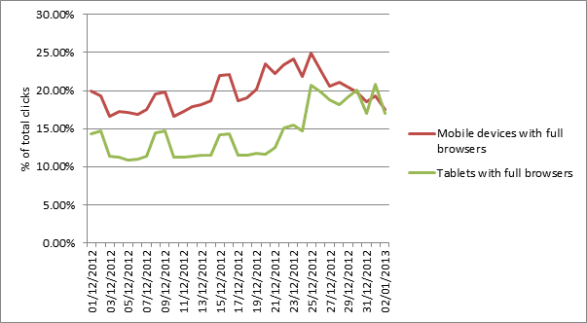
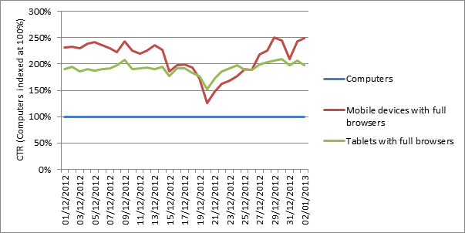
46% of Christmas Day search traffic was on tablets and mobiles
https://econsultancy.com/blog/61899-46-of-christmas-day-search-traffic-was-on-tablets-and-mobiles
The source for my stats on use rate on Christmas. The next slide has data for 2015, but this has prettier images. Just don’t tell anyone the date.

Slide 7
Holiday Benchmark Data Alert: Updated Monday, January 5, 2015
http://www-01.ibm.com/software/marketing-solutions/benchmark-hub/alert.html
Here’s the Christmas 2015 data. Way too much other stuff, so I’ll quote the bit we care about:
Mobile traffic accounted for 45 percent of all online traffic for the 2014 holiday season, an increase of 25.5 percent YoY
Smartphones Browse, Tablets Buy: Smartphones drove 31.2 percent of total online traffic, nearly two and a half times that of tablets, which accounted for 13.4 percent of all online traffic. However, tablets are winning the shopping war. Tablet sales accounted for 13.4 percent of online sales, compared to smartphones, which accounted for 9.1 percent of total online sales, a difference of 47.3 percent.

Slide 8
Infographic: 2013 Mobile Growth Statistics
http://www.digitalbuzzblog.com/infographic-2013-mobile-growth-statistics/
As much as I hate the needless infographic trend, this has good stats, the charts are pretty enough you could slice them out and put them in your own slideshows, and they even break out some bits as text.
91% of all people on earth have a mobile phone
56% of people own a smart phone
50% of mobile phone users, use mobile as their primary Internet source
80% of time on mobile is spent inside apps
72% of tablet owners purchase online from their tablets each week
Some of this is the same exact data Tomi shares, but his charts are ugly as sin.

Slide 9
Mobile, ecosystems and the death of PCs
http://ben-evans.com/benedictevans/2015/11/7/mobile-ecosystems-and-the-death-of-pcs
I regularly discuss how mobile is not just the next connected computing thing, but is the new normal, and replaces the PC. Good article on the march of technology here.

Slide 10
The Rise of the Mobile-Only User
http://blogs.hbr.org/2013/05/the-rise-of-the-mobile-only-us/
Karen McGrane (one of those people you should listen to) shares the drivers behind my contention that it’s a mostly-mobile world, and you need to forget that you are issued a desktop or laptop at work. Just one bit:
Young adults: 50 percent of teen smartphone owners, aged 12-17, say they use the internet mostly on their cell phone, according to a 2013 Pew Internet report on Teens and Technology. Similarly, 45 percent of young adults aged 18-29 reported in 2012 that they mostly go online with a mobile device.
And this is from 2013. It’s more mobile every day.

Slide 11
Phone Subsidy for Poor Could Expand to Include Broadband
http://www.wsj.com/articles/phone-subsidy-for-poor-could-expand-to-include-broadband-1457460517
In the US they are thinking of expanding the lifeline coverage (free minimal home phone for safety, etc.) to not just mobiles, but the internet. Every nerd assumes cable modems, I assume mobile phones with internet coverage will count also.
WSJ is being all paywall to me today, but there is a great quote about the internet being required to participate in the economy now, but 20% cannot afford it.

Slide 12
The Demographics of Device Ownership
http://www.pewinternet.org/2015/10/29/the-demographics-of-device-ownership
Even in the lowest penetration segments, practically everyone has a mobile phone.
Some 78% of adults ages 65 and older own a cellphone, compared with 98% of 18- to 29-year-olds. Lower-income adults are less likely to own a cellphone. Rural residents are slightly less likely than urban and suburban residents to have cellphones. Still, nearly nine-in-ten rural residents (87%) have them.
Lots of other stats in there, so good data for tablets, eReaders and more.

Slide 13
50 Astonishing Mobile Search Stats and Why You Should Care
http://www.cision.com/us/2013/06/50-mobile-search-stats-and-why-you-should-care/
Once you have read the other resources, you won’t be as astonished by most of these, but it’s a nice collection of them, and may be better to share with some clients/bosses/coworkers than making them dig into the more original sources.
A few of these are from sources I don’t otherwise use, so it’s still good data. Give it a glance.

Slide 14
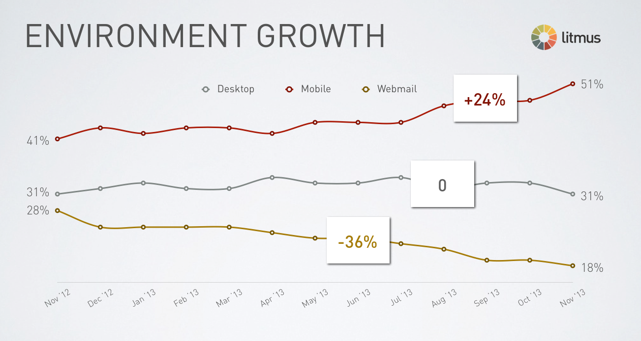
Mobile Opens Hit 51%; Android Claims #3 Spot
https://litmus.com/blog/mobile-opens-hit-51-percent-android-claims-number-3-spot
One of those from 2013 we should probably find new stats for, but the trend is solid:
It’s official: mobile now accounts for the majority of email opens, with a 51% share. That’s an increase of three percentage points since the previous record of 48% from September and October. Desktop opens now make up 31% of opens, while webmail has dipped to 18%.

Slide 15
Browsers are another platform
http://www.businesswire.com/news/home/20161116005308/en/Report-Shows-720x1280-Smartphone-Screen-Resolution
Lots of stats here, lots we do not care about like screen resolution. But check this out:
Samsung Browser is now the third most used mobile browser worldwide, after Safari and Chrome Mobile
It’s not a fight between Mobile Safari and Chrome Android. The OEM overlays are critical and change behaviors a lot. Are you testing on Samsung Browser?

Slide 16
Fifty Essential Mobile Marketing Facts
http://www.forbes.com/sites/cherylsnappconner/2013/11/12/fifty-essential-mobile-marketing-facts/
Another list, but also a nice one and from a major business magazine. Adwall, so just wait a few seconds to skip it. The article is there.
My favorite two facts:
91 percent of adults keep their smartphones within arm’s reach. (Source: Morgan Stanley) Guilty as charged.
Even more important to entrepreneurs: 9 out of 10 mobile searches lead to action. More than half lead to sales. (Source: SearchEngineLand) Stunning.

Slide 17
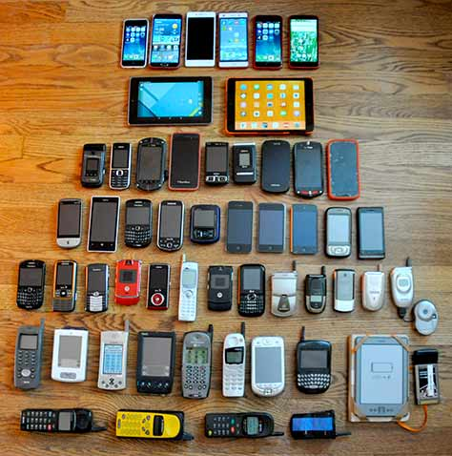
What Phones Do I Carry?
http://www.uxmatters.com/mt/archives/2017/01/build-a-mobile-device-lab.php
I should update the deck, but I wrote this article in January 2016, which is not just up to date, but expresses principles well. You need more than just an iPhone.

Slide 18
4ourth Mobile Design Pattern Library
http://4ourth.com/wiki
I will be putting more links to articles and other resources of mine up here, but let’s start with this. A lot of stuff is here, but most of all the full content (plus updates!) from my book Designing Mobile Interfaces.

Slide 19
Want More?
Get the entire 13 part series, with resources and exercises, at:
https://www.udemy.com/mobile-user-experience-the-complete-guide-to-mobile/#/
The Phones are Here to Stay
People & Technology
Platform Choices
Hybrid or Native App?
Adaptive or Responsive?
Information Architecture
Outside & Between
Back & the Stack
Interface Design by Zones
Interaction & Touch
Input & Entry
Interaction & Specification
Designing at Scale

