Slide 1
TIMING/VIDEO
Remove auto-advancing after creating a video version:
On/Off:
In the tabs (not menu): “Slide Show”
[X] Play Narrations
[X] Use Timings
[ ] Show Media Controls
Clear the timings completely:
Select all the slides
Right click a slide > “Slide Transition…”
In the “Advance slide” section uncheck “Automatically after”
The complete guide to Designing Mobile User Experiences 1) The phones are here to stay Assignment
@shoobe01
4ourth.com

Slide 2
The phones are here to stay
The best way to learn is to try this out yourself. Pick a project you are currently working on, or have just finished. How would you apply the information you have just learned?
As you proceed through the lessons, keep track of your decisions and revise your design to take advantage of this information. Keep it somewhere safe, so you can use the same design revisions for the next lesson.
Be sure to check the Assignment for each section and complete it before proceeding to the next one.

Slide 3
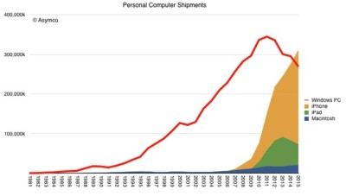
What do your users use?
Your first task is to stop making assumptions, and figure out what your users really use. It’s not a desktop PC anymore. The PC installed base is dropping, and in 2015 more iOS devices were shipped than windows. http://www.cultofmac.com/406708/ios-devices-finally-outnumber-windows-pcs/
Android outnumbers those like 6:1.
What devices do your users really
have?

Slide 4
Want More?
Get the entire 13 part series, with resources and exercises, at:
https://www.udemy.com/mobile-user-experience-the-complete-guide-to-mobile/#/
The Phones are Here to Stay
People & Technology
Platform Choices
Hybrid or Native App?
Adaptive or Responsive?
Information Architecture
Outside & Between
Back & the Stack
Interface Design by Zones
Interaction & Touch
Input & Entry
Interaction & Specification
Designing at Scale

