Slide 1
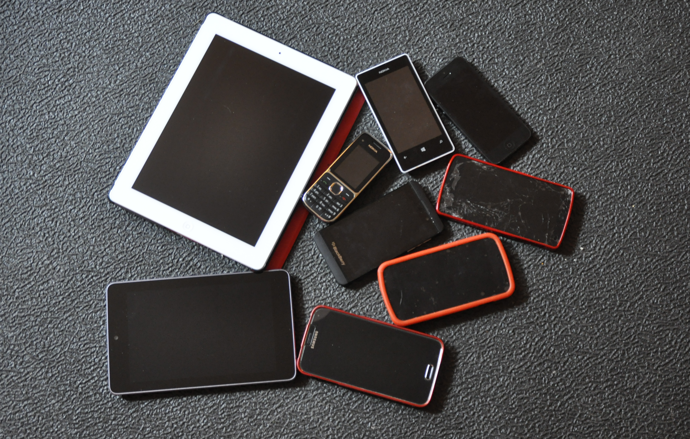

Notes:
Mobile is not the next big thing. It's already here…

Slide 2
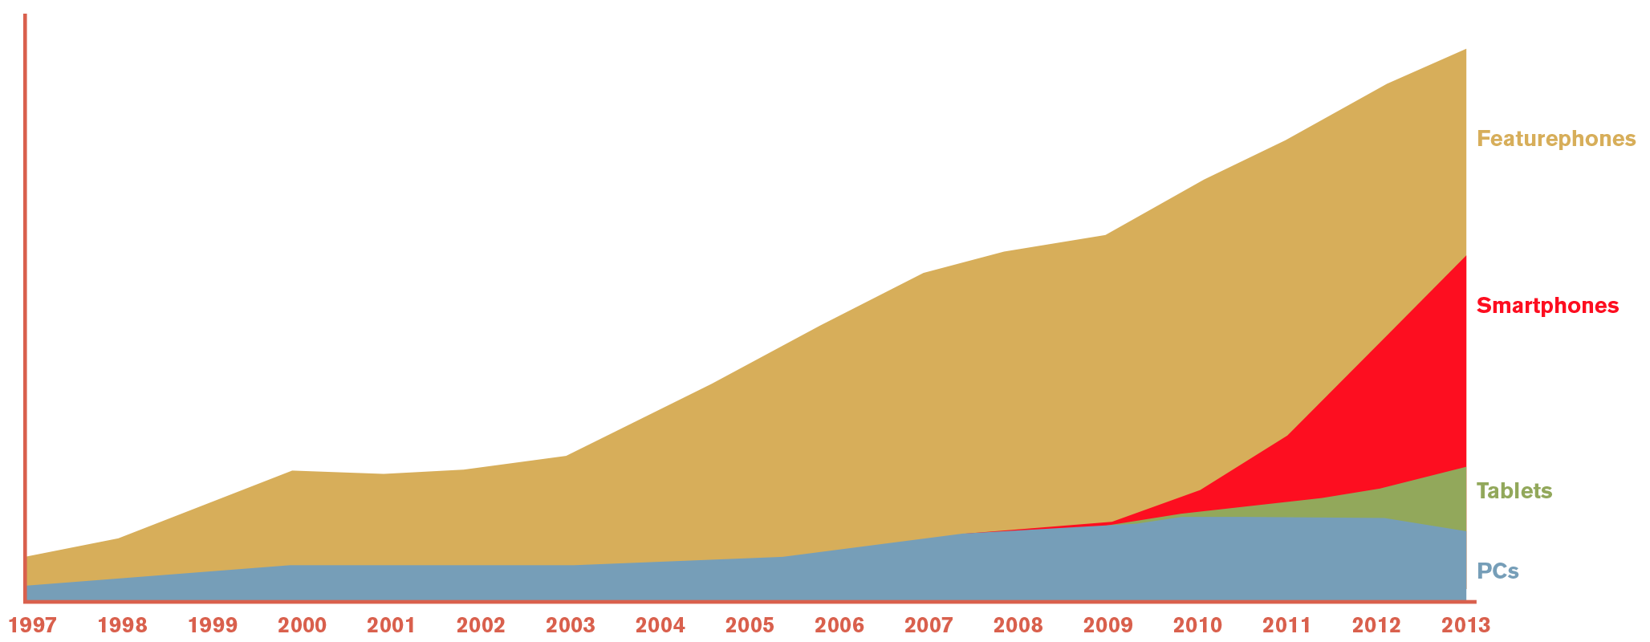
Notes:
and is the only way many people interact with data, communicate, or get on the Internet. Simply having a great idea, great technology, or hoping the competition isn't there yet won't fly. You need to build great experiences for your customers on mobile.

Slide 3
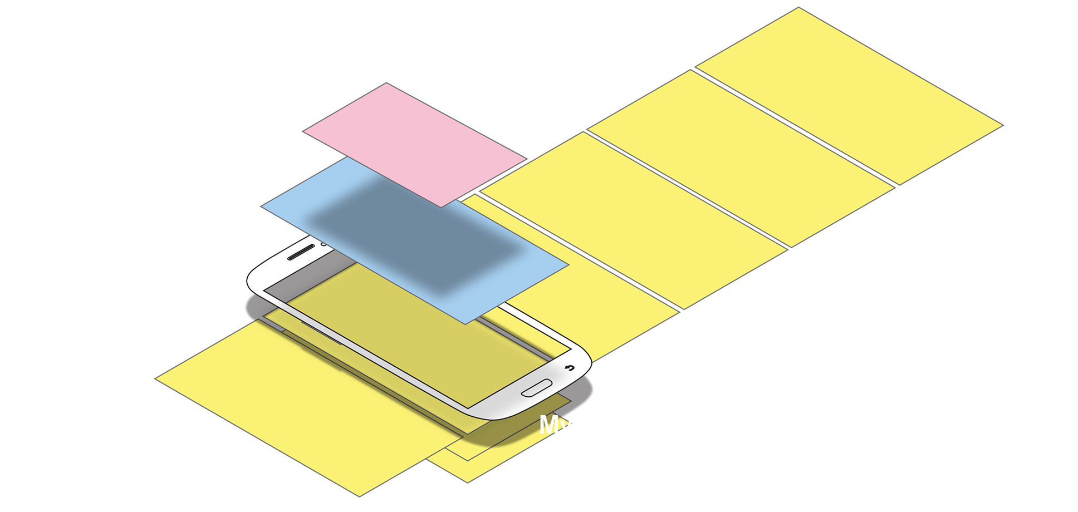
Notes:
This course will outline how to design your mobile products — websites and apps mostly — not just to be pretty, but to be usable, useful and to drive customers to close sales, or get the information they need so they stay happy with your organization.

Slide 4
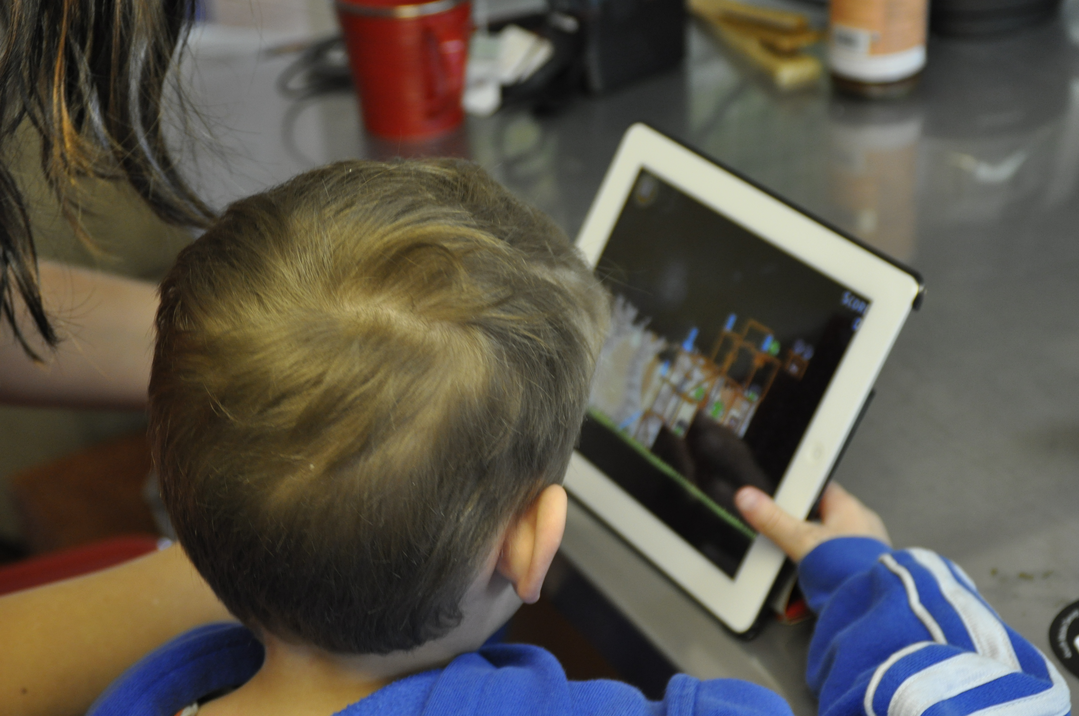
Notes:
While mobile is relatively new and different, people are not. I will teach you how to understand the technology of mobile — the opportunities and constraints of devices, networks, screens, cameras, GPS and more — but also to remember humans use these devices, to understand how people think and work, and how to consider mobile and other portable connected devices as part of your organization's whole product, content and development strategy.

Slide 5
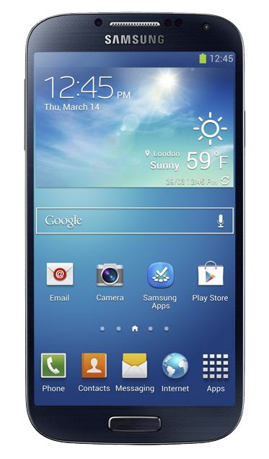
Gesture
Proximity
Light level
Light color
Capacitive Touch Screen
Cover sensor
Gryosensor
Accelerometer
Notes:
I will review trends in technology, and use of devices, give you checklists to help make choices for platforms and development strategies like hybrid or native, responsive or adaptive.

Slide 6

Notes:
Together we will build information architectures, interactions, interfaces and discuss how to lay out pages and pick controls. I will give you patterns, guidelines and rules to design for input, touch and outline simple solutions to prepare your product to work on multiple platforms, encourage sharing and re-engage users.

Slide 7
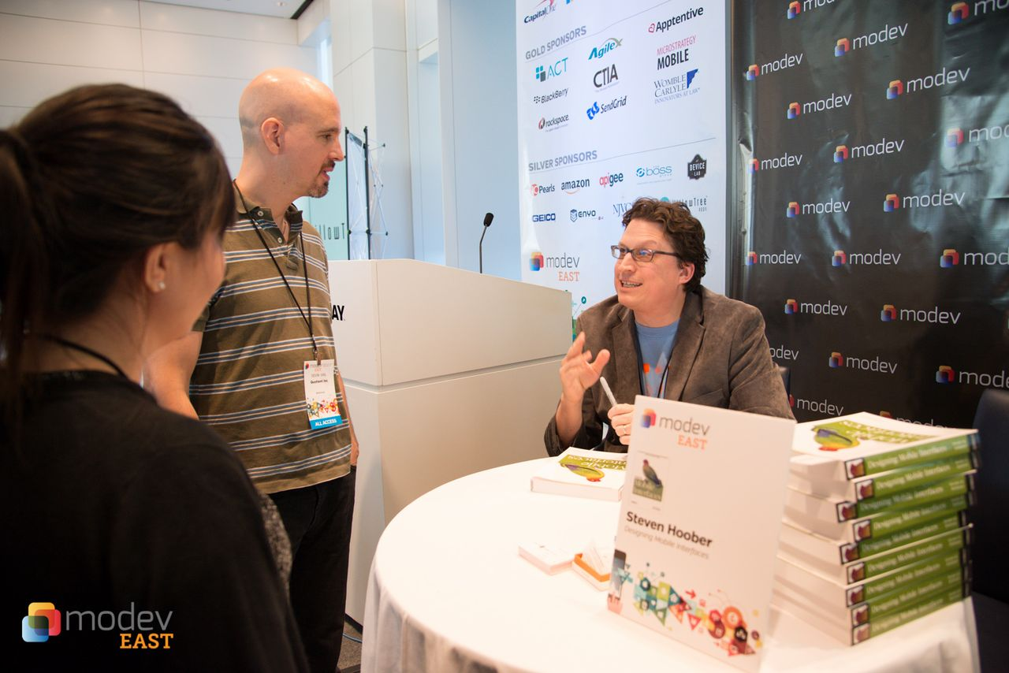
Notes:
You can trust me to tell you this because I wrote the book on mobile design patterns, and am best known these days for performing my own research into how people really hold and touch their phones, phablets and tablets. I have been doing what we now call UX for over 20 years, and have been designing mobile and multi-channel experiences since 1999.

Slide 8
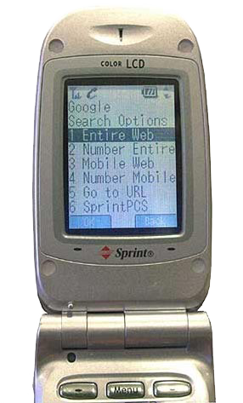
Notes:
I designed the earliest mobile app store, the first Google mobile search ever, several mobile browsers including parts of the one in your Samsung smartphones, many big mobile sites such as Weather.com, and apps for companies like Hallmark, US Bank and Cummins.

Slide 9
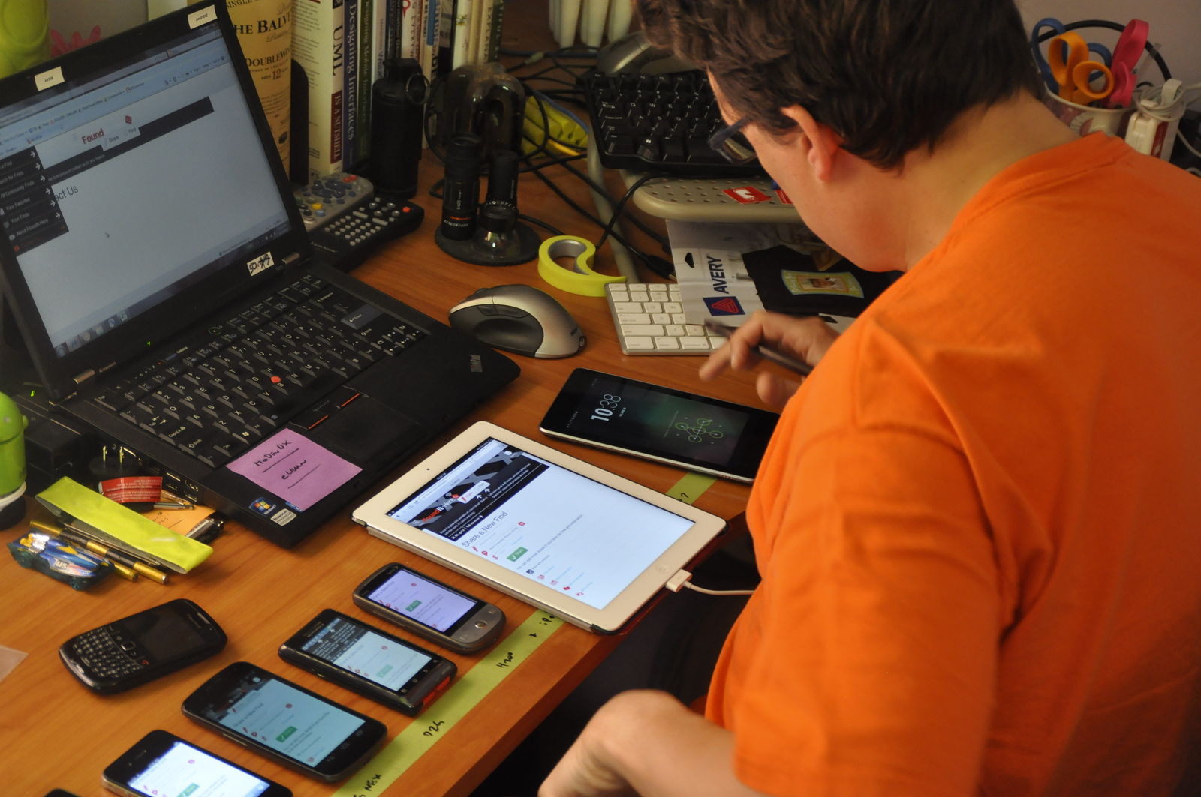
Thing
Notes:
The information and processes I will present are not just my favorite way to do things because I have one successful app, but is backed by all that experience designing and building mobile experiences for mobile operators, big companies, and startups.
And I'll prove it to you; every lesson is accompanied by a list of resources -- articles you can read up on, technical guidelines and examples, and usability or market research about how people use the patterns.

Slide 10
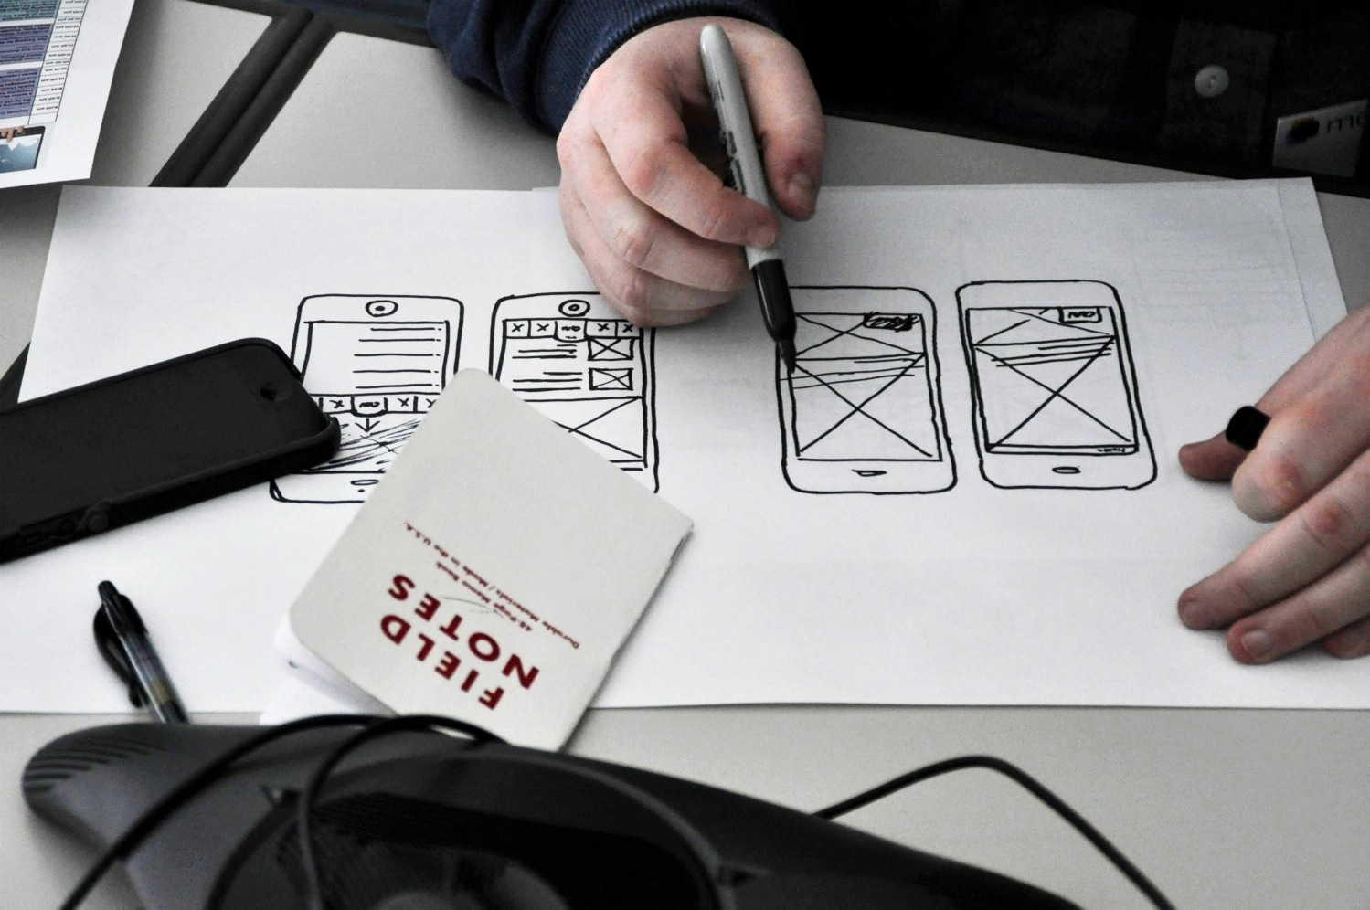
10
Notes:
And there's homework, too: Come with your own needs, ideas or troublesome projects, and you can follow along, step by step and apply each lesson to your work right away.
I hope you take my course.

