Slide 1

The guide to
Designing Products
for Everyone
Digital accessibility in public accommodations
@shoobe01
4ourth.com
Notes:
You are watching this video because you want to know about designing for accessibility. And I’ll tell you that. But in the end, we’re not going to address the blind, the elderly, or any other one group specifically, but EVERYONE.

Slide 2
Outline
Providing access for the disabled
Providing access for everyone
Accessibility is required
Accessibility functionality
What does it mean to be accessible
Testing and compliance
Notes:
Today, we’re going to cover ALL these topics. Hopefully, the order will make perfect sense once we’re done, and you’ll see not just how to strictly be in compliance as a digital public accommodation, but why it’s important, and tactics to design to avoid problems.

Slide 3
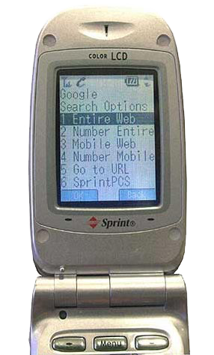
Notes:
Since I am not sure who I am talking to, we can’t go out for a beer afterwards, and you cannot see me, let me introduce myself.
I’m old. Well, I feel that way. Years after I got into being a web developer, DBA and – once we invented the term – a UX designer, I did things like this.
I have been doing what we now call UX work since 1996, and mobile design since 1999. Yes there were good, worthy interfaces, used by billions of people, long before the iPhone.
Yes, there’s opportunity galore today, but I got in at a fun time, and early on got to design the first Google mobile search ever, and work on the first music phone in the world along with it’s accompany music and app store before anyone had one we could copy.

Slide 4
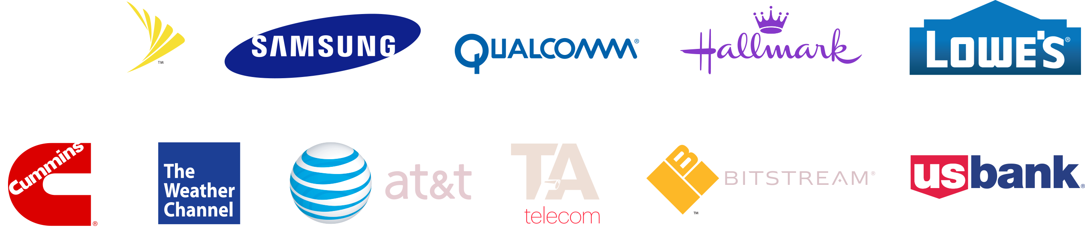
Notes:
Since then I have worked for a lot of people. I’ve worked on phones and embedded software for telecoms, service providers, and phone makers, I have helped build mobile sites such as Weather.com, and apps for companies like Hallmark, US Bank and Cummins.
I’ve designed, at least in part, five mobile browsers.

Slide 5
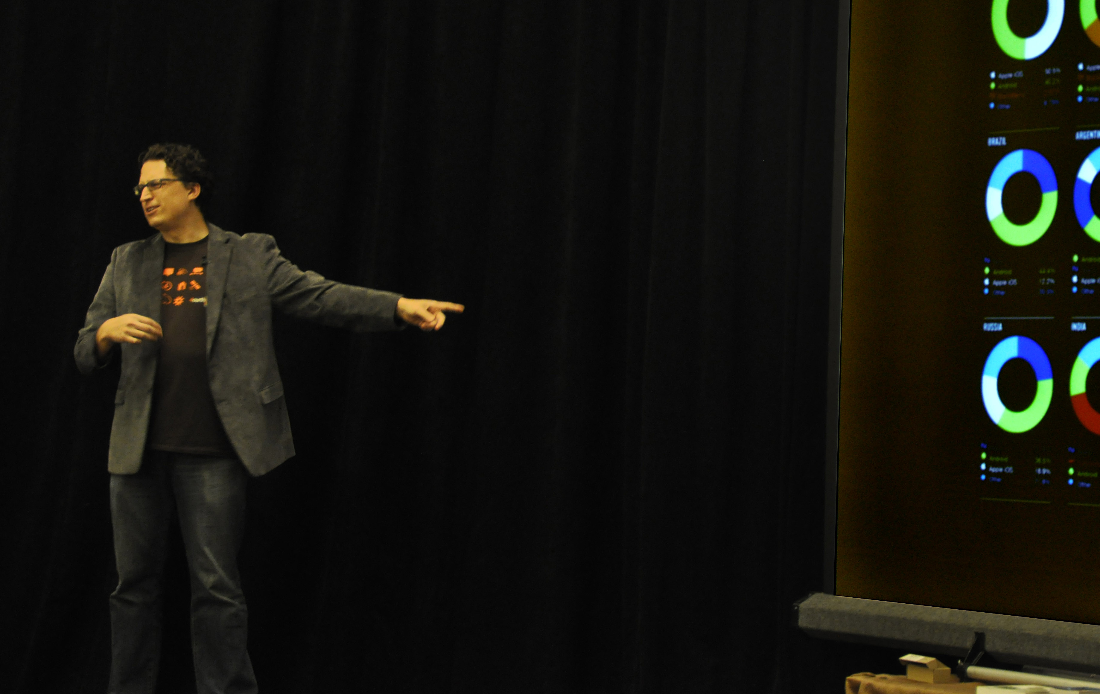
Notes:
And you aren’t the first people I am sharing my information with. I have been gathering and analyzing for years.
Much of what I say today comes not just from rote repetition of government regs, or from the awesomeness and successes I have had, but the failures. Sometimes, bad failures. This is why I share the information: we already know stuff that needs to be passed along and shared to make sure we’re all doing the best possible job designing for our users and clients.

Slide 6
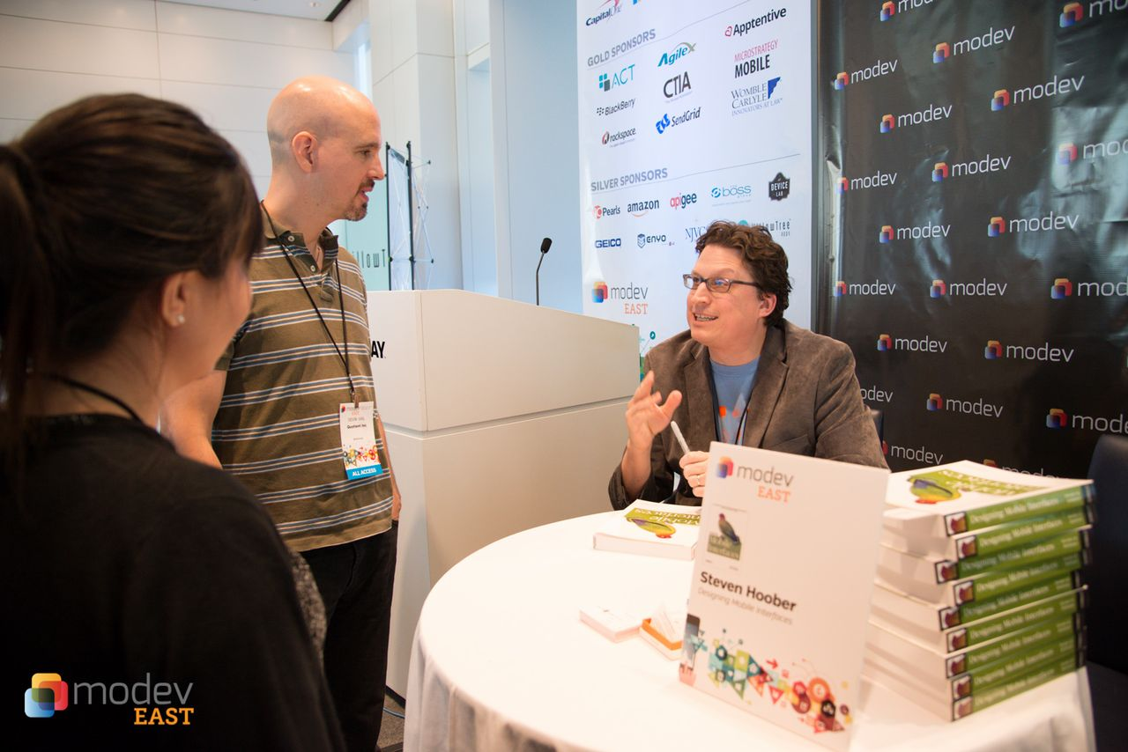
Notes:
I do this formally. I regularly write for Uxmatters, have written for many others like UX Magazine and have been printed in ACM Interactions.
I wrote a book on mobile design patters, and have contributed to or edited other books.

Slide 7

Providing Access for the Disabled
Notes:
We generally define accessibility as providing access and functionality for those with a physical or cognitive limit. People other than what are generally called the “able bodied.”

Slide 8
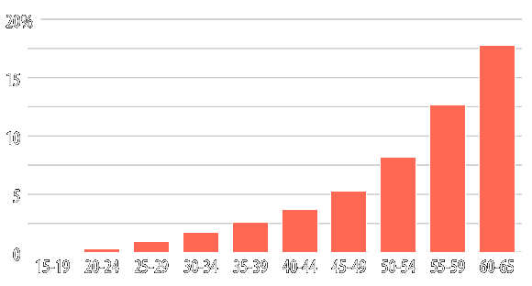
billion
people
worldwide
Longer Point, Explained
15 %
of world’s population
1
74.6
million americans
Subtitle or key takeaway
If you have questions nt.
Notes:
Who is disabled? Well, it turns out, everyone.
Around 15 per cent of the world's population, or estimated 1 BILLION PEOPLE ARE LIVING with disabilities.
This makes it the world's largest minority by far.
If you need more manageable numbers, in the US, about 74.6 million people have some type of physical disability. That’s over 20% of the population.
http://www.un.org/disabilities/default.asp?id=18
http://www.disabled-world.com/disability/statistics/\
http://www.cbpp.org/research/chart-book-social-security-disability-insurance

Slide 9
8 years
average time living with a disability
11. 5 %
average lifetime living with a disability
1 in 4
will become disabled before retirement
Notes:
Disabilities are not all congenital, and appear over time. Medical improvements in developed countries like the US mean that we live longer, with impairments from age and disease. This is going to become more pronounced over time.
People like you and I can expect to spend an average of about 8 years, that’s /11-1/2 percent of their life/, living with one or more disabilities.
Of today's 20 year-olds, over 1 in 4 will become disabled before they retire.
http://www.disabled-world.com/disability/statistics/

Slide 10

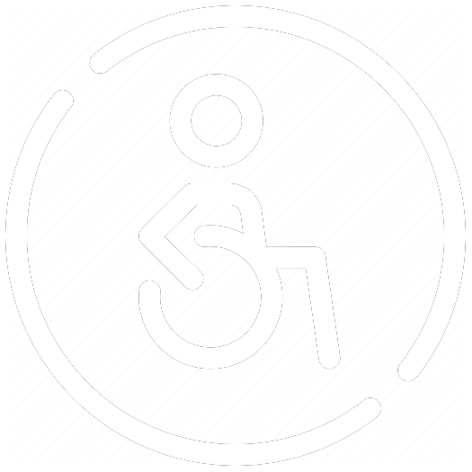

12 . 2 %
7 . 8 %
Notes:
Disabled folks are successful in business.
Companies report that employees with disabilities have better retention rates, reducing the high cost of turnover, says a 2002 U.S. study. Other American surveys reveal that after one year of employment, the retention rate of persons with disabilities is 85 per cent. (Unger, 2002)
In the US people with disabilities have a higher rate of self-employment and small business experience than persons without a declared disability.
http://www.worksupport.com/documents/proed_employersattitudes1.pdf
http://www.census.gov/prod/www/decennial.html

Slide 11
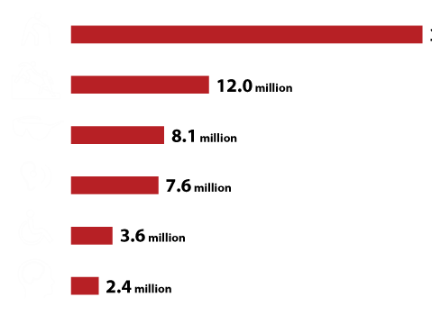
Notes:
What sorts of disabilities are we talking about?
30 million people still walk on their feet, but have trouble getting around and need a cane, walker or helper for some tasks.
12 million need assistance with everyday tasks around the house in one way or another.
Obvious disabilities, and the icon for much of this even I use, people in wheelchairs: only 3.6 million Americans.
https://www.census.gov/newsroom/releases/pdf/cb14ff-15_disability_graphic.pdf

Slide 12
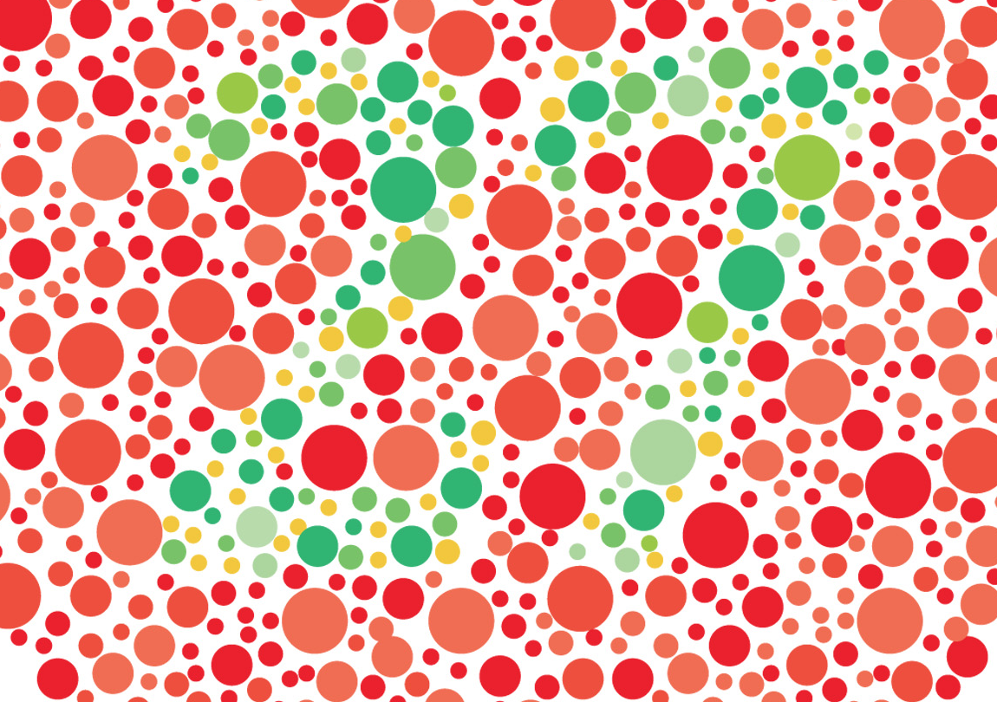
Notes:
For our purposes, a key disability is colorblindness. Someone you work with is colorblind per our definitions. Because not everyone is red/green colorblind, and many people have /reduced/ color vision, but aren’t totally color-BLIND. We’re bad at defining this, but when you consider all those cases, it might be 20% of the population.
But have you ever met a colorblind person with a pro-colorblindness T-shirt, who had a handicapped license plate, who didn’t get a job due to it?
Disability is not always a horrible impediment, and not always visible. It only matters when we design for a certain definition of “normal” that problems occur.
Whether it’s 12 or 20 percent, that’s On Top Of the 20% of conventional, obvious and declared disabilities. I’m not going to review other low-grade physical or cognitive deficits and do the math, but it adds up. It’s a LOT of the population.
http://4ourth.com/wiki/Color%20Deficit%20Design%20Tools

Slide 13

Designing Products for Everyone
@shoobe01
Providing Access for Everyone
Notes:
And a LOT of your users.
So as I said up front, we’re not entirely going to talk about designing for the disabled, as some group of people who are not us, but designing for everyone.
http://ctrlclickcast.com/episodes/accessibility-101 – Hour long podcast interviewing Greg Tarnoff. Listen to it all. Maybe not now, but soon.

Slide 14
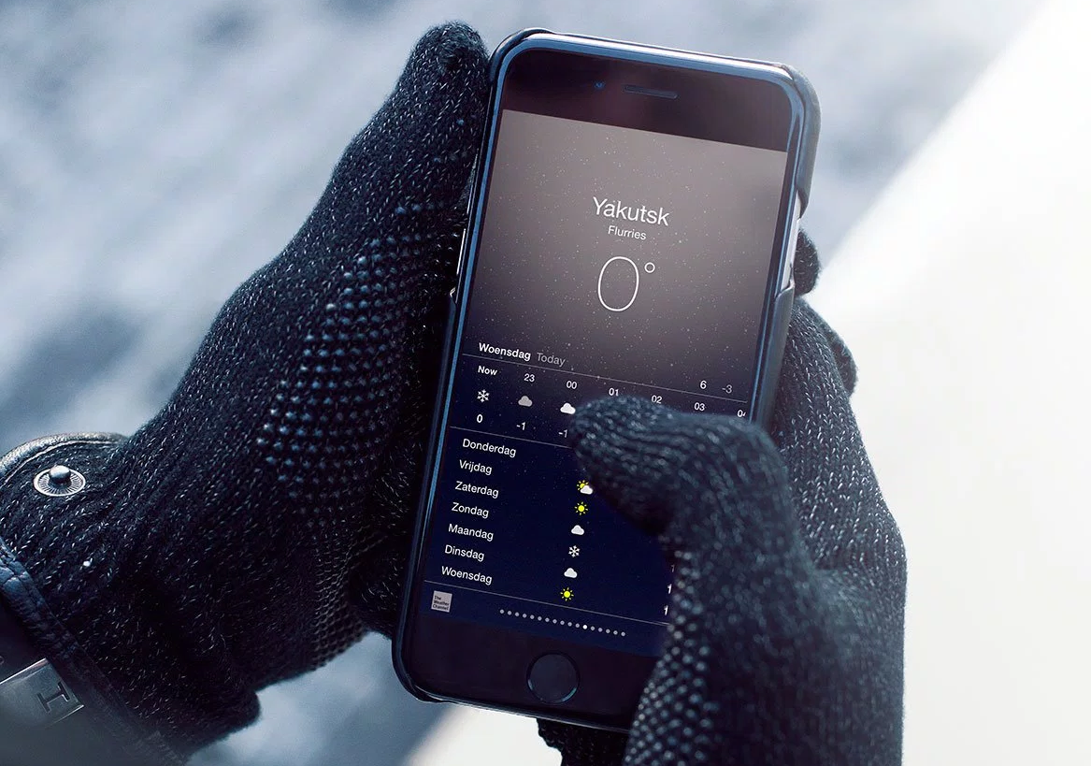
Notes:
And I mean /everyone/.
Robin Christopherson, a blind designer, discusses the concept of “temporary disability.” Not illness, but things like distraction or transient physical conditions that change how you work. When you are in the kitchen, or the shop, you ever have dirty hands? When it’s cold, you wear gloves. How do you use your phone or computer? Differently. Maybe badly.
https://twishort.com/fI0jc – Robin doesn’t do articles or decks or videos, but here’s a list of links of cool stuff he referred to once. It’s something.

Slide 15
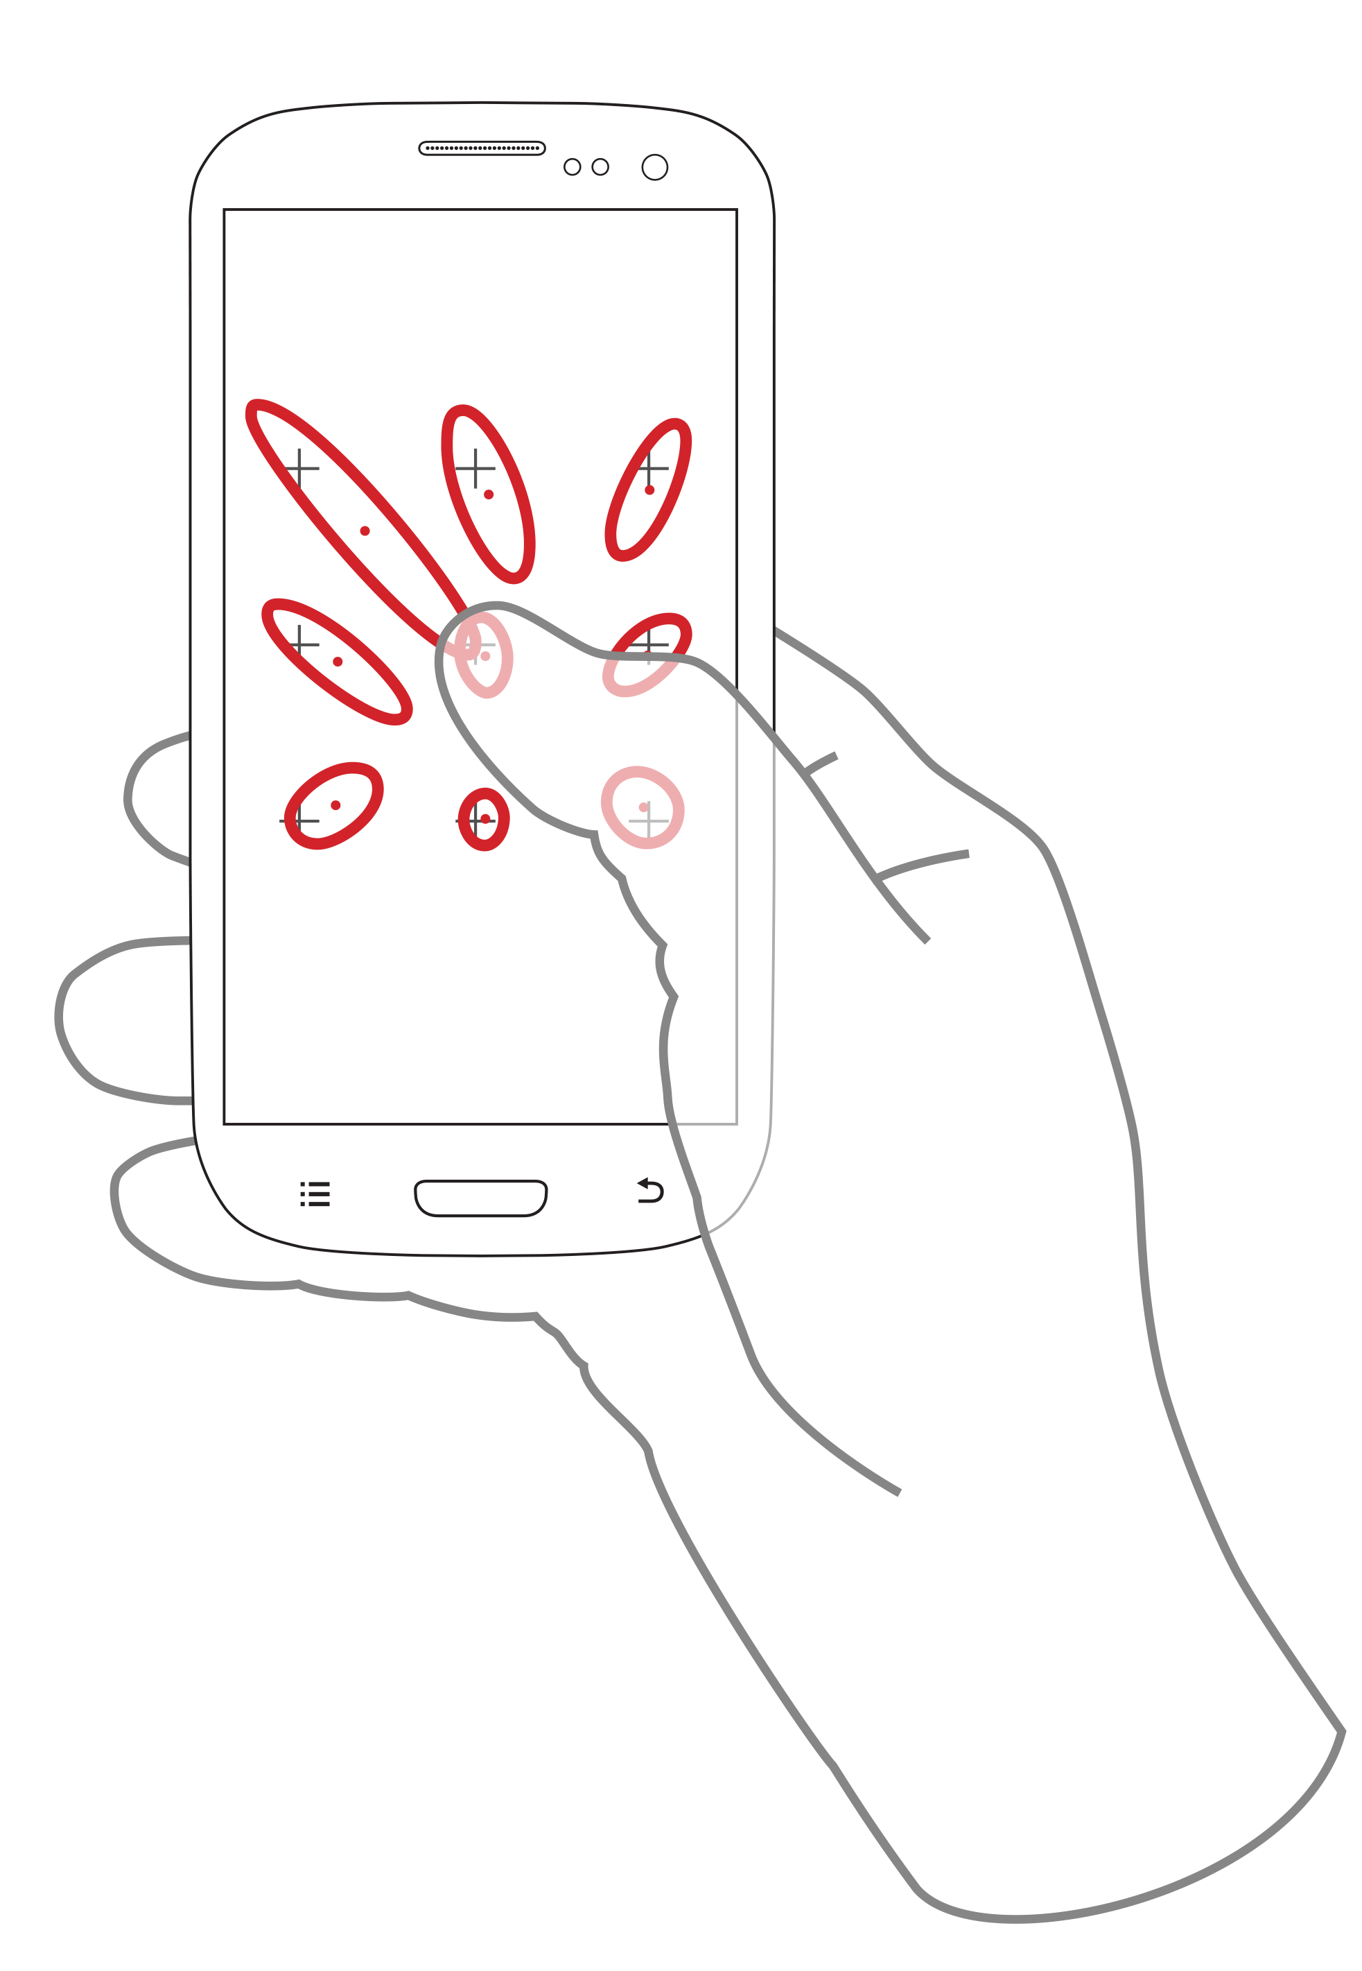
Notes:
There’s even data about this. People use their mobile phones all the time, so something as simple as carrying groceries changes how accurately they can tap. A lot.
Accounting for that means people can use your product in more places AND more people can use your product.
http://www.uxmatters.com/mt/archives/2015/01/phones-arent-flat-designing-for-real-people-in-diverse-contexts.php#sthash.9gYLPuiA.dpuf
http://insights.wired.com/m/blogpost?id=6544125%3ABlogPost%3A99367

Slide 16

Notes:
Microsoft, as part of their Inclusive tools (which are otherwise worth checking out) has a lovely chart about levels of disability that I think says this better than I previously have.
Disability is not a health condition, but when interactions mismatch; at a school for the deaf, the individual who doesn’t sign is the disabled one.
https://www.microsoft.com/en-us/design/inclusive

Slide 17
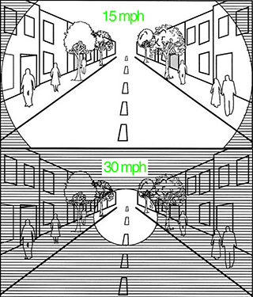
Notes:
Your brain is tricky. Our input processor shares audio and video input. Paying too much attention to something visual (even just reading something on screen) and you can literally not hear things.
The human brain can only take in so much information. Roadway designers know that the faster you drive, the more you have to zero in on what’s in front of you; your brain can’t process everything that’s going on. So you can totally miss roadsigns, cross-traffic, or pedestrians off to the side. They have a concept called the Design Speed of a roadway.
I like that term. Design for an expected amount of information being absorbed at once. What is the design speed of your website or app?
http://abcnews.go.com/Health/watch-visual-concentration-leave-temporarily-deaf/story?id=35650144
https://www.minnpost.com/cityscape/2014/07/everything-youve-always-wanted-know-about-crosswalks

Slide 18
Designing for disability makes everyone’s experience better.
Notes:
This is one reason I sometimes get called out on accessibility standards, AND why I had to make much of this deck for you guys, instead of pulling from my history.
Especially on mobile, what with glare and distraction and rain and babies, and busses, and everything, you have to design as though for colorblind, nearsighted people with muscle tremors. All my standards for “Normal” design assume all this, so I often do not talk about design for accessibility.
If you make sure your design accommodates everyone’s abilities, it works better for literally everyone, all the time.

Slide 19
Accessibility is Required
Notes:
However, accessibility is also a legal, regulatory or contractual requirement a lot of the time.

Slide 20
Rehabilitation Act of 1973
“An Act to replace the Vocational Rehabilitation Act, to extend and revise the authorization of grants to States for vocational rehabilitation services, with special emphasis on services to those with the most severe disabilities, to expand special Federal responsibilities and research and training programs with respect to individuals with disabilities, to establish special responsibilities in the Secretary of Health, Education, and Welfare for coordination of all programs with respect to individuals with disabilities within the Department of Health, Education, and Welfare, and for other purposes.”
Notes:
This was a crazy idea back in the 70s when the first laws began to be passed about providing accommodation for the disabled.
The Rehabilitation Act prohibits discrimination on the basis of disability in programs conducted by federal agencies, in which receive federal financial assistance, in federal employment, and in for the employment practices of federal contractors.
So it immediately impacted lots of companies. You build airplanes for the government? Now you have to provide for your workers per this law.

Slide 21

Notes:
The foundations of UX are in Human Factors, and those principles, guidelines and stats were created originally by the US military, especially Air Force and Navy aviation.
Over time, as for example cockpits have gotten more advanced displays, have they kept in mind principles to assure everyone can use them? No. They have tightened restrictions on who can get certain jobs. No one with any color vision deficit can be aircrew.
You can’t use that principle for your customers. Not just because you miss the spending of a billion users, but legally.
http://99percentinvisible.org/episode/on-average/ "The built world was not designed for you. It was designed for the average person. Standardized tests, building codes, insurance rates, clothing sizes, The Dow Jones – all these measurements are based around the concept of an “average.”" Good overview of all this, and a lot of it is about ergonomics. We live by that, even if you don't know it, so this is super worth understanding.

Slide 22
Section 508 of the Rehabilitation Act of 1973, as amended (29 U.S.C. 794d) (1998)
Requires federal agencies to make their electronic and information technology (EIT) accessible to people with disabilities. The law applies to all Federal agencies when they develop, procure, maintain, or use electronic and information technology. Agencies must give persons with disabilities, both federal employees and members of the public, access to information that is comparable to access available to others.
Notes:
In 1998, Section 508 was added to the Rehabilitation Act.
This means now you have to provide digital products that meet the same needs. If a government worker, or worker of a contractor, might use a digital system of any sort, these need to be able to be used, regardless of any disability they may have.
When a telecom wants to get a government contract – and I worked on these – the website where they buy and manage the service has to comply with these principles.
https://en.wikipedia.org/wiki/Section_508_Amendment_to_the_Rehabilitation_Act_of_1973

Slide 23
Medicare EHR Incentive Program
Meaningful use is a set of measures to improve quality of electronic, or electronically-supported healthcare products.
Twenty-First Century Communications and Video Accessibility Act of 2010
Requires advanced communications services and products to be accessible by people with disabilities.
Notes:
More requirements apply to specific industries or specific technologies. The threat of lawsuits alone mean if you have video, you better caption it.
If you build for Electronic Health Records, as some people I know do, then you have to meet federal requirements to make them have quality outcomes. The next stages require it to be usable and accessible as well.
The CVAA is a very vague law, which can be can be interpreted to mean you need lots of accessibility in mobile devices. You may, but also can use it to prove your company must be accessible, or fear it being broadly interpreted and a lawsuit.
http://www.healthit.gov/policy-researchers-implementers/meaningful-use-regulations
https://www.fcc.gov/guides/21st-century-communications-and-video-accessibility-act-2010
http://www.kelleydrye.com/publications/client_advisories/0787
http://www.commlawgroup.com/site/files/cvaa_compliance_guide_sample.pdf

Slide 24
Not just Websites!
Software Applications and Operating Systems
Web-based Intranet and Internet Information and Applications
Telecommunications Products
Videos or Multimedia Products
Self Contained, Closed Products
Desktop and Portable Computers
Notes:
It’s not just websites. If you knew this, great, but I find a LOT of people who think Section 508 is a law about websites.
It covers pretty much all electronic communications, from video and audio, to telecom, to computers and the Internet. The principles are universal.
http://www.hhs.gov/web/508/index.html

Slide 25
Comparable access
Notes:
And the one key principle is of "comparable access.” You don’t have to offer the exact same thing. Let’s just say you offer video services, but the deaf cannot get the whole content as the audio component is missing. All you have to do is /something/ to offer the same content, even if it’s in another format. That’s what Closed Captions are for.
The same basic content in another, maybe slightly lower fidelity manner, may be a principle you are already familiar with from Web design. Yup, it’s the same thing as graceful degradation. When well done, you never remove content or functionality, just make it work in some other way.

Slide 26
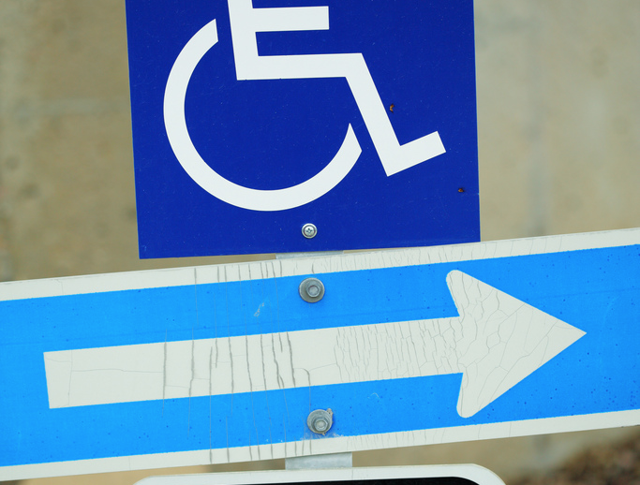
Notes:
For the past couple decades, many business have lived by the exceptions allowed in the law. It even had vague provisions about undue hardship, but mostly by lack of comparable access. Until the modern smartphone era, there pretty much were no good, accessible mobile phones so they were simply not provided to employees. Phone companies were fine with this.
That’s no longer a thing. The world is changing, and increasingly, provisions for access by everyone are the law.
http://www.universitybusiness.com/article/web-accessibility-required-not-optional

Slide 27
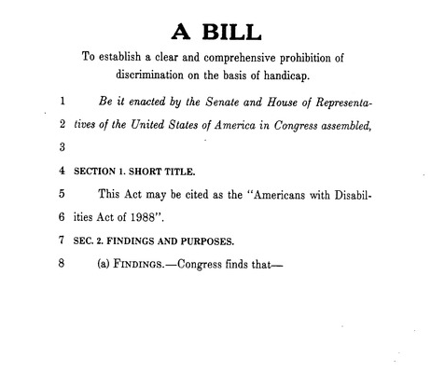
Notes:
The Americans With Disabilities Act is a civil rights law that prohibits discrimination based on disability.
It is similar in scope and power to the Civil Rights Act of 1964. Unlike the Civil Rights Act, the ADA also requires most employers to provide “reasonable accommodations” to employees with disabilities, and imposes accessibility requirements on public accommodations.

Slide 28
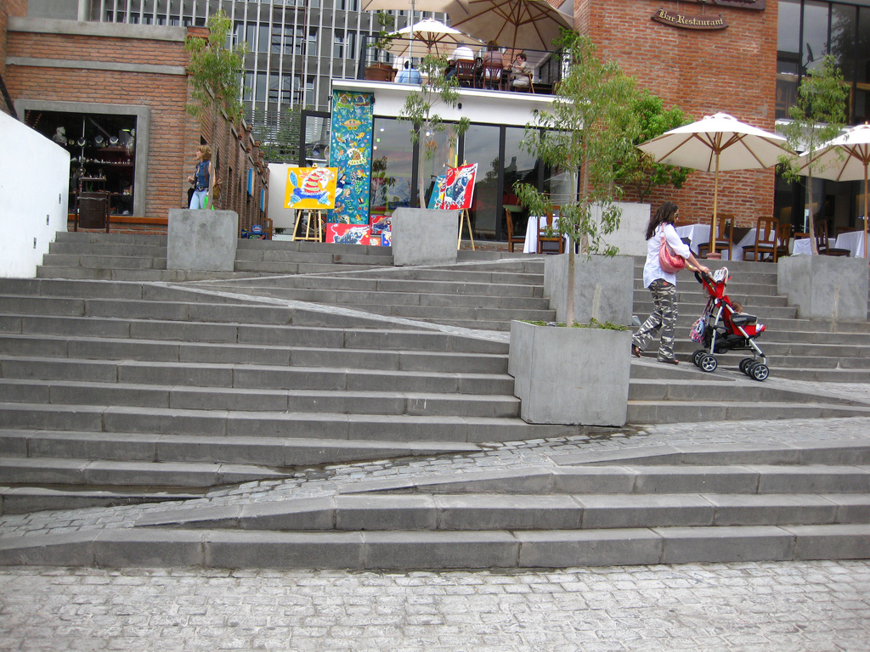
Notes:
Public accommodations seemed obvious back in the late 80s. Outdoor spaces. Public roads and sidewalks. Restaurants, stores, hospitals, etc. And look, adding ramps and curbcuts doesn’t have to ruin the architecture, and also helps other people in their day to day life, so again accessible design is universal, human design.
But this has been a key sticking point as we move into the digital era. Although computers and especially connected devices have empowered everyone, but especially traditionally disenfranchised groups, rights on the internet have lagged behind as a matter of law and regulation.

Slide 29
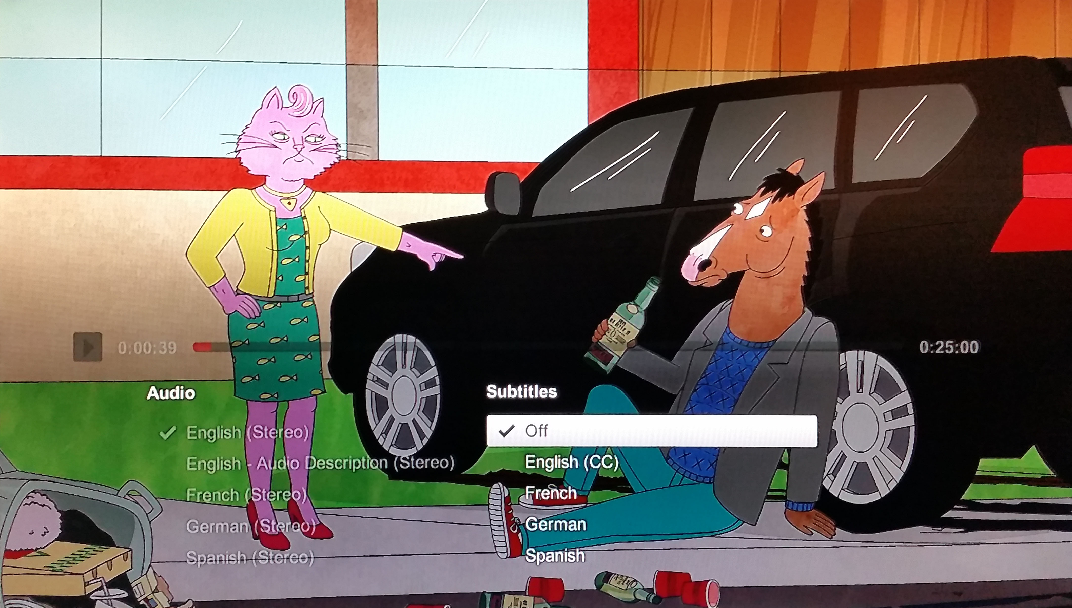
Notes:
So in 2010 the National Association for the Deaf, after years of asking, begging, cajoling and griping, ended up just suing Netflix over their policy of not offering subtitles. In 2012, it was settled, and they captioned ALL programming they offer by the end of 2014. They even did things like added kill dates to devices they couldn’t easily update, so every Netflix experience is accessible and I had to buy a new BluRay player.
But to add confusion, in April of this year, it was reversed in the 9th Circuit court. Regardless, others are getting federal lawsuits, like Scribd.
http://arstechnica.com/tech-policy/2012/10/netflix-settles-with-deaf-rights-group-agrees-to-caption-all-videos-by-2014/
http://arstechnica.com/tech-policy/2015/04/9th-circuit-rules-netflix-isnt-subject-to-disability-law/
http://www.forbes.com/sites/ericgoldman/2015/03/26/scribd-must-comply-with-the-americans-with-disabilities-act/

Slide 30

Notes:
The DOJ has ruled that it totally applies to government agencies, and still has a statement they are in the process of rule-making, so will clearly be bringing regulations to the forefront, soon.
I am sure there will be more court cases, but consider this as a civil rights issue. It’s not likely to go back, but mis-steps along the way notwithstanding, forward. Accessibility will be required, and there’s no point in arguing about it.
http://www.ada.gov/websites2.htm
http://www.interactiveaccessibility.com/services/ada-compliance
https://www.google.com/url?sa=t&source=web&rct=j&url=http://info.deque.com/Portals/153358/docs/ada_accessibility_and_bank_websites.pdf&ved=0CDUQFjAGahUKEwjCyJO2tfbGAhXIn4AKHdxJAAY&usg=AFQjCNHBZnPsS_ggq3e8kJNhtfTC43I3MA&sig2=2V4OSvQ_nEtS7I-QObfFqQ

Slide 31
New Page
Notes:
And this is an awesome example of “accessibility features” being useful for the general population. I am sure you, like me, have turned on captions or subtitles when watching TV because your friends, dog, or kids won’t be quiet.
Well, everyone does this. Facebook improved captioning support when they found 80 percent of users watch video with the audio off. Advertising is starting to notice, and has embraced captioning on internet videos. So, we’re seeing some tide turning here finally.
https://m.facebook.com/business/news/updated-features-for-video-ads

Slide 32
Accessibility Functionality
Notes:
What are accessible functions of your app, website or other digital product?

Slide 33
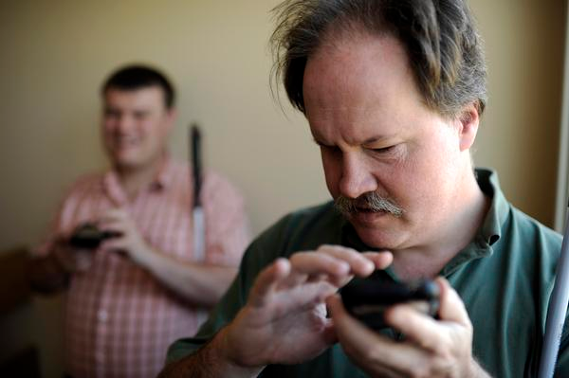
Notes:
As I discussed, there are lots of factors involved in this, but one of the things we all rely on as designers, not to mention humans, is vision. So, let’s turn on some accessibility mode functions on our phones for low-vision users.

Slide 34
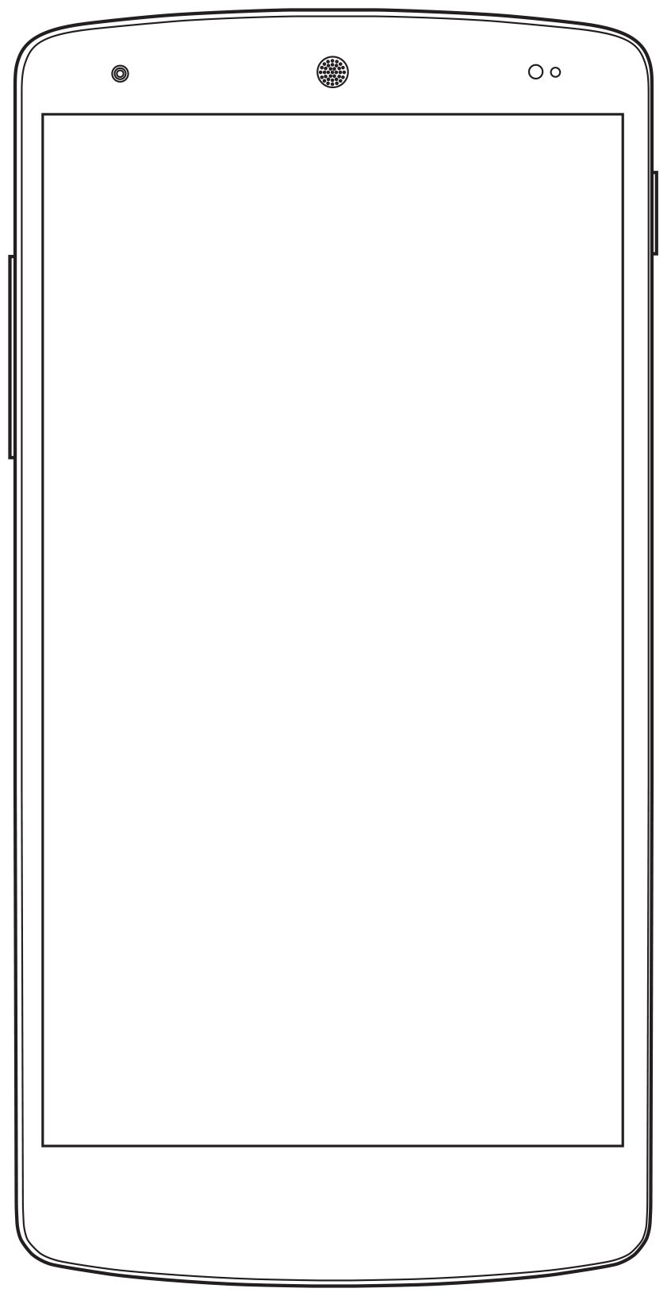
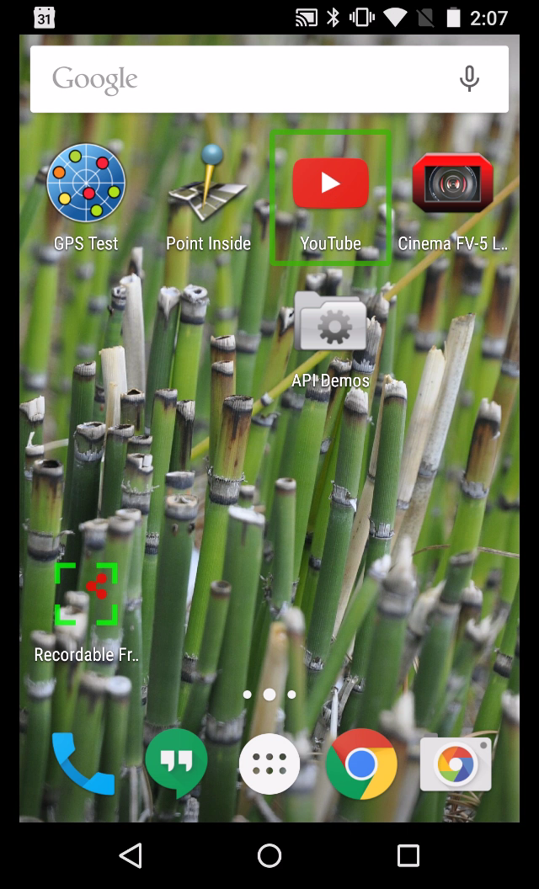
Notes:
If you want to see how this works, I’ll show you an example now. It’s only Android because the two are very similar. Since it talks constantly, I won’t talk during it, so:
- I turned on touch points in the developer options. The gray circle is where I am touching the screen.
- In Android, as part of the Talk Back settings, it highlights the selection with the green box. So when following along that’s another hint about what is happening.
- I go back and forth, and hit the same item multiple annoying times as I am mostly doing it with my eyes closed, and trying to use it the right way. I am not good at being blin
I admit this is a bit long, but I show off several types of controls, and it takes a while. You can fast forward, or come back later if you want, but do be sure to understand how this works.

Slide 35
Notes:
VIDEO SHOULD AUTO PLAY

Slide 36
Notes:
Note how some things are gibberish, like the way they coded the YouTube tab bar. Some things are tedious and useless, like counts of views, or details of products. But some things are easier, as ambiguous icons are replaced with perfectly reasonable names.
If you haven’t before, try this yourself. You can try it on anything, but at least in part make it something you worked on. A website or an app, doesn’t matter. Open it up, close your eyes, and try it.

Slide 37
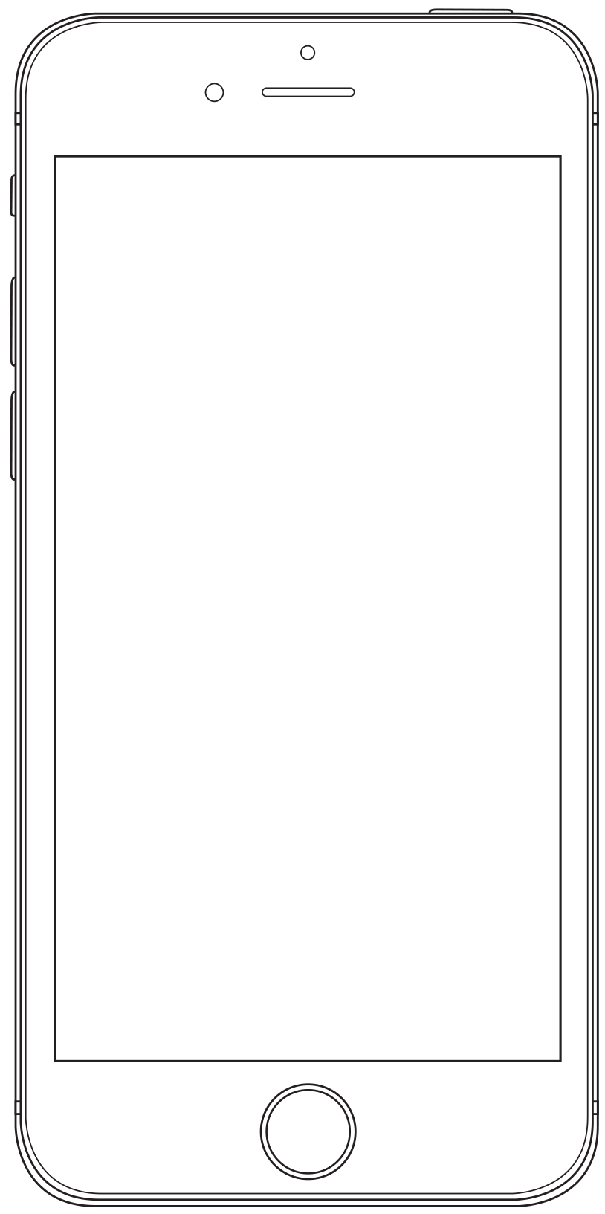
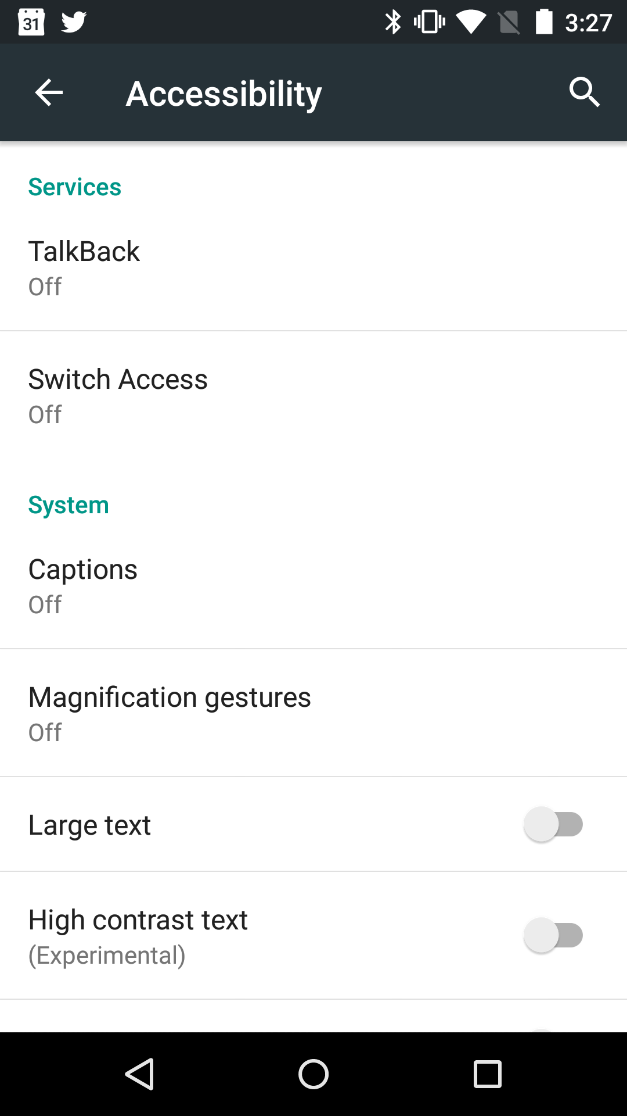
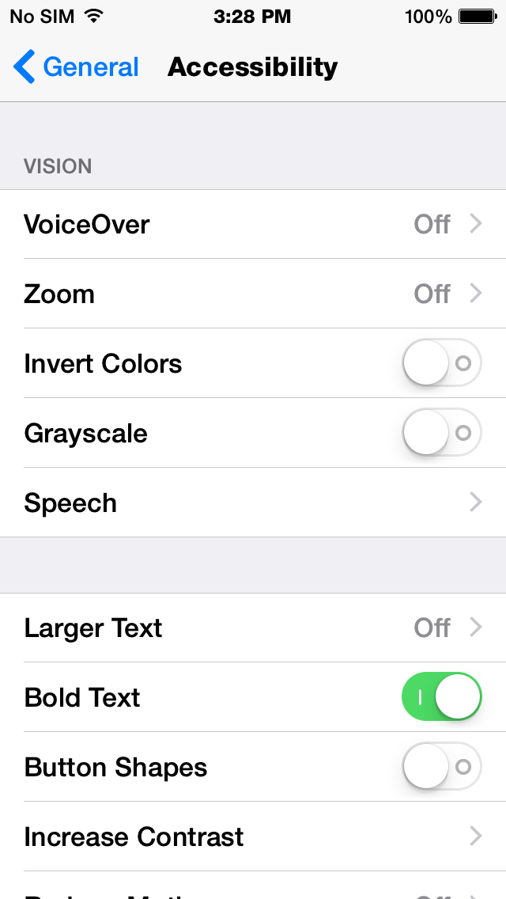
Notes:
I’ll assume you all have a smartphone, and I’d suggest you grab some headsets so you can do this more easily without bugging your wife, the cat or everyone else in the office.
To get into this for Android:
Go into Settings, find the “Accessibility” section, tap it. Lots of features, but turn on TalkBack. This changes the entire way touch works. Drag or tap around to find out what is on the screen. Two finger gestures scroll windows. The last item read remains in focus, so you can double tap anywhere on the screen to select it. Unusual interactions are usually described so just wait for the read description.
And for iOS:
Go to Settings > General > Accessibility. When you turn it on, be aware the whole touch interaction mode will change. Drag your finger around, or tap, to hear what's under it. It remembers what you last touched, so double tap anywhere to select the last item read. Try it with your eyes closed (and on headset to not annoy everyone else) and it makes more sense than trying read and listen.
If you have a Blackberry or Windows phone, um… sorry. Under 2% installed base, and dropping, so I didn’t bring those with me today.
You will note many other accessibility features as well. Try them all out sometime.
http://www.androidcentral.com/accessibility-features-android-50-lollipop
http://4ourth.com/wiki/Design%20for%20Accessibility

Slide 38
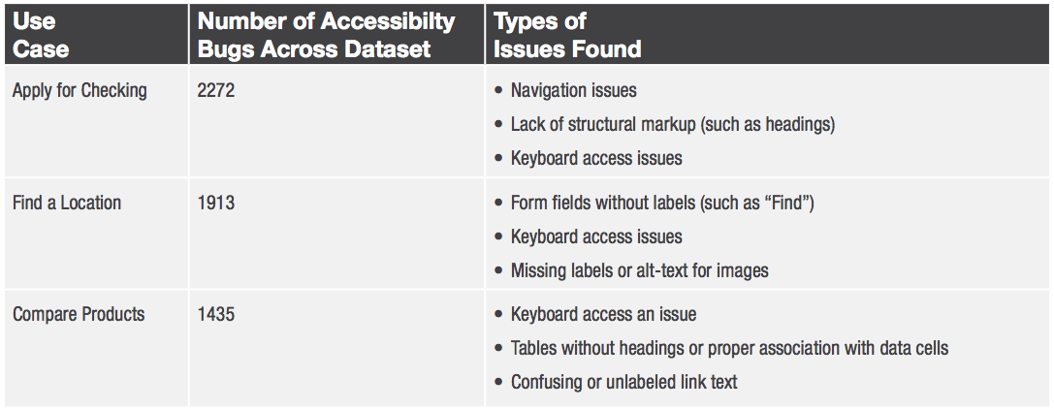
Notes:
Remember to close your eyes. Scoot your finger around the screen. Remember, it doesn’t just read, but changes the way it works. The last thing read stays in focus, then you double tap (anywhere) to select it.
Things like two finger scroll are needed to, well, scroll as one finger is used to scoot around the screen and explore what is available.
Try to actually perform some simple task. Get to an article, find some specific piece of information.
Do the labels make sense when read? Are there labels? I find a lot of apps and websites use the wrong components and don’t label them, so there’s nothing read, or something nonsensical like “button.”
Is the information in a sensible order? When you find something, can you predict what is below it? You are going to find things wrong. Here’s the sort of things found by someone who surveyed a bunch of bank sites.

Slide 39
What Does It Mean
to be Accessible?
Notes:
Which might lead you to ask, what is the definition of accessibility?

Slide 40
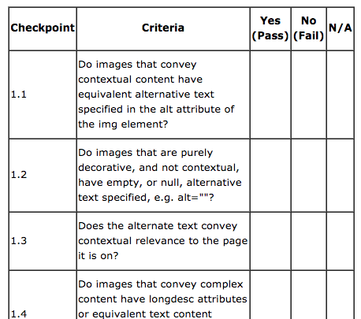
Notes:
You can hire people to come and do compliance checks, and they will give you a report based off these sorts of checklists.
Now, these ARE from Section 508 of the Rehabilitation Act itself, but they are checks. They are effectively QA points. They don’t say HOW to get there. See, 1.2 doesn’t say to use ALT tags, just something like them.
If you only do a classic compliance check then by the time you get one of these done, it’s too late.
Let’s instead talk about planning to design for accessibility instead, and some key tactics to get there.
http://www.hhs.gov/web/508/accessiblefiles/checklists.html
http://webaim.org/standards/508/checklist

Slide 41
WCAG
Perceivable
Provide text alternatives.
Provide captions.
Content can be presented in different ways without losing meaning.
Make it easier for users to see and hear content.
Operable
Make all functionality available from a keyboard.
Give users enough time to read and use content.
Do not use content that causes seizures.
Help users navigate and find content.
Understandable
Make text readable and understandable.
Make content appear and operate in predictable ways.
Help users avoid and correct mistakes.
Robust
Maximize compatibility with current and future user tools.
Notes:
WCAG is the Web Content Accessibility Guidelines, from the Web Accessibility Initiative, a working group within the W3C. Which I hope you have heard of.
They have much better guidelines, which are more tactical and usable. But also very, very web oriented. And sadly, this means the desktop web. They assume everyone has a computer with a keyboard and pointing device. In fact, many more people have smartphones than computers, and due to the cost and complexity of screen readers, those with vision problems are gravitating to mobile devices over computers.
So even for “the web” we have to use these carefully.
http://www.w3.org/WAI/WCAG20/glance/

Slide 42
Principles of Accessible Design
Content first
Semantic code
Information design
WAI-ARIA
Alt text, comparable access
Unambiguous control in all modes
Color and contrast
Scale, reflow and zoom
Notes:
I’ve got an even smaller list of core principles, that try to be more about principles, strategy and design than interface and code.
Content first, last and always.
Write code as though people will look at it, as they are.
Design structures to support your content, before you worry about pixels and colors.
For the web, use ARIA roles when basic types don’t cut it.
Embrace comparable access, but not blindly. Alt tags can bite.
Make sure the function is as clear as the content, in all contexts.
Be able to set aside color, to make sure contrast works.
And assure your whole product works on all devices, with all plugins for scale, size and zoom.
http://www.w3.org/WAI/impl/Overview
Google has a rather nice set of accessibility design principles as well http://www.google.com/design/spec/usability/accessibility.html

Slide 43
Content first.
Notes:
Content first is actually a bit of a buzzword in certain UX design circles now. But it should not need to be a buzzword. If you aren’t starting with content, why are you bothering with architecture, color, spacing or anything else?
In accessibility, content is all. Function too, sure, but think back to what was confusing about accessibility mode: labels on buttons, lists and forms. You cannot act without information. Information IS content.

Slide 44
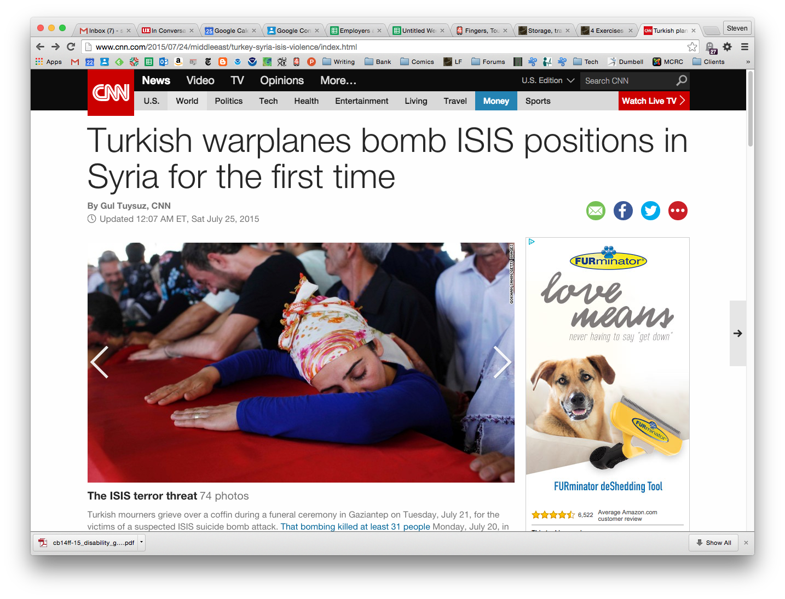
Notes:
So, let’s look at some really info-dense places, like news sites. CNN starts right in with a title, and so on bringing you straight to the article.

Slide 45
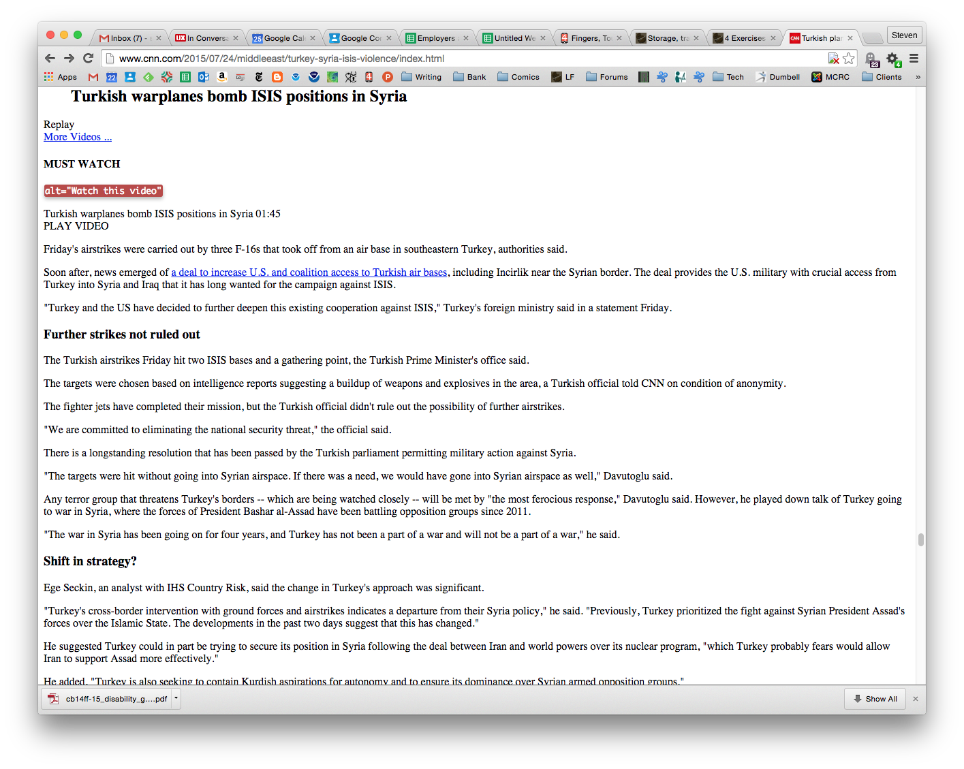
Notes:
Well coded, the markup is all the same. The title is text, so can be read easily, there’s very little junk in the article, just a single link to the video which is great. Maybe you want to watch it or listen to it. Then the article itself, all with properly semantic use of subtitles, paragraphs, and so on. Easy to read in any format.
This stuff is also easy to scan by bots, so your SEO values are better the more well formed and well designed your content is.
http://blog.siteimprove.com/web-governance-blog/semantic-markup-and-web-accessibility
http://volgarev.me/blog/57432081897

Slide 46

Notes:
But… the article is still unreadable, as it’s waaaaayyyy down here.
The rest of the page is occupied with navigation, with every single frame and caption of a long slideshow, and so on. It’s very hard to read the article at all with style sheets off, and almost impossible if you were using a screen reader that had to scan all the content.
Style sheet removers about. I use this for Chrome: chrome-extension://bfbameneiokkgbdmiekhjnmfkcnldhhm/about/about.html

Slide 47
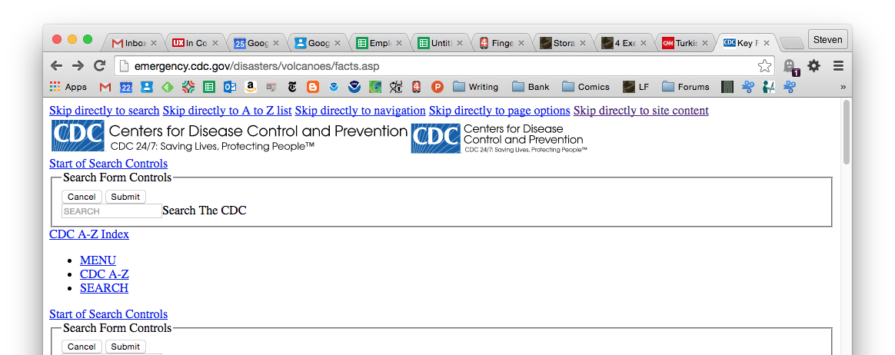
Notes:
The US Government, due to the compliance needs we talked about, has pretty good websites. The article from this page on the CDC is pretty far down, past the navigation and so on, but the very, very first thing are links to the search, the navigation and the content itself. This is a good solution.
I call the practice of organizing information the page Information Design. It’s the next level down from Information Architecture. You form the structure and flow of your app or site, then the structure and flow of each page.
A well designed, well-coded page will not just lead the eye down the page, but will present the key info first. You can use coding tricks to make this work well, placing navigation at the end, then using CSS to put it up top. A link at the top SHOULD be there to jump the user to the navigation. But do you really think anyone using a screen reader will use anything on your site if they have to wade through the whole sitemap first?

Slide 48
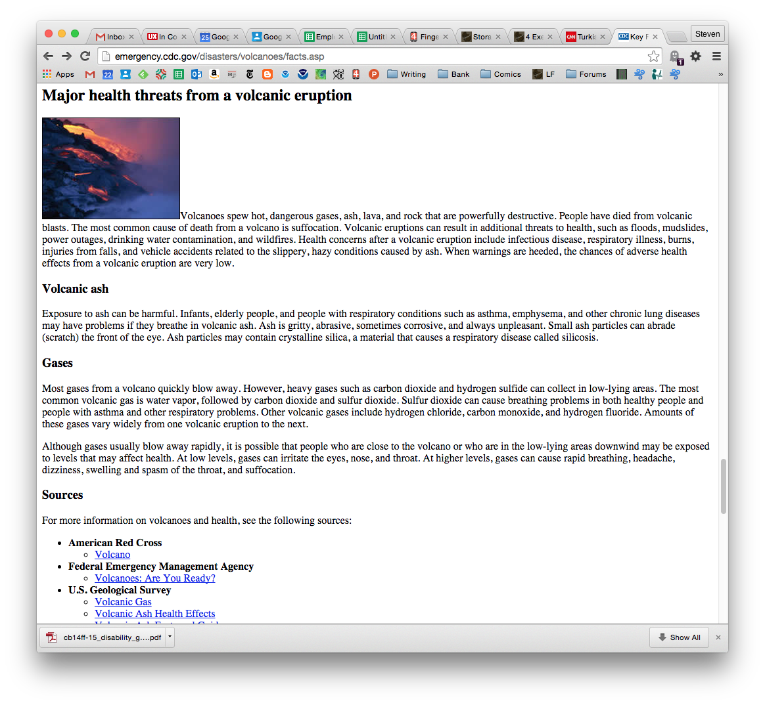
Notes:
You can also find good information on this by looking up Semantic Markup. Semantics is just a nerd term for “meaning” and here is the principle of matching content to a type of code.
Titles should never be a paragraph tag with styles to make them bigger, but an H1 so it IS intrinsically a title. It can be found, read, sized, etc. the right way. By computers, computer interpreters like websites and screen readers, and therefore by people.
Know what code means. Never use italics, but use <em> for emphasis. It defaults to italics, but it /means/ emphasis so is read differently by people, and screen readers.
There are a LOT of different bits of markup in HTML -- and similar stuff on apps – so for any content, be sure to find the right element type for your content.
http://webstyleguide.com/wsg3/5-site-structure/2-semantic-markup.html
https://en.wikipedia.org/wiki/Semantic_HTML

Slide 49
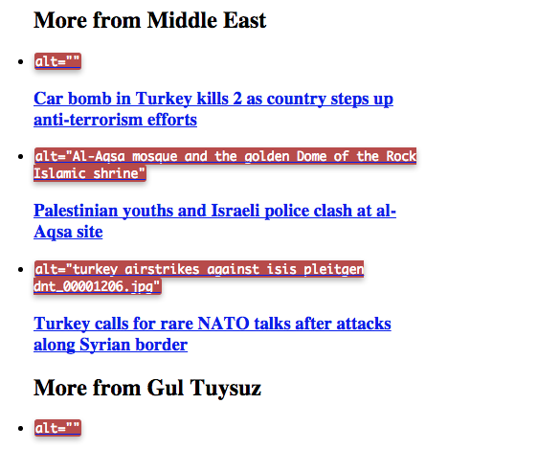
Notes:
Comparable access can be a lot of things, but easy to understand ones are closed captions like we already talked about, and also ALT text.
I say you must leave out ALT text if your image is purely decorative, not content-bearing, or is covered elsewhere. Like here, is it really helpful that the alt text is the same as the actual caption? No. And these could be described differently and more completely, I’ll bet. There’s LOTS of information in a photo.
TITLE tags are another problem. We’ve been told for years they are useful for screen readers, to add context. Not so I have found out. Readers ignore them. The best way to make a link accessible is to make the anchor text relevant and descriptive. Even the W3C suggests ways to turn an irrelevant “click here” link into a contextual link, but I say even for sighted users, you are best to just make it simple. People in real life glance at things, so loose context all the time anyway. No hacks needed.
Overview of title text vs alt text: https://silktide.com/i-thought-title-text-improved-accessibility-i-was-wrong/
And did you know that emoji don’t have a readable component? http://www.superlinguo.com/post/153441950023/what-do-emoji-sound-like

Slide 50
WAI-ARIA
<form action="">
<fieldset>
<legend>Add or subtract ten</legend>
<div>
<label for="number">Current value</label>
<input type="text" role="alert" aria-live="assertive"
readonly value="0" id="number" />
<button type="button" title="add 10" aria-
controls="number">Add</button>
<button type="button" title="subtract 10" aria-
controls="number">Subtract</button>
</div>
</fieldset>
</form>
Notes:
ARIA is another standard from the WAI group of W3C. It’s a way to make Web technologies more accessible to people with disabilities. It adds little tags to the HTML, but isn’t needed for boring old semantic web stuff. There are implicit ARIA tags on those semantic web tags so a button is a button, and you don’t need to add the Aria role saying it’s a button again.
ARIA helps with dynamic content and other advanced user interface controls developed with Ajax, HTML, JavaScript, and so on. This will be useful with certain webapps, and as we use new dynamic technologies. The code here is used to present errors on a form submission inline, more easily than usual, and without jumping through so many hoops to keep it accessible.
IF you code them right, even advanced features can be accessible.
http://www.w3.org/WAI/intro/aria.php

Slide 51
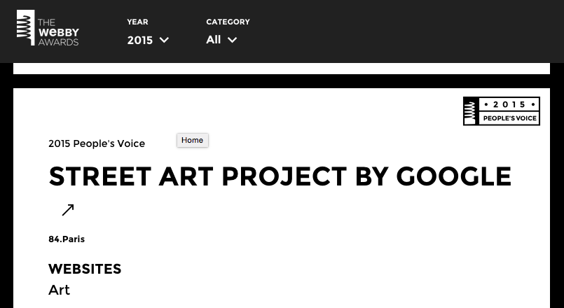
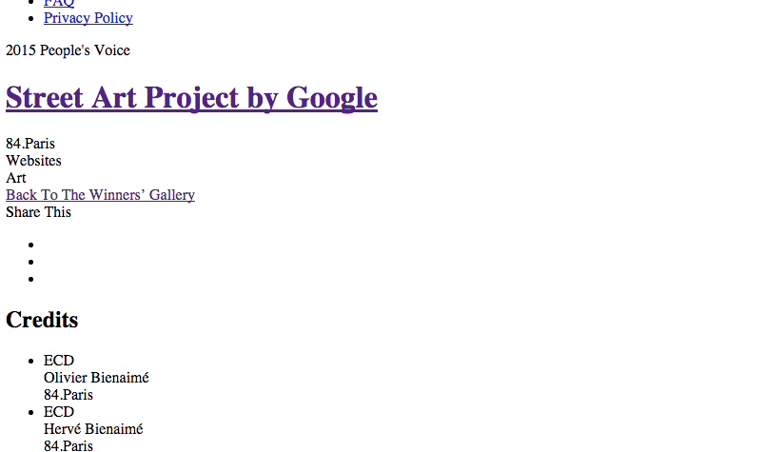
Notes:
Don’t let anything become cryptic when any one thing fails. Here, on A GOOD WEB DESIGN AWARDS PAGE, the only indication that the link goes to a remote site is the icon. I didn’t know what it meant at first, and images don’t always load. It’s supposed to be at the end of the line, but they coded it badly, so here it’s wrapped.
A screen reader is hardly any worse, and it just has the link name.
Make sure everything works well, clearly and unambiguously, then make sure it is coded to work equally well for /every/ user.
http://www.webbyawards.com/winners/2015/websites/general-website/art/street-art-project-by-google

Slide 52
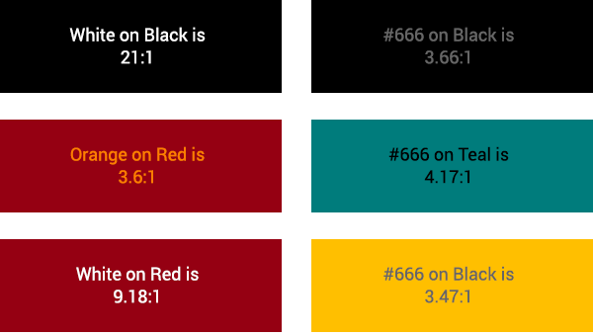
WCAG 2.0
Level AAA
Contrast Ratios
4 . 5 :1
Large text
7 : 1
Normal text
Notes:
The one most important thing to make type readable to most users is to be sure it has the right contrast ratio. This is not a fixed number, but varies by the size of the type. Larger text needs less contrast for complex reasons having to do with the resolution and a concept called the smallest perceptible difference.
Most people design to WACG level AA. I don’t.
WCAG 2.0 level AAA requires a contrast ratio of 7:1 for normal text and 4.5:1 for large text.
Black on white is 23:1 contrast, so I think these AAA requirements aren’t that arduous.
Lots of color design tools at the bottom of this:
http://4ourth.com/wiki/Color%20Deficit%20Design%20Tools
Great description of resolution and viewing just anything at all:
http://blogs.discovermagazine.com/badastronomy/2010/06/10/resolving-the-iphone-resolution/

Slide 53
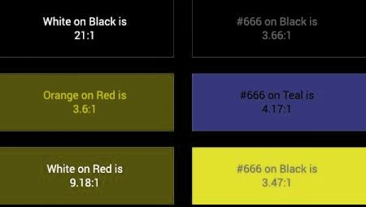
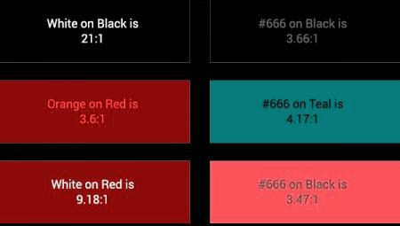
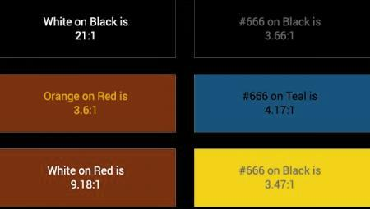
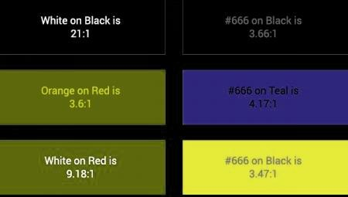
Notes:
Colorblindness (as shown here for four of the main types that exist) is only about the hue of a color. So, when you check suitability of two colors by contrast, that is unaffected.
Notice that, say, the lower left box on each of these (white on red) with a 9.18:1 contrast ratio is very readable no matter how it is perceived.
So, you can design is grayscale, and check for your colors before settling on them.

Slide 54

Notes:
Even for color vision users, understanding how color vision works can help make your product more readable.
Say you want to have a warning message, so you pick a bright red icon… well, there’s sort of no such thing as ”bright red.” The luminous efficacy -- and the eye sensitivity function – of red Is lower than orange, or yellow or GREEN. This is why contrast is based on color (or Hue) not just the intensity or brightness.
I call this ”Chromatic Brightness” but I totally made that up and it’s slightly inaccurate. Point still holds though: Not all colors are equally bright, so if you want to get someone’s attention, yellow on black will work a lot better than red.
Whether the highest contrast color fits in the messaging scheme, by meaning, is something else, of course.
FIG 16.7 here, and related sections, cover it nicely: https://www.ecse.rpi.edu/~schubert/Light-Emitting-Diodes-dot-org/Sample-Chapter.pdf

Slide 55
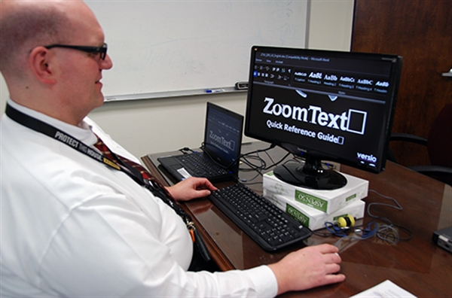
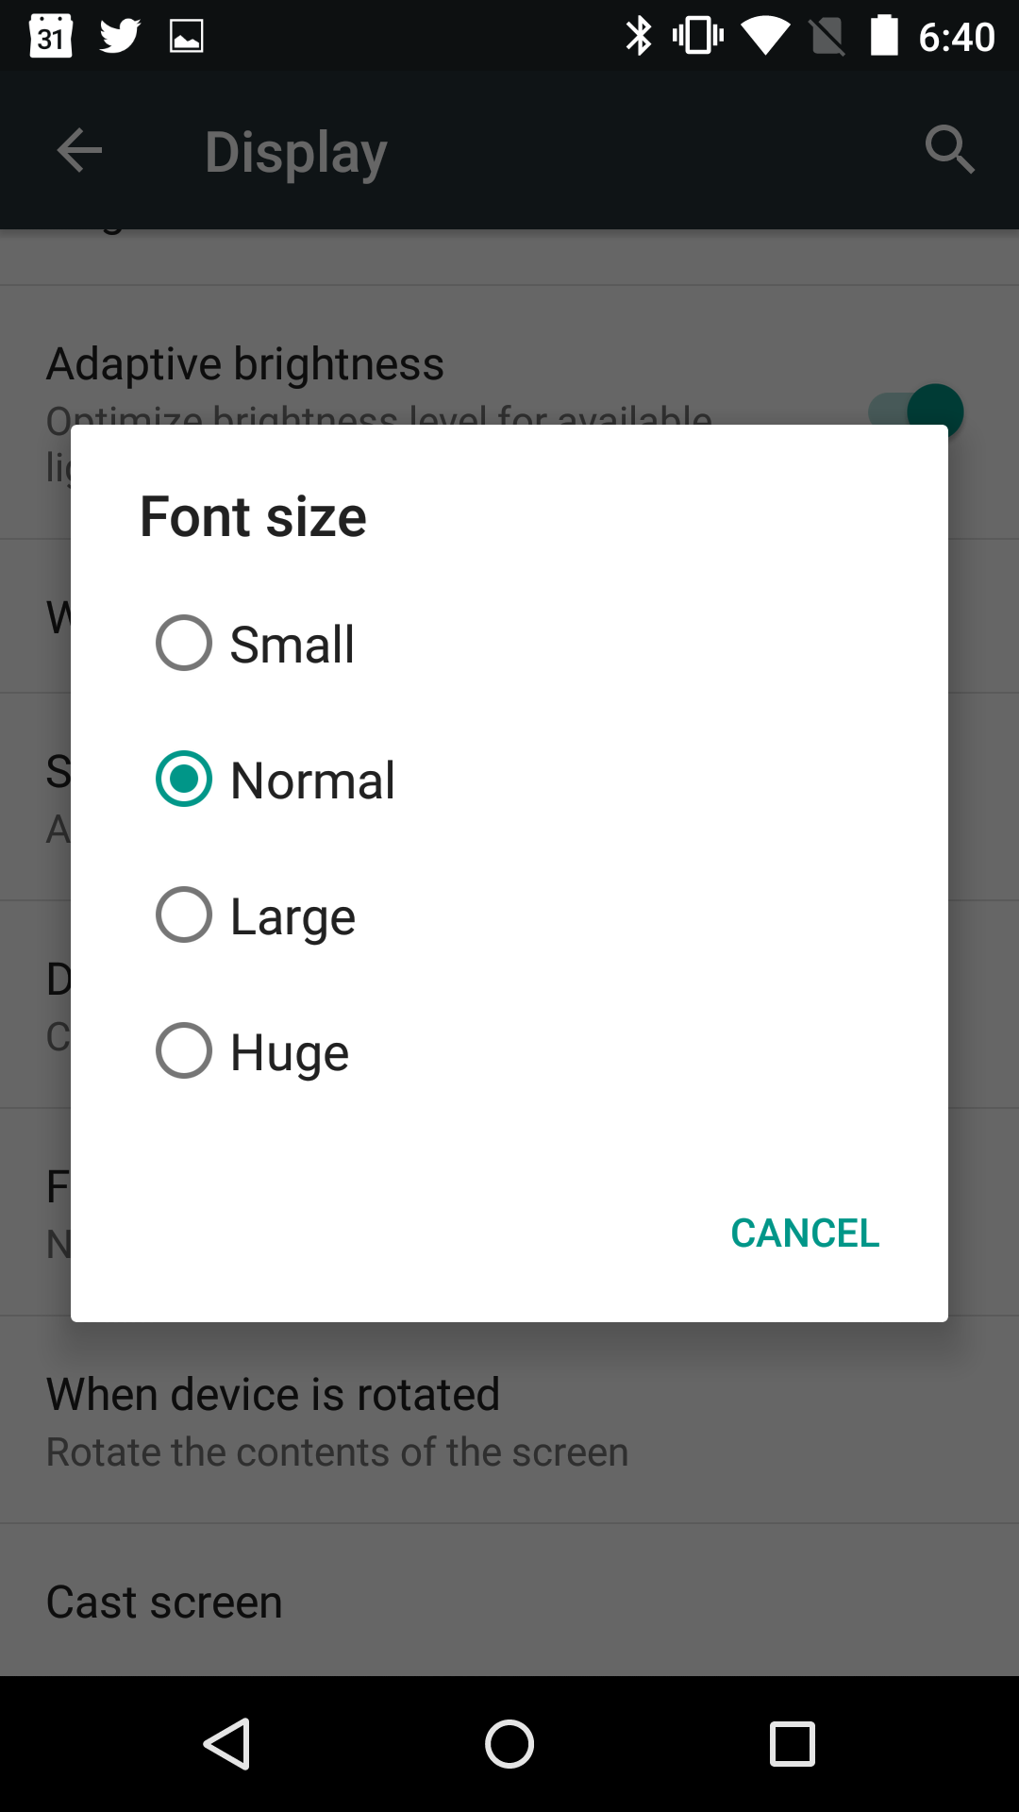
Notes:
Low vision users very often select larger text sizes on their entire computer or phone. This is increasingly easy to get to, and sometimes even pops up during the original setup process.
It is inherited by every app and website… IF You Do Your Job. There is a choice of coding, say, Android apps with fixed or scalable size type. Pick scalable for all content so a users default setting works in your app.
Some users with specific disabilities such as the aged as their eyesight goes, use zoom tools. These are also partly built into some OSs, but third party tools are available also. As you seen here, it can zoom so only a few words are on the page.
Don’t do anything that confounds or prevents zooming, or scaling. And think hard about how your content will work with less context, or if it wraps a lot more due to different sizing.

Slide 56
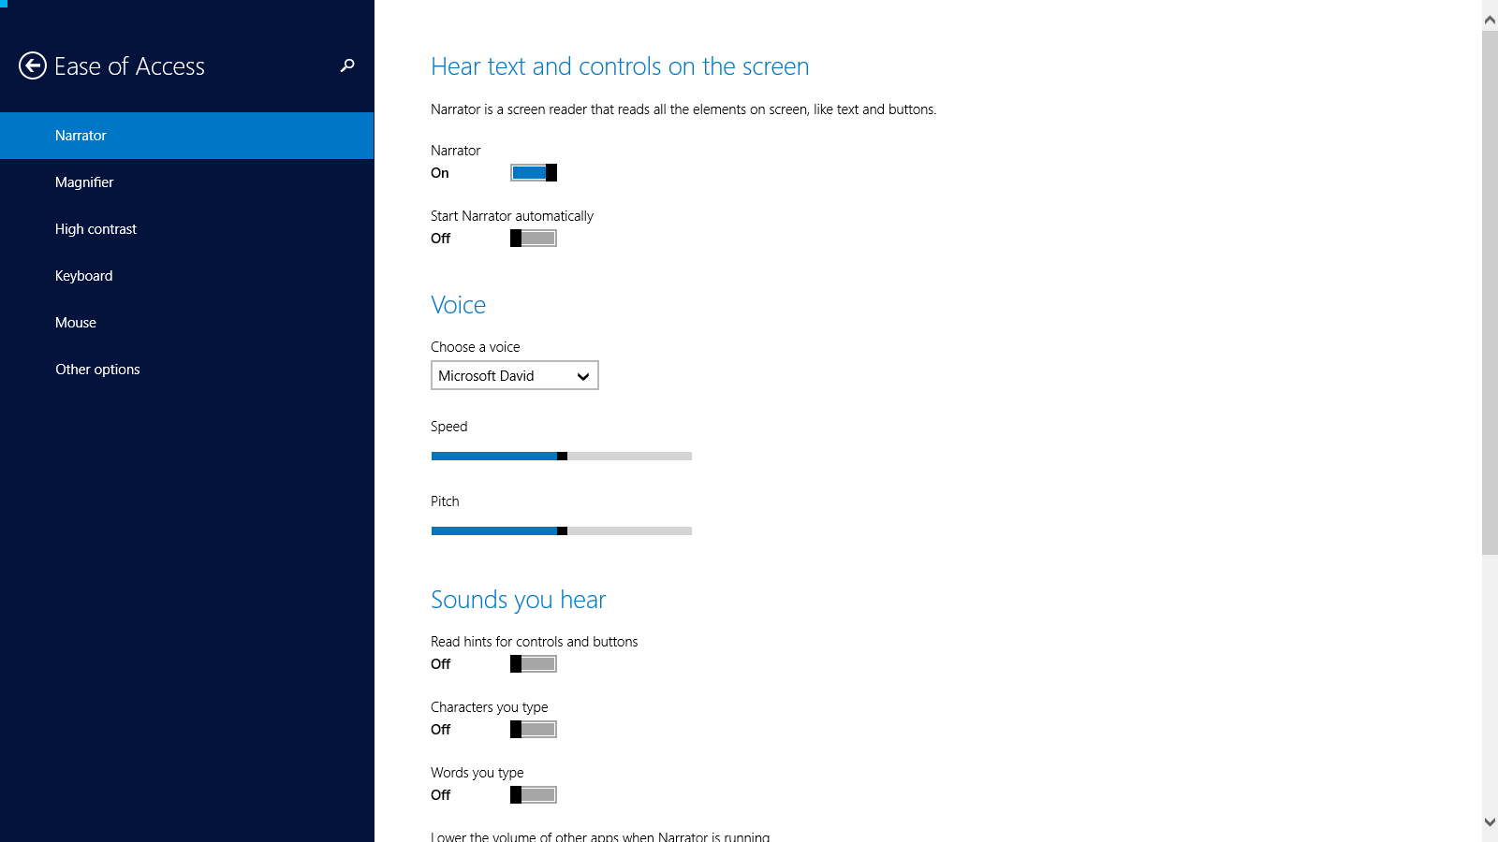
Notes:
People very often do not admit they are disabled. Especially for temporary or changing conditions, such as illness or ageing, people are not well handled.
Try to make your product work as much as possible without accessibility features in the browser and OS.
Greg Tarnoff talks about accessibility a lot, and I think this talk includes discussions of people not admitting they are disabled. If not, watch it anyway.
https://vimeo.com/110360523

Slide 57
Notes:
Let’s look a little at designing the structure of your product. Say you have a function like a dialog box. This isn’t bad, right? The dialog says what it wants.
But say you have a zooming monitor like a couple slides ago, or the mobile screen readers where your finger is hovering it alone, have a cognitive problem that makes it harder to connect concepts or you forget rapidly, or you are simply distracted or busy and glancing at key areas.
Then you see…
http://dbushell.com/2012/02/13/are-you-sure-the-user-experience-of-confirmation-dialogs/

Slide 58
Notes:
…this. Couldn’t you maybe say “Uninstall” instead of “OK”? Yeah, for everyone, design everything better. Pay attention to every guideline for good design.
http://www.uxmatters.com/mt/archives/2014/11/fundamental-principles-of-great-ux-design-how-to-deliver-great-ux-design.php
http://www.slideshare.net/whitneyhess/design-principles-the-philosophy-of-ux

Slide 59
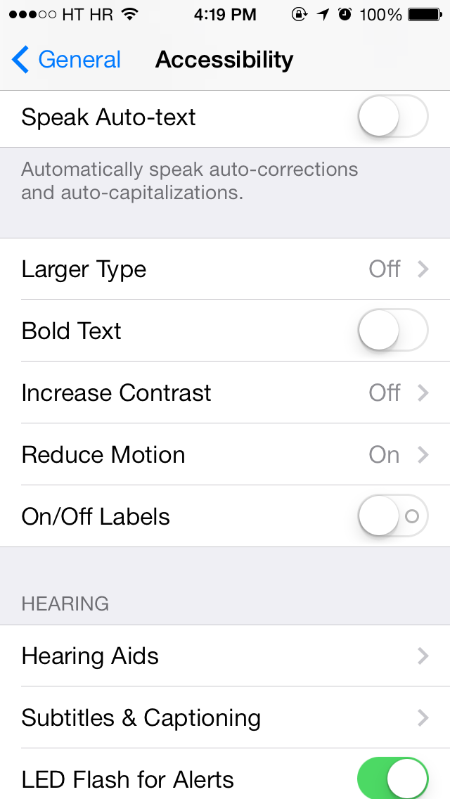
Updated
Notes:
Did you know a lot of people have “vestibular disorders”? I occasionally am one of those. People with inner ear conditions like this, or with epilepsy, can get dizzy (often debilitingly so) when seeing certain patterns, or movements. I’m not showing an example for this entire slide, for obvious reasons. If you don’t get what or why this is an issue, the YouTube link in the notes here is a good talk about it, and has some examples at 21 minutes in.
The current trend, especially what iOS does by default with animation and transparency, is a serious problem for these people.
Avoid:
Large areas of movement.
Parallax effects. For many people they simulate 3D space, with foreground items moving more, but for others the two different movement rates cause issues.
Side scrolling (or items flying in) when scrolling down. Make controls map correctly to actions.
DO give user control, so they can pause or stop movement. And like everything, make sure there’s a reason your animation exists, and it communicates content and control to the user.
iOS is, it must be said, giving user control at the OS level, to reduce or remove parallax and other animations. People probably won’t customize your app or site, so think hard about what you include by default.
https://www.youtube.com/watch?v=QhnIZh0xwk0
http://alistapart.com/article/designing-safer-web-animation-for-motion-sensitivity
Design of fluid motion is not just the way things move but HOW things move: Some examples http://codepen.io/sdras/full/JbaGwg/

Slide 60
New Page
Notes:
In mid-2016, the genetics testing company 23 and did a genome-wide search for the genes responsible for motion sickness, and found that around 2/3 of the population has a propensity for this.
Now, only 70% of the causes of motion sickness are genetic (mine may not be) so it could be worse. But at least 2/3 of the population may have trouble with AR/VR, parallax scrolling, 3D video, auto-playing video, animated gifs bouncing in their timeline, etc.
This is not a preference that you can blow off under the assumption that the world will get used to it. No, it’s baked in fact, and something we need to get used to. Many new techniques and technologies are not going to be broadly successful because we physiologically cannot handle them.
The genomic research: http://blog.23andme.com/23andme-research/the-genetics-of-motion-sickness-2/
A primer on vestibular disorders: http://a11yproject.com/posts/understanding-vestibular-disorders/

Slide 61
Testing and Compliance
Notes:
Once you have built your product in an accessible, universally-usable manner, you have to:
Test
Monitor
React, and…
Prove it

Slide 62
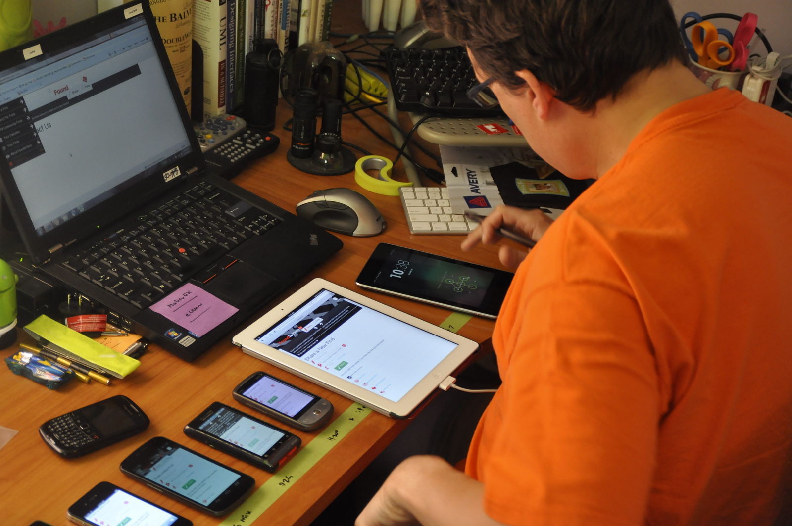
Test
Notes:
Perform expert reviews throughout the design process, and conduct usability tests at the end of key phases.
You hopefully already do this, but now will add on key accessibility attributes to check for.
A lot of accessibility guidelines, as a heuristics checklist: http://accessibility.voxmedia.com/ with sources. Some details I disagree with, so see the rest of this presentation.

Slide 63
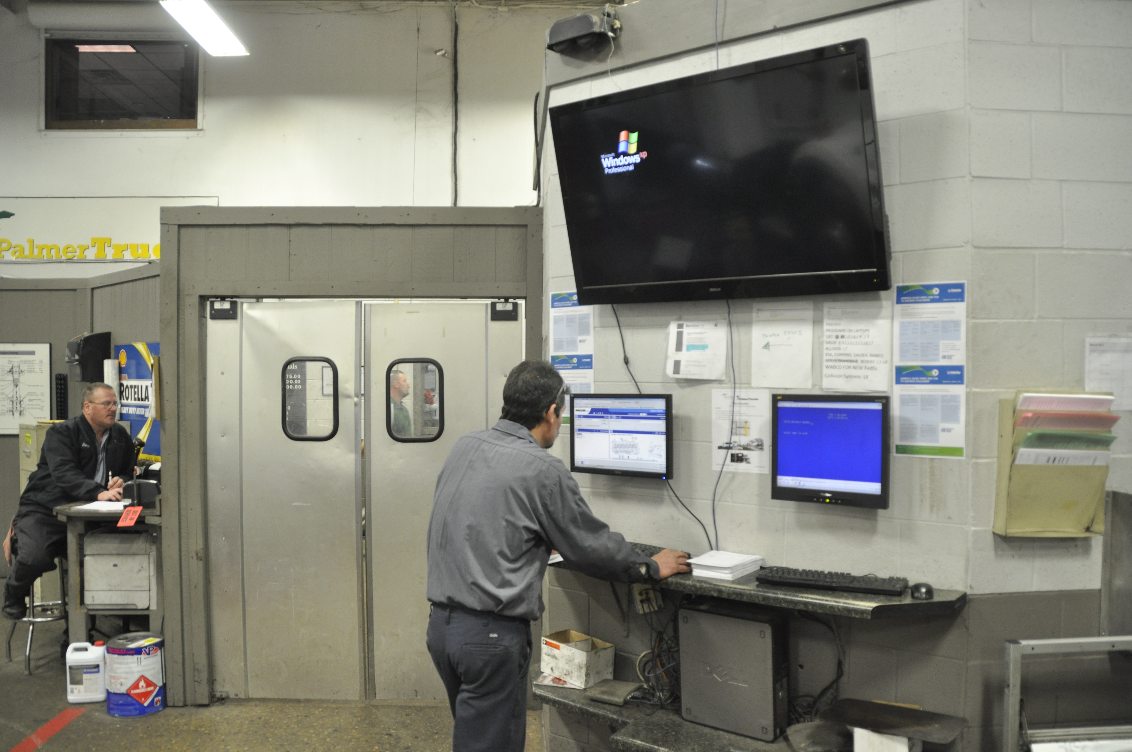
Test
Notes:
I like ethnography, a lot. That’s just the practice of observational research. Instead of having users into the lab, or asking them questions, you go to their homes or offices and watch how they work.
This guy would be recorded as a desktop PC user on any analytics, and if you made him fill out a survey he’d probably say the same. But he’s standing. And behind him is a truck repair shop. He wears eye protection and earplugs. This is not a desktop experience.
You have to get out and see how your users, disabled, distracted, or otherwise, actually work with your systems.

Slide 64
Test
Accessibility Testing Tools
Most tools are Web only
Functional Accessibility Evaluator 2.0
  http://fae20.cita.illinois.edu/
MAUVE Multiguideline Accessibility and Usability Validation Enviroment
  http://giove.isti.cnr.it/tools/MAUVE/home
Chrome Accessibility Developer Tools
  https://chrome.google.com/webstore/detail/accessibility-developer-t/fpkknkljclfencbdbgkenhalefipecmb?hl=en
Notes:
You will need to use other techniques and careful expert evaluation for apps, other types of documents, most multimedia content, and so on, but if you just run a website, there are many, many tools you can use to automatically check.
The best of these are very much like setting up automated system test; they do not just work, but require some time and effort.
Many, many tools listed here: http://www.w3.org/WAI/ER/tools/
If your workflow involves many Adobe CS tools, this is helpful: http://help.adobe.com/en_US/creativesuite/cs/using/WS3F71DA01-0962-4b2e-B7FD-C956F8659BB3.html#WS473A333A-7F61-4aba-8F67-5553208E349C

Slide 65
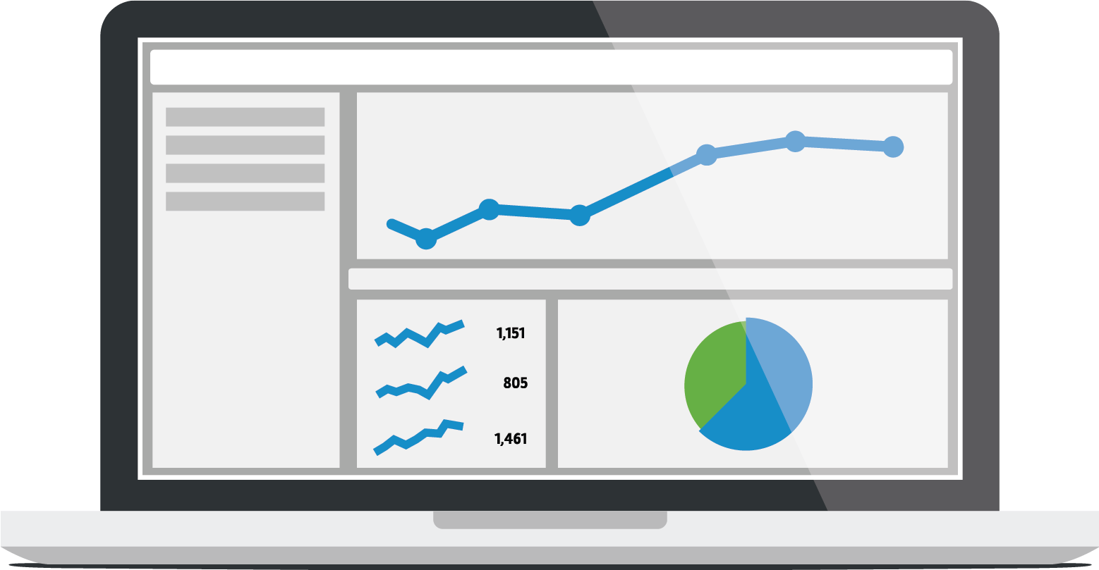
React
Notes:
You also need to watch and listen. On an ongoing basis, for the entire lifecycle of the project, you have to account for change and let the community provide feedback.
You will make changes, and the world changes around you. You cannot rely on browsers or behaviors staying the same so need to check constantly.

Slide 66

Monitor
Notes:
Customers may have different equipment or needs than you are used to, and are your largest testing cadre. Have a method to find and fix bugs based on customer care feedback. Too often, customer care and development are separated, but add a way for care to report bugs.
And don’t leave it there with the customer. Known bugs with workarounds, generally or for specific accessibility problems, need to make it back to the customer care knowledgebase so users can be actually helped. Helping them once on email or the phone is fine, too, but letting them help themselves afterwards is better.
This should be part of your DevOps group. They will be good at handling issues like this.
Don’t have devops, or even know what I mean? Read this http://www.slideshare.net/jedi4ever/mobile-delivery-with-a-devops-mindset-velocityconf-nyc-2015

Slide 67

Prove It
Notes:
Write this all down.
From design principles on down, record everything as a process you undertake for the organization, the project and as an ongoing effort. Record the compliance with your own plan to prove you carried it out.
Link back all your points to law, regulation or best practice so you can demonstrate – if something goes badly – that you have made a deliberate, organized and concerted effort to meet the federal guidelines.
It is probably best to designate a compliance person, or group if a big enough organization.
I have been unimpressed by professional accessibility certification vendors, mostly because there is no good central clearinghouse that certifies /them/. If you can design a website, you can also build for accessibility, and certify it internally.

Slide 68
Summary
Disability is everywhere
Design for accessibility is design for everyone
Follow existing recommendations and guidelines
Expect more regulations and risk in the future
Use design best practices
Evaluate, test and help customers
Document your process and activities
Notes:
Even if you have no morals, you should provide accommodation to every user just because it's a huge, and productive part of the population. You can make money off this underserved segment.
Even if you are not sure yet your digital assets are a public accommodation, wait a few months. It's going that way, and you will. It's time to make your products accessible, today.
We have guidelines for accessible design today, but many of the core principles lead to better work, and making your digital products work for every one of your users, all the time.
Since there is a legal requirement, or at least a chance of lawsuits, you should prove this. Include accessibility in your user tests, your analytics, and customer feedback. Be ready to fix problems, and address their needs immediately through other channels.
Make a plan, record your methods, and follow it scrupulously.

Slide 69



4ourth.com
^{Steven Hoober}
^{steven@4ourth.com}
⁺¹ ⁸¹⁶ ²¹⁰ ⁰⁴⁵⁵
^{@shoobe01}
^{shoobe01:}
^{www.4ourth.com}
Notes:
If you have questions, first download the PPT. Many slides have links to articles or videos explaining in more detail. Look in the speaker notes.
And if you still have questions, feel free to ask me.

